Slide 1
Management Strategy Evaluation for kitefin shark Dalatias licha

Slide 2
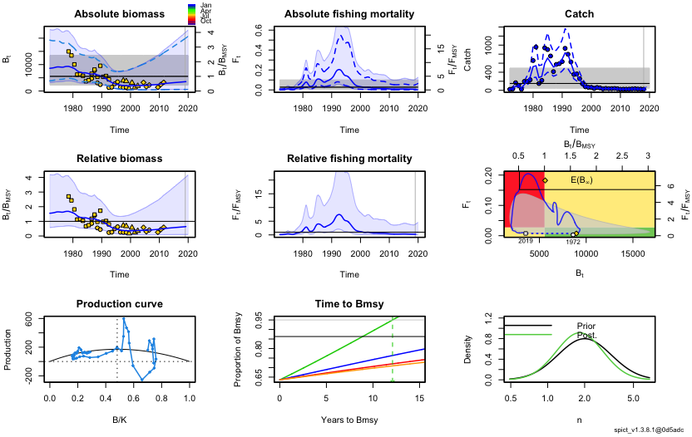
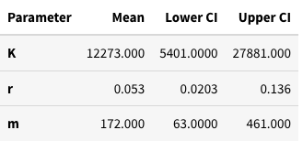
The estimation model

Slide 3
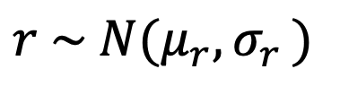
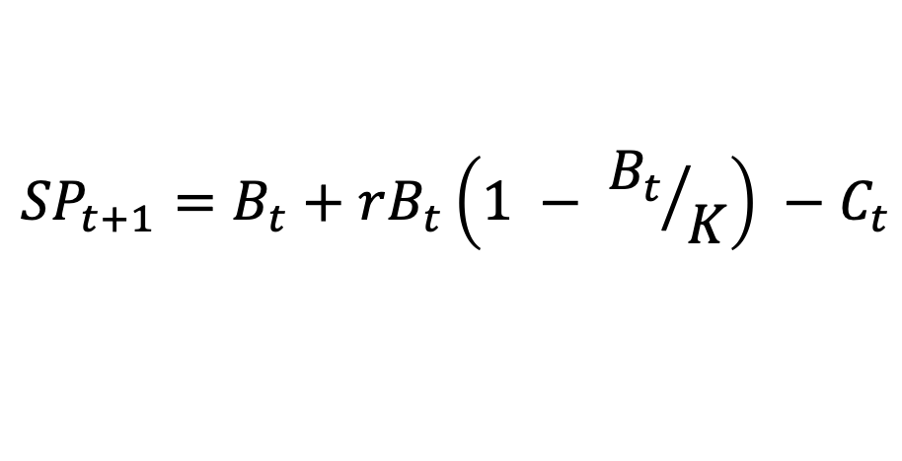
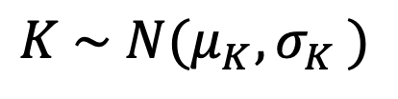
The operating model
Projected surplus production is calculated from parameters estimated from base SPiCT model
Uncertainty is incorporated by drawing r and K replicates at each simulation
$${SP}_{t+1}=B_{t}+rB_{t}\left(1 − {B_{t}}/K\right) −C_{t}$$
$$r \sim N(μ_{r}{,σ}_{r})$$
$$K \sim N(μ_{K}{,σ}_{K})$$

Slide 4
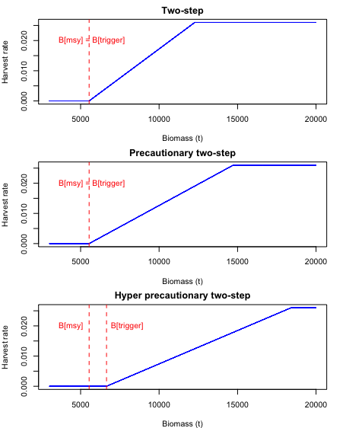
The HCRs

Slide 5
The results

Slide 6
The results

