Slide 1


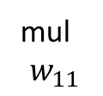







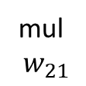




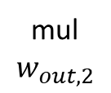





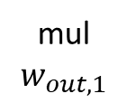
mul
$$w_{11}$$
mul
$$w_{out,1}$$
$$x$$
$$V_{1}$$
$$V_{2}$$
Z(z)
mul
$$w_{12}$$
+
$$V_{5}$$
$$V_{6}$$
$$V_{7}$$
$$y$$
$$V_{3}$$
$$V_{4}$$
mul
$$w_{21}$$
+
$$V_{13}$$
$$f$$
$$V_{8}$$
mul
$$w_{out,2}$$
Z(z)
+
$$V_{10}$$
$$V_{11}$$
$$V_{12}$$
mul
$$w_{22}$$
$$V_{9}$$

