Slide 1
Allegheny County Home Value Index Case Study
For a Fidelity Management and Research Interview
Matheus C. Fernandes (PhD Candidate - Harvard University)
2/11/2021
Please find more information and full code at https://git.fer.me/fidelity-interview

Slide 2
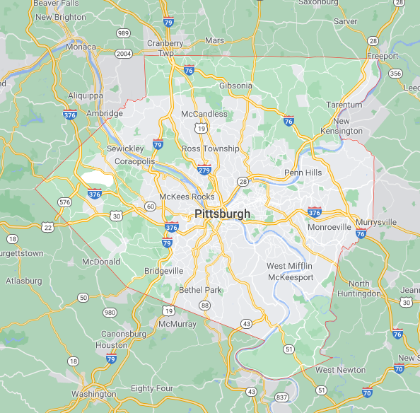
About Allegheny County
Located in southwest Pennsylvania
State’s second-most populated county
City of Pittsburgh is in center
With 446 bridges, Pittsburgh has more bridges than any other city in the world*
*https://uncoveringpa.com/facts-about-pittsburgh
Notes:
Yes, it has even more bridges then Venice. Pittsburgh is called the ‘city of bridges’. A good idea might be to invest in civil engineering or bridge service companies in the area.

Slide 3
About the Allegheny County Dataset
86 columns (potential features)
580,997 property assessments
Columns contain information on:
Property features: bedrooms, bathrooms, fireplace etc.
Location: physical address and location codes
Different levels of assessment values – county, local for building and land

Slide 4
About the Allegheny County Dataset
Has numerical, categorical, and binary variables
Dataset contains repetitive information i.e. descriptions of codes
Contains administrative information i.e. deed recording information and legal descriptions

Slide 5
Goal of Analysis
Develop a monthly “Allegheny County Home Value Index” (HVI) to understand key features of the market.
Create model to gain insights for investment opportunities.

Slide 6




Structure of Data Science Workflow
Data Cleaning
Exploratory Data Analysis
Model Exploration and Selection
Computing Home Value Index

Slide 7
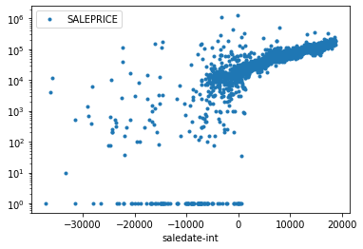
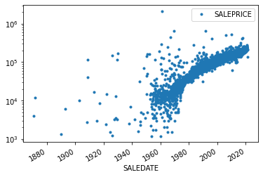
Missing Data and Data Types
Removing false data
Price [$]
Price [$]
SALEDATE Integers

Slide 8
Missing Data and Data Types
Remove data missing important information such as:
Sale price
Sale date
Sale price is 0 or unreasonably low (<$1000)

Slide 9
Missing Data and Data Types
Imputed missing data depending on datatype
Creating a new category of unknown, zero, or boolean
Replacing mean of data for continuous variables
Imputing information from different column

Slide 10
Missing Data and Data Types
Converted variable types to increase bit efficiency
From 64 bit to 32bit and 8 bit
Reduced memory ~380MB to ~120MB without loosing information
Converted date types to numerical
Standardize input data

Slide 11
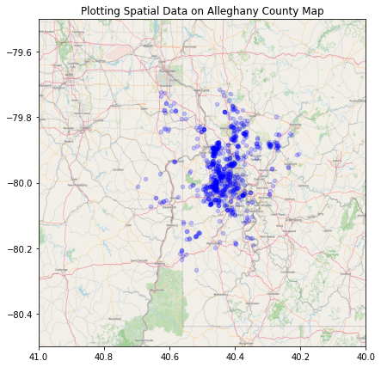
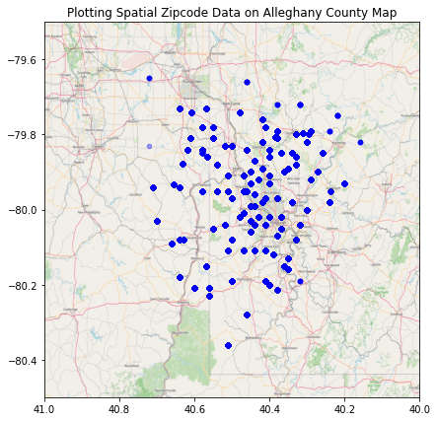
Feature Engineering
Geolocation Exploration
Address Granularity
Zip code Granularity
Notes:
In real estate, everyone is told: location, location, location…. we can test how true that actually is.
Address granularity has a lot of errors and is slow to get information from geospacial database servers. The good APIs for also have an associated cost with it. Zipcode granularity is stored in computer and is quick and offers enough distribution on location.

Slide 12
Structure of Data Science Workflow
Data Cleaning
Exploratory Data Analysis
Model Exploration and Selection
Computing Home Value Index

Slide 13
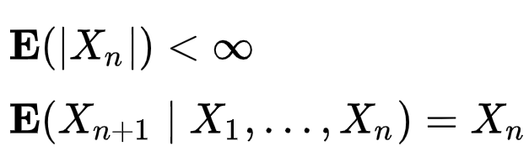
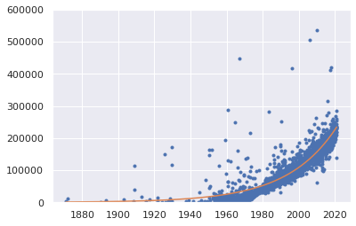

Martingale?
Is housing prices in Allegheny county a martingale?
By fitting an exponential line, we see that the expectation follows an exponential growth.
$$y=ae^{bx}$$

Slide 14
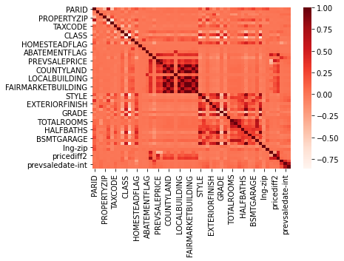
Exploratory Data Analysis
Correlation Matrix
Provides information on correlation of variables
No correlation does not mean no useful information
High correlation between variables means potential redundancy between those variables.

Slide 15
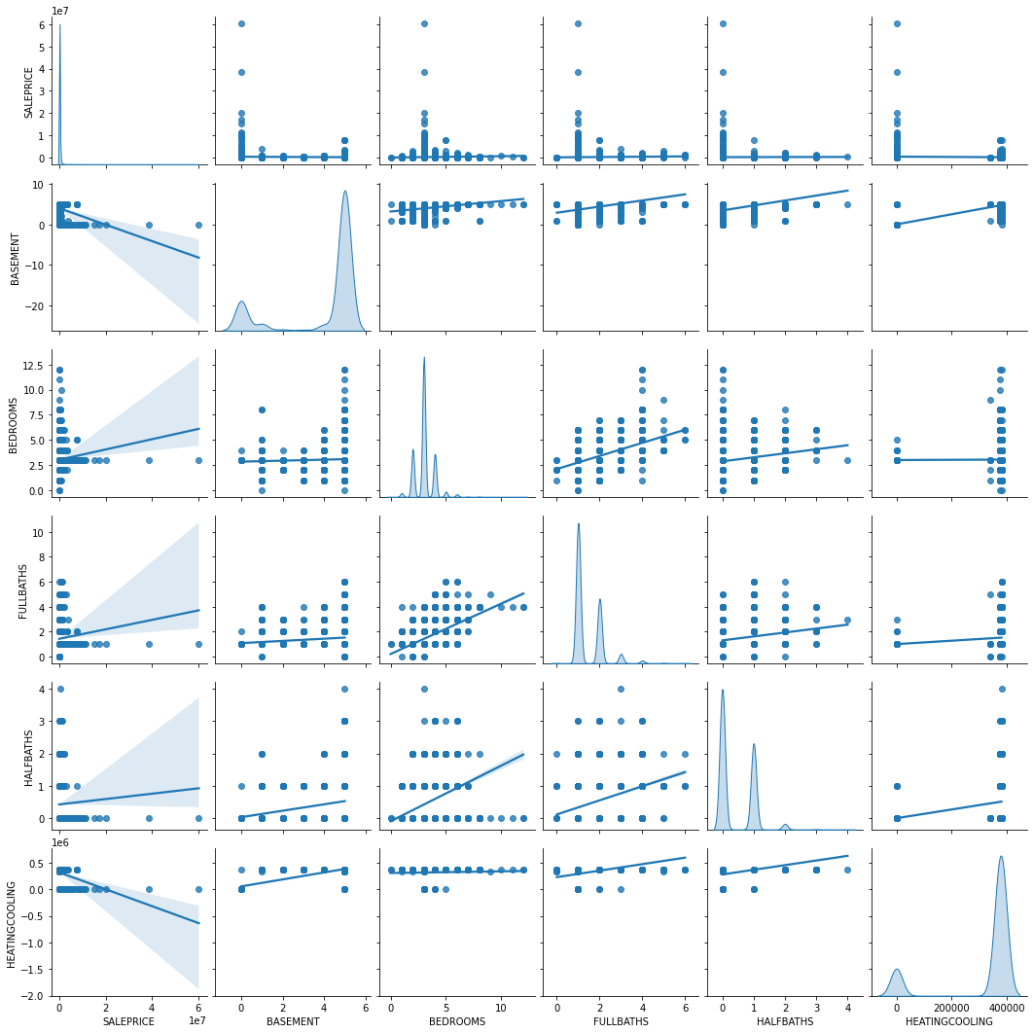
Exploratory Data Analysis
A deeper dive into the data
How does each variable depends on the other
Look for trends in the data
How does property sale price depends on each feature

Slide 16
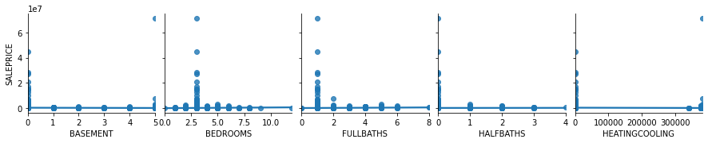
Exploratory Data Analysis
How do house properties impact pricing?

Slide 17
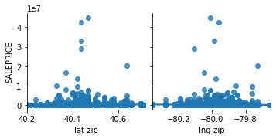
Exploratory Data Analysis
How does location of properties impact pricing?

Slide 18
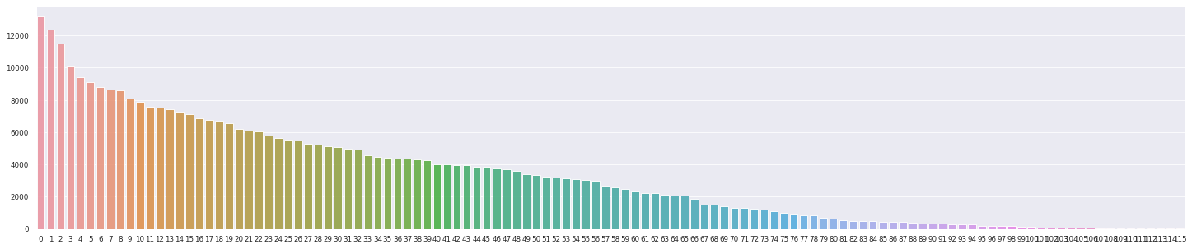
Exploratory Data Analysis
What is the distribution of the data across different locations?
15237.0 13195 15108.0 12371 15235.0 11500 15212.0 10138 15221.0 9421
...
15083.0 19
15321.0 18
15012.0 12
16229.0 12
16056.0 2
Name: PROPERTYZIP, Length: 116

Slide 19
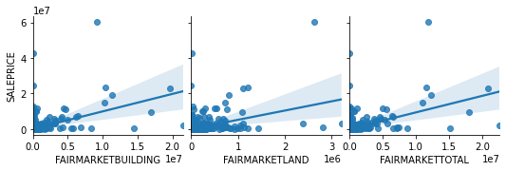
Exploratory Data Analysis
How do the assessments impact pricing?

Slide 20
Structure of Data Science Workflow
Data Cleaning
Exploratory Data Analysis
Model Exploration and Selection
Computing Home Value Index

Slide 21
Model Information
Model Goal: Predict valuation of existing homes for a variable sale date.
Target variable: Sale Price
Input variables: Sale date and important features that provide information on the valuation of a property at a certain date

Slide 22
Model Information
Model Assumptions:
No information on the buyers side (demand)
No listing prices or spread of ask/bid
No information on interest rates
No demographic information
No information on the economy
No refined information on location
Based on assessments only from 2021 (dataset)
Discrete daily sampling

Slide 23
Model Choices
Seek these regression model characteristics:
Deal with sparse data
Good for dealing with categorical and numerical data
Efficient at training (limited computational resources on my end)
Scalable to potentially adding more data in the future

Slide 24
Model Choices
Model | Train Score | Test Score
Linear Model: LassoCV | 0.573 | 0.495
Support Vector Machine (SD) | 0.201 | 0.007
Ensemble: Random Forest | 0.900 | 0.523
Ensemble: Bagging | 0.930 | 0.588
Ensemble: Adaptive Boosting (SD) | 0.829 | 0.380
Ensemble: Extreme Gradient Boosting | 0.814 | 0.767
*Scores are measured using R2 Score: 1-(sum of square residuals/total sum of squares)
SD = sampled dataset

Slide 25
What is XGBoost?
Decision-tree-based ensemble model
Uses gradient boosting framework
Converting weak to strong learner through sequential learning
Gradient descent algorithm
Great for small-to-medium structured/tabular data
Boosting optimized for software and hardware parallelization

Slide 26
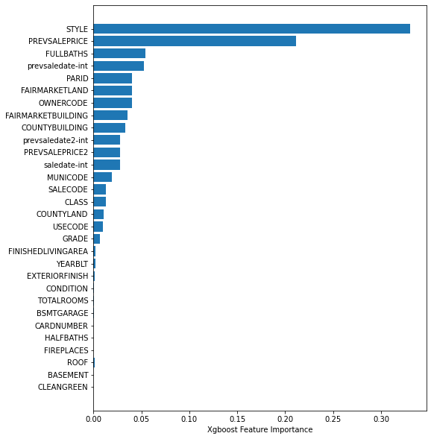
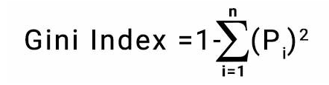
Another Level of Feature Selection
Feature Importance
Based on Gini importance
The higher the importance the more crucial it is for prediction
Notes:
The Gini Index is determined by deducting the sum of squared of probabilities of each class from one, mathematically, Gini Index can be expressed as:
Gini Index Formula
Where Pi denotes the probability of an element being classified for a distinct class.

Slide 27
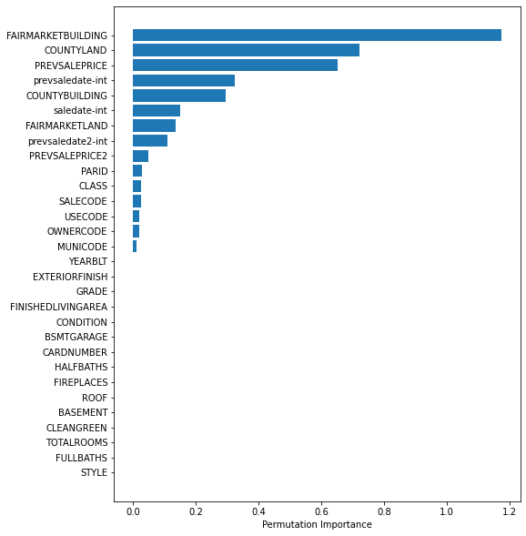
Another Level of Feature Selection
Permutation Importance
Compute score of model
For each feature shuffle column and compute score for corrupted dataset
The higher the importance the more crucial a particular feature

Slide 28
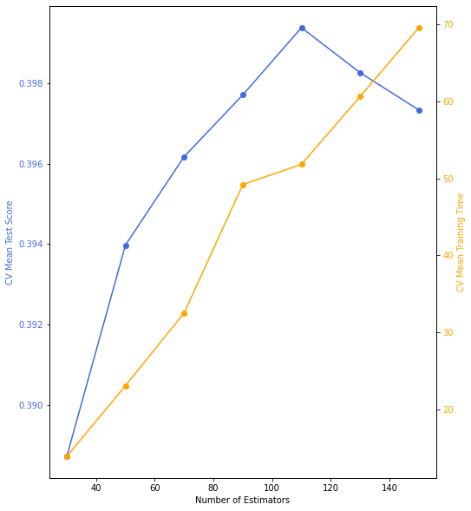
XGBoost Hyperparameter Tuning
For computational efficiency, only tuned 1 param – number of estimators
Use cross-validation with 4-way split
A bias-variance balance is obtained at n=110, with underfitting before and overfitting after
As n increases computational time increases

Slide 29
Structure of Data Science Workflow
Data Cleaning
Exploratory Data Analysis
Model Exploration and Selection
Computing Home Value Index

Slide 30
Home Value Index
What does it mean? (based on Zillow’s definition)
Insight on typical expected home values
Insight on housing market at a given time
Appreciation over time

Slide 31
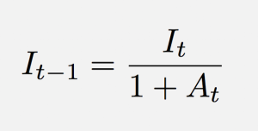
Home Value Index
How is it defined:

Slide 32
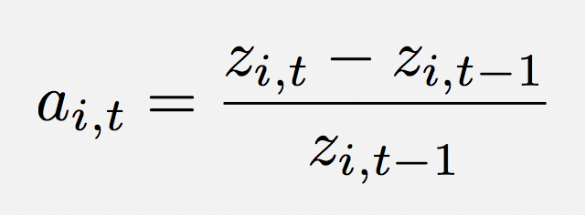
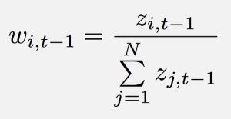
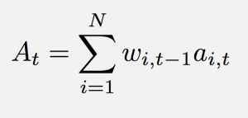
Home Value Index
How is it defined:

Slide 33


Home Value Index
How is it defined:
XGBoost Prediction

Slide 34
Home Value Index
How is it defined:
XGBoost Prediction
Moving average using previous 24 months

Slide 35
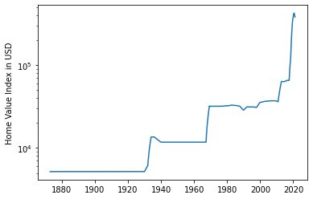
Results
Monthly time series of index
Extract key economic features
Late 1930s housing boom
1990 housing crisis
Dot-com bubble
2007 housing bubble
2007 housing recovery
2020 pandemic

Slide 36
Conclusions and Recommendations
Model needs further development and validation
Must relax certain model assumptions
Allegheny county real estate has historically been a good long-term investment
Based on recent trends I would advise not investing in the housing stock of Allegheny county

Slide 37
Model Extension
Create monthly HVI for each separate Zip code and create an index based on that
Implement a better geolocation scheme to refine location
Account for economic data such as interest rates into the model
Include additional sale data and historical assessment data from multiple listing service (MLS)

Slide 38
Thank you for the opportunity!
For a Fidelity Management and Research Interview
Matheus C. Fernandes (PhD Candidate - Harvard University)
Please find more information and full code at https://git.fer.me/fidelity-interview

