Slide 1
(one of) Our first jchoco program(s)

Slide 2
Constraint satisfaction
Constraint satisfaction problem (CSP) is a triple <V,D,C> where:
  V is set of variables
  Each X in V has set of values, D_X
    Usually assume finite domain
    {true,false}, {red,blue,green}, [0,10], …
  C is set of constraints
Goal: find assignment of values to variables to satisfy all the constraints

Slide 3
V4
V4 < V3
V3
V1 ≤ V4 − 1
V4 + V2 = 5
V2 + V3 > 6
V1
V2
V1 < V2
Di = {1,2,3,4,5}
What can you infer?
AR33 figure 18, page 35

Slide 4
V4
V4 < V3
V3
V1 ≤ V4 − 1
V4 + V2 = 5
V2 + V3 > 6
V1
V1 < V2
V2
Di = {1,2,3,4,5}
D1 = {1,2}
D2 = {2,3}
D3 = {4,5}
D4 = {2,3}
Was that easy?
Do you agree?

Slide 5
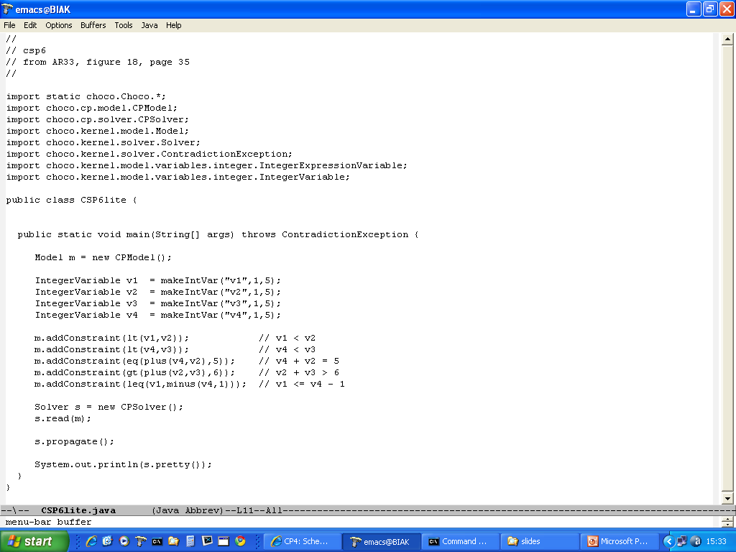
A program that models csp6

Slide 6
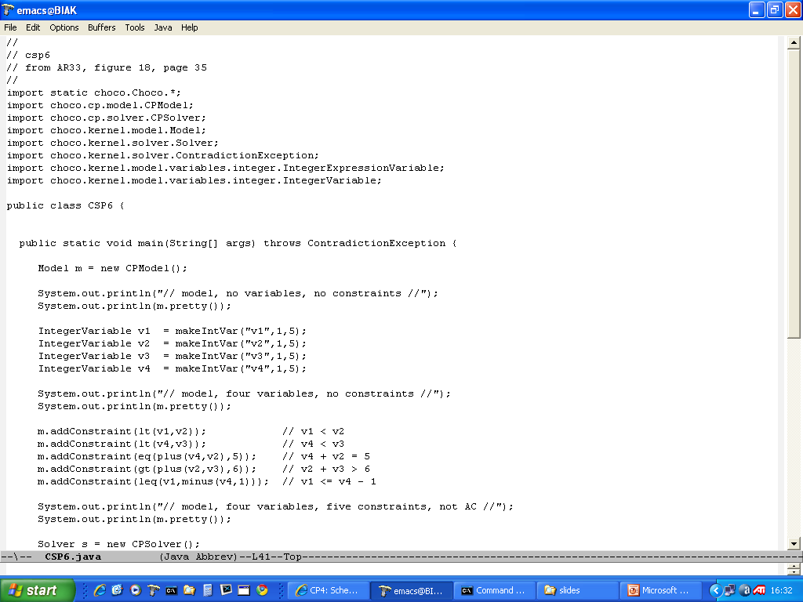
With print statements and search

Slide 7

Packages used

Slide 8
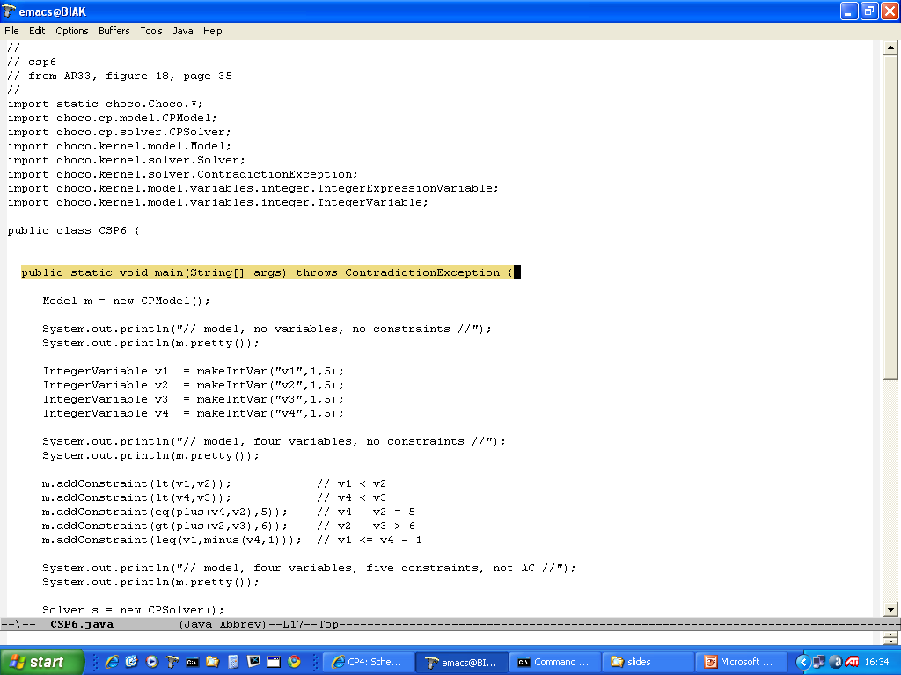
Can throw an exception

Slide 9
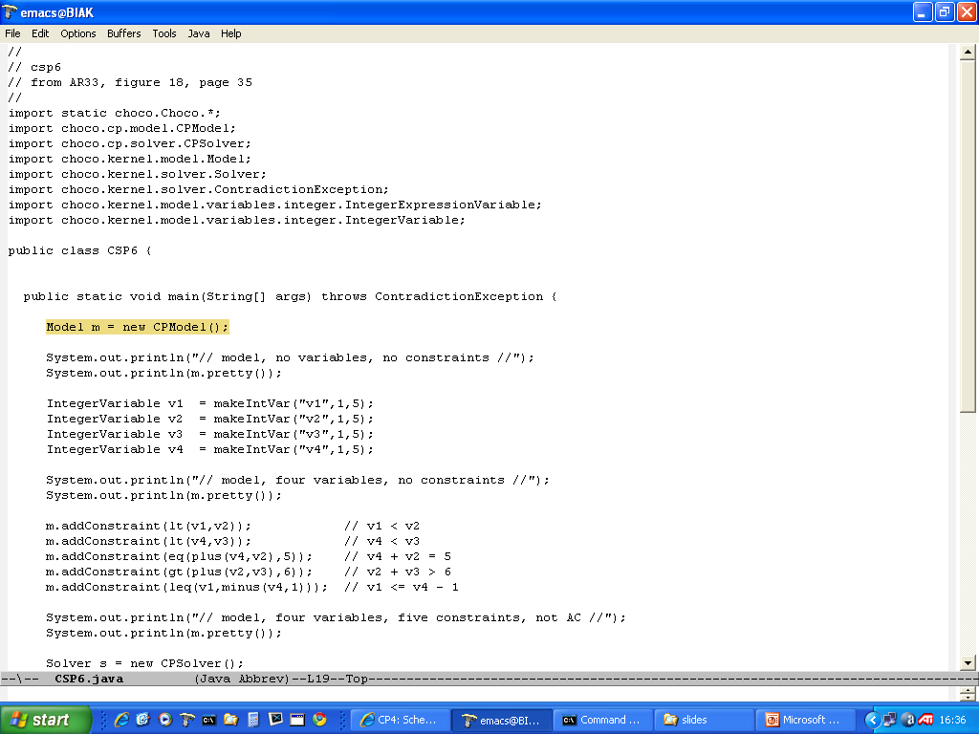
Create a model

Slide 10
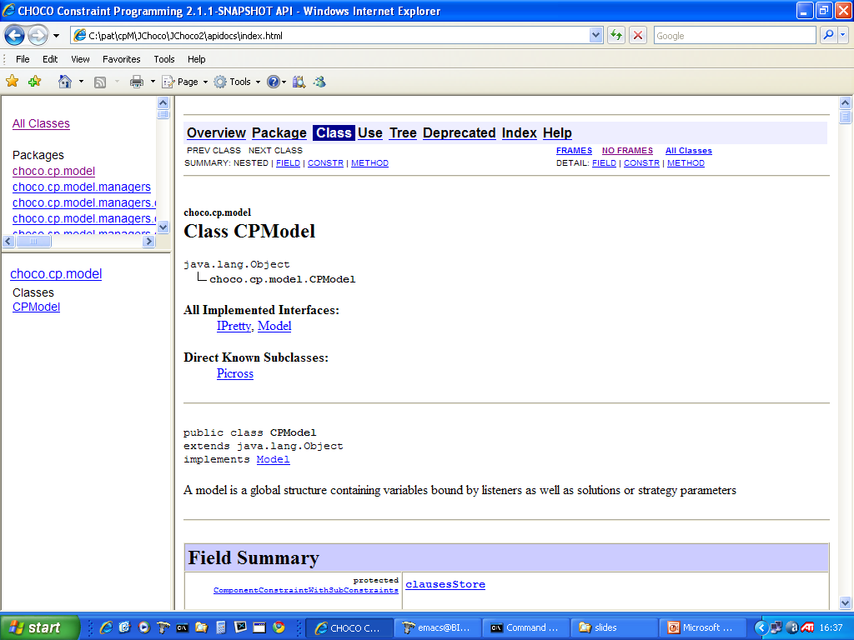

Slide 11
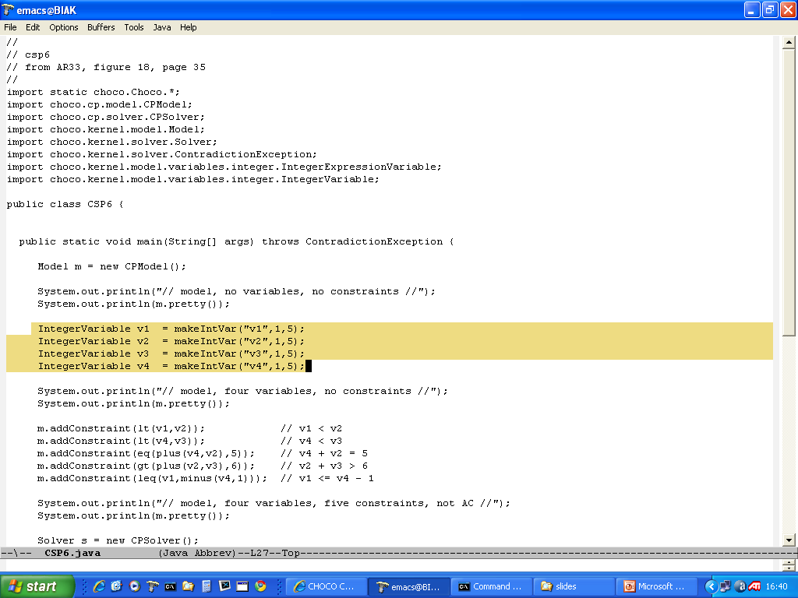
Create variables

Slide 12
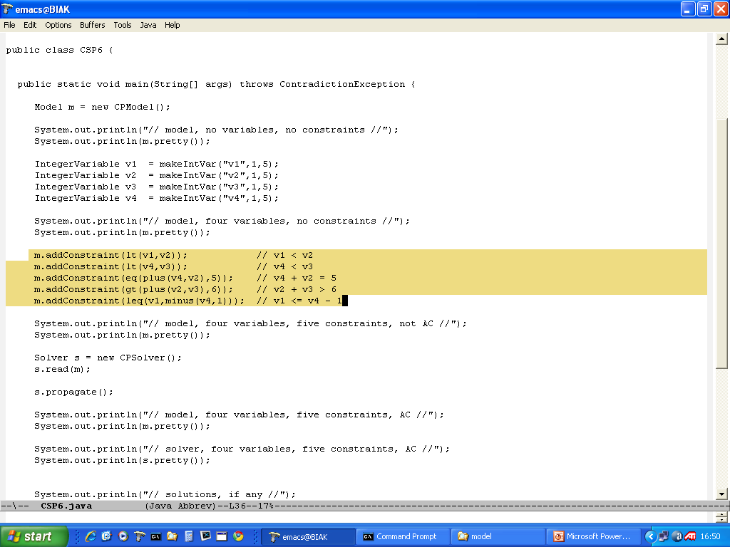
Post constraints

Slide 13
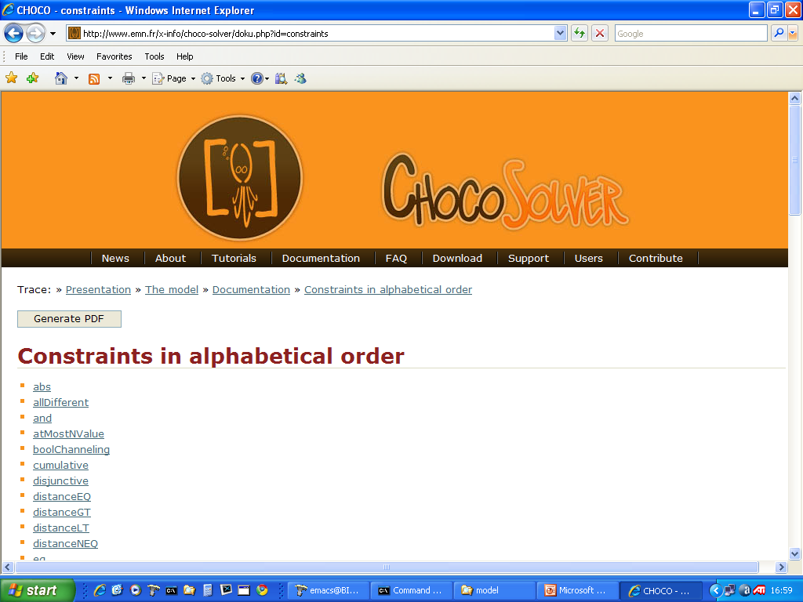

Slide 14
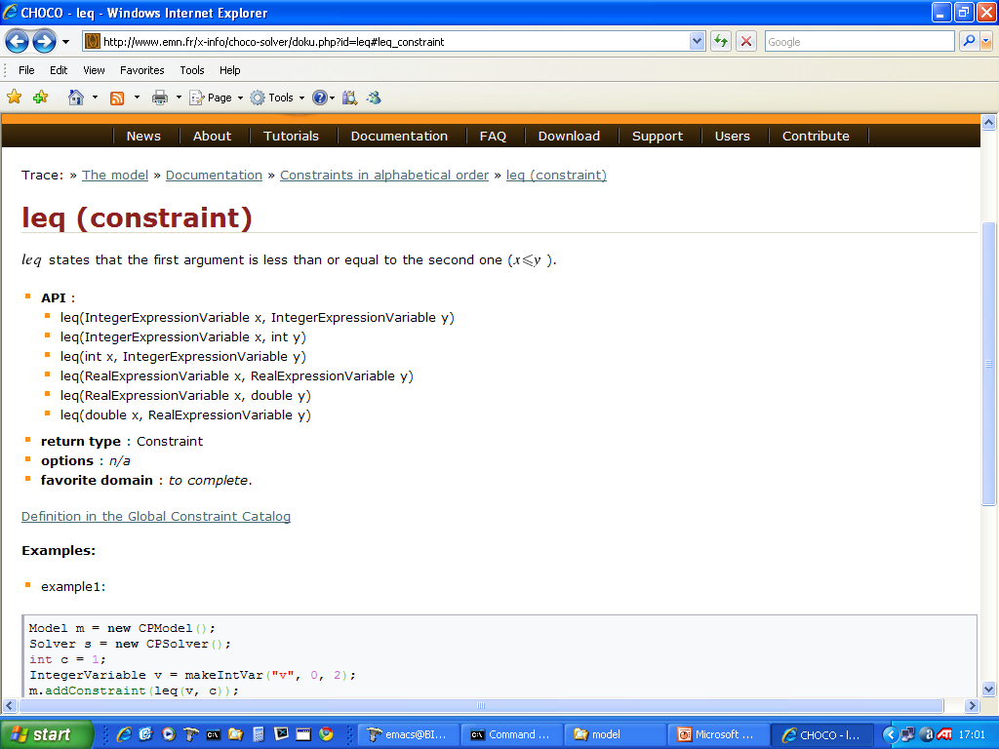

Slide 15
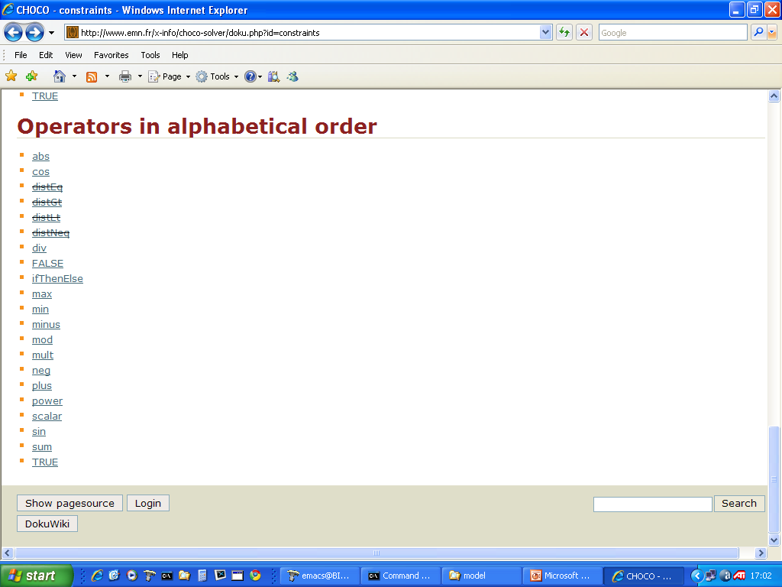

Slide 16
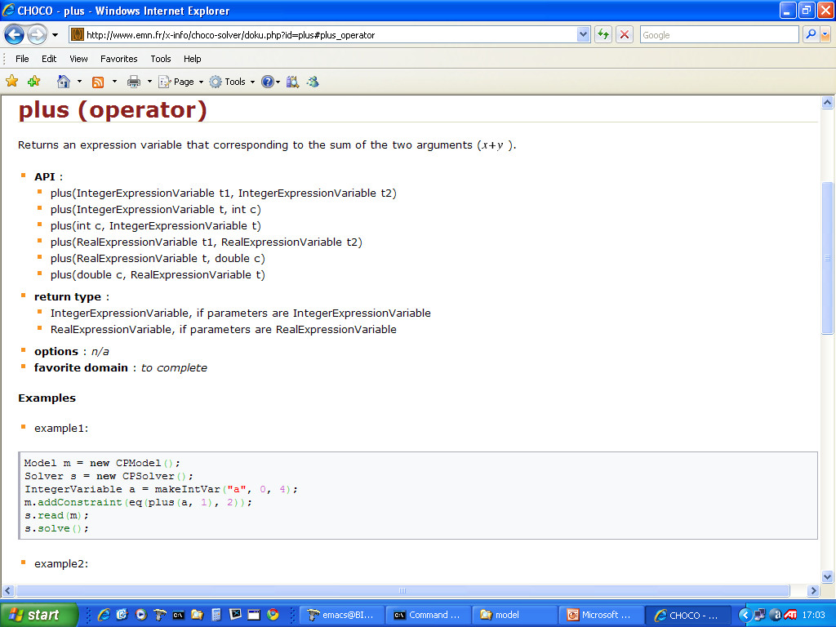

Slide 17
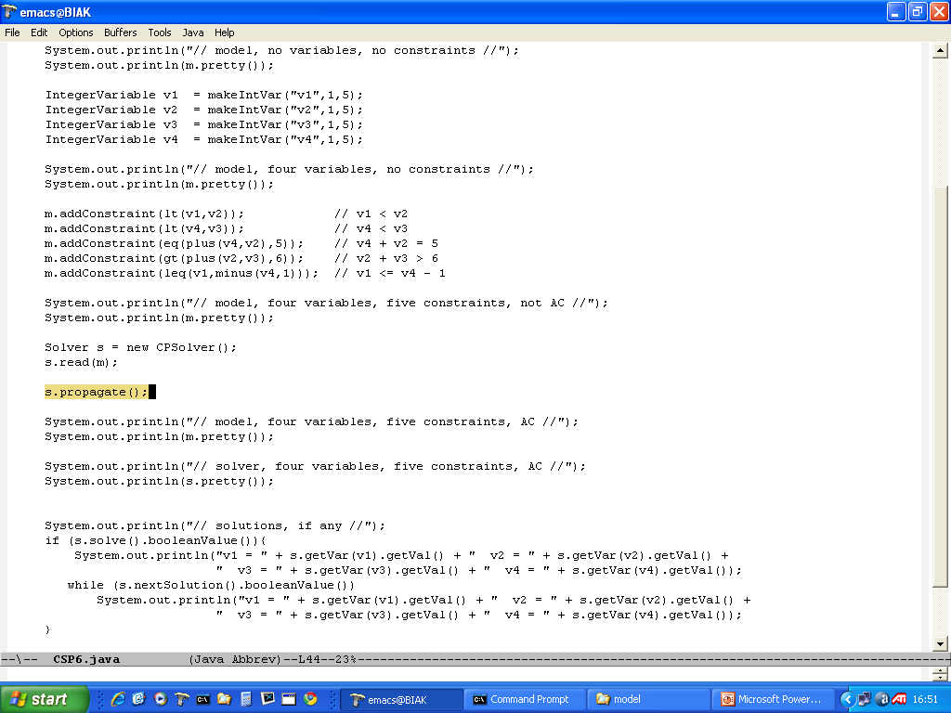
Establish AC

Slide 18
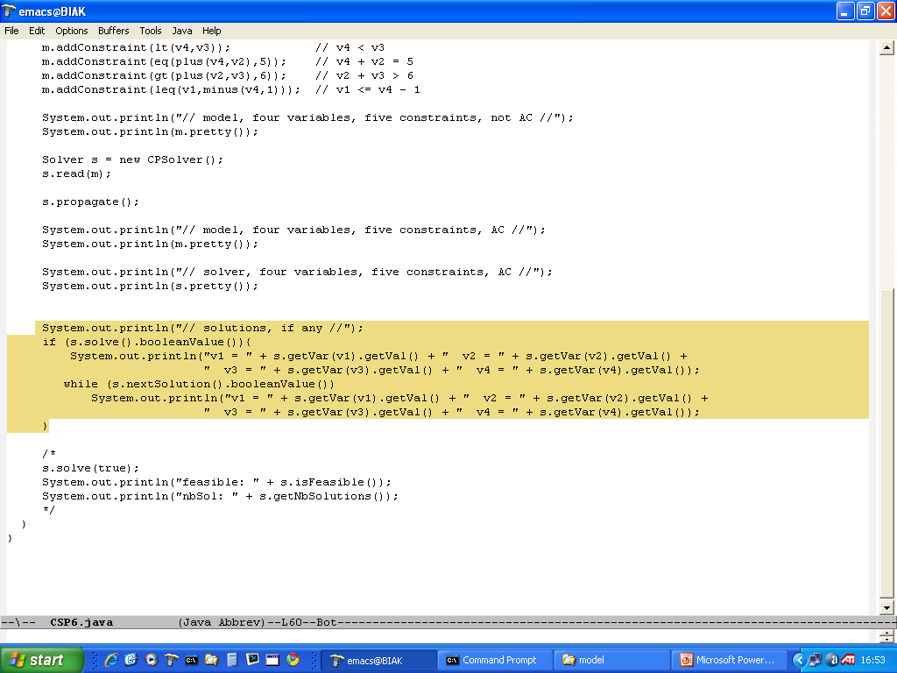
Magic code to get all solutions

Slide 19
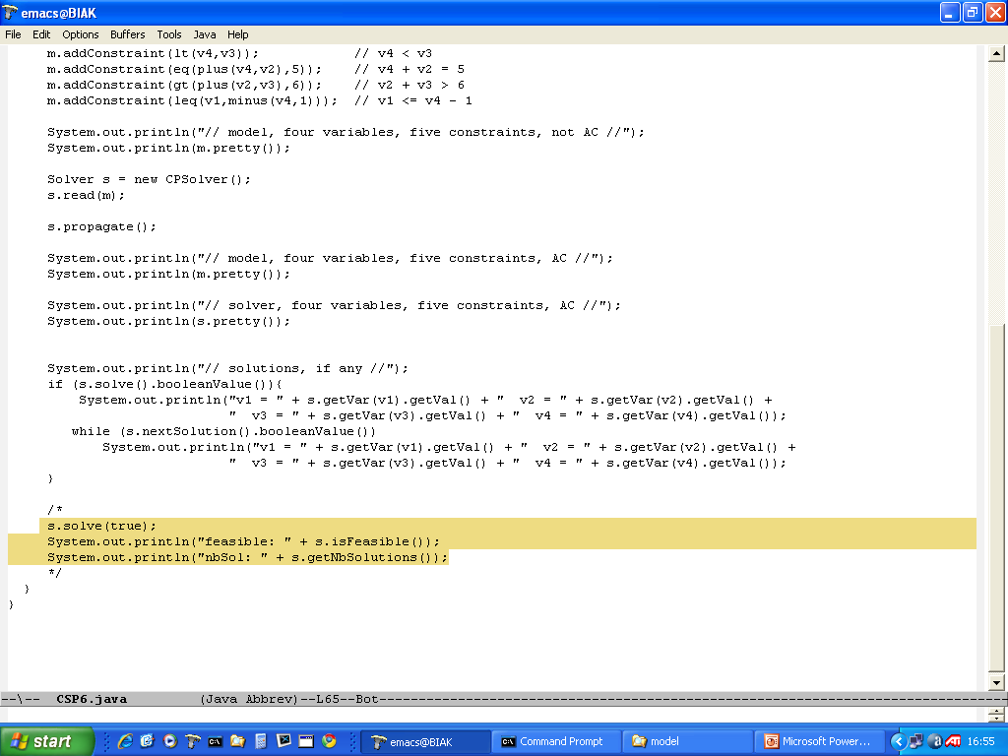
Code to count solutions

Slide 20
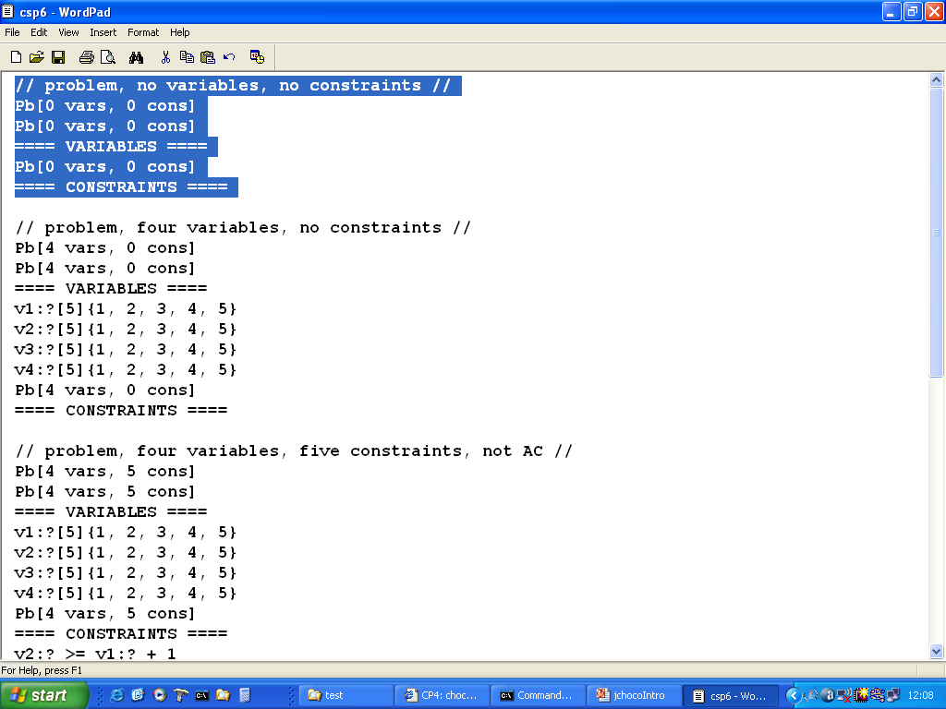
output/trace
Problem with no V or C

Slide 21
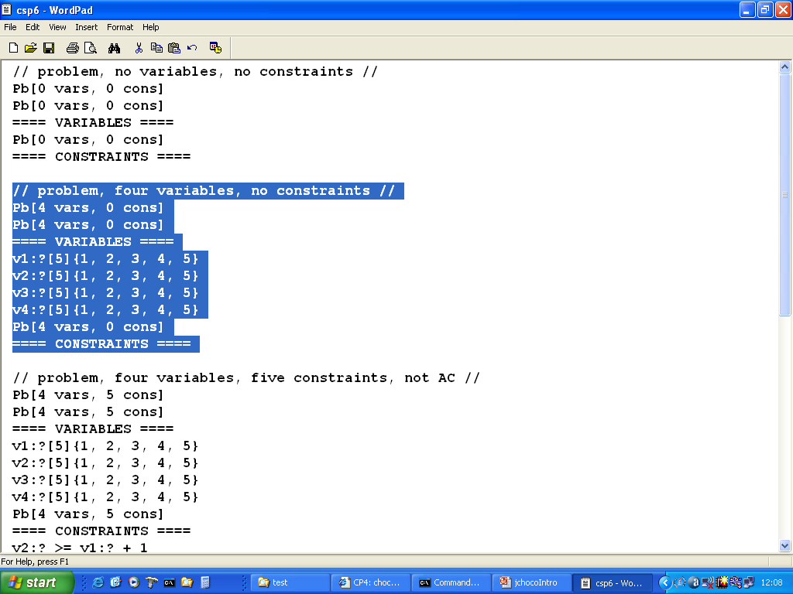
variables

Slide 22
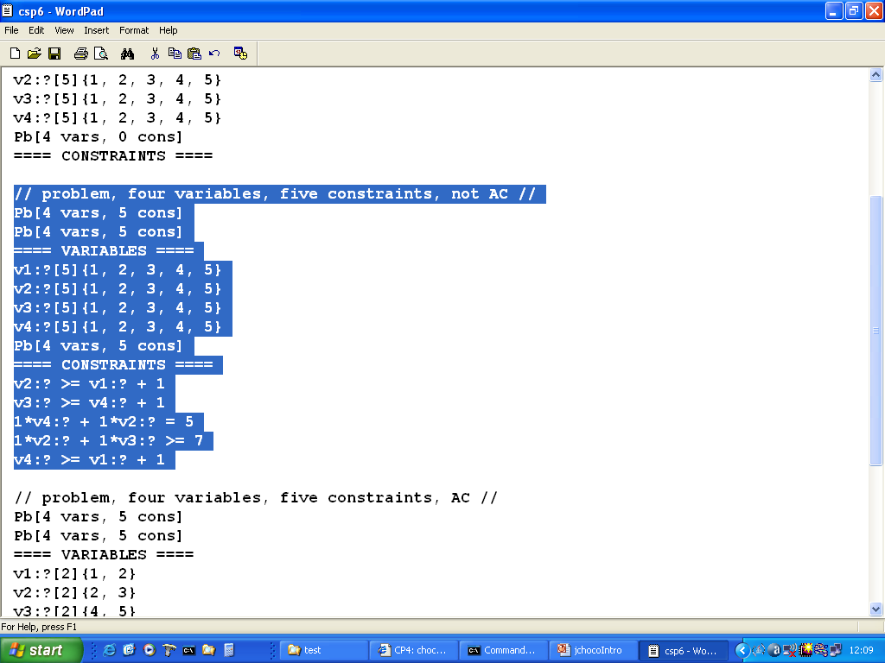
Variables and constraints

Slide 23
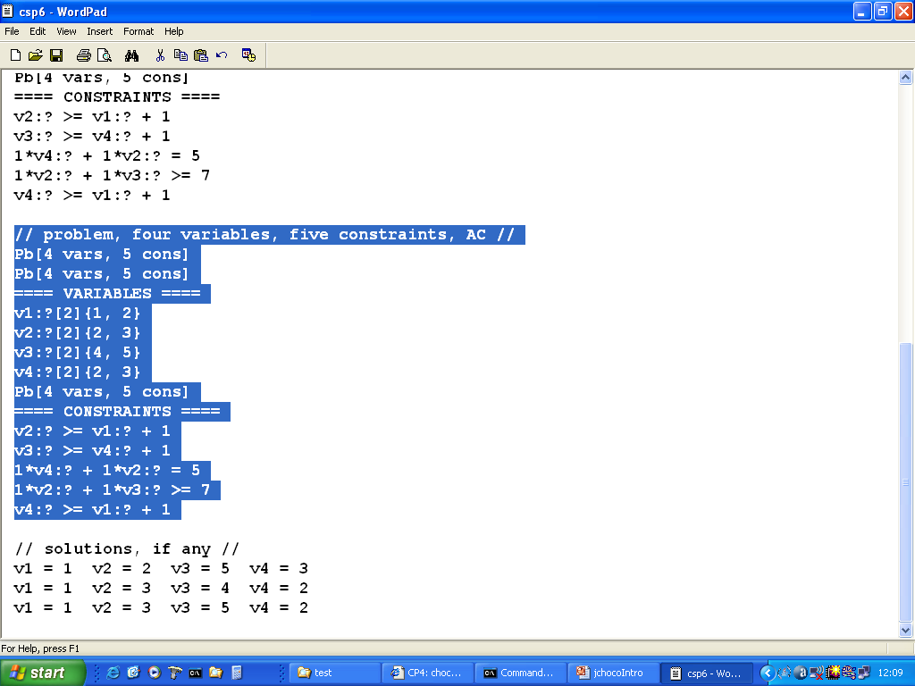
Made AC

Slide 24
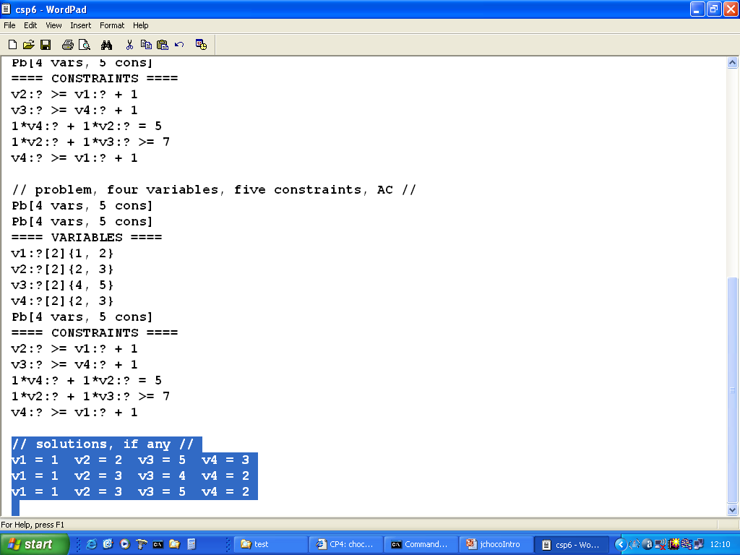
All solutions

Slide 25


Slide 26


