Slide 1
Put a different number in each circle (1 to 8) such
that adjacent circles cannot take consecutive numbers

Slide 2
Constraint Programming
An Introduction
by example
with help from Toby Walsh, Chris Beck,
Barbara Smith, Peter van Beek, Edward Tsang, ...

Slide 3
A Puzzle
Place numbers 1 through 8 on nodes
  Each number appears exactly once
  No connected nodes have consecutive numbers
?
?
?
?
?
?
You have
8 minutes!
?
?

Slide 4
Heuristic Search
Which nodes are hardest to number?
?
?
?
?
?
?
?
?

Slide 5
Heuristic Search
?
?
?
?
?
?
?
?

Slide 6
Heuristic Search
Which are the least constraining values to use?
?
?
?
?
?
?
?
?

Slide 7
Heuristic Search
Values 1 and 8
?
?
?
1
8
?
?
?

Slide 8
Heuristic Search
Values 1 and 8
?
?
?
1
8
?
?
?
Symmetry means we don’t need to consider: 8 1

Slide 9
Inference/propagation
?
?
?
1
8
?
?
?
We can now eliminate many values for other nodes

Slide 10
Inference/propagation
{1,2,3,4,5,6,7,8}
?
?
?
1
8
?
?
?

Slide 11
Inference/propagation
{2,3,4,5,6,7}
?
?
?
1
8
?
?
?

Slide 12
Inference/propagation
{3,4,5,6}
?
?
?
1
8
?
?
?

Slide 13
Inference/propagation
{3,4,5,6}
?
?
?
1
8
?
?
?
{3,4,5,6}
By symmetry

Slide 14
Inference/propagation
{3,4,5,6}
{1,2,3,4,5,6,7,8}
?
?
?
1
8
?
?
?
{3,4,5,6}

Slide 15
Inference/propagation
{3,4,5,6}
{2,3,4,5,6,7}
?
?
?
1
8
?
?
?
{3,4,5,6}

Slide 16
Inference/propagation
{3,4,5,6}
{3,4,5,6}
?
?
?
1
8
?
?
?
{3,4,5,6}

Slide 17
Inference/propagation
{3,4,5,6}
{3,4,5,6}
?
?
?
1
8
?
?
?
{3,4,5,6}
{3,4,5,6}
By symmetry

Slide 18
Inference/propagation
{3,4,5,6}
{3,4,5,6}
?
?
?
1
8
?
{3,4,5,6,7}
{2,3,4,5,6}
?
?
{3,4,5,6}
{3,4,5,6}

Slide 19
Inference/propagation
{3,4,5,6}
{3,4,5,6}
?
?
?
1
8
?
{3,4,5,6,7}
{2,3,4,5,6}
?
?
{3,4,5,6}
{3,4,5,6}
Value 2 and 7 are left in just one variable domain each

Slide 20
Inference/propagation
{3,4,5,6}
{3,4,5,6}
?
?
7
1
8
2
{3,4,5,6,7}
{2,3,4,5,6}
?
?
{3,4,5,6}
{3,4,5,6}
And propagate …

Slide 21
Inference/propagation
{3,4,5}
{3,4,5,6}
?
?
7
1
8
2
{3,4,5,6,7}
{2,3,4,5,6}
?
?
{3,4,5}
{3,4,5,6}
And propagate …

Slide 22
Inference/propagation
{3,4,5}
{4,5,6}
?
?
7
1
8
2
{3,4,5,6,7}
{2,3,4,5,6}
?
?
{3,4,5}
{4,5,6}
And propagate …

Slide 23
Inference/propagation
{3,4,5}
{4,5,6}
?
?
7
1
8
2
?
?
{3,4,5}
{4,5,6}
Guess a value, but be prepared to backtrack …

Slide 24
Inference/propagation
{3,4,5}
{4,5,6}
3
?
7
1
8
2
?
?
{3,4,5}
{4,5,6}
Guess a value, but be prepared to backtrack …

Slide 25
Inference/propagation
{3,4,5}
{4,5,6}
3
?
7
1
8
2
?
?
{3,4,5}
{4,5,6}
And propagate …

Slide 26
Inference/propagation
{5,6}
3
?
7
1
8
2
?
?
{4,5}
{4,5,6}
And propagate …

Slide 27
Inference/propagation
{5,6}
3
?
7
1
8
2
?
?
{4,5}
{4,5,6}
Guess another value …

Slide 28
Inference/propagation
3
5
7
1
8
2
?
?
{4,5}
{4,5,6}
Guess another value …

Slide 29
Inference/propagation
3
5
7
1
8
2
?
?
{4,5}
{4,5,6}
And propagate …

Slide 30
Inference/propagation
3
5
7
1
8
2
?
?
{4}
{4,6}
And propagate …

Slide 31
Inference/propagation
3
5
7
1
8
2
4
?
{4}
{4,6}
One node has only a single value left …

Slide 32
Inference/propagation
3
5
7
1
8
2
4
6
{6}

Slide 33
Solution
3
5
7
1
8
2
4
6

Slide 34
The Core of Constraint Computation
Modelling
  Deciding on variables/domains/constraints
Heuristic Search
Inference/Propagation
Symmetry
Backtracking

Slide 35




A Commercial Reality
First-tier software vendors use CP technology

Slide 36
Hardness
The puzzle is actually a hard problem
  NP-complete

Slide 37
Constraint programming
Model problem by specifying constraints on acceptable solutions
  define variables and domains
  post constraints on these variables
Solve model
  choose algorithm
    incremental assignment / backtracking search
    complete assignments / stochastic search
  design heuristics

Slide 38
Constraint satisfaction
Constraint satisfaction problem (CSP) is a triple <V,D,C> where:
  V is set of variables
  Each X in V has set of values, D_X
    Usually assume finite domain
    {true,false}, {red,blue,green}, [0,10], …
  C is set of constraints
Goal: find assignment of values to variables to satisfy all the constraints

Slide 39
How complex?

Slide 40
Assume
n variables
each with a domian size of m
how many states might we consider?

Slide 41
Example CSP
Variable, v_{i} for each node
Domain of {1, …, 8}
Constraints
  All values used
allDifferent(v₁ v₂ v₃ v₄ v₅ v₆ v₇ v₈)
  No consecutive numbers for adjoining nodes
|v₁ - v₂ | > 1
|v₁ - v₃ | > 1
…
?
?
?
?
?
?
?
?

Slide 42
Constraints
Constraints are tuples <S,R> where
  S is the scope, [X1,X2, … Xm]
    list of variables to which constraint applies
  R is relation specifying allowed values (goods)
    Subset of D_X1 x D_X2 x … x D_Xm
    May be specified intensionally or extensionally

Slide 43
Constraints
Extensional specification
  List of goods (or for tight constraints, nogoods)
Intensional specification
  X1 =/= X2
  5*X1 + 6*X2 < X3
  alldifferent([X1,X2,X3,X4]), …

Slide 44
more examples?

Slide 45
Do you know any constraint satisfaction problems?
To a man with a hammer, everything looks like a nail.

Slide 46
Exam timetabling

Slide 47
An Example, Exam Timetabling
Someone timetables the exams
We have a number of courses to examine
  how many?
    Dept has 36
    Faculty?
    University?
There are constraints
  if a student S takes courses Cx and Cy
    Cx and Cy cannot be at same time!
  If Cy and Cz have no students in common
    they can go in room R1 if there is space
  Temporal and resource constraints

Slide 48
An Example, Exam Timetabling
Represent as graph colouring
  vertices are courses
  colours are time
  vertices have weight (room requirements)
  edge connects vertices of diff colour
How complex is this
  if we have n vertices and k times
    an n-digit number to the base k?
How would you solve this
  backtracking search?
  Greedy?
  Something else
    GA?
    SA, TS, GLS, HC, ...

Slide 49
An Example, Exam Timetabling
How does the person solve this?
Is that person intelligent?
Is there always a solution?
If there isn’t, do we want to know why?
  Do you think they can work out “why”?

Slide 50
Crossword puzzle generation

Slide 51
An example
1
2
3
4
5
6
7
4
Make a crossword puzzle!
Given the above grid and a dictionary, fill it.
Then go get the clues (not my problem)

Slide 52
An example
1
2
3
4
5
6
7
1A
4D
4
2D
4A
1A 1 across
4D 4 down
2D 2 down
4A 4 across
7D 7 down
7D
Variables

Slide 53
An example
1
2
3
4
5
6
7
1A
4D
4
2D
4A
1A-4D: 4th of 1A equals 1st of 4D
1A-2D: 2nd of 1A equals 1st of 2D
2D-4A: 4th of 2D equals 2nd of4D
4D-4A: 4th of 4A equals 4th of 4D
4A-7D: 7th of 4A equals 2nd of 7D
7D
Constraints

Slide 54
An example
1
2
3
4
5
6
7
1A
4D
4
2D
4A
1A: any 6 letter word
4A: any 8 letter word
4D: any 5 letter word
2D: any 7 letter word
7D: any 3 letter word
7D
Domains (also unary constraints!)

Slide 55
An example
1
2
3
4
5
6
7
1A
4D
4
2D
4A
Find an assignment of values to variables, from their domains, such that the constraints are satisfied (or show that no assignment exists)
7D
A CSP!

Slide 56
An example
1
2
3
4
5
6
7
1A
4D
4
2D
4A
Choose a variable
Assign it a value
Check compatibility
If not compatible try a new value
If no values remain re-assign previous variable
7D
Good old fashioned BT!

Slide 57
Questions?
1
2
3
4
5
6
7
1A
4D
4
2D
4A
What variable should I choose?
7D
What value should I choose?
What reasoning can I do when making an assignment?
What reasoning can I do on a dead end?
Decisions, decisions!

Slide 58
An example
1
2
3
4
5
6
7
4
Is there an alternative representation?

Slide 59
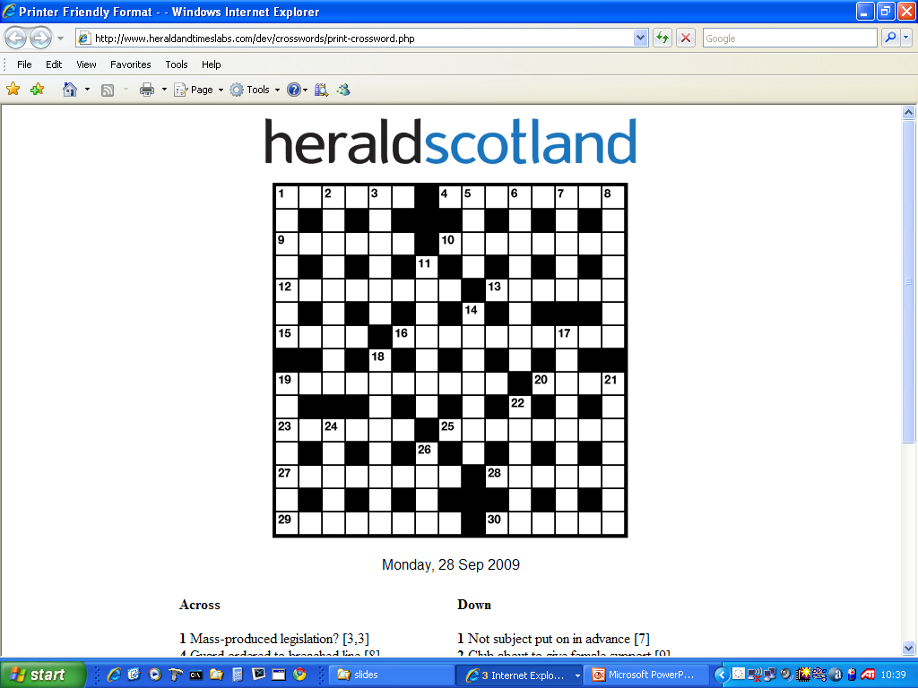

Slide 60
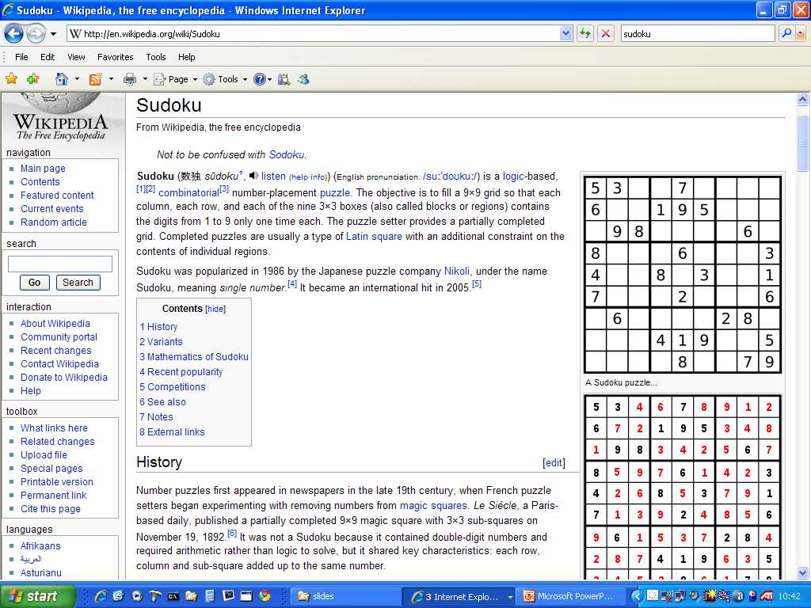

Slide 61
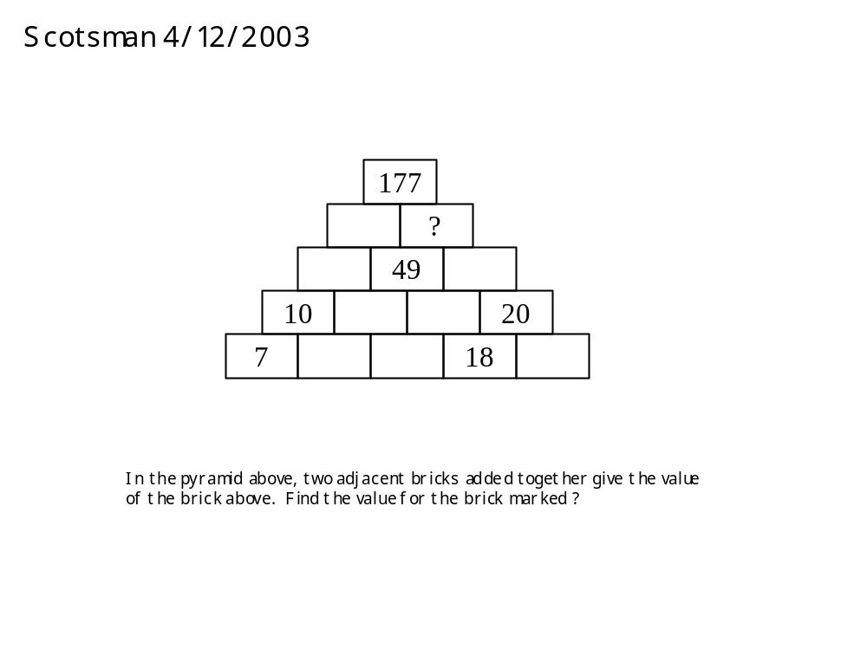
The n-queens problem
A demo in Oz

Slide 62
Problems of interest to CP
These are some of the problems that have
been tackled by CP
factory scheduling (JSSP)
vehicle routing (VRP)
packing problems (NumPart and BinPack)
timetabling (exams, lectures, trains)
configuration and design (hardware)
workforce management (call centres, etc)
car sequencing (assembly line scheduling)
supertree construction (bioinformatics)
network design (telecoms problem)
gate arrival (at airports)
logistics (Desert Storm an example)
aircraft maintenance schedules
aircraft crew scheduling (commercial airlines)
air cover for naval fleet

Slide 63
What will be covered in course
the technology behind constraint programming (cp)
cp in JChoco/java
modelling and solving problems
the state of the art

