Slide 1
Functional Programming

Slide 2
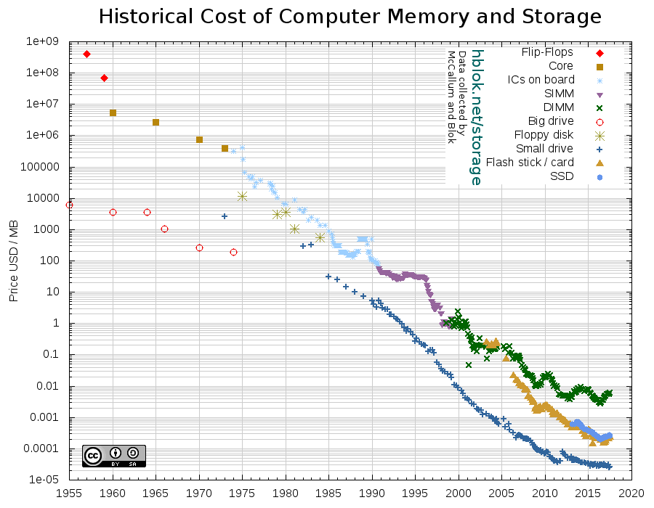

Slide 3
A programming paradigm

Slide 4
Pure functions
Immutability
High order functions
First class functions

Slide 5
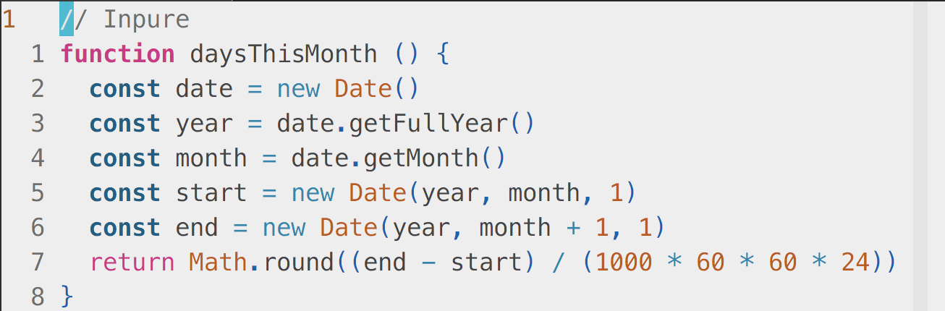
Inpure function :(

Slide 6
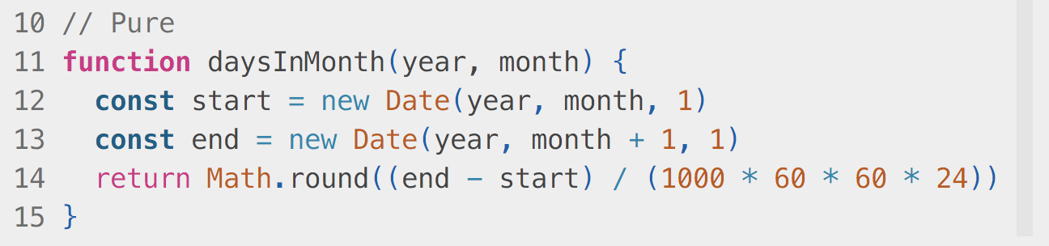
Pure function :)

Slide 7
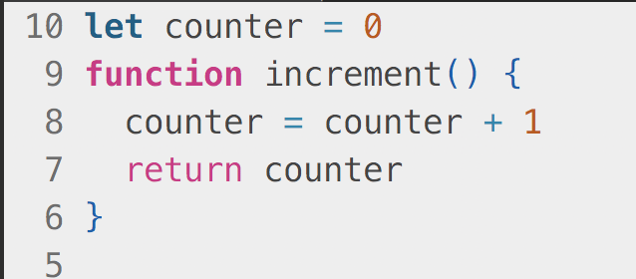
Side effect :(

Slide 8
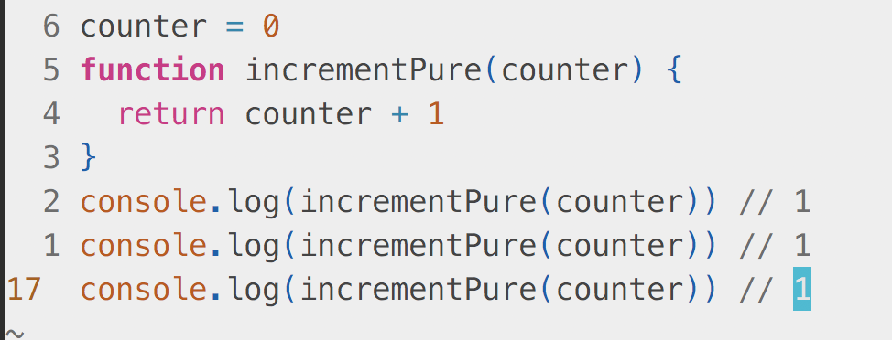
Side effect free :)

Slide 9
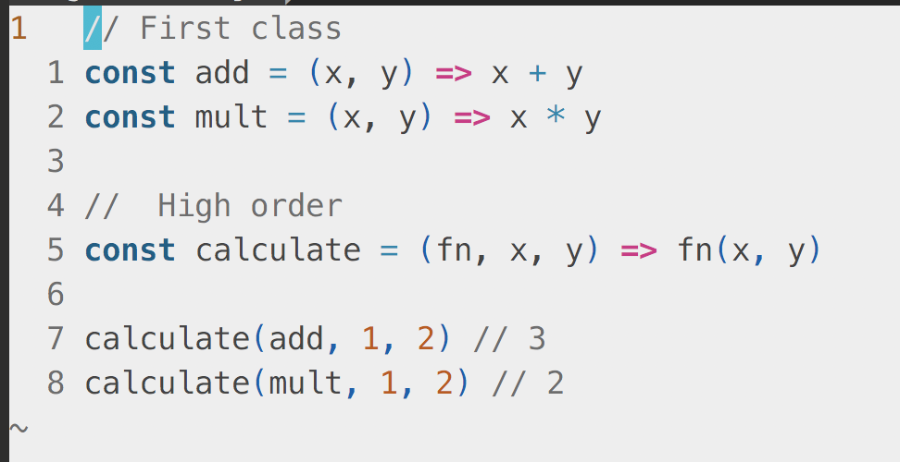
First class & High order functions

Slide 10
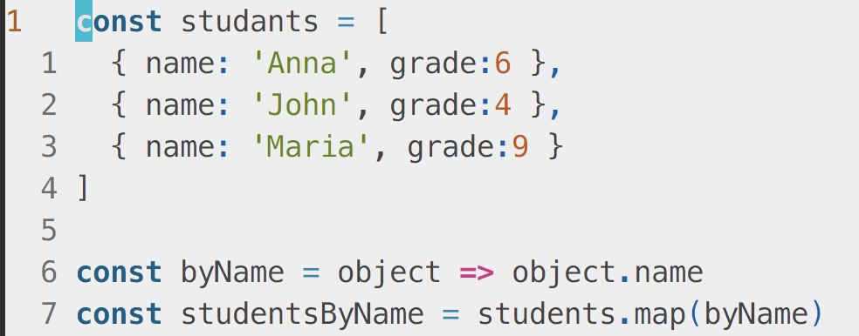
Map

Slide 11
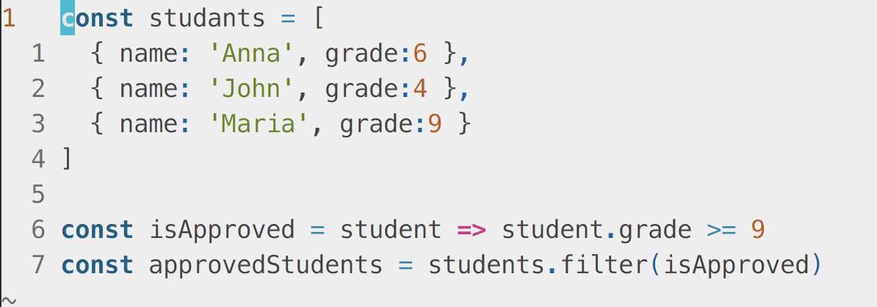
Filter

Slide 12
Pros vs Cons
Previsibility
Performance
Easier to test / debug
Memory usage

Slide 13
Clojure
Elixir
Erlang
Scala
Haskell
F#

