Slide 1

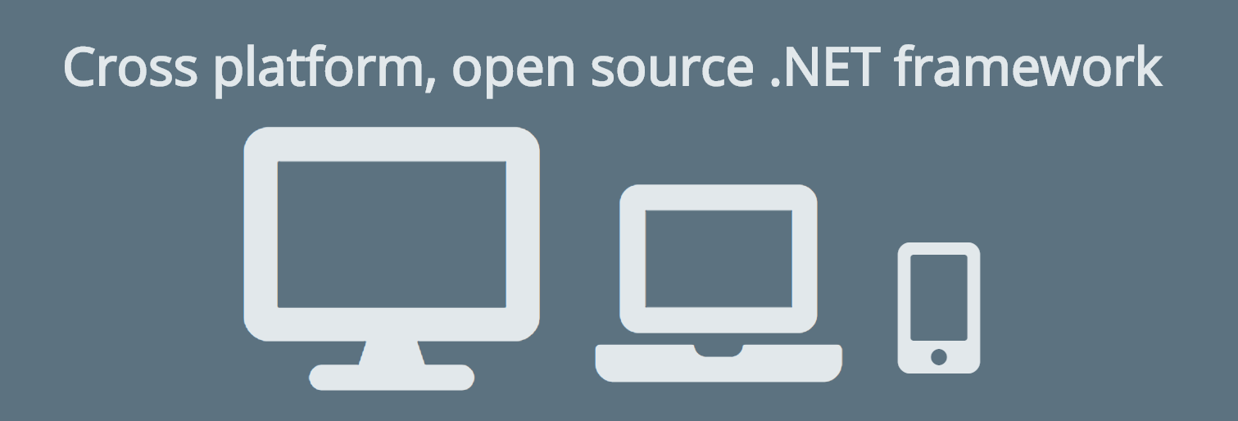
European Computer Manufacturers Association
Standard ECMA-335 (CLI) / ECMA-334 (C#)
Ximian / Novell

Slide 2

European Computer Manufacturers Association
Standard ECMA-335 (CLI) / ECMA-334 (C#)
Ximian / Novell

Slide 3
.NET Core vs .NET Framework
.NET Framework
.NET Core
Windows
Windows, Linux, Mac …
NET Core SDK

Slide 4
.NET Core vs .NET Framework
.NET Framework
.NET Core
.NET Core Runtime
Windows
Código da aplicação
Código da aplicação
Windows
Windows, Linux, Mac …

Slide 5



.NET Standard

Slide 6
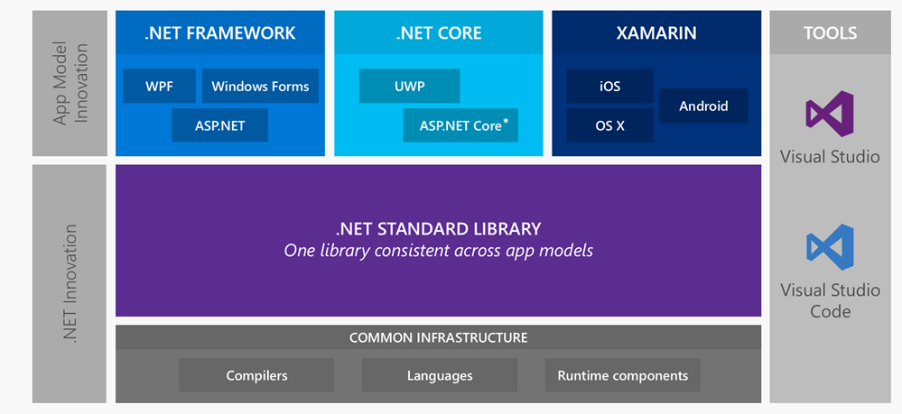
.NET Standard
https://www.slideshare.net/dotnet18/moving-forward-with-aspnet-core

Slide 7
.NET Standard
.NET Standard | 1.0 | 1.1 | 1.2 | 1.3 | 1.4 | 1.5 | 1.6 | 2.0
.NET Core | 1.0 | 1.0 | 1.0 | 1.0 | 1.0 | 1.0 | 1.0 | 2.0
.NET Framework | 4.5 | 4.5 | 4.5.1 | 4.6 | 4.6.1 | 4.6.1 | 4.6.1 | 4.6.1
Mono | 4.6 | 4.6 | 4.6 | 4.6 | 4.6 | 4.6 | 4.6 | 5.4
Xamarin.iOS | 10.0 | 10.0 | 10.0 | 10.0 | 10.0 | 10.0 | 10.0 | 10.14
Xamarin.Mac | 3.0 | 3.0 | 3.0 | 3.0 | 3.0 | 3.0 | 3.0 | 3.8
Xamarin.Android | 7.0 | 7.0 | 7.0 | 7.0 | 7.0 | 7.0 | 7.0 | 8.0
UWP | 10.0 | 10.0 | 10.0 | 10.0 | 10.0 | 10.0.16 | 10.0.16 | 10.0.16
Windows | 8.0 | 8.0 | 8.1
https://github.com/dotnet/standard/blob/master/docs/versions.md

Slide 8
.NET Core
Plataforma de desenvolvimento de propósitos gerais
Executa sobre Windows, Linux, macOS, nuvem ou dispositivos embarcados
Open source
Compatível com .NET Framework, Xamarin e Mono via .NET Standard.

Slide 9


ASP.NET Core
O que mudou?

Slide 10

ASP.NET Core
Kestrel
Global.asax
Application_Start
Application_End
Application_Error
…
Web Forms
MVC
MVC
Startup
ConfigureServices
Configure
Modules
Web API
appsettings.json e variáveis de ambiente
Handlers
Injeção de dependência nativo
Web.config
Middlewares

Slide 11
ASP.NET Core
MVC
MVC
Web API 2
Escolha ruim para o nome da biblioteca ou estaria a Microsoft tentando ressuscitar o ASP.NET MVC?

Slide 12

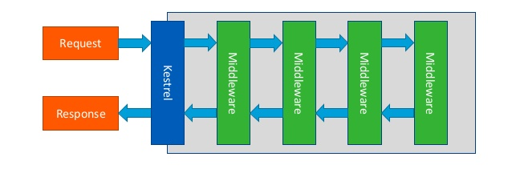
ASP.NET Core
https://imasters.com.br/dotnet/configuracao-e-deploy-de-aplicativos-asp-net-core-2-0-no-iis
https://www.slideshare.net/Avanade-Nederland/introduction-to-aspnet-core

