Slide 1
HW3 – Tomasulo with Speculation Template

Slide 2
Cycle 1
Reorder Buffer /
Instruction Status Iter 1
Reorder Buffer /
Instruction Status Iter 2
Register Result Status
Instructions | ROB Entry # | IS | EX | WB | CMT
LD F0, 0(R1) | 1 | 1
DIVD F2, F0, F6 | 2
LD F6, 8(R1) | 3
DIVD F6, F6, F2 | 4
SD F6, 16(R1) | 5
DADDI R1, R1, #-32 | 6
BNEQZ R1, LOOP | 7
ROB Entry # | IS | EX | WB | CMT
8
9
10
11
12
13
14
Reg | F0 | F2 | F6 | R1
ROB # | #1
CDB | ROB #
Reservation Stations
LD/SD Buffers
Time (until complete) | Name | Busy | Op | Vj | Vk | Qj | Qk
 | Add1
 | Add2
 | Mult1
 | Mult2
 | Mult3
 | Mult4
Time (until complete) | Name | Busy | Addr | Qj
2 | Ld1 | Yes | 0+R1
 | Ld2
 | Sd1
 | Sd2

Slide 3
Cycle 2
Reorder Buffer /
Instruction Status Iter 1
Reorder Buffer /
Instruction Status Iter 2
Register Result Status
Instructions | ROB Entry # | IS | EX | WB | CMT
LD F0, 0(R1) | Head 1 | 1 | 2-
DIVD F2, F0, F6 | Tail 2 | 2
LD F6, 8(R1) | 3
DIVD F6, F6, F2 | 4
SD F6, 16(R1) | 5
DADDI R1, R1, #-32 | 6
BNEQZ R1, LOOP | 7
ROB Entry # | IS | EX | WB | CMT
8
9
10
11
12
13
14
Reg | F0 | F2 | F6 | R1
ROB # | #1 | #2
CDB | ROB #
Reservation Stations
LD/SD Buffers
Time (until complete) | Name | Busy | Op | Vj | Vk | Qj | Qk
 | Add1
 | Add2
 | Mult1 | Yes | DIVD |  | F6 | #1
 | Mult2
 | Mult3
 | Mult4
Time (until complete) | Name | Busy | Addr | Qj
1 | Ld1 | Yes | 0+R1
 | Ld2
 | Sd1
 | Sd2

Slide 4
Cycle 3
Reorder Buffer /
Instruction Status Iter 1
Reorder Buffer /
Instruction Status Iter 2
Register Result Status
Instructions | ROB Entry # | IS | EX | WB | CMT
LD F0, 0(R1) | Head 1 | 1 | 2-3
DIVD F2, F0, F6 | 2 | 2
LD F6, 8(R1) | Tail 3 | 3
DIVD F6, F6, F2 | 4
SD F6, 16(R1) | 5
DADDI R1, R1, #-32 | 6
BNEQZ R1, LOOP | 7
ROB Entry # | IS | EX | WB | CMT
8
9
10
11
12
13
14
Reg | F0 | F2 | F6 | R1
ROB # | #1 | #2 | #3
CDB | ROB #
Reservation Stations
LD/SD Buffers
Time (until complete) | Name | Busy | Op | Vj | Vk | Qj | Qk
 | Add1
 | Add2
 | Mult1 | Yes | DIVD |  | F6 | #1
 | Mult2
 | Mult3
 | Mult4
Time (until complete) | Name | Busy | Addr | Qj
0 | Ld1 | Yes | 0+R1
2 | Ld2 | Yes | 8+R1
 | Sd1
 | Sd2

Slide 5
Cycle 4
Reorder Buffer /
Instruction Status Iter 1
Reorder Buffer /
Instruction Status Iter 2
Register Result Status
Instructions | ROB Entry # | IS | EX | WB | CMT
LD F0, 0(R1) | Head 1 | 1 | 2-3 | 4
DIVD F2, F0, F6 | 2 | 2
LD F6, 8(R1) | 3 | 3 | 4-
DIVD F6, F6, F2 | Tail 4 | 4
SD F6, 16(R1) | 5
DADDI R1, R1, #-32 | 6
BNEQZ R1, LOOP | 7
ROB Entry # | IS | EX | WB | CMT
8
9
10
11
12
13
14
Reg | F0 | F2 | F6 | R1
ROB # | #1 | #2 | #4
CDB | ROB #
 | #1
Reservation Stations
LD/SD Buffers
Time (until complete) | Name | Busy | Op | Vj | Vk | Qj | Qk
 | Add1
 | Add2
15 | Mult1 | Yes | DIVD | 0+R1 | F6
 | Mult2 | Yes | DIVD |  |  | #3 | #2
 | Mult3
 | Mult4
Time (until complete) | Name | Busy | Addr | Qj
 | Ld1
1 | Ld2 | Yes | 8+R1
 | Sd1
 | Sd2

Slide 6
Cycle 5
Reorder Buffer /
Instruction Status Iter 1
Reorder Buffer /
Instruction Status Iter 2
Register Result Status
Instructions | ROB Entry # | IS | EX | WB | CMT
LD F0, 0(R1) | 1 | 1 | 2-3 | 4 | 5
DIVD F2, F0, F6 | Head 2 | 2 | 5-
LD F6, 8(R1) | 3 | 3 | 4-5
DIVD F6, F6, F2 | 4 | 4
SD F6, 16(R1) | Tail 5 | 5
DADDI R1, R1, #-32 | 6
BNEQZ R1, LOOP | 7
ROB Entry # | IS | EX | WB | CMT
8
9
10
11
12
13
14
Reg | F0 | F2 | F6 | R1
ROB # |  | #2 | #4
CDB | ROB #
Reservation Stations
LD/SD Buffers
Time (until complete) | Name | Busy | Op | Vj | Vk | Qj | Qk
 | Add1
 | Add2
14 | Mult1 | Yes | DIVD | 0+R1 | F6
 | Mult2 | Yes | DIVD |  |  | #3 | #2
 | Mult3
 | Mult4
Time (until complete) | Name | Busy | Addr | Qj
 | Ld1
0 | Ld2 | Yes | 8+R1
 | Sd1 | Yes | 16+R1 | #4
 | Sd2

Slide 7
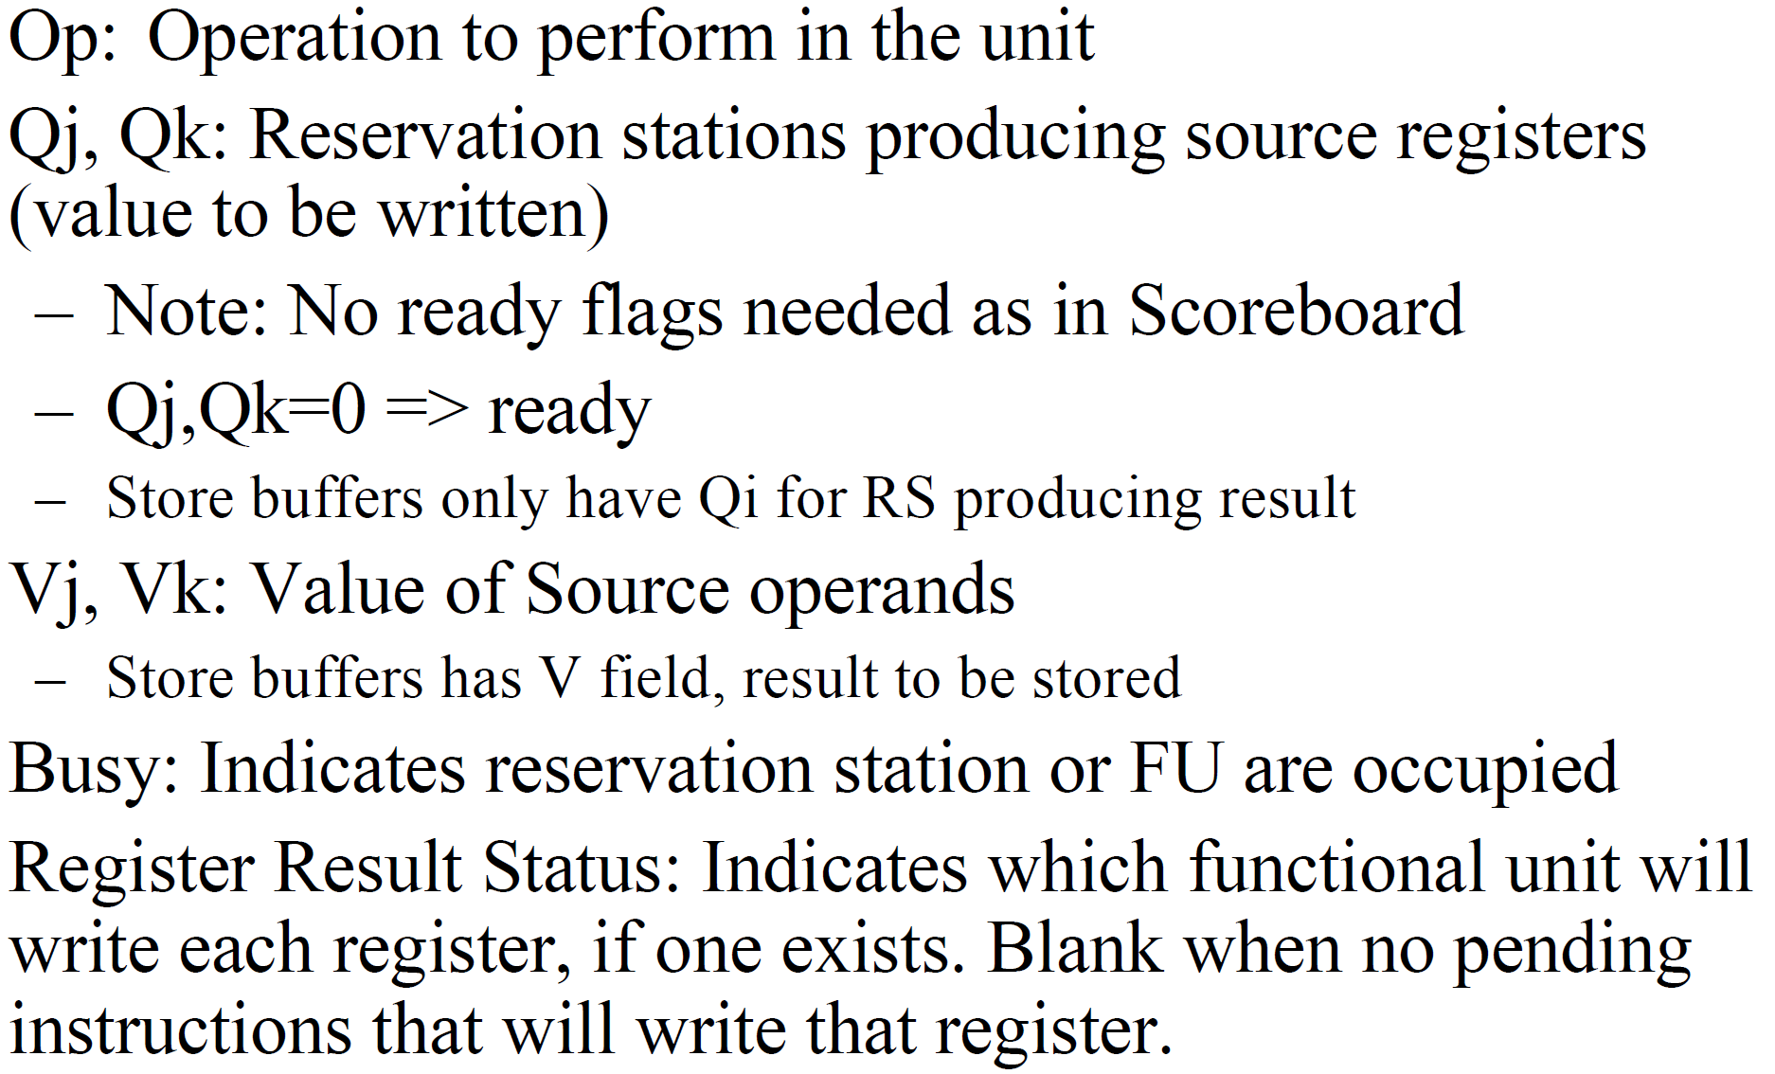
Reservation Station Notes

Slide 8
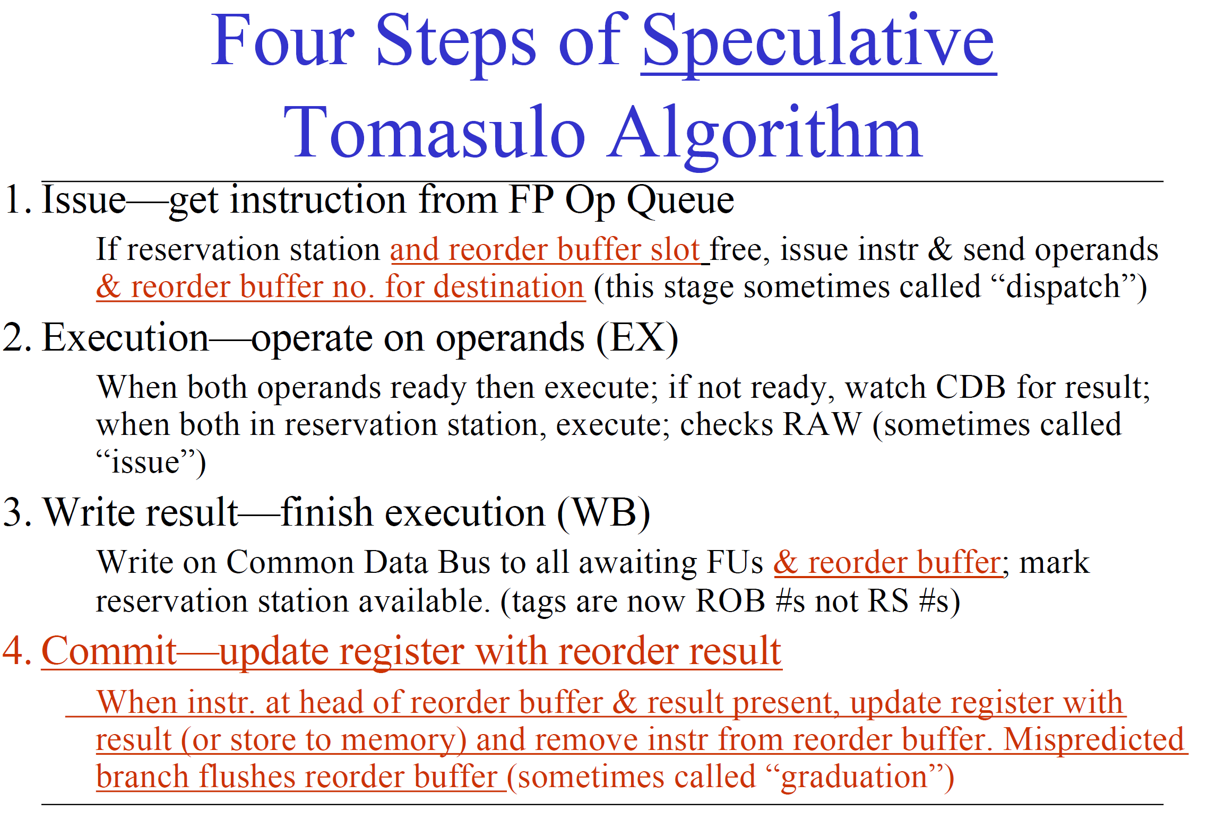

Slide 9
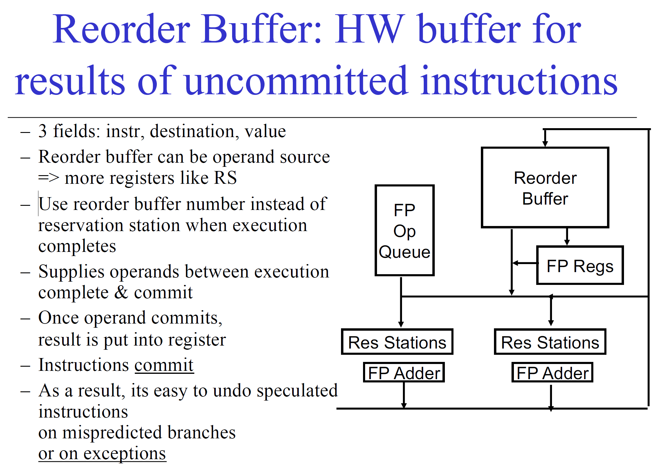

Slide 10
Tips: How to Update each Slide
Renumber Cycle on Slide
To Issue an Instruction
Add cycle number when issued
Update Reservation Station
Check if instruction inputs are ready (Vi, Vk) or not ready (Qi, Qk)
If data is not ready, identify which Function Unit will produce using Register Result Status
For non SD / BR instructions – must update Register Result Status
Move Tail
To Update Instructions in Execution
Change time to finish execution
If time = 0, write in cycle on exe in Instruction Status table
To Update Instructions in Write Result
For non SD / BR instructions – write FU to CDB
Fill in cycle number for write back
Only 1 instruction may write to CDB at a time (but SD / BR can also be in Write Result stage since not using CDB)
Remove data from reservation station
Update all Reservation Stations which depended on FU for data
To Commit an Instruction
Instruction must have finished write back
Move Head

