Slide 1
INTEGRATIVE PROJECT
Computer Networks
Creation of a new IT Room for FAESA
Developed by Matheus Dias Tecchio

Slide 2
Purchase of equipment
For the project of creating a new computer room, the first thing is to think about the equipment needed for the new room, all the equipment will be new, bought observing the need and capacity of the room, both physical and operational.
The following is a list of the equipment purchased and their respective specifications, or equivalents:
10 Computers with latest generation i3 processor, 8GB RAM;
1 Laser printer with RJ-45 network connection;
1 Wireless Router up to 300 Mbps;
1 Switch of 16 ports type 10/100/1000 Mbps;
1 14" Network Rack;
1 File Server up to 1Tb
100 Metres of Cat5e Network Cable

Slide 3
Equipment Position
After the acquisition of the equipment, we need to position in the best way possible, 10 computers (5 at the top and another 5 at the bottom of the room), 1 printer in the upper-center side and 1 wireless router in the lower-center side.
On the upper right side of the room, 1 network rack was installed with a File Server for all the computers in the room, and in this same rack 1 Switch was also installed, which organizes the LAN network data in the new FAESA IT room.

Slide 4
Network Architecture
After positioning and installing the devices, let's connect the LAN Network
of FAESA. To this end, a Star Network Topology was architected, where all the devices in the room are centralised in the Switch, which directs the data in the best possible way.
The Switch in the room is an L2 and is connected to another Switch, which is L3.
All devices are connected by Cat5e twisted pair cables with RJ-45 connectors, as it has speeds of up to 1000Mbps, which is the best value for money for us.
The following is a drawing of our project:

Slide 5

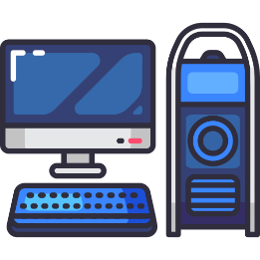

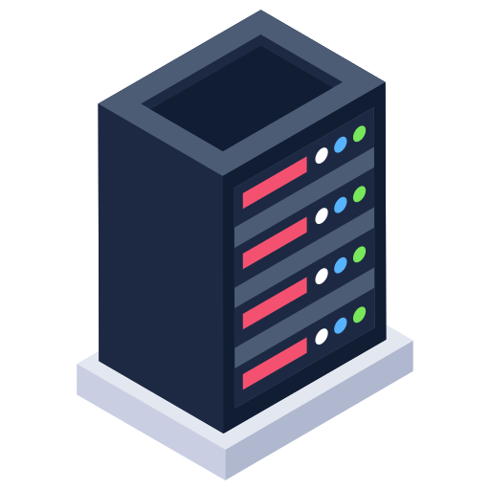
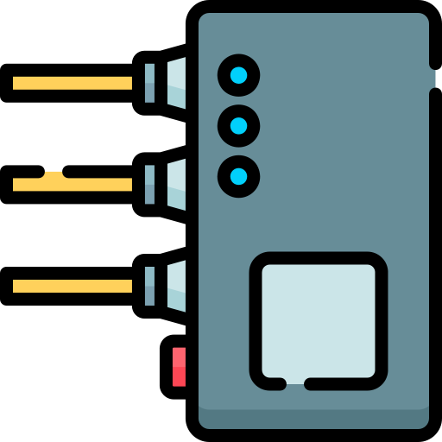



Slide 6
Drawing legend
Computers with latest generation i3 processor, 8GB RAM
Legend for the colour of cables
Laser printer with RJ-45 network connection
Wireless Router up to 300 Mbps
Individual Network Cable
Multiple Network Cable
Network cable L2 to L3
14" Network Rack
File Server up to 1Tb
16-port 10/100/1000 Mbps switch
RJ-45 connector

Slide 7
Configurations and Testing
When everything is properly connected and tidy, we should configure the devices on the LAN network. We will configure the Switch, all computers, the printer, the router and the server, everything should be properly connected on the LAN network.
Once connected, we will test and see if everything is working, if the printer is communicating with the computers, if the file server is connected, test the network speed and check if there is packet loss, or bottlenecks.
At the end of the project, we will present the room to the rectory of FAESA!

