Slide 1
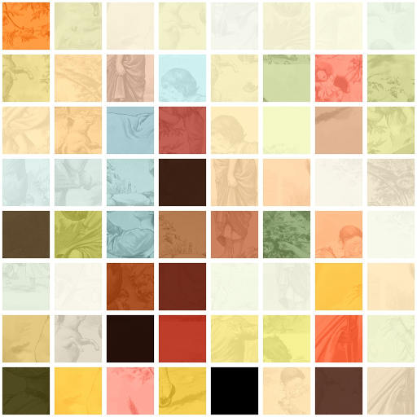
Yes
Liquid
Liquid criteria
hydrometeor
No
Unknown
Cloud Mask
Yes
Ice criteria
Ice
Cloud
No
No
Pixel Dilatation
Mixed-Phase
Groups of hydrometeor
Yes
Cloud type
Rainy criteria
Pixel Relaxation
100 pixels?
Yes
Precipitating - [cloud type]

