Slide 1
Sound Realty Price Model
Scaling and monitoring
Resp: Matheus Torres

Slide 2
Objective
Implement a Machine Learning model to predict house Prices as an API.
Requirements:
REST API endpoints
full features
subset of features
Simple yet robust solution
Scalable
Highly available

Slide 3

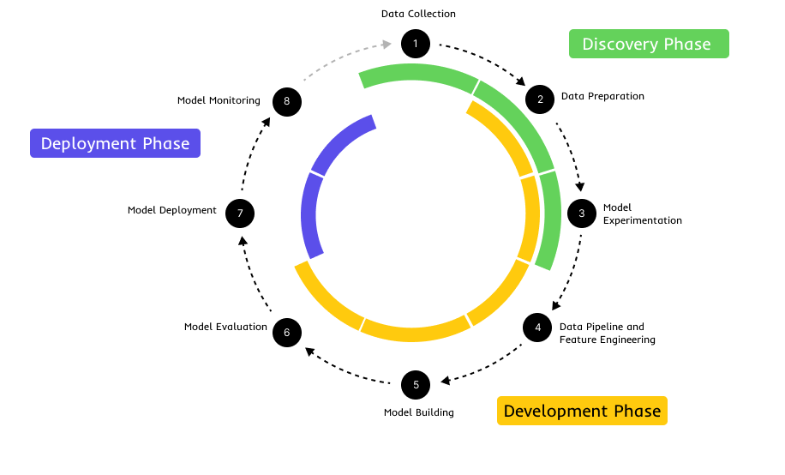
Concepts
Traditional Modeling using CrispDM method
Machine Learning Lifecycle
Monitoring is Key!

Slide 4

Solution
{
bedrooms: 2,
bathrooms: 1,
qrft_living: 93,
...
}
{
request: {bedrooms: 2, ...},
response: {price: 45912},
model: KNeighborsRegressor,
version: 1.0,
pred_time: 16,
...
}
Auto scales based on number of requests
{
metric_dev: 0.7,
metric_prod: 0.8,
data_distribution_check: True
}
Application 1
Model Instance
{price: 450912}
API
.
.
.
Model Instance
LOGs & metrics
...
Application N
{request}
Model Instance
{response}
Update Model
Model Version N
System Logs
{
error: Error description,
timestamp: 1755384812648,
...
}

Slide 5
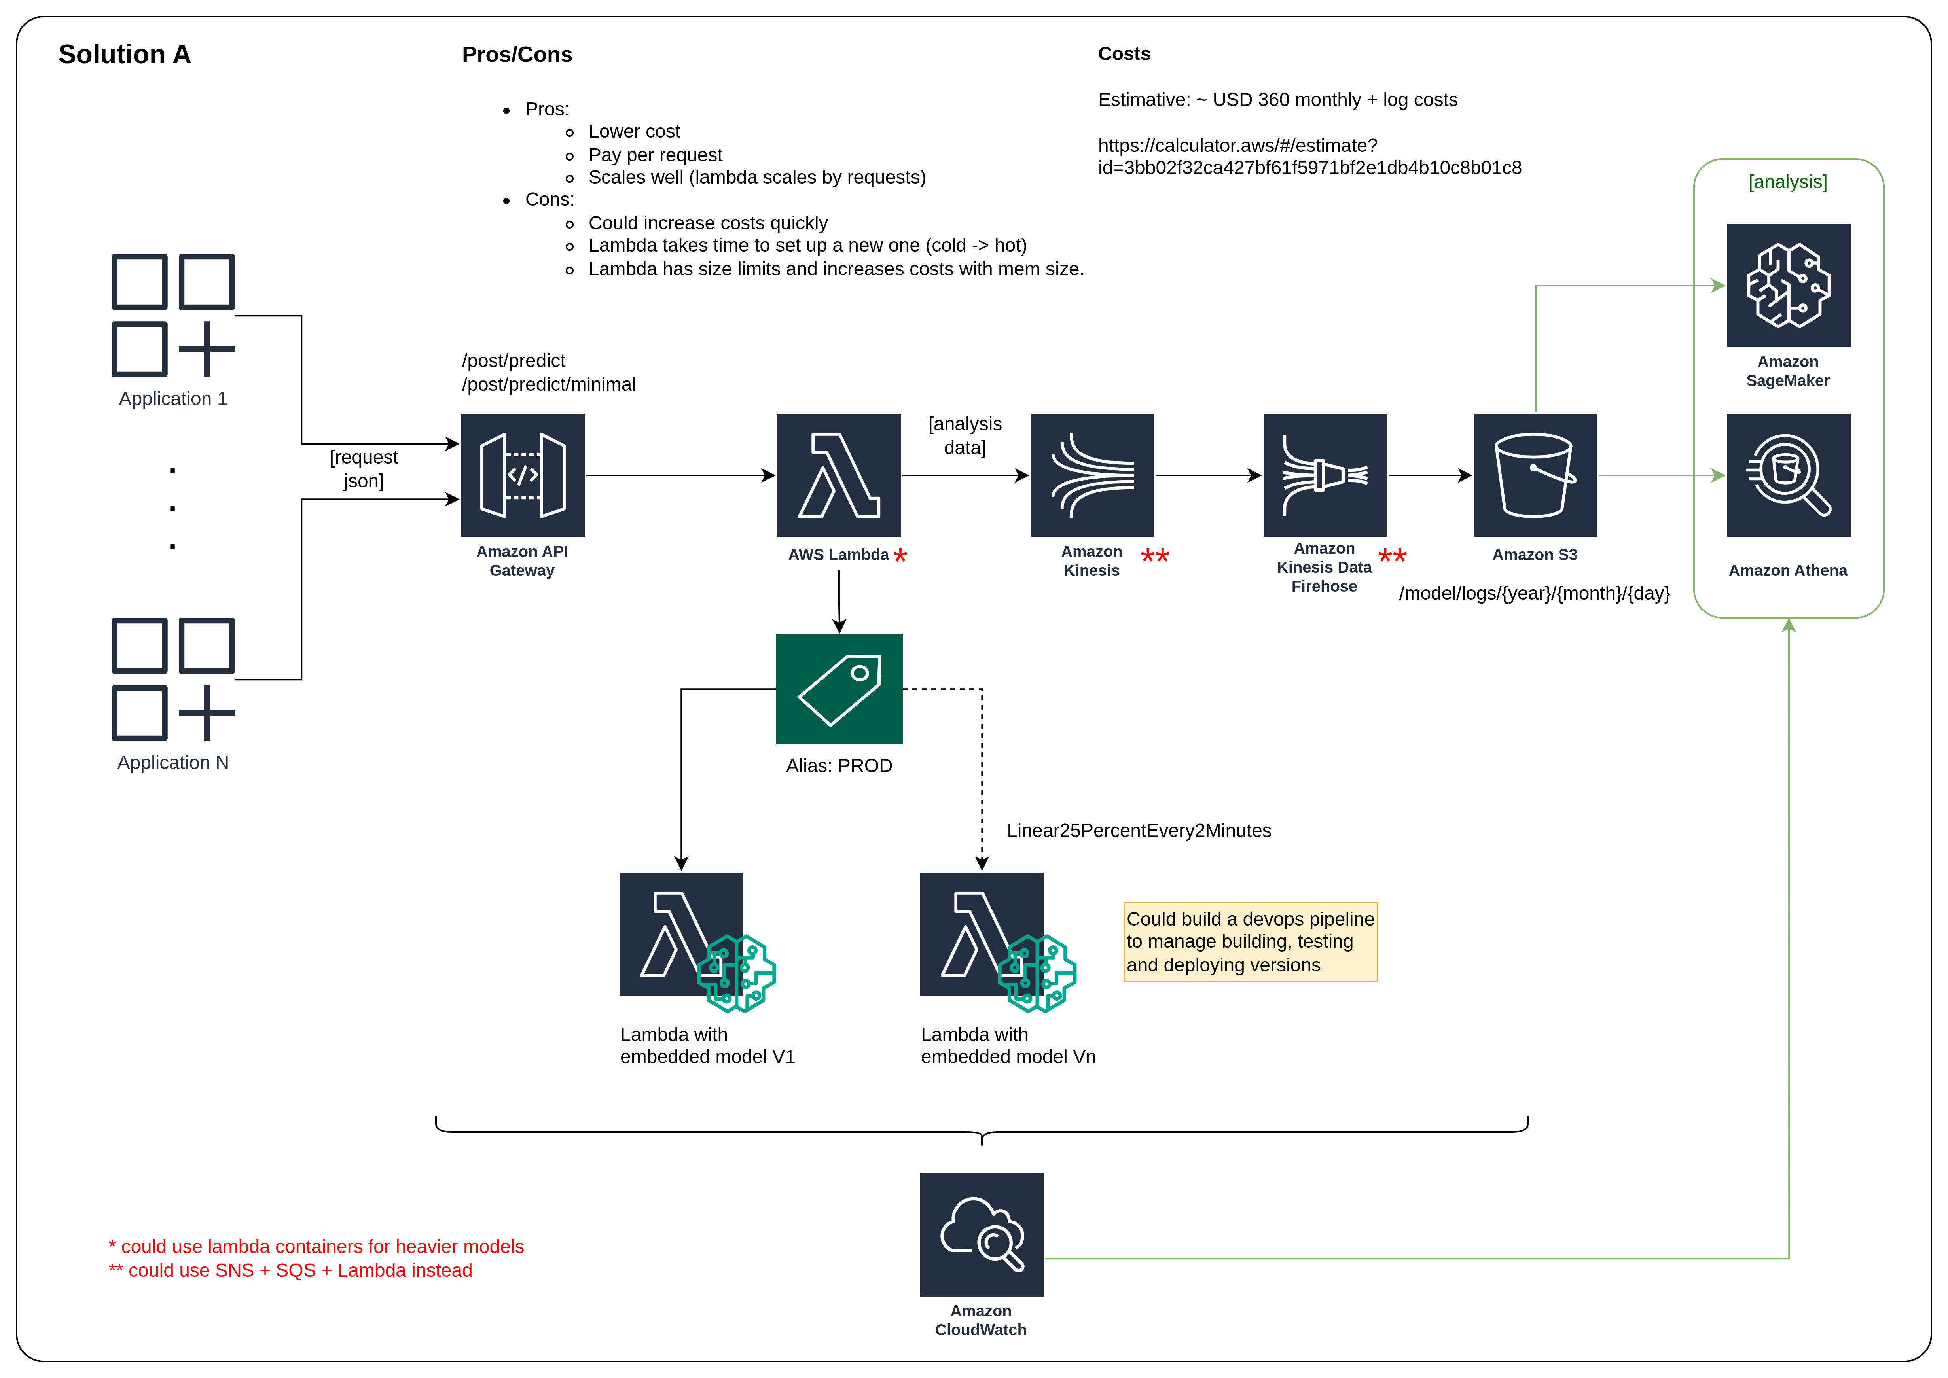
Technical Solution

Slide 6
Roadmap
API Modeling
Infrastructure
Validation
START
END
1 week
4 days
2 days
1 week
Get access
Onboard
Initial agreements
Kickoff
Routes
Documentation
Integrations
Tests
Services
Documentation
Integrations
Tests
Tests with client
Acceptance Document
Handover + Training
Acceptance Document
Gate 0
Gate 1

