Slide 1

MCA MINI PROJECT • FINAL PRESENTATION
SMART DIGITAL
GRAMA PANCHAYAT
SERVICES
A role-based e-Governance portal for certificates, complaints, waste collection, alerts and verified digital services.
ABIN MATHEW | MLM25MCA-2005
Guide:
Department of Computer Applications
Mangalam College of Engineering, Ettumanoor
Academic Year 2025–27
Ms. Anjaly Sajeev
(Assistant professor)
APJ Abdul Kalam Technological University

Slide 2
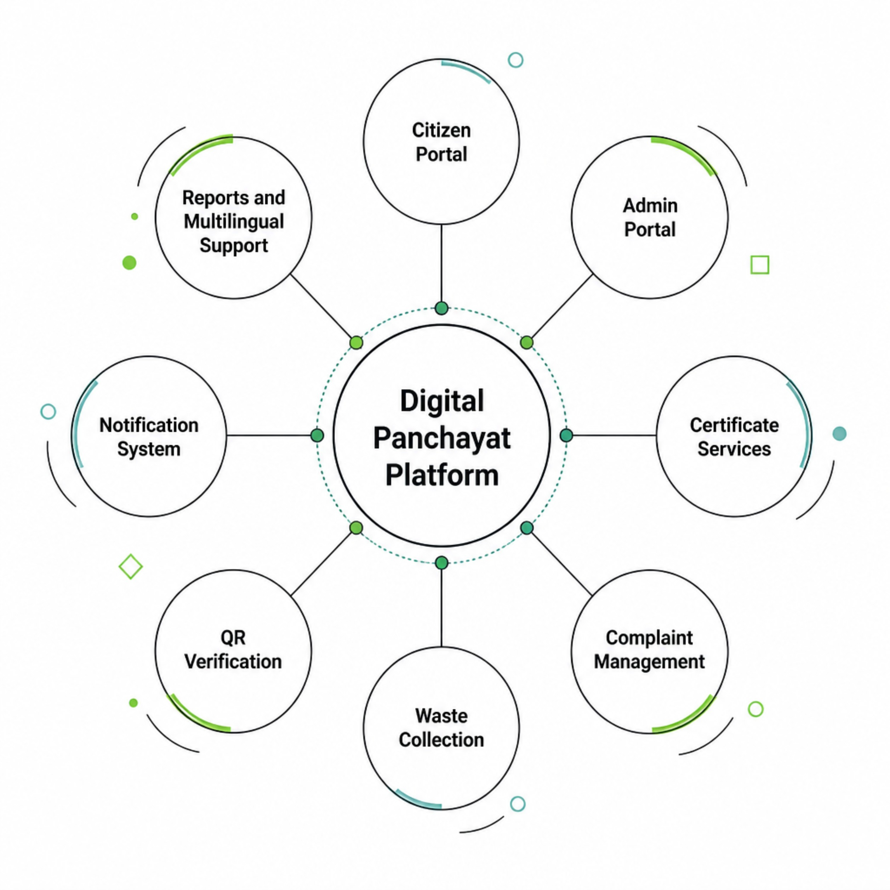
Introduction
Why a unified digital Panchayat platform is needed
Gram Panchayat services often depend on office visits, paper forms and manual follow-up.
Citizens need a single place to submit requests, track status and receive official updates.
Officials need structured workflows, audit history, reporting and role-based access.
The project combines routine services and emergency communication in one Django portal.
Core idea
Citizen focus
One request → one traceable lifecycle → one accountable digital record
Accessible service delivery with English ⇄ Malayalam switching

Slide 3
Abstract
Project overview, technology and achieved outcome
Web-based e-Governance platform for certificates, complaints, waste pickup, announcements, reports and safety alerts.
79
Citizens, Panchayat officials and waste collectors receive separate role-based workspaces and permissions.
Automated tests passed
Approved certificates generate fixed PDFs with QR-linked verification and SHA-256 fingerprint checking.
3
Primary operational roles
English / Malayalam translation switching is available for citizen and collector interfaces with saved preference.
5
Built using Python, Django 5.2, HTML/CSS/JavaScript, SQLite/MySQL configuration, ReportLab and QRCode/Pillow.
Certificate categories
Academic demonstration — not an official government service

Slide 4
Problem Definition
One clear problem statement and its practical effects
Manual and disconnected Panchayat service processes make applications difficult to track, slow to verify and hard to manage consistently across citizens, officials and field staff.
Repeated office visits
Fragmented records
Citizens depend on physical follow-up for progress and decisions.
Applications, documents and status history may be stored separately.
Weak verification
Limited coordination
Printed certificates are harder to verify without an online validity check.
Complaints, waste pickup and alerts need role-specific workflows and reporting.

Slide 5
Objectives
What the system is designed to achieve
Digitize services
Role-based access
Trace every request
Submit and track certificates, complaints and waste requests online.
Separate citizen, official and collector responsibilities securely.
Maintain references, status history, notes and notifications.
Verify certificates
Improve communication
Support local language
Use QR-linked validity checks and exact PDF fingerprint comparison.
Provide notice board, alerts, reports and optional SMS outbox.
Enable English ⇄ Malayalam switching for citizen-facing workflows.
Expected outcome: faster visibility, better traceability, simpler citizen access

Slide 6
Existing System
Typical manual / semi-manual Panchayat workflow
1
2
3
4
5
6
Visit office
Collect / fill form
Attach documents
Manual verification
Return for status
Receive output
Main limitations
Repeated data entry and risk of misplaced physical files
No real-time request status or consolidated history for citizens
Manual counting and reporting for officials
Limited coordination between office staff and waste collection staff
Certificate authenticity may require direct office confirmation

Slide 7
Proposed System
A unified Smart Digital Grama Panchayat service portal
Online registration, login and personalized dashboards
Certificate applications with private supporting documents
Complaint tracking with status updates and resolution notes
Waste requests with scheduling, collector assignment and completion
QR verification, PDF fingerprint checking and revocation awareness
Digital notice board, reports, notifications and safety alerts
English ⇄ Malayalam translation switch for citizen / collector pages
Django MVT + centralized workflow services

Slide 8
Scope of the Project
Users, functions, boundaries and possible applications
Target users
Functional coverage
Included technology
Citizens • Panchayat officials • Waste collectors • Superuser / administrator
Certificates • complaints • waste pickup • notice board • reports • safety alerts • QR verification
Django authentication • relational database • PDF/QR generation • CSV export • localization • SMS outbox
Current boundaries
Application potential
No official government registry, payment gateway, legal digital signature, production encryption-at-rest or guaranteed SMS delivery.
Can be adapted for village offices, campus administration, community service portals and other local-body workflows.
Academic prototype with a clear path to real deployment hardening

Slide 9
Literature Review
Selected studies most relevant to the implemented system
Title & Year | Author / Publication | Method / Algorithm | Feature / Methodology | Metric | Key Finding
Smart Governance in Rural India (2025) | R. Dhamale, V. Patil | React + Spring Boot + MySQL | Integrated Panchayat e-services | Qualitative | Supports centralized, traceable digital service delivery
E-Gram Panchayats (2023) | M. Thorat et al. | Web / mobile + data mgmt. | Accessibility & transparency | Qualitative | Shows value of centralized rural administration records
E-Governance Adoption in Rural Areas (2022) | S. N. Fatmi, M. Swalehin | Empirical assessment | Digital literacy & adoption | Adoption factors | Motivates simple UI and multilingual support
ICT Reforms in Kerala Panchayats (2015) | A. K. Thottunkel, S. V. Kuppathanath | Process-based workflow study | Decision-making automation | Case study | Digitization should redesign workflow—not just copy paper forms
Certificate Security with QR (2021) | IEEE conference paper | Digital signature + QR | Certificate authenticity | Verification integrity | QR improves verification; digital signatures provide stronger assurance
Title & Year
Author / Publication
Method / Algorithm
Feature / Methodology
Metric
Key Finding

Slide 10
Technologies Used
Technology stack used in the current implementation
Backend
Frontend
Database
Python 3.12/3.13
Django 5.2
Django ORM & migrations
HTML5
Bootstrap 5 CSS
Custom CSS + JavaScript
SQLite (demo)
MySQL configuration provided
Relational models
Documents & QR
Localization
Messaging & Tools
ReportLab
QRCode + Pillow
SHA-256 fingerprint
jsQR scanner
Django language helper
Malayalam JSON catalogue
Client-side language.js
Saved user preference
Traccar Android SMS Gateway / Twilio
CSV export
Waitress
Git / VS Code

Slide 11
Software & Hardware Requirements
Development and demonstration environment
Software Requirements
Hardware Requirements
• Windows / Linux
• Python 3.12+
• Django 5.2
• SQLite or MySQL 8+
• Modern browser
• VS Code / PyCharm
• ReportLab, QRCode/Pillow, python-dotenv
• Optional Traccar / Twilio SMS configuration
• Dual-core or better processor
• 4 GB RAM minimum (8 GB recommended)
• 1 GB free storage for development/demo
• Internet connection for dependency setup and external SMS
• Smartphone for QR scanning / SMS gateway demo (optional)
• Webcam not required for core project
Browser-based client — no Node.js build required

Slide 12
System Architecture
Overall flow: User → Frontend → Backend → Database / Services
Users
Presentation Layer
Application Layer
Business Logic
Data / External
Citizen
Official
Waste Collector
Django templates
Bootstrap / JS
EN ⇄ മലയാളം
Views + Forms
Permission checks
URL routing
Workflow service
Notifications
PDF / QR
Reports
SQLite / MySQL
Private uploads
SMS provider
Security
Auditability
Integration
Authentication • ownership checks • CSRF • private file access
StatusUpdate history • actor • note • timestamp
QR verification • CSV • SMS outbox • language preference

Slide 13
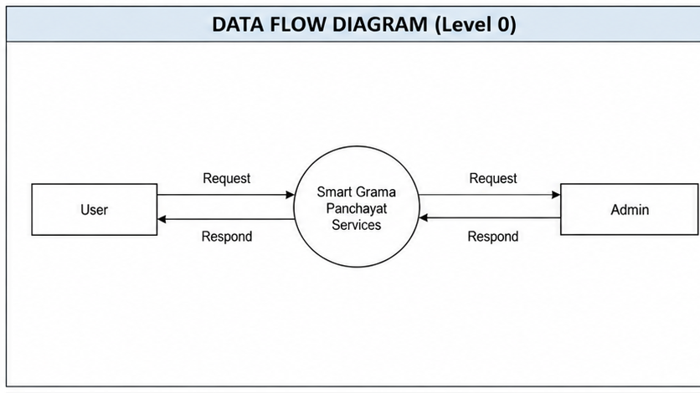
DFD Level 0
Design Diagrams

Slide 14
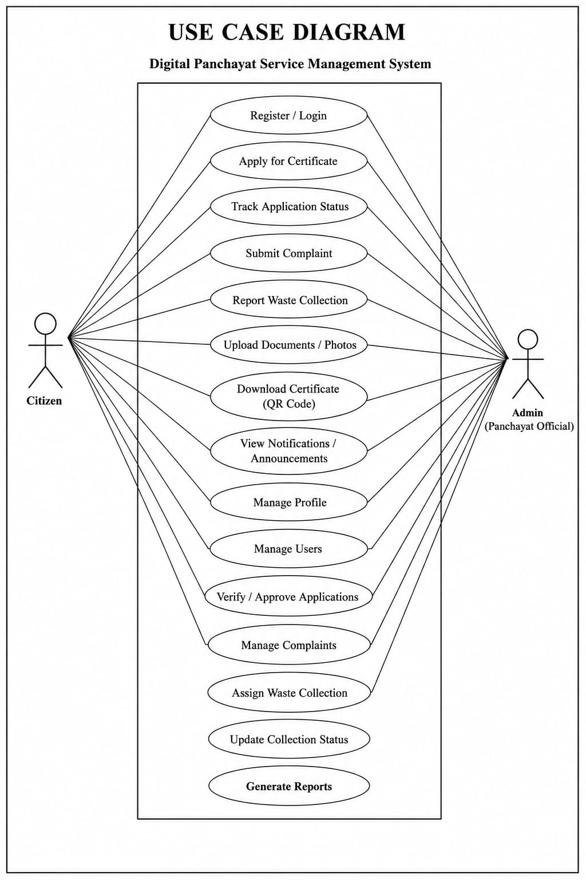
Use Case Diagram
Design Diagrams

Slide 15
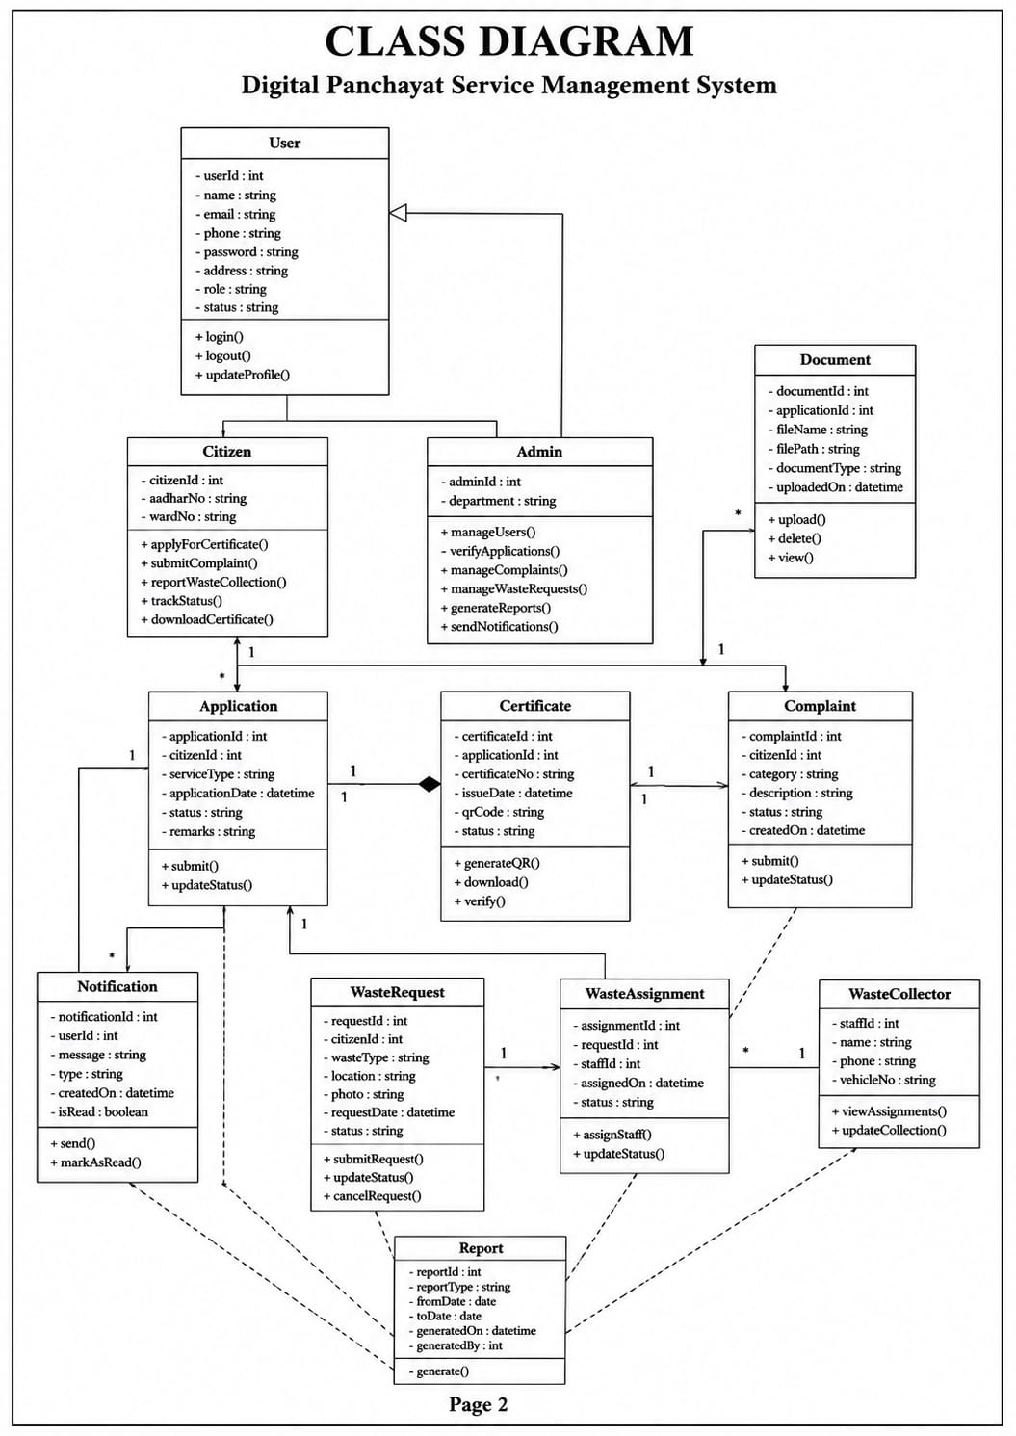
Class Diagram
Design Diagrams

Slide 16
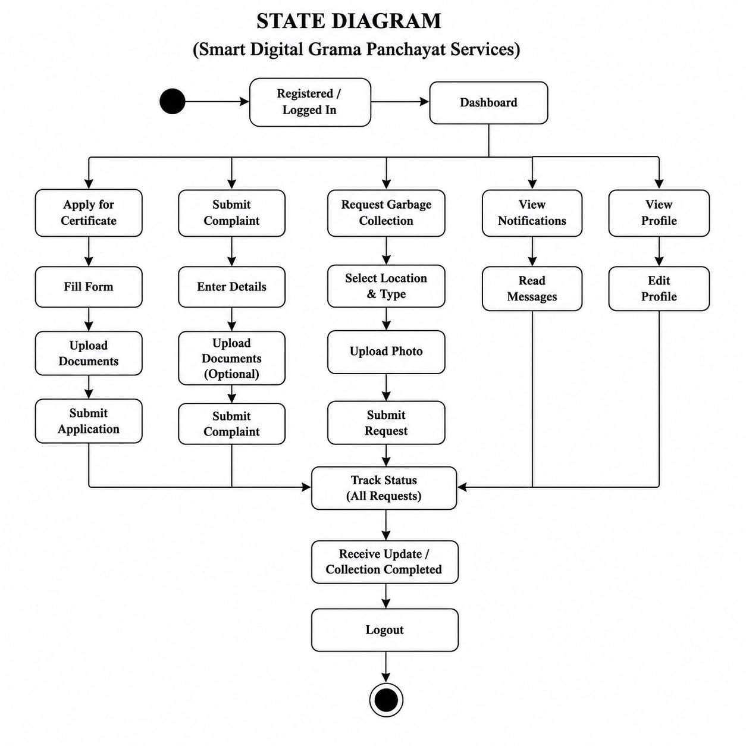
State Diagram
Design Diagrams

Slide 17
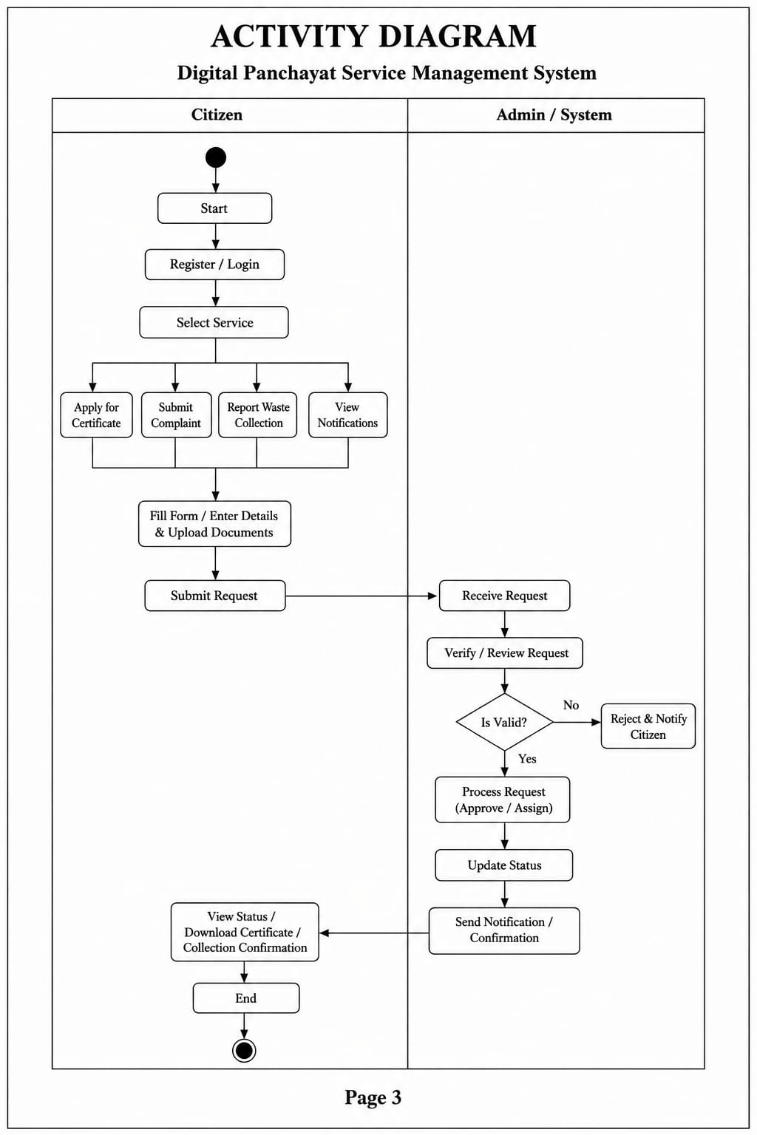
Activity Diagram
Design Diagrams

Slide 18
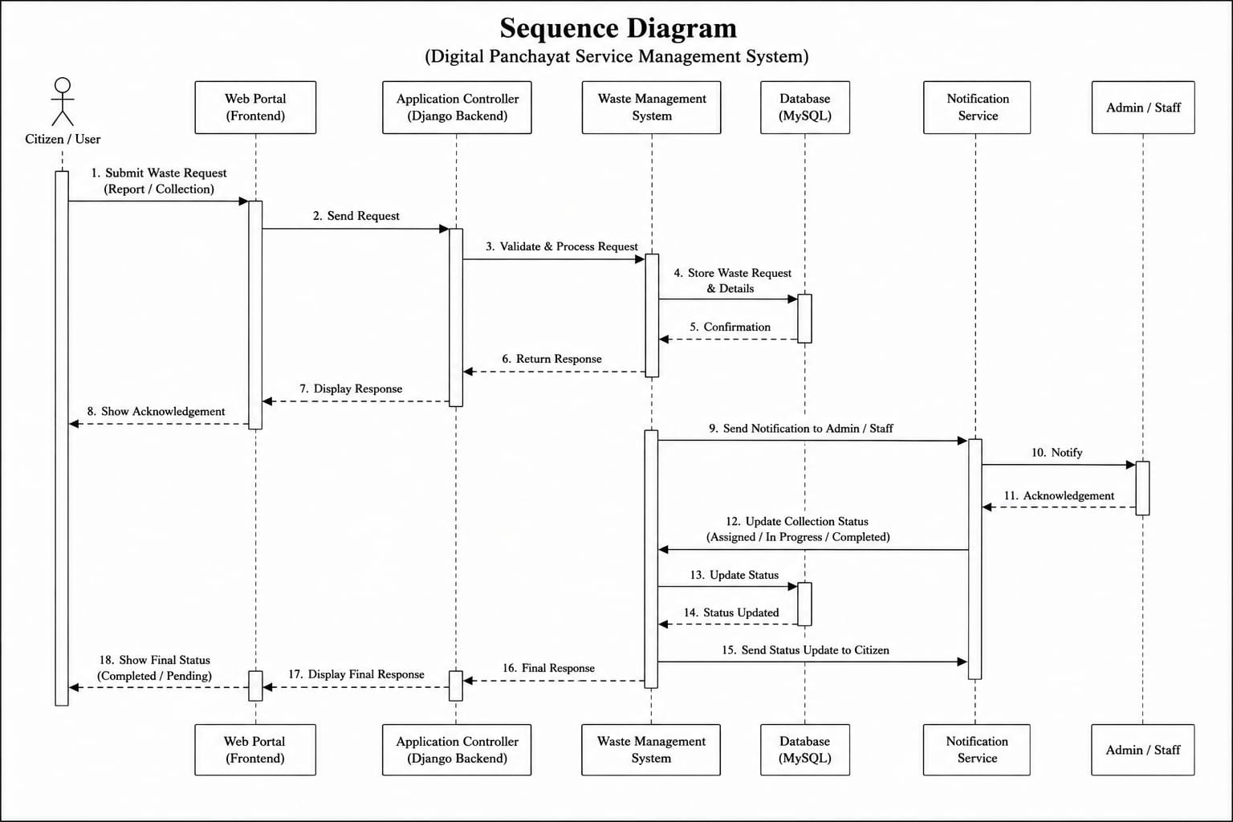
Sequence Diagram
Design Diagrams

Slide 19
Module Description
Major functional modules in the implemented application
Citizen Module
Certificate & QR
Register/login, profile, dashboard, request tracking, notifications and language preference.
Apply for birth/death/residence/property/general certificates; approve, PDF generation, QR verification.
Complaint Module
Waste Collection
Submit categorized civic complaints, follow status updates and resolution notes.
Request pickup, preferred date, admin scheduling, collector assignment and completion.
Safety Alerts
Admin / Reports
Official-issued alerts, ward targeting, safe-place instructions, notifications and optional SMS outbox.
Request management, notice board, user administration, dashboard metrics and CSV export.

Slide 20
Algorithm / Methodology
Development phases and core backend algorithms
Requirements
Design
Database
UI
Development
Testing
Deployment Prep
A. Request Transition Algorithm
B. Certificate Verification
C. Language Selection
1. Read authenticated actor and target request
2. Re-check role and allowed transition
3. Validate action-specific data
4. Update request inside transaction
5. Write StatusUpdate audit record
6. Create recipient notifications
7. Commit / rollback atomically
1. Approve request
2. Generate fixed PDF + QR token
3. Store SHA-256 fingerprint
4. Public verification checks current status
5. Uploaded PDF fingerprint is compared
6. Revocation immediately invalidates verification
1. User chooses English or Malayalam
2. Preference stored in Profile.language
3. Middleware/helper activates language
4. Translation catalogue renders UI strings
5. language.js updates client-side labels
6. Citizen-entered data remains unchanged

Slide 21
Implementation
How the project is organized in code
Key project files
Database
Backend
Profile, ServiceRequest, StatusUpdate, Notification, Announcement, CertificateDocument, SafetyAlert / Recipient / SMS
Django auth, ORM, transactions, validation, ownership checks and workflow state rules
portal/models.py → persistent entities
portal/forms.py → validated input
portal/views.py → role-protected pages
portal/services.py → workflow transitions
portal/certificates.py → PDF + QR generation
portal/language.py → localization helper
portal/sms.py → SMS outbox/provider logic
templates/ → server-rendered UI
static/js/ → QR + language + alerts
Frontend
Documents
Responsive templates, Bootstrap, custom CSS/JS, QR scanner and bilingual interface controls
Private uploads, fixed certificate PDF, SHA-256 fingerprint and revocation-aware verification
Messaging
Reports
In-app notifications + safety warnings + optional Traccar/Twilio SMS outbox
Administrator metrics, searchable requests and CSV export with spreadsheet-formula protection

Slide 22
Results / Analysis
Observed validation results from the updated project build
79 / 79
0
1 page
200 OK
Automated portal tests passed
Django system-check issues
A4 birth/death certificate output
Admin & collector pages validated
Workflow validation
Security / integrity
UI / integration
Certificate submission → approval → PDF → QR verification
Complaint submission → progress → resolution
Waste request → schedule → assignment → collection
Role restrictions • private documents • CSRF rejection • invalid transition checks • revocation • CSV formula escaping
Mobile viewport checked with no page-level overflow • QR scanner tests • Malayalam preference persistence • SMS provider tests
Validation environment: Python 3.12.14 + Django 5.2.17 + SQLite

Slide 23
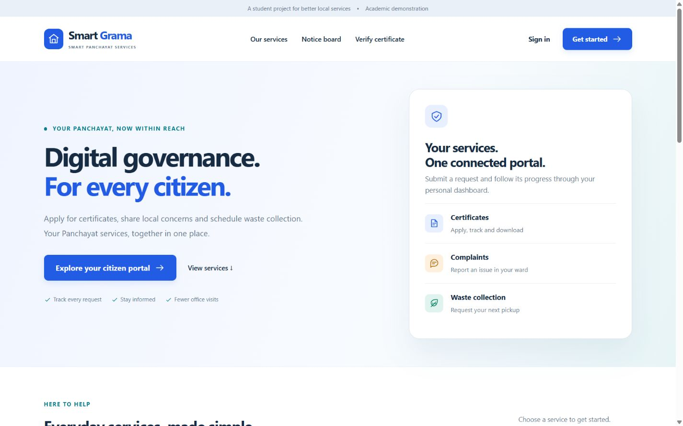
Home
Screenshots / Output

Slide 24
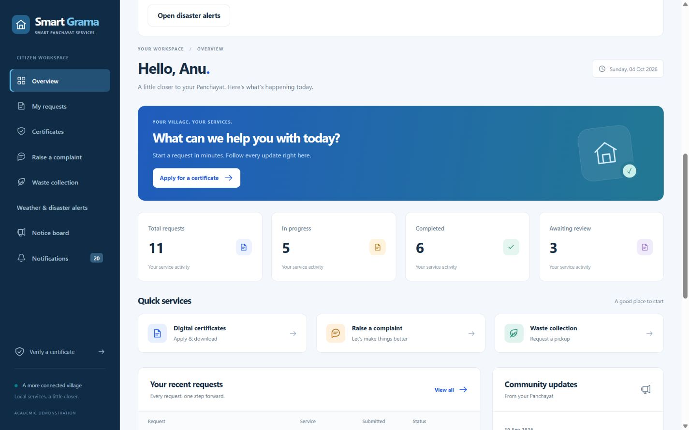
Citizen Dashboard
Screenshots / Output

Slide 25
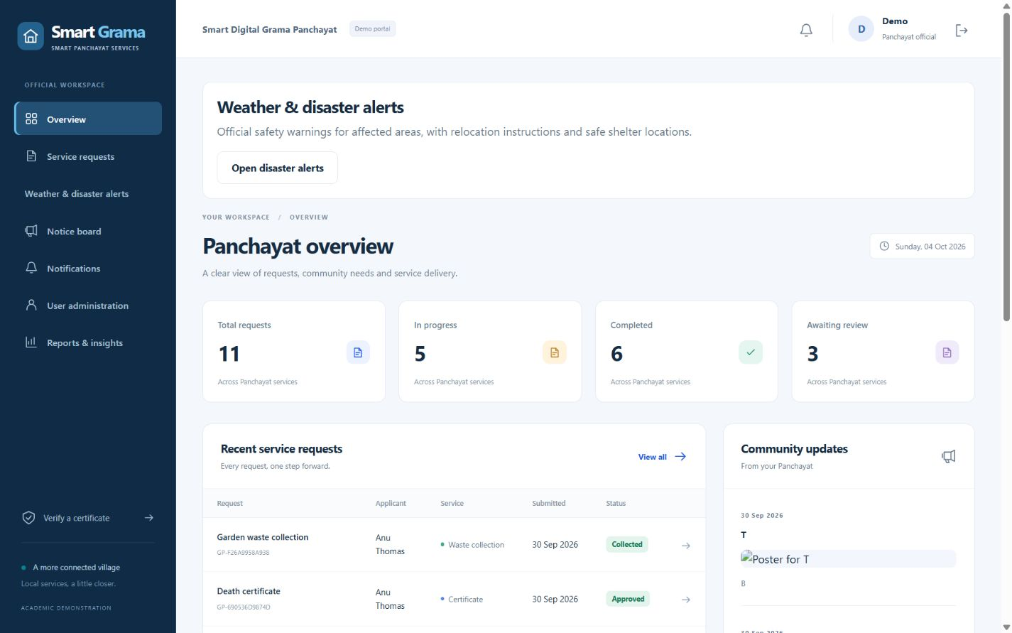
Admin Dashboard
Screenshots / Output

Slide 26
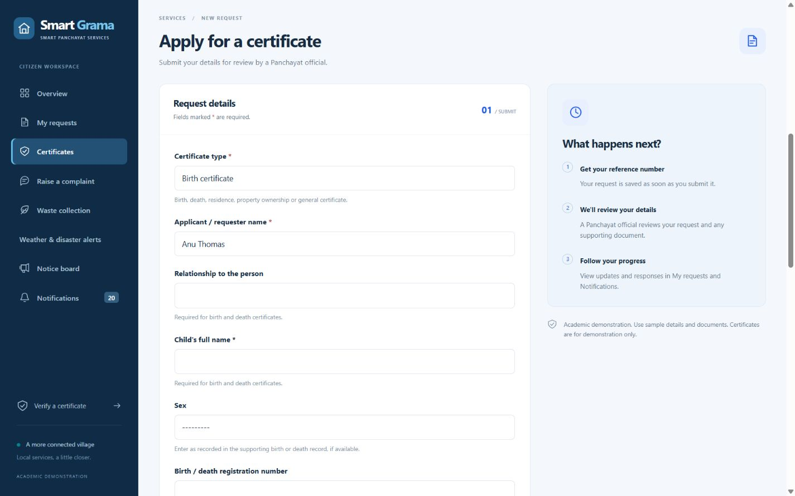
Certificate Application
Screenshots / Output

Slide 27
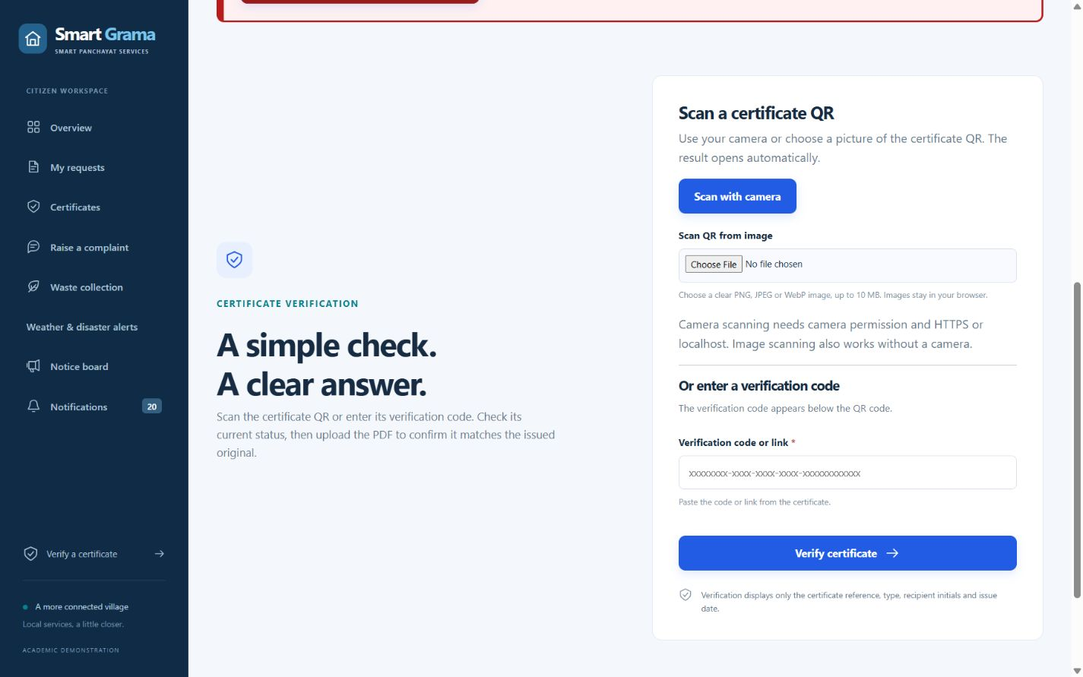
QR Verification
Screenshots / Output

Slide 28
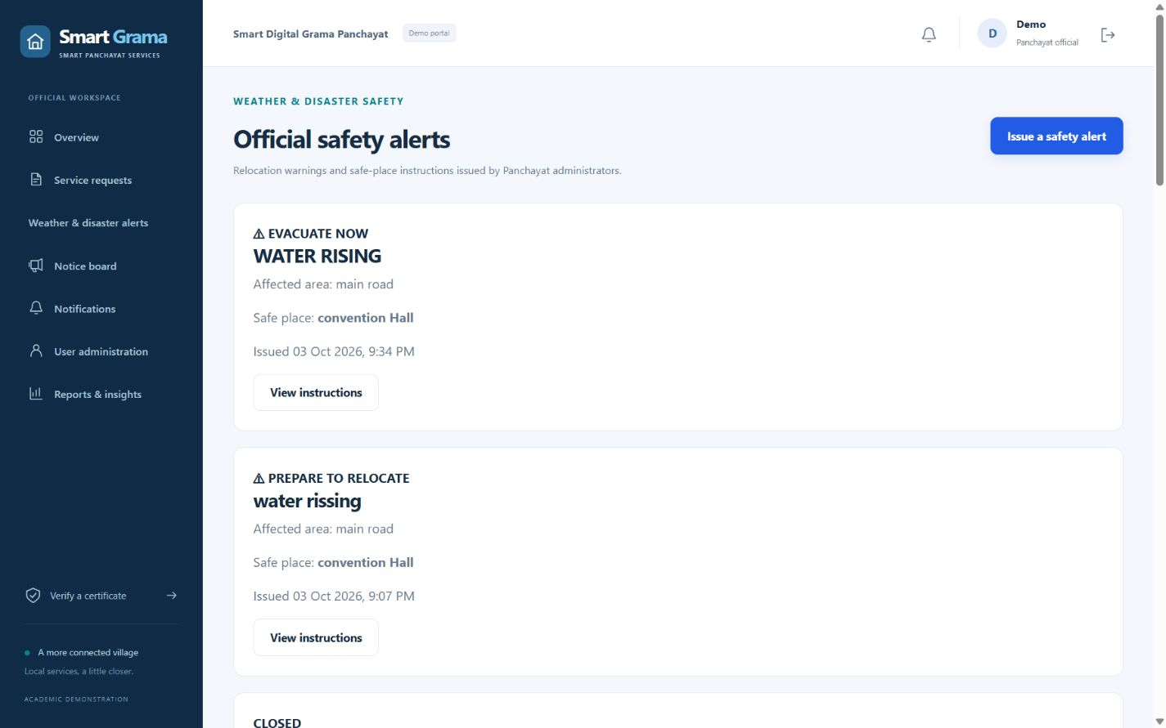
Safety Alerts
Screenshots / Output

Slide 29
Comparison with Existing System
Observed differences between manual workflow and the proposed portal
Feature | Existing System | Proposed System
Service submission | Office visit / paper forms | Online role-based forms
Status tracking | Phone / repeated visit | Live status + history + notifications
Certificate verification | Manual office confirmation | QR + database validity + PDF fingerprint
Waste collection | Informal request / manual assignment | Preferred date + schedule + collector assignment
Safety communication | Notice / ad-hoc calls | Targeted in-app warnings + optional SMS outbox
Language access | Mostly manual assistance | English ⇄ Malayalam switch for citizen / collector
Reporting | Manual counting / spreadsheets | Dashboard metrics + CSV export
Feature
Existing System
Proposed System

Slide 30
Testing
Functional, integration, security and regression validation
Test Case | Expected Result | Actual Result | Status
Valid login | User reaches correct dashboard | Successful | PASS
Cross-user request access | Unauthorized record is blocked | Blocked | PASS
Certificate approval | PDF + QR produced once | Generated | PASS
Altered PDF verification | Fingerprint mismatch reported | Mismatch detected | PASS
Waste scheduling | Active collector + valid date required | Validated | PASS
Language preference | English / Malayalam choice persists | Persisted | PASS
Test Case
Expected Result
Actual Result
Status
manage.py test portal → 79 tests passed

Slide 31
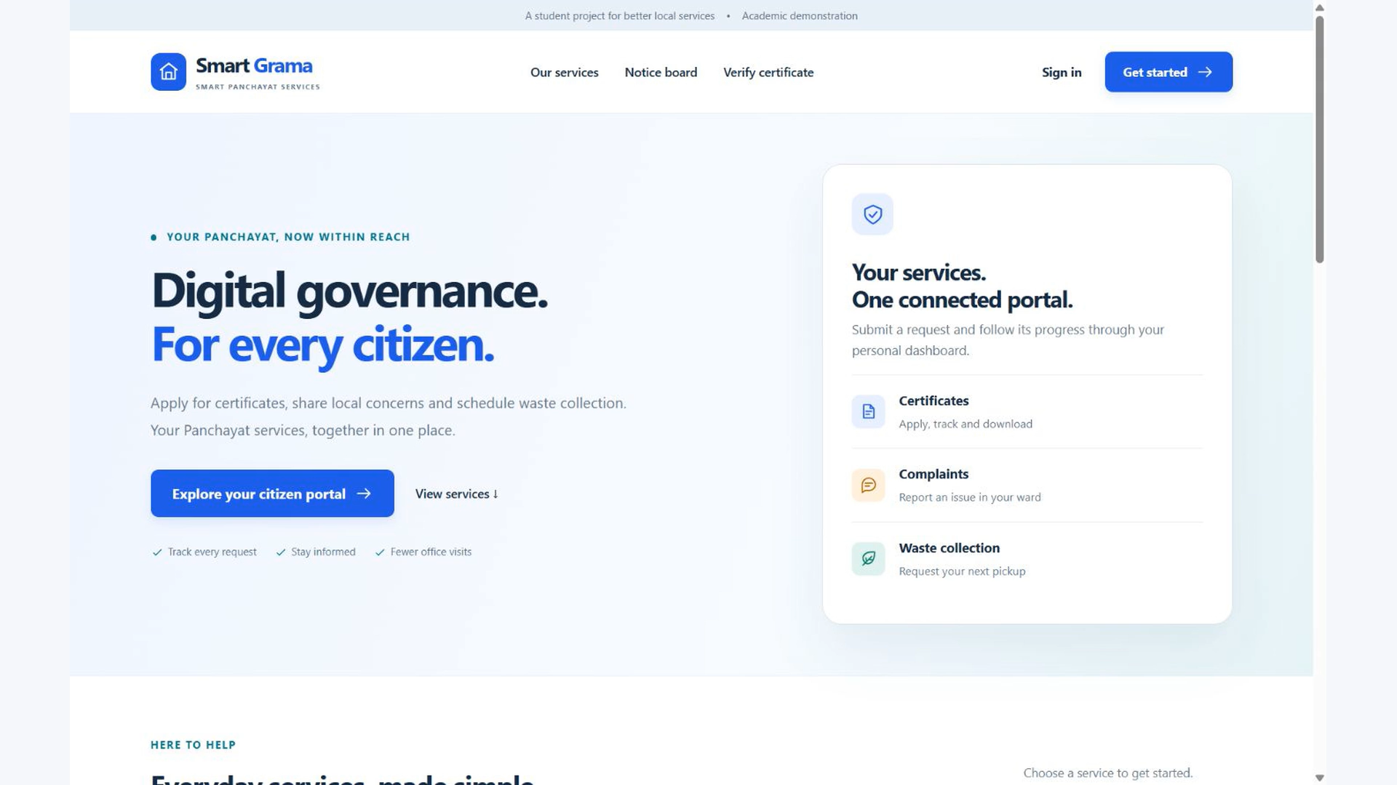
Demo Video
Short project walkthrough for the final presentation
INSERT / EMBED 2–3 MINUTE PROJECT DEMO VIDEO HERE

Slide 32
Advantages
Benefits provided by the proposed system
Unified portal
Transparency
Role separation
Multiple citizen services share one account and one tracking model.
References, history and notifications make request progress visible.
Backend permission checks reduce unauthorized actions.
Verified output
Field coordination
Inclusive interface
QR and PDF fingerprinting provide demonstration-level integrity checks.
Waste requests can be scheduled and assigned to collectors.
English / Malayalam switching improves local usability.

Slide 33
Limitations
Current boundaries of the academic prototype
No connection to official Panchayat, civil-registration or identity databases.
Generated certificates are academic demonstration outputs, not legally signed government documents.
SQLite is the validated local demo database; live MySQL integration was not tested in this environment.
SMS delivery depends on external provider / gateway setup and cannot be guaranteed by the portal alone.
Storage encryption at rest, production monitoring, backups and rate limiting require deployment hardening.
Malayalam localization currently focuses on citizen / collector interfaces rather than every administrative page.
These limitations define the next production-readiness steps

Slide 34
Conclusion
What the completed project demonstrates
1. Complete Service Workflow
2. Practical e-Governance Prototype
3. Trust + Accessibility
The project goes beyond static forms: requests move through validated states, generate audit history, notify users and support role-specific actions.
Certificates, complaints, waste collection, reports, notice board and safety alerts are integrated within one Django application and relational data model.
QR verification, private uploads, role checks, bilingual citizen interfaces and automated tests improve traceability, privacy and usability for an academic prototype.
Result: a working, extensible foundation for citizen-service digitization

Slide 35
Future Scope
Recommended enhancements beyond the current prototype
Government integration
Digital signatures
Connect to approved identity, registry and Panchayat back-office systems.
Use legally recognized signing and timestamping for issued certificates.
Full localization + voice
Production infrastructure
Extend Malayalam to official pages and add text-to-speech / voice assistance.
HTTPS, server-grade DB, secure object storage, backups, monitoring and rate limiting.
Payments & notifications
Intelligent routing
Add authorized payment gateway, email / push notifications and delivery tracking.
Explore carefully evaluated AI assistance for complaint classification and prioritization.

Slide 36
References
Selected sources — IEEE-style presentation format
[1] R. Dhamale and V. Patil, “Smart Governance in Rural India: Designing an E-Gram Panchayat System for Efficient Public Service Delivery,” 2025.
[2] M. Thorat et al., “E-Gram Panchayats: Enhancing Accountability and Transparency in Rural Administration,” 2023.
[3] S. N. Fatmi and M. Swalehin, “Adoption of E-Governance Services among Rural People: An Assessment Study of Uttar Pradesh,” Journal of Exclusion Studies, vol. 12, no. 2, pp. 163–174, 2022.
[4] A. K. Thottunkel and S. V. Kuppathanath, “ICT-based Reforms in Local Government Decision-making in the Gram Panchayats of Kerala,” 2015.
[5] NIST, “Role-Based Access Control for the Web,” 1998.
[6] Ministry of Panchayati Raj, Government of India, “e-GramSwaraj — official project information and architecture.”
[7] Django Software Foundation, “Django Documentation — Authentication, ORM, Forms, CSRF Protection and File Uploads.”

Slide 37
THANK YOU
Questions & Discussion
ABIN MATHEW • MLM25MCA-2005
Smart Digital Grama Panchayat Services
English ⇄ മലയാളം

