Slide 1
Speech Signal Processing
Mathew Cigi EE23S031

Slide 2
Problem Statement
Train these models, show the loss curves, and the decode outputs on test data
- ESPNET Based ASR Systems
Data taken
Language – Malayalam (https://asr.iitm.ac.in/)
Train dataset consists of 20,348 .wav files
Dev dataset consists of 3,136 .wav files
Eval dataset consists of 2,494 .wav files
Token type was chosen as “bpe”(Byte per encoding) with the number of bpe as 175(Malayalam) – asr.sh file

Slide 3
Training of model
Training epoch – 120
Batch size – 32
Model chosen – Transformer
Optimizer used – Adam optimizer
Learning rate chosen – 0.0005

Slide 4
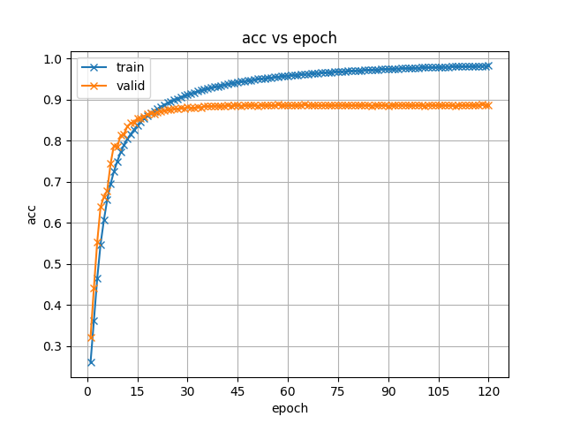
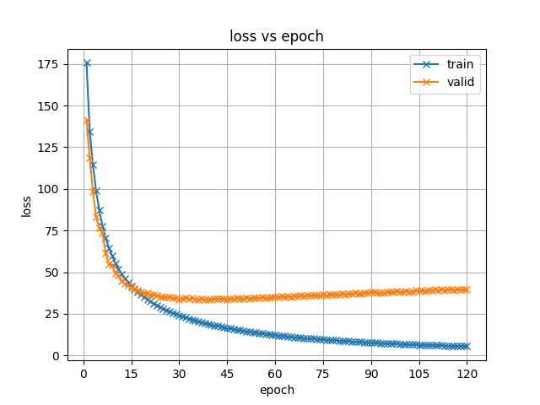
Accuracy curve
Loss curve

Slide 5
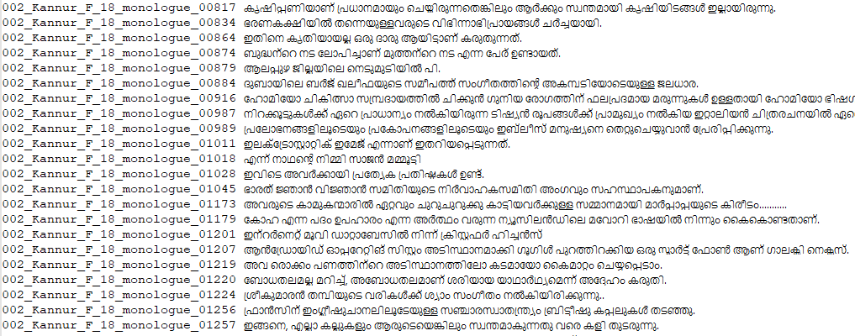
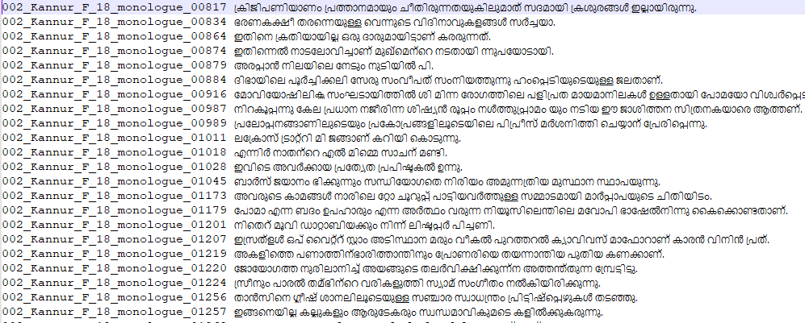
Decoding
Actual Test set
Predicted Test set
WER – 45.7%
CER – 6.4%

Slide 6
THANK YOU

