Slide 1

EE6130: Advanced Topics in Signal Processing
Assignment - 2
Mathew Cigi EE23S031

Slide 2
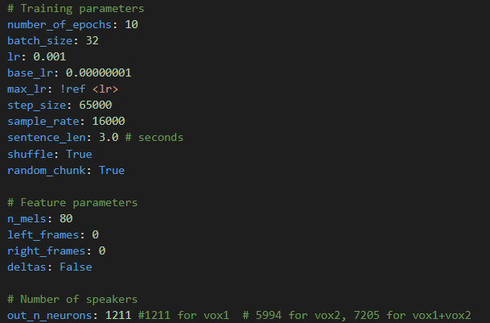
Problem Statement
Task – Speaker Recognition
Toolkit – Speech Brain
Dataset – VoxCeleb1
Dataset
Consist of 1251 speakers (55% Male) with 352 hours of data
Total Utterance - 153,516
Train, Dev Utterance - 148,642 & Test Utterance – 4874
1211 were taken for training and 40 speakers data as testing/verification
Since VoxCeleb -1 dataset were taken, 1211 chosen as the output neuron

Slide 3
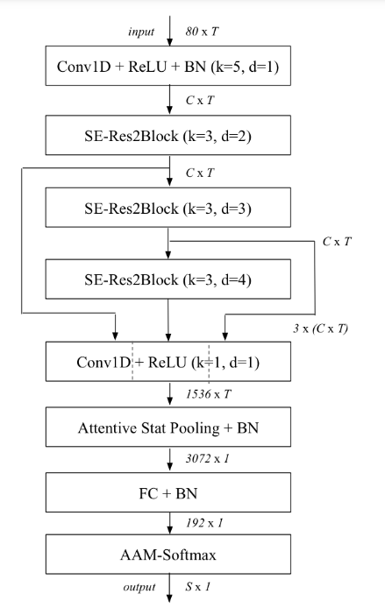
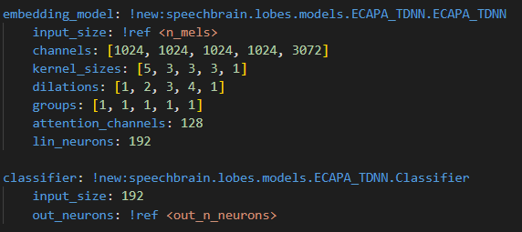
ECAPA-TDNN model
k -> kernel size
C -> Number of channels
T -> Temporal dimension of the feature maps
d -> dilation spacing of the SE-Res2Block
S -> The number of speakers

Slide 4
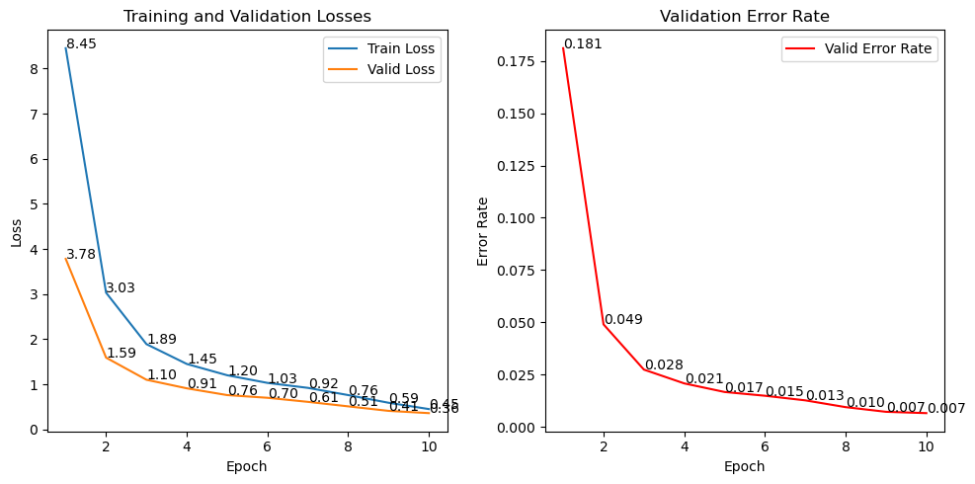
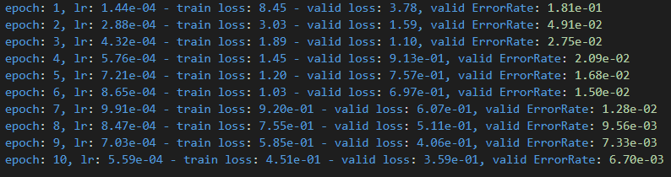
Train log
Number of epoch = 10
From train_log.txt

Slide 5
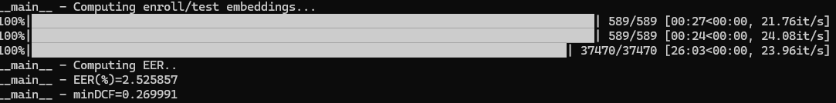
Speaker verification
“pretrain_path” in the “verification_ecapa.yaml” file should be changed to the location where the trained model is present else, the pre-trained model will be taken
EER(%) = 2.52%
minDCF = 0.269
Speaker verification using cosine similarity
EER -> Equal error rate
minDCF -> Minimum Detection Cost Function

Slide 6
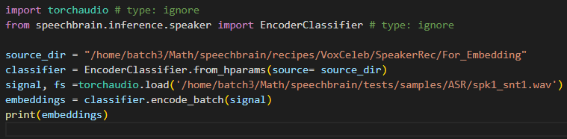
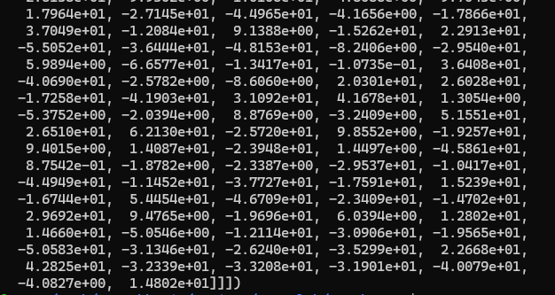
Speaker Embedding(with example wav file)
- ‘Source_dir” contains the hyperparams.yaml file
- The corresponding speaker embedded is calculated

Slide 7
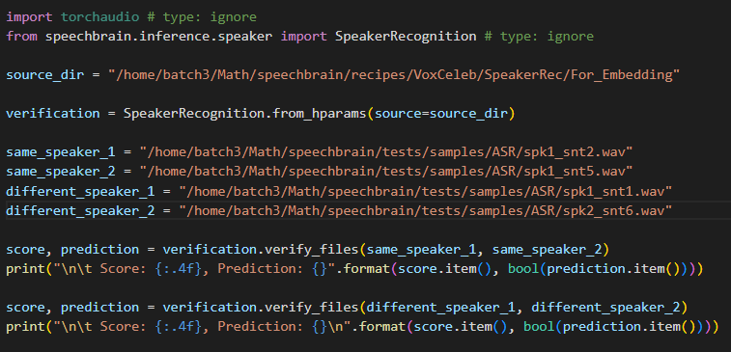

Speaker verification(with example wav files)
For same speaker
The prediction will be True for the same speakers and False for different speakers
For different speakers

Slide 8
THANK YOU

Slide 9
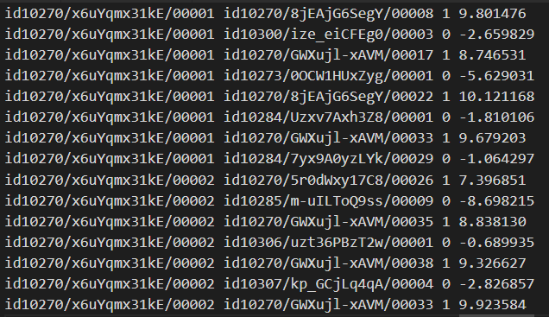

Extra Slides
From Score.txt
Speaker 1
Speaker 2
Enrollment ID
Test ID
Label
Score

