Slide 1
WavLM

Slide 2
Problem Statement
Task – Speaker Identification(SI), Voice activity detection(VAD), Speech recognition(ASR), Emotion recognition(AER)
AER (Voice activity detection)
Takes features from WavLM
Perform emotion classification
WavLM model
Used as a shared encoder
Takes raw waveform(.wav) as input
Output is a frame sequence with frameshift of 20ms
ASR (Speech recognition)
Takes features from WavLM
Perform speech recognition
VAD (Voice activity detection)
Takes features from WavLM
Perform frame-level speech/nonspeech detection
SI (Speaker Identification)
Takes features from WavLM
Perform Speaker classification
Dataset – IEMOCAP
12 hours of English audio
151 dialogues including 10,039 utterances
40% of frames in the segmented utterances are silent – so it can be used for VAD
Emotions – Happy, Angry, Neutral, Sad, Other

Slide 3

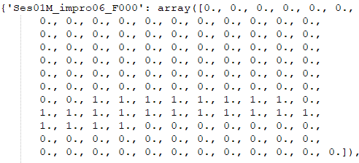
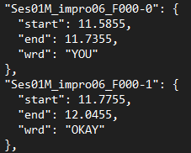
Data preparation
# Neutral emotion
'Ses01F_impro01_F000': 'neu’,
# Sad emotion
'Ses01F_impro01_F001': 'sad',
Convert the stereo channel to a single channel
Organize raw transcriptions from the IEMOCAP
Remove punctuation and special marker
Preparing Emotion labels
IEMOCAP dataset
- For compatibility reasons
- To reduce file size
Creates a CSV files which contains the transcriptions.
[Utterance ID]\t[Sentence]
Ses01F_impro01_F000 Excuse me.
Ses01F_impro01_M000 Do you have your forms?
Ses01F_impro01_F001 Yeah.
Ses01F_impro01_M001 Let me see them.
Converting all text to Uppercase
Remove extra whitespace and multiple spaces, special symbols, and punctuation
5 emotion classes are used: “happy”, “sad”, “angry”, “neutral”, “other”
“Happy” and “excited” is taken as “happy”
Store in .npy file
Create JSON files that contain(for each utterance)
Wav file location
Duration
Speaker id
Start time
Stop
Words/sentence
Preparing training, validation and testing data
Preparing VAD labels
Train – 75%
Valid – 10%
Test – 15%
- For speech, it is taken as "1" else as "0"(For every frame within each utterance)

Slide 4
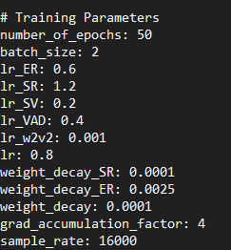
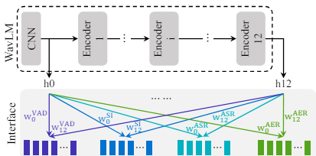
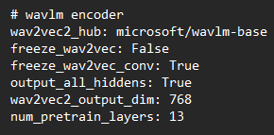
Overall model
LSTM *4
ECAPA-
TDNN
BiLSTM *4
Transformer encoder *2
FC
Avg. pooling
Speech/
Non speech
Speaker
embedding
Transcription
FC
Emotion

Slide 5
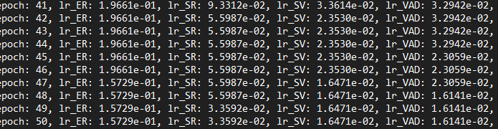
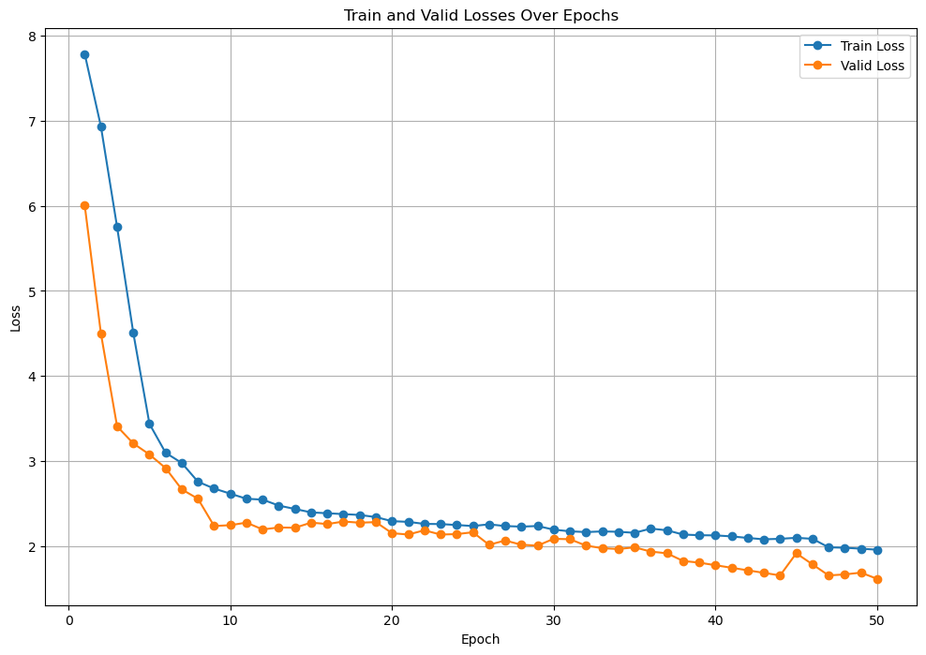

Training log
Train.log
WavLM Base + downstream head were fine tunned while CNN was kept fixed
Speed perturbation was applied to ASR and SI heads
Speed perturbation is not given to AER model
ASR head is trained using CTC loss
Other 3 head using cross-entropy loss
Scaling coefficients
Taken as 1.2
Taken as 1

Slide 6














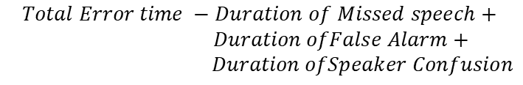
Evaluation metrics(formula)
VAD
ASR
$$False alarm rate (FAR)=$$
$$\frac{FP}{TP+FN}$$
$$Word Error Rate (WER)=$$
$$\frac{S+D+I}{N}$$
$$\frac{FN}{TP+FN}$$
$$S −Number of substitutions$$
$$Missed Rate (MSR)=$$
$$D −Number of deletions$$
$$I −Number of insertions$$
$$N −Total number of words in the reference text$$
SI
$$Diarization Error Rate (DER)=$$
$$\frac{Total Error time}{Total reference speech time}$$
$$Total Error time −Duration of Missed speech+$$
$$Duration ofFalse Alarm+$$
$$Duration ofSpeaker Confusion$$
AER
$$Time weighted Emotion error rate(TEER)=$$
$$\frac{MS+FA+{CONF}_{emo}}{TOTAL}$$
$$FA −Duration of False alarm speech$$
$$MS −Duration of Missed speech$$
$$\frac{MS+FA+{CONF}_{emo+spk}}{TOTAL}$$
$${CONF}_{emo}−Duration where emotion is wrongly classified$$
$$Speaker−attributed TEER(sTEER)=$$
$${CONF}_{emo+spk}−Duration where emotion or speaker is wrongly classified$$

Slide 7

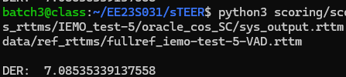

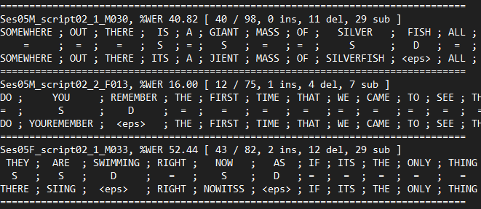




Evaluation metrics(Results)
VAD
SI
$$False alarm rate \left(FAR\right)=1.8 \%$$
(With 4*LSTM)
$$Diarization Error Rate \left(DER\right)=7.08\%$$
$$Missed Rate \left(MSR\right)=2.45\%$$
(With ECAPD-TDNN)
$$Diarization Error Rate \left(DER\right)=10.7\%$$
$$False alarm rate \left(FAR\right)=3.3 \%$$
(With 4*FC)
(With XVector)
$$Missed Rate \left(MSR\right)=3.95\%$$
ASR
AER
$$TEER=72.5\%$$
(With WavLM-base)
$$sTEER=70.37\%$$
$$Word Error Rate \left(WER\right)=31.60\%$$
$$TEER=66.03\%$$
(With WavLM-base-plus)
$$sTEER=65.17\%$$

Slide 8
THANK YOU

