Slide 1
Your presentation title
Your subtitle · Your name · Date
Notes:
Title slide. The bar wipes in, the title zooms in and the subtitle floats in, all automatically. Change timing in Animations > Animation Pane.

Slide 2
Agenda
01
Section one
02
Section two
03
Section three
04
Section four
Notes:
Agenda. The highlighted row ('!!Panel') and the numbers zoom into the next slide with Morph. To add a section: duplicate this slide and the section slide after it, move the panel to the next row, and keep the names that start with !! (Home > Arrange > Selection Pane).

Slide 3
01
Section one
One sentence on what this section covers.
Notes:
Section divider. The number, label and highlight panel come from the agenda slide before it (Morph). The intro line floats in after the move.

Slide 4
Agenda
01
Section one
02
Section two
03
Section three
04
Section four
Notes:
Agenda. The highlighted row ('!!Panel') and the numbers zoom into the next slide with Morph. To add a section: duplicate this slide and the section slide after it, move the panel to the next row, and keep the names that start with !! (Home > Arrange > Selection Pane).

Slide 5
02
Section two
One sentence on what this section covers.
Notes:
Section divider. The number, label and highlight panel come from the agenda slide before it (Morph). The intro line floats in after the move.

Slide 6
Your key points
Point one: a short sentence
Point two: a short sentence
Point three: a short sentence
Point four: a short sentence
Key message
One line that sums it up.
Notes:
Bullet build. Each point floats in on its own click (fade and rise); the key message zooms in last. Add points with Enter: new paragraphs get the same animation in Animations > Animation Pane > Effect Options > Text Animation > By paragraph.

Slide 7
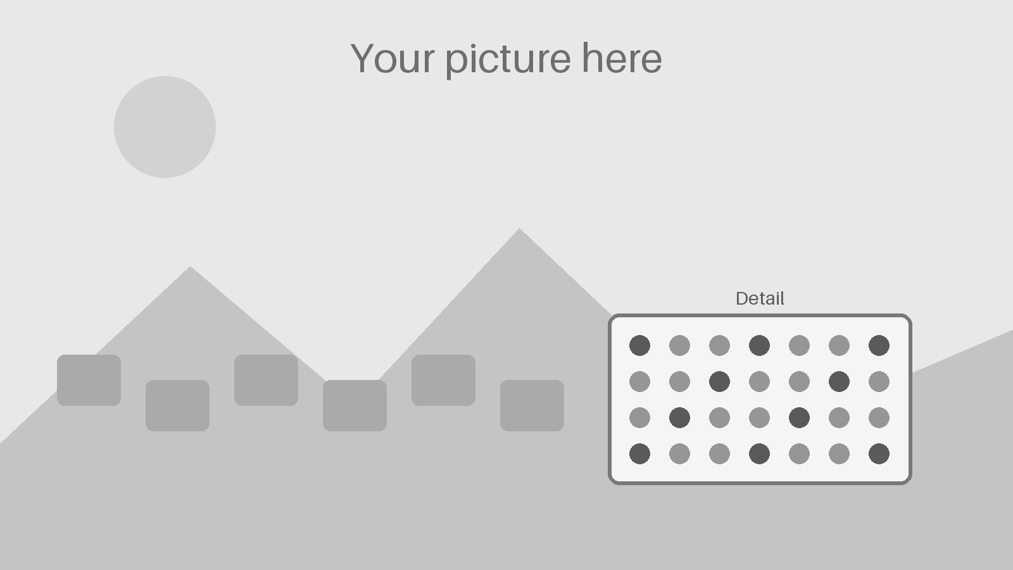
Your picture
Your caption
Say what to look at.
Notes:
Picture zoom. Replace the picture on BOTH slides (right-click > Change Picture). On the zoomed slide, use Picture Format > Crop to choose the detail again. Keep the name !!Picture on both.

Slide 8
Your detail
Your caption
Say what the detail shows.
Why it matters
Notes:
Zoomed slide: Morph enlarges the picture to the detail (the same picture, cropped). After changing the picture, crop it again (Picture Format > Crop) so the detail fills the frame.

Slide 9
How it works
Yes
Decision?
Step one
Step two
Result
A short note
A short note
A short note
A short note
Notes:
Flow chart that builds. Each click wipes in the next arrow, then the next box zooms in. The arrows are glued to the boxes: move a box and its arrows follow.

Slide 10
Your process
Step 1 of 4
Step one
Step two
Step three
Step four
What happens in step 1.
Notes:
Flow chart that moves (Morph, 4 slides). On each slide the active step is bigger and coloured; Morph grows it and shrinks the last one. Edit the step names on all four slides; keep the !! names.

Slide 11
Your process
Step 2 of 4
Step two
Step one
Step three
Step four
What happens in step 2.
Notes:
Flow chart that moves (Morph, 4 slides). On each slide the active step is bigger and coloured; Morph grows it and shrinks the last one. Edit the step names on all four slides; keep the !! names.

Slide 12
Your process
Step 3 of 4
Step three
Step one
Step two
Step four
What happens in step 3.
Notes:
Flow chart that moves (Morph, 4 slides). On each slide the active step is bigger and coloured; Morph grows it and shrinks the last one. Edit the step names on all four slides; keep the !! names.

Slide 13
Your process
Step 4 of 4
Step four
Step one
Step two
Step three
What happens in step 4.
Notes:
Flow chart that moves (Morph, 4 slides). On each slide the active step is bigger and coloured; Morph grows it and shrinks the last one. Edit the step names on all four slides; keep the !! names.

Slide 14
Our timeline
Q1 2026
Milestone one
Q3 2026
Milestone three
Q1 2027
Milestone five
Q2 2026
Milestone two
Q4 2026
Milestone four
Notes:
Timeline that builds up. Each click wipes the progress bar to the next point, then the marker zooms in and its label floats in. For a hands-free build, set every effect to After Previous in the Animation Pane.

Slide 15
Where we are
2025
Q1 2026
Q2 2026
Q3 2026
Q4 2026
Q1 2027
2027+
Start
Milestone one
Milestone two
Milestone three
Milestone four
Milestone five
Next
Notes:
Timeline that slides along (Morph, 3 slides). The whole timeline moves so the current point sits in the middle; points off the slide wait outside it. For another step, duplicate the last slide and move every !! object one gap (3.2 in) to the left.

Slide 16
Where we are
2025
Q1 2026
Q2 2026
Q3 2026
Q4 2026
Q1 2027
2027+
Start
Milestone one
Milestone two
Milestone three
Milestone four
Milestone five
Next
Notes:
Timeline that slides along (Morph, 3 slides). The whole timeline moves so the current point sits in the middle; points off the slide wait outside it. For another step, duplicate the last slide and move every !! object one gap (3.2 in) to the left.

Slide 17
Where we are
2025
Q1 2026
Q2 2026
Q3 2026
Q4 2026
Q1 2027
2027+
Start
Milestone one
Milestone two
Milestone three
Milestone four
Milestone five
Next
Notes:
Timeline that slides along (Morph, 3 slides). The whole timeline moves so the current point sits in the middle; points off the slide wait outside it. For another step, duplicate the last slide and move every !! object one gap (3.2 in) to the left.

Slide 18
Your cycle
Stage one
Stage one: what happens
Stage two: what happens
Stage three: what happens
Stage four: what happens
Stage four
Your cycle
Stage two
Stage three
Notes:
Cycle that spins in. Each click spins in the next stage and its arrow; the last click spins the centre ring once. Edit the stage names in the circles and the notes on the right.

Slide 19
Our cycle, step by step
Stage four
Stage one
What happens in this stage, in one or two lines.
Stage one
Stage three
Stage two
Notes:
Cycle that turns (Morph, 4 slides). Each slide turns the stages one place, so the active stage sits next to its explanation. Edit the names on every slide; keep the !! names.

Slide 20
Our cycle, step by step
Stage one
Stage two
What happens in this stage, in one or two lines.
Stage two
Stage four
Stage three
Notes:
Cycle that turns (Morph, 4 slides). Each slide turns the stages one place, so the active stage sits next to its explanation. Edit the names on every slide; keep the !! names.

Slide 21
Our cycle, step by step
Stage two
Stage three
What happens in this stage, in one or two lines.
Stage three
Stage one
Stage four
Notes:
Cycle that turns (Morph, 4 slides). Each slide turns the stages one place, so the active stage sits next to its explanation. Edit the names on every slide; keep the !! names.

Slide 22
Our cycle, step by step
Stage three
Stage four
What happens in this stage, in one or two lines.
Stage four
Stage two
Stage one
Notes:
Cycle that turns (Morph, 4 slides). Each slide turns the stages one place, so the active stage sits next to its explanation. Edit the names on every slide; keep the !! names.

Slide 23
Option A or option B?
Option A
Point one
Point two
Point three
Option B
Point one
Point two
Point three
Notes:
Comparison. On the second slide the winner grows and takes the accent colour (Morph); the badge zooms in. To make A the winner, swap the two cards' sizes and colours on the second slide.

Slide 24
Option A or option B?
Recommended
Option B
Point one
Point two
Point three
Option A
Point one
Point two
Point three
Notes:
Comparison. On the second slide the winner grows and takes the accent colour (Morph); the badge zooms in. To make A the winner, swap the two cards' sizes and colours on the second slide.

Slide 25
Results at a glance
42%
1.2 M
3×
+18
Your first measure
Your second measure
Your third measure
Your fourth measure
Notes:
Numbers. The tiles' numbers zoom in one after another; the next click makes the first number pulse to point at it. Type your own numbers over the samples.

Slide 26
Your chart
What it shows
One line on the trend.
Notes:
Chart reveal. The axes appear first, then each click wipes in one category from the bottom. Change the numbers: right-click the chart > Edit Data. The colours follow the theme.

Slide 27
Thank you
Questions? · Your name · your.email@example.com
Notes:
Closing slide. The text zooms in and the circles follow, automatically.

Slide 28
How to use this template
1. Fill in
Click any 'Your …' text and type. Delete the slides you do not need.
2. Morph pairs
A slide with the Morph transition moves objects from the slide before it. Duplicate both slides together; keep the names that start with !! the same on both (Home > Arrange > Selection Pane).
3. Animations
Animations > Animation Pane: change the order, On Click or After Previous, and the speed.
4. Pictures
Right-click > Change Picture, on both zoom slides. On the zoomed one, crop again.
5. Charts
Right-click the chart > Edit Data. The bars keep their animation.
6. Colours
Design > Variants > Colors recolours every slide (next slide).
Notes:
How to use the template. Delete this slide and the next before presenting.

Slide 29
How to change the colours
Windows
Design > Variants > More (▾) > Colors, then pick a set, or Customize Colors to make your own.
Mac
Design > Variants (▾) > Colors.
iPad, phone, web
Download a ready colour version from the website (Ocean, Graphite, Sunrise).
Accent 1
Accent 2
Accent 3
Accent 4
Accent 5
Accent 6
Text 2
Background 2
This file: 'Ocean' colours.
Fonts: Design > Variants > Fonts.
Notes:
Changing colours. Every shape uses the theme colours shown here.

