Slide 1
A Systematic Review of Climate Change and Aging
Mathew Hauer & Kyle Rose

Slide 2
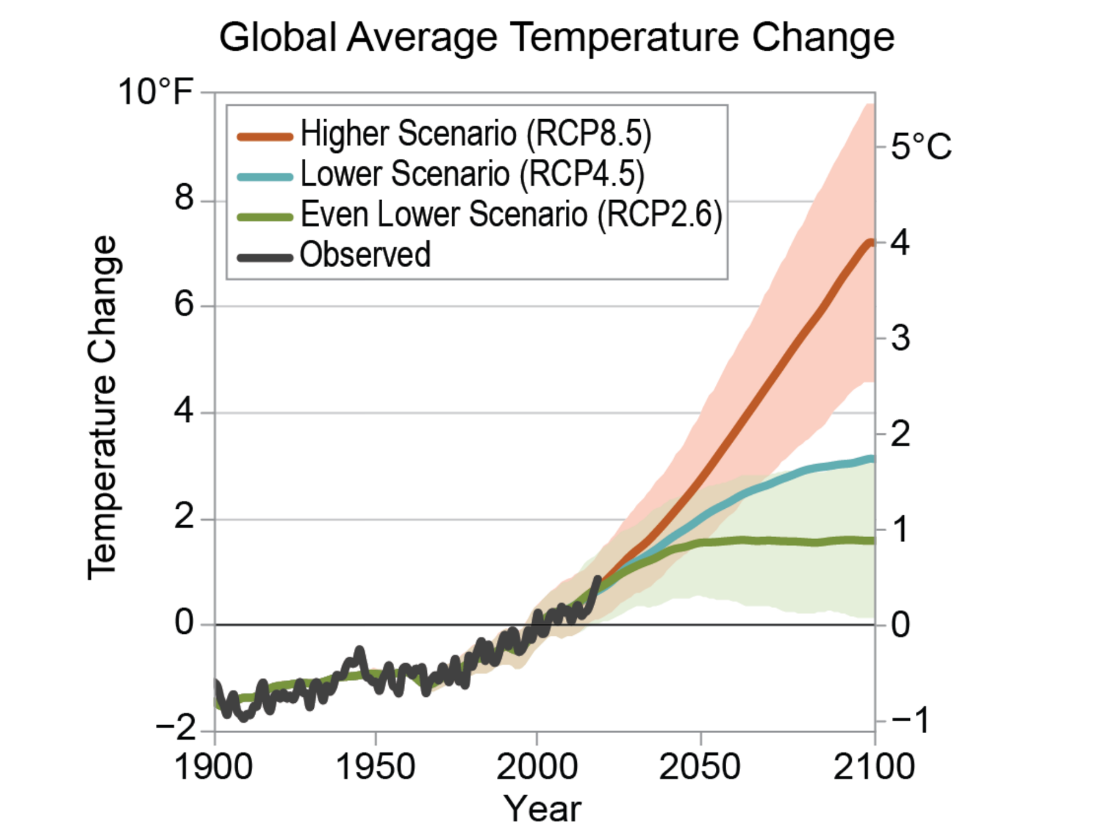
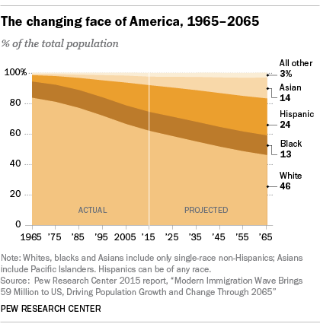
Two Immutable Trends this century
Two seemingly immutable trends will crash head-on during this century:
  (1) the US populace will continue to age and diversify
  (2) global climate change impacts will worsen as the century progresses.

Slide 3
Two Immutable Trends this century
Consider this: the global population aged 75+ is expected to grow from 271M people today to 1.4B by 2100.
In 2100, More than half of all countries will be as old or older than Japan, Italy, and Germany – the three oldest countries in the world today.
Over the same period, global temperatures are expected to increase by 3C compared to the pre-industrial period.
More frequent droughts, wildfires, extreme heat, and weather events are all likely.
Climate change will make the world of 2100 considerably more precarious compared to today – a precarity amplified by a globally aging population.

Slide 4
Two Immutable Trends this century
Nearly every climate impact is heightened by age due to older people’s social vulnerability and physiological susceptibility.
Older people have:
  Reduced ability to adapt
  Limited transportation
  Reduced mobility
  Smaller social networks
  Lower incomes
  Chronic health problems
  Social isolation
  Cognitive decline
  General frailty
Potential biosocial cocktail of problems

Slide 5
Two Immutable Trends this century
Despite known climate impacts, climate change and aging intersect in multiple ways, beyond just climate impacts.
As we will show, most research tends to focus on the impact of extreme temperatures on older populations.
Here, we conduct a systematic review of “Climate Change” & “Aging” to offer a more varied view on the relationship between older adults and global environmental change.

Slide 6
Quick Background on Climate Change
Two main axes of climate change: mitigation (reduction of emissions) and adaptation.
Vulnerability = Exposure x Sensitivity x Adaptive Capacity
Perception of climate change plays important roles in mitigation, adaptation, and denial.
Retrospective studies vs. prospective studies.

Slide 7
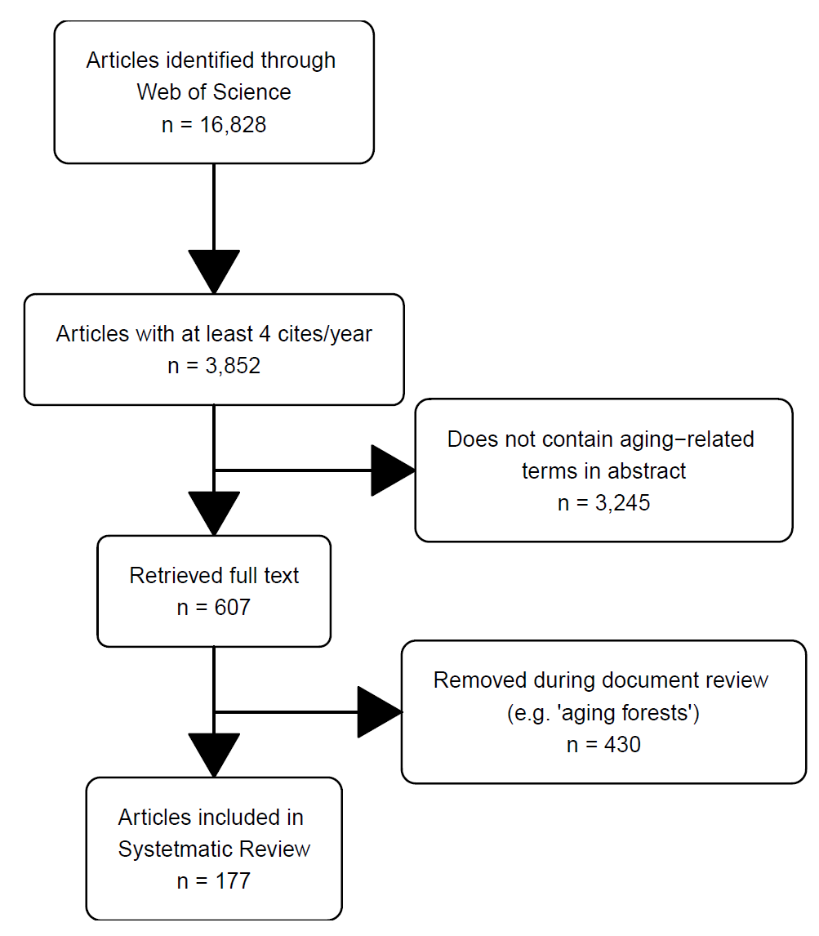
Methods
We searched the Web of Science-expanded search engine on September 7, 2022 using
  “TS=(aging OR aged OR elderly) AND TS=(“climate change”)”
This search yield 16,828 articles.
Filtered to include high-impact articles.
Filtered again containing the primary words in the abstract.
We retrieved 607 articles for review.
177 included after removing spurious articles.

Slide 8
Methods
We searched the Web of Science-expanded search engine on September 7, 2022 using
  “TS=(aging OR aged OR elderly) AND TS=(“climate change”)”
This search yield 16,828 articles.
Filtered to include high-impact articles.
Filtered again containing the primary words in the abstract.
We retrieved 607 articles for review.
177 included after removing spurious articles.

Slide 9
Methods
We searched the Web of Science-expanded search engine on September 7, 2022 using
  “TS=(aging OR aged OR elderly) AND TS=(“climate change”)”
This search yield 16,828 articles.
Filtered to include high-impact articles.
Filtered again containing the primary words in the abstract.
We retrieved 607 articles for review.
177 included after removing spurious articles.

Slide 10
Methods
We searched the Web of Science-expanded search engine on September 7, 2022 using
  “TS=(aging OR aged OR elderly) AND TS=(“climate change”)”
This search yield 16,828 articles.
Filtered to include high-impact articles.
Filtered again containing the primary words in the abstract.
We retrieved 607 articles for review.
177 included after removing spurious articles.

Slide 11
Methods
We developed a questionnaire to survey the 177 articles to document and characterize the primary topics related to climate change.
We coded all papers based on
  (1) the primary and (2) secondary climate effect studied
  (3) The climate impact type (sensitivity, vulnerability, or exposure)
  (4) The climate impact studied (morbidity, mortality, etc.)
  If the article concerned (5) mitigation, (6) adaptation, or (7) perceptions.
  If the article included a projection (8)
  (9) The historic time period
  (10) the general area studied.
We also gathered general information on authorship, publication year, and citation counts

Slide 12
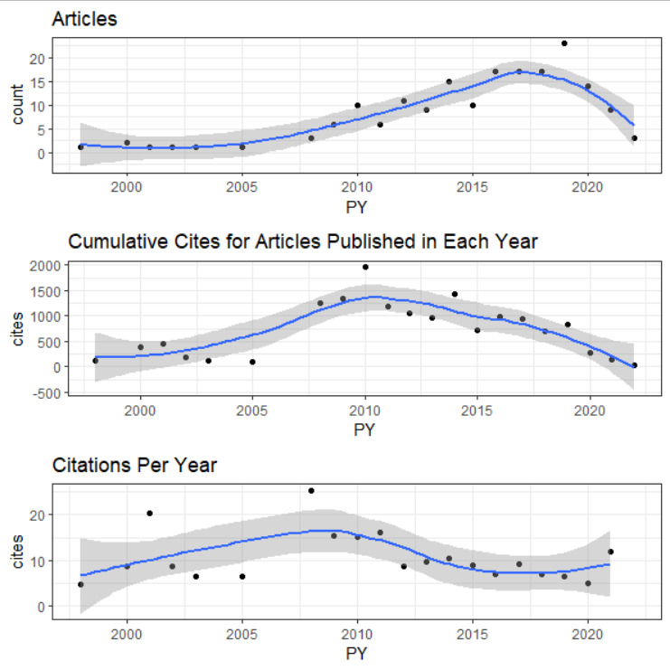
Results
# of articles is increasing per year.
  Small decline in this literature since 2020.
Citations for this literature peaked in 2010.
  Most likely coinciding with IPCC AR4 (2007)
  Curiously, no increase with AR5 (2014)

Slide 13
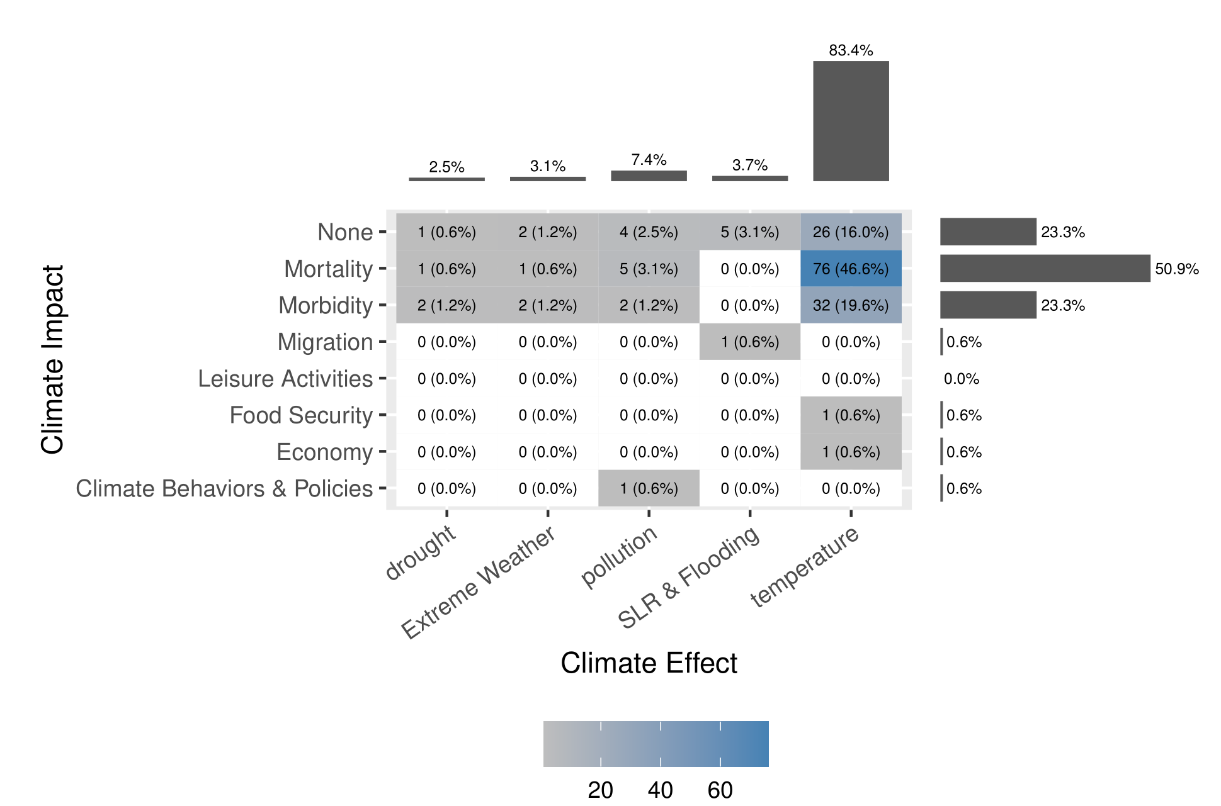
Results

Slide 14
Results
47% of all articles concerned Temperature and Mortality.
  51% were about mortality and 83% were about temperature.
20% of all articles concerned Temperature and Morbidity.
2/3rds of all articles concern Temperature and Mortality/Morbidity.
And more than 83% concern Temperature.

Slide 15
Results
Temperature effects included:
  Heat (n=32)
  Heatwaves( (n=16)
  Daily temperature range (n =9)
  Ambient temperature (n=6)
Morbidity effects included:
  Hospital admissions (n=9)
  Ambulance attendance (n=1)

Slide 16
Results
Temperature effects included:
  Heat (n=32)
  Heatwaves( (n=16)
  Daily temperature range (n =9)
  Ambient temperature (n=6)
Morbidity effects included:
  Hospital admissions (n=9)
  Ambulance attendance (n=1)

Slide 17
Results
Small section of the literature concerning the effect of pollution on aging (n=12).
More than half concerned Mortality/Morbidity (n=7).

Slide 18
Results
Climate Impacts are incredibly varied in the broader climate change literature but not in the Climate Change & Aging literature.
Pollution (n=12), Flooding and SLR (n=6), Extreme Weather and Wildfires (n=5), and Drought (n=4) are understudied.

Slide 19
Results
Only Mortality/Morbidity concerned multiple climate impacts.
Notable omissions in the literature include:
  Elder migration due to drought, wildfires, and temperatures.
  Food security due to drought, flooding, and wildfires.
  Economic impacts due to drought, flooding, wildfires

Slide 20
Results
Broad categories of VESA also show important areas.
Adaptation of the elderly is
seriously understudied.
Vulnerability is studied largely as a function of exposure and sensitivity, which is not how VESA suggests.
 | Vulnerability | Exposure | Sensitivity | Adaptive Capacity | TOTALS
Vulnerability | 27 | 2 | 9 | 0 | 38
Exposure |  | 6 | 36 | 2 | 46
Sensitivity |  |  | 35 | 1 | 81
Adaptive Capacity |  |  |  | 5 | 8
 |  |  |  |  | 123

Slide 21
Results
 | Yes | No | %
Adaptation | 51 | 121 | 30%
Mitigation | 19 | 153 | 11%
Perceptions | 13 | 159 | 8%
Prospective | 23 | 149 | 13%
Retrospective | 118 | 54 | 69%
Broader Climate Categories show additional gaps.
IPCC has 3 working groups: physical science, Impacts/Adaptation, and Mitigation.
  Impacts , Adaptation , Mitigation

Slide 22
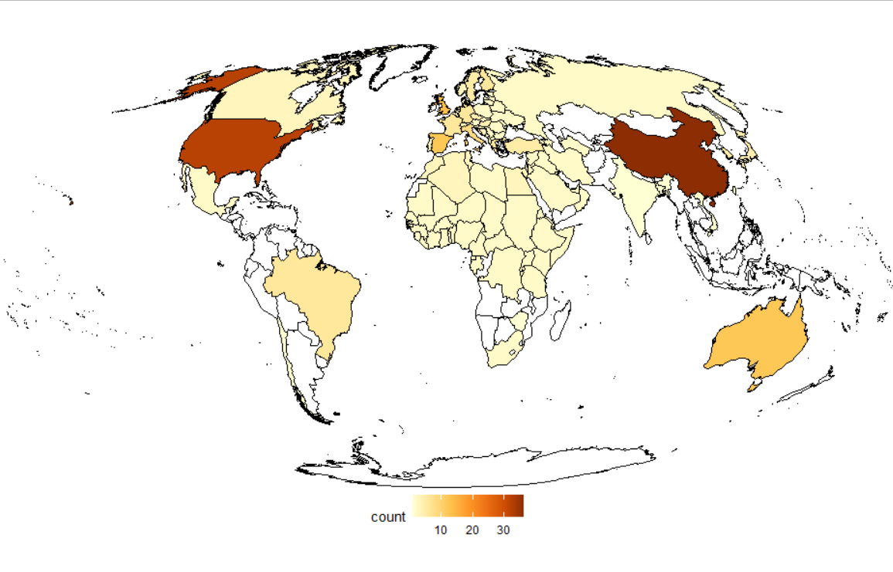
Results
Geographically, this literature needs a lot of work.
China (36), USA (32), and Global (21) studies dominate.
Africa (µ=2), South America (BRA = 6), and SE Asia (Vietnam=1) are massively understudied.
The regions most impacted by CC, but also the most youthful populations, are understudied.

Slide 23
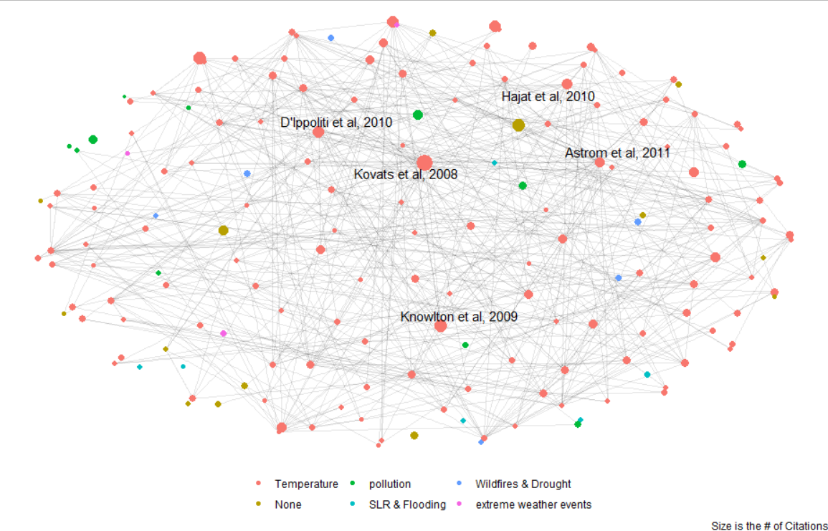
Results – Who Cites Who?
 | TC | Edges
Kovats et al, 2008 | 937 | 24
Hajat et al, 2010 | 319 | 18
Astrom et al, 2011 | 256 | 17
Knowlton et al, 2009 | 449 | 15
D'Ippoliti et al, 2010 | 400 | 15
Berrang-Ford et al’s “Are we adapting to Climate Change?” (500 citations) only connected to 1 article.

