Slide 1
EMORY UNIVERSITY · GERMAN STUDIES
Patterns of
Linguistic Indifference
in the American
College Context
How closely are you really reading?
Mathew Kang · Umi Pak · Prof. Hiram H. Maxim

Slide 2
THE PROBLEM
When was the last time you read
something word for word?
–7.5%
~30 sec
#1 use
Drop in English & Literature
bachelor's degrees, 2012–2014
Average time spent reading
a webpage before leaving
AI is increasingly used
to replace reading & analysis
Sources: American Academy of Arts & Sciences Humanities Indicators; Nielsen Norman Group; Konukati (2024)

Slide 3
KEY CONCEPT
Linguistic Indifference (LI)
"The dismissal or diminishment of the role of language
as a material component for knowledge-making."
— Gramling & Malakaj, The Pipestone Group
01
02
03
Skimming over
close reading
Language form
vs. meaning
Outsourcing to AI
Standardized test culture trains students
to find the "right answer," not analyze text.
Treating words as transparent vehicles for
information, not as tools for knowledge-making.
Using generative AI to bypass the cognitive
work of reading and writing analytically.

Slide 4
ABOUT THE STUDY
We're building the first
scale to measure LI.
DESIGN
TARGET
Cross-observational,
online survey
50–80 Emory
undergrad participants
LI has never been rigorously measured in students. This study is the first attempt to create an empirical, validated instrument — the Linguistic Indifference Scale — to understand how students engage with language and academic texts.
METHOD
IRB
How linguistically indifferent are Emory undergrads?
Likert scale + qualitative
text response task
Emory IRB
approved
Do close reading habits, AI use, and language attitudes form distinct measurable dimensions?
How does LI show up in real-world text analysis tasks?

Slide 5
YOUR PARTICIPATION
One 30-minute online survey. That's it.
1
2
3
4
Consent &
Screening
Background
Questions
Likert Scale
Survey
Text Analysis
Task
Read & sign the digital consent form. Confirm your eligibility.
Quick questions about your major, year, language background & AI use.
19 attitude statements about reading, word choice & AI — rate your agreement.
Share your thoughts on 2 real social media posts. No right or wrong answers!
✓ Emory undergrad, 18 or older, fluent in English · Completely anonymous · No compensation, but your data helps improve education

Slide 6
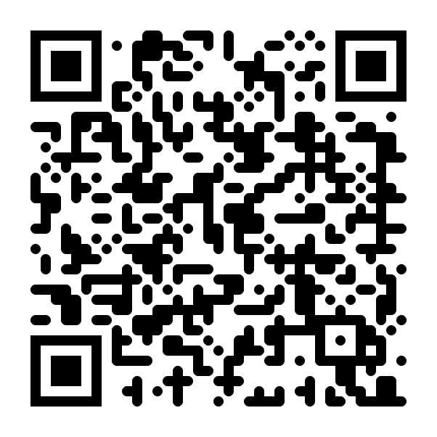
SCAN TO
PARTICIPATE
Takes about 30 minutes.
Anonymous. No compensation needed —
your responses help build better education.
tinyurl.com/mtaccdy8
Questions? Contact us: MWKANG@emory.edu · umi.pak@emory.edu
Scan with your phone camera
Emory University · German Studies · Spring 2026

