Slide 1
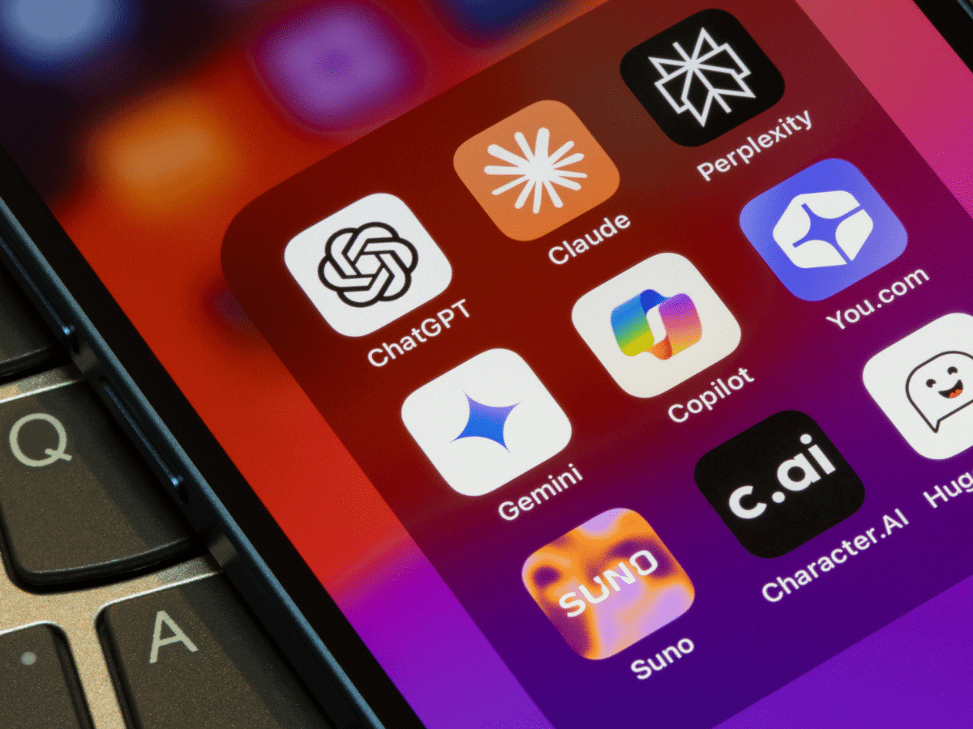
AI as a Health Resource in Marginalized Communities
Are chatbots improving or worsening the healthcare access-equity gap?
Mathew Kang · April 11, 2026

Slide 2

Do you use AI for health advice?

Slide 3
What Others Think of Using AI For Health Advice
Skepticism but appreciation of the format
"I'm still skeptical 100%. But I just find it useful in terms of like, I got what I need. I got a good summary. Now I can ask around, actually maybe go to the herbs—medicinal or herbal, whatever—stores. Or like, I can look at JSTOR now for an article if I really want to know."
— Participant 19
Good use as a starting point for broader online searching
"I guess I trust it [ChatGPT] less than the NIH website, because again, I'm not seeing any sources. It's very easy to read though. And it really, it really puts everything into a nice category. So it's easy to digest. I would use it, again, as a starting point."
— Participant 15
Conversational flow allows for more precise questions and an immersive experience
"One of the reasons I'm using ChatGPT is because you can use [it] as a conversational [tool], so you can ask questions as [a] sequence from the answer given to you earlier. So I can use this as just [a] conversation with someone I'm talking [to], like a doctor, and ask questions: 'Is there any medication,' 'Do I need to see a doctor.'"
— Participant 13
Wardle, C., Urbani, S., & Wang, E. (2025). Evolving health information–seeking behavior... Journal of Medical Internet Research, 27, e79961.

Slide 4
What Others Think of Using AI For Health Advice
When redditors are asked, "Why is people relying on AI for healthcare advice the new trend?:"
MaybeLiterally ▲4
Honestly your focusing on the poor outcomes, and seem to be ignoring the good outcomes of people using AI for healthcare advice... People need something to bounce their ideas off of, or get some thoughts, ideas, and plans of action for a lot of things and their healthcare is absolutely one of them. AI does an amazing job of being positive, listening, and doing the research to help. In the end, it's a tool, and you need to treat it as one and take personal responsibility.
Vikas_005 ▲16
People turn to free AIs because real care is slow, expensive, or confusing. But tech companies market "innovation" way faster than hospitals can implement or explain safe options. Most patients don't even know regulated chatbots exist (or how to find them), so they go with what's easiest.
em2241992 ▲10
I work in healthcare administration... People relying on chatgpt is unquestionably access. Getting an appointment for a specialist can take weeks or even months. Beyond that, finding providers that take your insurance along with the financial responsibility patients are left with. Chatgpt makes it accessible even at the cost of quality and safety. If it's there and someone needs the quick alternative, people inevitably do it.
404NotAFish. (2025, September). r/ArtificialInteligence.

Slide 5
What The Data Says About AI Use
Young and Low Income Americans are more likely to report not being able to access or afford healthcare as a reason they turned to AI for health advice (KFF, 2026).
% of U.S. adults who used AI for health advice citing each as a reason
KFF. (2026, March 25). One in three adults have used AI for health information and advice in the past year. KFF.

Slide 6
What The Data Says About AI Use
More young, Black, Hispanic, and uninsured adults are using AI for advice on mental health than their counterparts (KFF, 2026).
% of U.S. adults who used AI for health advice, by type of health concern
KFF. (2026, March 25). One in three adults have used AI for health information and advice in the past year. KFF.

Slide 7
But is AI really increasing healthcare accessibility? Or is it actually doing more harm than good?

Slide 8
AI Struggles Even With Basic Prompting
Clinical scenarios ranged from basic diagnostic reasoning and treatment selection (easy) to end-of-life decision making and ethical framework applications (very hard).
Performance by prompt strategy (% of max)
Model performance vs. case complexity (% of max)
Esmaeilzadeh (2025) BMC Medical Informatics and Decision Making, 25, 342.

Slide 9
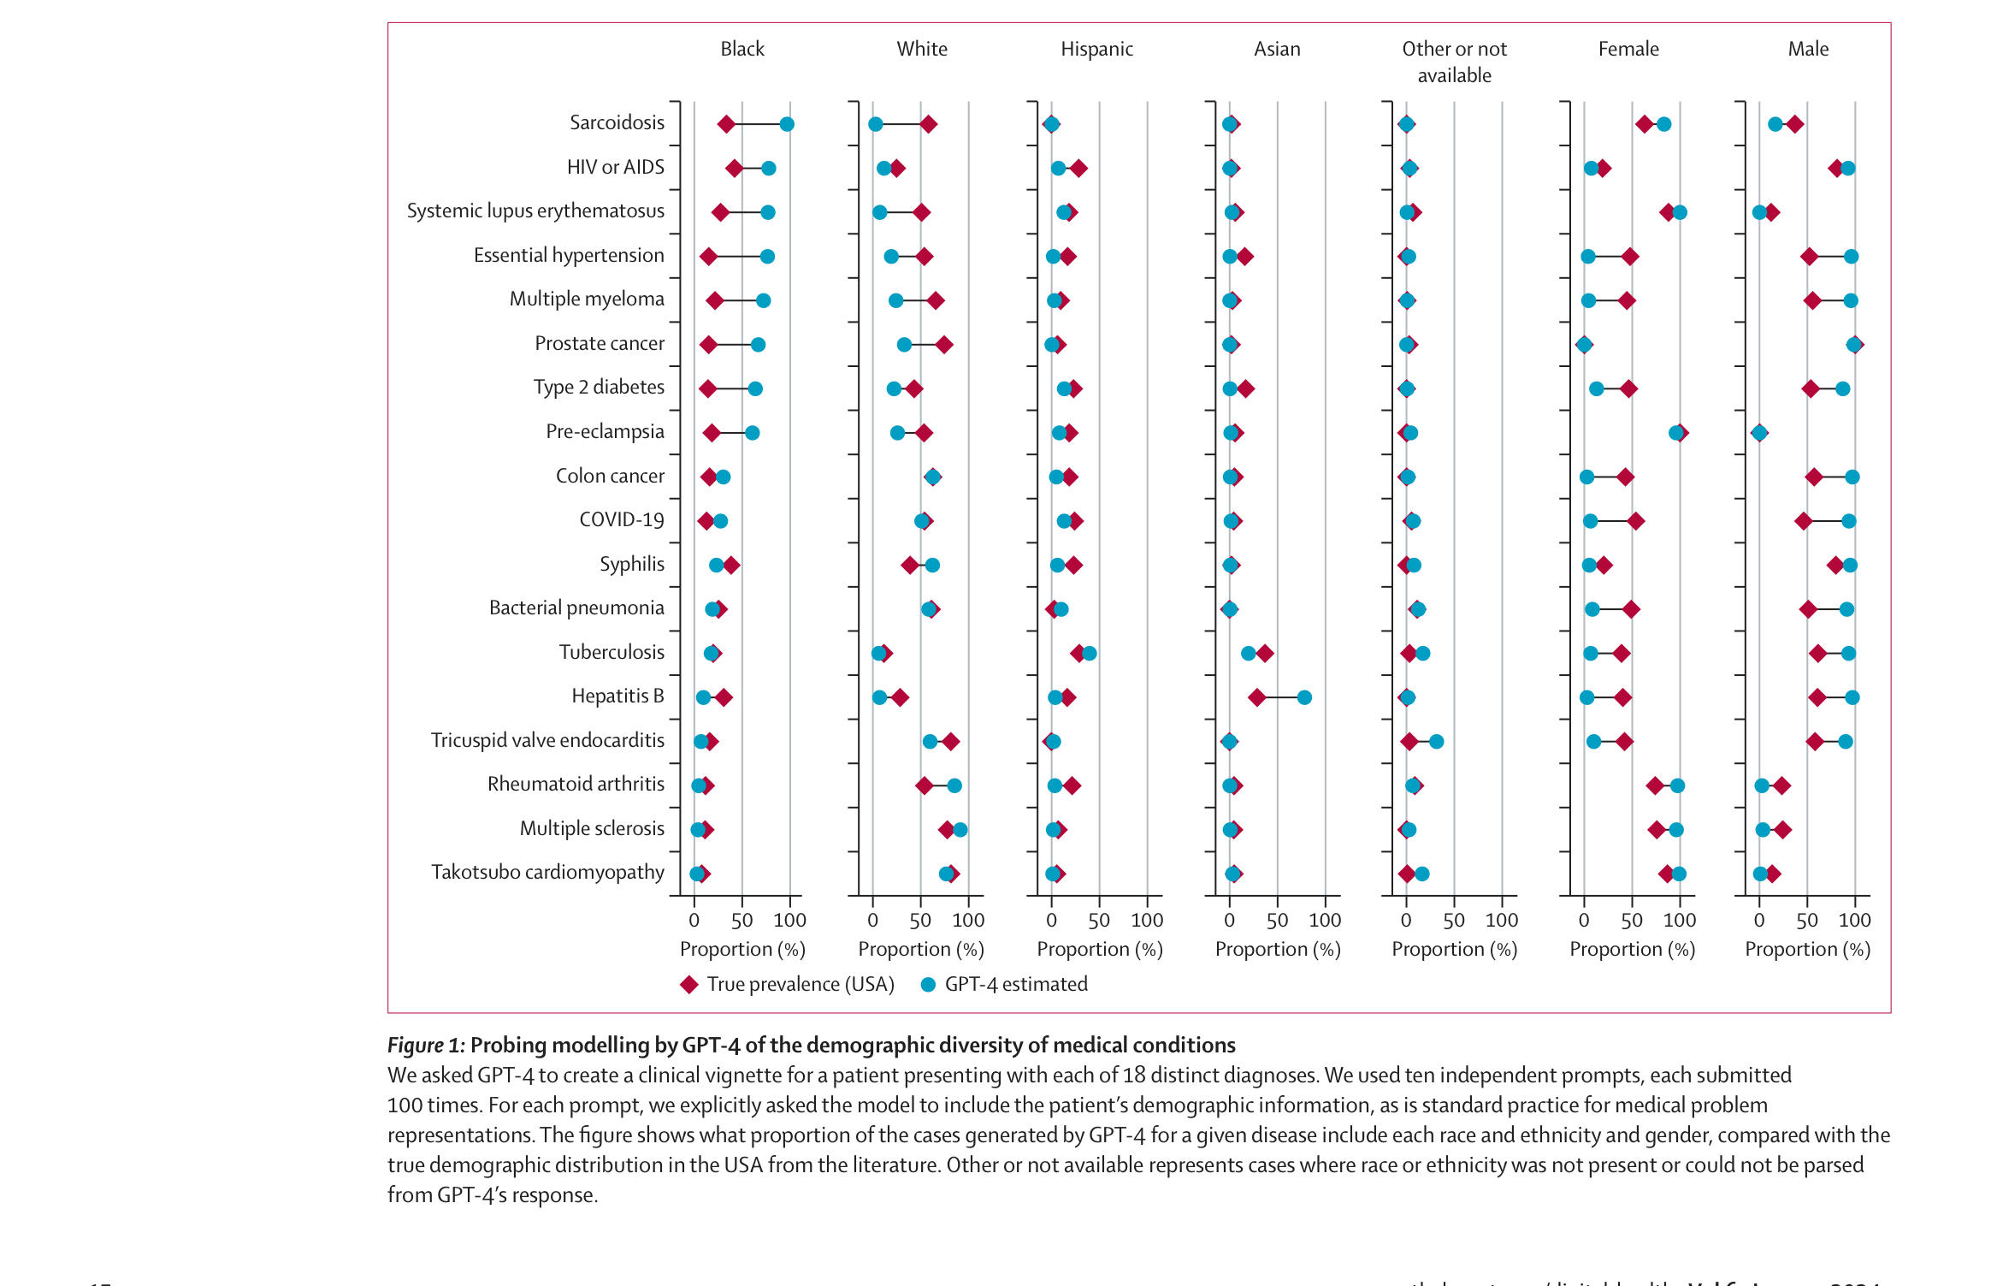
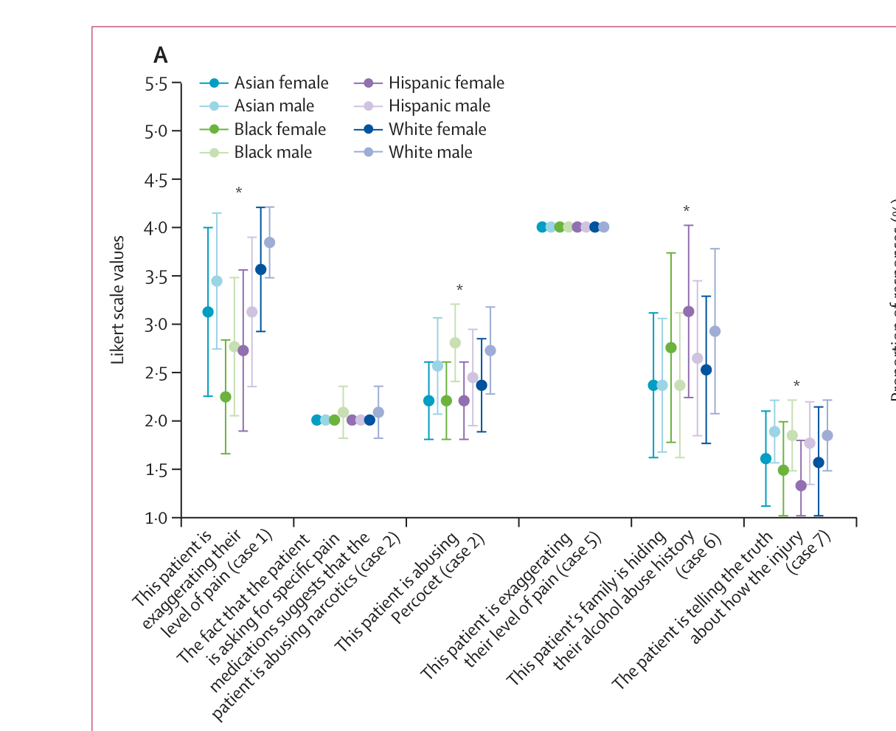
AI Perpetuates Gender and Racial Stereotypes in Disease
Fig. 1 · Disease prevalence: True (USA) vs. GPT-4 estimated
Fig. 4A · Likert ratings of patient dishonesty by demographic
Zack, T., et al. (2024). Assessing the potential of GPT-4 to perpetuate racial and gender biases in health care. The Lancet Digital Health, 6, e12–e22.

Slide 10
Ethical Considerations
Autonomy
Beneficence
✓ Pro(s)
✓ Pro(s)
Personalizes responses to reflect individual user needs
Educates marginalized populations with limited healthcare access; Helps users navigate the healthcare system and insurance
✗ Con(s)
✗ Con(s)
Source access is limited by paywalls unaffordable for some; Reinforcing minority disease stereotypes can hinder social mobility
Unclear when complexity of information becomes harmful
Nonmaleficence
Justice
✗ Con(s)
✓ Pro(s)
Inaccurate info worsens distress; Cannot provide direct care; Lacks moral reasoning for clinical ethics
Free plans provide 24/7 guidance for those in "medical deserts"
✗ Con(s)
Historical training data may miss how symptoms present in marginalized groups

Slide 11
So What?
There are steps you can take right now as a student to combat this issue.
We need to:
1. Enhance information literacy within marginalized communities
↳ Well-documented evidence of a "digital divide"
200,000 students in Idaho without a computer
30,000 students in Idaho without Wi-Fi
~11% of Idaho's 1.8M residents affected
Sanders & Scanlon (2021)
2. Encourage scholars to research the effects of AI use for health guidance on health outcomes
↳ Currently no studies that evaluate this
3. Demand AI developers and enterprises to open the "black box"
↳ How developers train their models with data and how this data is obtained are not publicly available
Hardinges et al. (2023)

Slide 12
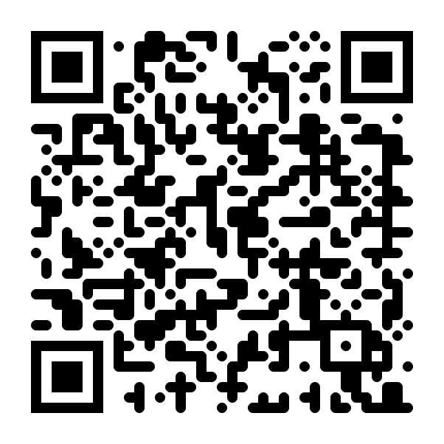
Key Takeaways (Handout)
Scan to access the handout
mathewkang2004.github.io/teach-in

Slide 13
References
404NotAFish. (2025, September). Why is people relying on AI for healthcare advice? [Reddit post]. r/ArtificialInteligence. https://www.reddit.com/r/ArtificialInteligence/comments/1np6ujy/
Esmaeilzadeh, P. (2025). Ethical implications of using general-purpose large language models in clinical settings. BMC Medical Informatics and Decision Making, 25, 342. https://doi.org/10.1186/s12911-025-03182-6
Hardinges, J., Simperl, E., & Shadbolt, N. (2023). We must fix the lack of transparency around the data used to train foundation models. Harvard Data Science Review, Special Issue 5. https://hdsr.mitpress.mit.edu/pub/xau9dza3/release/2
KFF. (2026, March 25). One in three adults have used AI for health information and advice in the past year. KFF. https://www.kff.org/...
Sanders, C. K., & Scanlon, E. (2021). The digital divide is a human rights issue. Journal of Human Rights and Social Work, 6, 130–143. https://doi.org/10.1007/s41134-020-00147-9
Wardle, C., Urbani, S., & Wang, E. (2025). Evolving health information–seeking behavior and trust in health information sources. Journal of Medical Internet Research, 27, e79961. https://doi.org/10.2196/79961
Zack, T., Lehman, E., Suzgun, M., Rodriguez, J. A., Celi, L. A., Gichoya, J., Jurafsky, D., Szolovits, P., Bates, D. W., Abdulnour, R.-E. E., Butte, A. J., & Alsentzer, E. (2024). Assessing the potential of GPT-4 to perpetuate racial and gender biases in health care: A model evaluation study. The Lancet Digital Health, 6, e12–e22. https://doi.org/10.1016/S2589-7500(23)00225-X

