Slide 1
COLLEGENOTICE
Digital Notice Board System
MCA Mini Project Final Presentation
Nithin Mathew
Roll No. 40, S2 MCA
Guide: Minnu V B, Assistant Professor
Department of Computer Applications (DCA)
Mangalam College of Engineering
Academic Year 2025–2027
1
Notes:
Presenter details: notice_board_review 2.pptx, slides 1 and 20. Academic year 2026–2027 confirmed by the presenter.

Slide 2
Introduction
CollegeNotice brings department and campus announcements into one web application.
Students can find exam schedules, events, academic updates and other notices.
Administrators publish and maintain notices through an authorised account.
The project supports clearer access to current information and important deadlines.
2
Notes:
Project evidence: CollegeNotice/README.md, board/models.py, board/views.py, board/ai.py, board/local_translation.py and static/*.js. Local demonstration and Django tests verified on 13 October 2026.

Slide 3
Abstract
Scattered notices make important updates difficult to find and revisit.
CollegeNotice provides a central board with search, bookmarks and notifications.
Django and REST APIs support the application. SQLite powers the local demonstration.
Local summaries, priority rules and English–Malayalam translation assist readers.
The working prototype demonstrates student access and administrator publishing.
3
Notes:
Project evidence: CollegeNotice/README.md, board/models.py, board/views.py, board/ai.py, board/local_translation.py and static/*.js. Local demonstration and Django tests verified on 13 October 2026.

Slide 4
Problem Definition
Students need a reliable way to find current college announcements because physical boards and informal message groups do not provide one searchable, organised record.
4
Notes:
Project evidence: CollegeNotice/README.md, board/models.py, board/views.py, board/ai.py, board/local_translation.py and static/*.js. Local demonstration and Django tests verified on 13 October 2026.

Slide 5
Objectives
Provide a central location for current college announcements.
Support department, category, date and keyword filtering.
Manage publication, expiry and archival through authorised accounts.
Help students save notices and receive relevant alerts.
Improve readability through summaries and English–Malayalam translation.
5
Notes:
Project evidence: CollegeNotice/README.md, board/models.py, board/views.py, board/ai.py, board/local_translation.py and static/*.js. Local demonstration and Django tests verified on 13 October 2026.

Slide 6
Existing System
Physical notice boards require students to visit the display location.
Informal group messages can push older announcements out of view.
Searching by department, category or date is difficult across separate channels.
Staff must manually track outdated notices and repeated enquiries.
6
Notes:
Baseline adapted from the supplied review PPT. These are qualitative workflow limitations, not results of a measured institutional survey.

Slide 7
Proposed System
A responsive web notice board provides one place to publish and read updates.
Students search, filter, bookmark and open the original notice.
Department administrators manage their own notices. A coordinator handles campus notices.
Publication creates relevant alerts, while expiry checks hide outdated notices.
Local language assistance supports summaries, priority detection and translation.
7
Notes:
Project evidence: CollegeNotice/README.md, board/models.py, board/views.py, board/ai.py, board/local_translation.py and static/*.js. Local demonstration and Django tests verified on 13 October 2026.

Slide 8
Scope of the Project
Users: students, department administrators and a campus coordinator.
Coverage: notices, attachments, search, bookmarks, alerts and profiles.
Administration: publishing, archive, catalogue management and CSV reporting.
Application areas: examinations, academics, events, library and placements.
Current scope is a local prototype. Institution-wide hosting is future work.
8
Notes:
Project evidence: CollegeNotice/README.md, board/models.py, board/views.py, board/ai.py, board/local_translation.py and static/*.js. Local demonstration and Django tests verified on 13 October 2026.

Slide 9
Literature Review
Title & Year | Authors | Algorithm | Key Features | Findings
Web-Controlled Centralized Digital Notice Board for smart intiutions (2025) | Ms.Madhuri Ninawe Ms.pooja sarangpure | NLP | Real time update of event management | Reduced manual work
Smart Digital Notice Board (2023) | S. Kumar, IEEE | MQTT | Remote updates, cloud, mobile notifs | Instant delivery, reduced paper
Web-Based College Notice Board (2022) | A. Sharma, IJCA | RBAC | Role-based login, dept notices | Secure access, higher satisfaction
Digital Notice Board Raspberry Pi (2021) | M. Reddy, IEEE | Display Control | LED display, wireless updates | Low-cost, low power
AI Smart Notice Board (2024) | J. Lee, Springer | NLP | Summarization, translation | Better readability & access
Cloud Notice Board (2023) | P. Patel, Elsevier | Cloud Sync | Cloud DB, secure auth, backup | High availability, scalability
Android Notice Board (2022) | R. Gupta, IJERT | Firebase | Push notifications, mobile | Higher engagement
9
Notes:
Sources: https://journals.mriindia.com/index.php/ijeecs/article/view/351 ; https://aclanthology.org/W04-3252/ ; https://aclanthology.org/W04-3252.pdf ; https://arxiv.org/abs/2207.04672 . The Ninawe paper is retained from the supplied review PPT. The other six generic citations in the earlier deck could not be verified from the supplied bibliographic details and are not used as evidence. TextRank is related research, not the implemented summary algorithm. Paper benchmark results are not CollegeNotice evaluation scores.

Slide 10
Technologies Used
Frontend: HTML, CSS and JavaScript with a responsive PWA interface.
Backend: Python, Django and Django REST Framework.
Data storage: SQLite for the local demo. PostgreSQL is configured for Docker.
Language tools: local rules, NLLB translation, CTranslate2 and SentencePiece.
Background services: immediate tasks locally. Celery and Redis are configured for Docker.
10
Notes:
Project evidence: CollegeNotice/README.md, board/models.py, board/views.py, board/ai.py, board/local_translation.py and static/*.js. Local demonstration and Django tests verified on 13 October 2026.

Slide 11
Software & Hardware Requirements
Software: Python 3.12, project dependencies and a current web browser.
Optional stack: Docker, PostgreSQL and Redis for distributed services.
Translation requires the local model, approximately 630 MB, plus its runtime.
Suggested demonstration hardware: 64-bit CPU, 8 GB RAM and free storage for the environment and model.
Internet is needed for initial downloads. Local translation works after setup.
11
Notes:
Project evidence: CollegeNotice/README.md, board/models.py, board/views.py, board/ai.py, board/local_translation.py and static/*.js. Local demonstration and Django tests verified on 13 October 2026. Hardware values are suggested demonstration resources, not benchmarked minimum requirements.

Slide 12
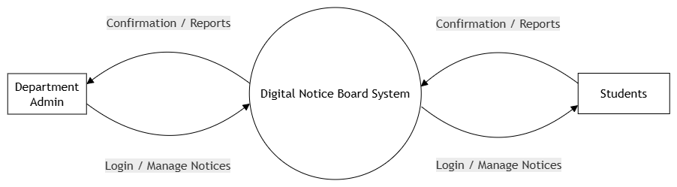
Design Diagrams: DFD LEVEL 0
12
Notes:
Project evidence: CollegeNotice/README.md, board/models.py, board/views.py, board/ai.py, board/local_translation.py and static/*.js. Local demonstration and Django tests verified on 13 October 2026.

Slide 13
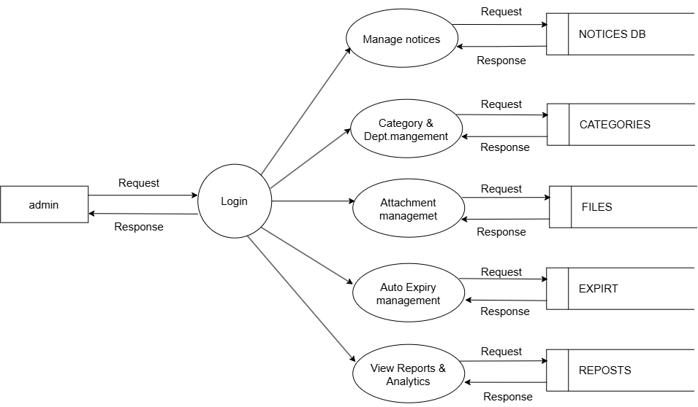
Design Diagrams: Admin DFD LEVEL 1
13
Notes:
Project evidence: CollegeNotice/README.md, board/models.py, board/views.py, board/ai.py, board/local_translation.py and static/*.js. Local demonstration and Django tests verified on 13 October 2026.

Slide 14
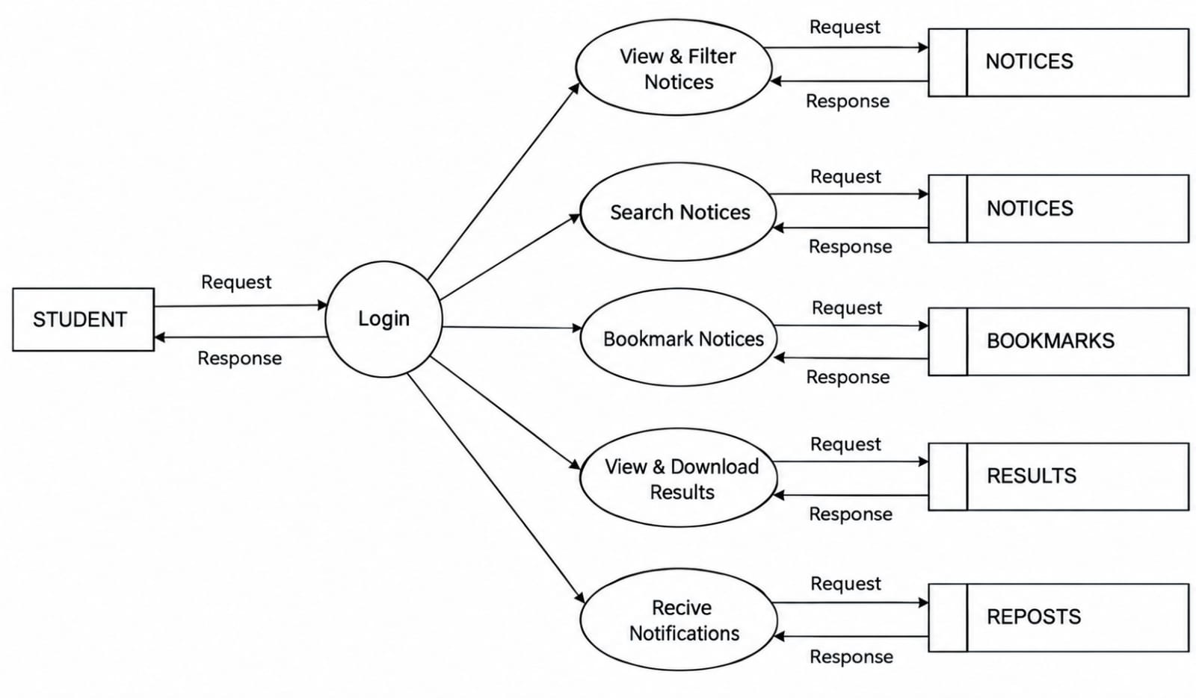
Design Diagrams: Student DFD LEVEL 1
14
Notes:
Project evidence: CollegeNotice/README.md, board/models.py, board/views.py, board/ai.py, board/local_translation.py and static/*.js. Local demonstration and Django tests verified on 13 October 2026.

Slide 15
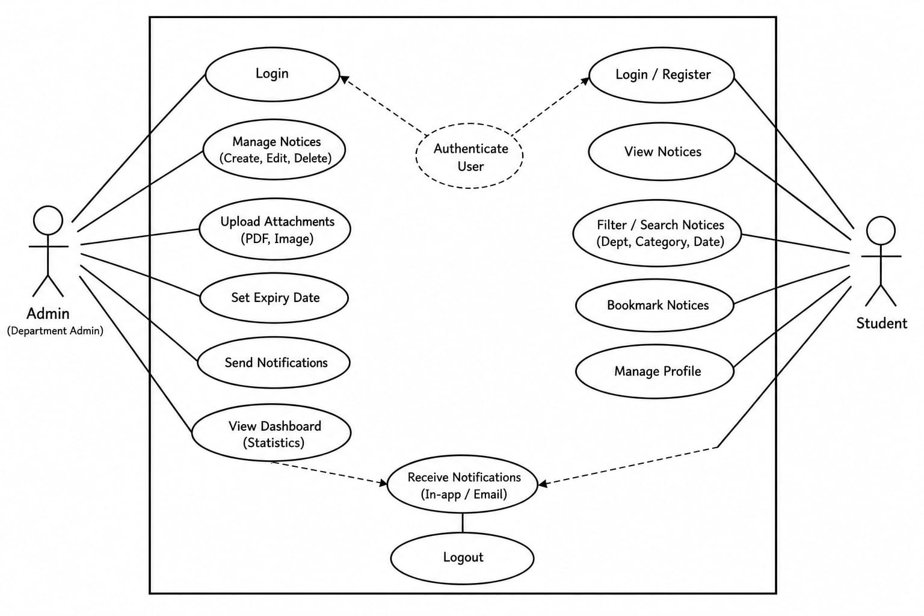
Design Diagrams: Use Case Diagram
15
Notes:
Project evidence: CollegeNotice/README.md, board/models.py, board/views.py, board/ai.py, board/local_translation.py and static/*.js. Local demonstration and Django tests verified on 13 October 2026.

Slide 16
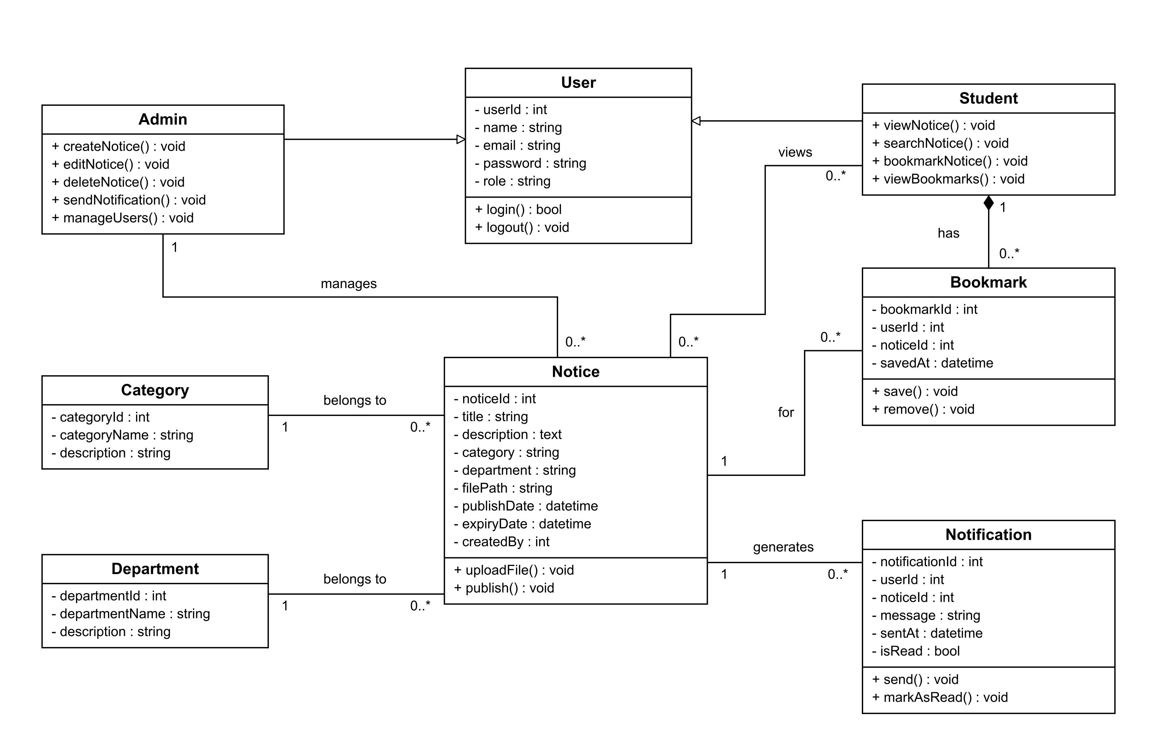
Design Diagrams: CLASS Diagram
16
Notes:
Project evidence: CollegeNotice/README.md, board/models.py, board/views.py, board/ai.py, board/local_translation.py and static/*.js. Local demonstration and Django tests verified on 13 October 2026. Simplified ER model, redrawn from review slide 17. Corrects department/category cardinality and bookmark-to-notice relationship. Campus-wide notices may have no department. Unique (user, notice) constraints prevent duplicates.

Slide 17
Design Diagrams: Sequence Diagram
Admin
Frontend
Django API
Database
Student
Sign in
Credentials
Validate user
Publish notice
Save notice + alerts
Poll notifications (10 s)
Return relevant alerts
Open notice
Email delivery follows the configured backend. The local recording uses demo email files.
17
Notes:
Project evidence: CollegeNotice/README.md, board/models.py, board/views.py, board/ai.py, board/local_translation.py and static/*.js. Local demonstration and Django tests verified on 13 October 2026.

Slide 18
System Architecture
Student / Department admin / Coordinator
HTML, CSS and JavaScript frontend
Local language tools
Summary, priority, NLLB
Django + REST API
Permissions, notice logic and validation
Alerts and email jobs
Immediate local tasks
SQLite database
Local demonstration
Docker configuration substitutes PostgreSQL and adds Redis, Celery worker and scheduler. SMTP is optional.
18
Notes:
Project evidence: CollegeNotice/README.md, board/models.py, board/views.py, board/ai.py, board/local_translation.py and static/*.js. Local demonstration and Django tests verified on 13 October 2026. Adapted from review slide 11. Replaces React/MySQL and unsupported external services with implemented components.

Slide 19
Module Description
User access: registration, sign-in, role checks and profile settings.
Notice management: publishing, editing, attachments, expiry and archive.
Student workspace: search, filtering, bookmarks and notifications.
Language assistance: summaries, priority rules, translation and source-linked answers.
Administration: catalogue maintenance, dashboard, email status and CSV reports.
19
Notes:
Project evidence: CollegeNotice/README.md, board/models.py, board/views.py, board/ai.py, board/local_translation.py and static/*.js. Local demonstration and Django tests verified on 13 October 2026.

Slide 20
Algorithm / Methodology
Validate the user role, notice fields and attachment before saving.
Score sentences using word frequency and date or deadline cues, then select up to two.
Detect priority using English and Malayalam rules, with an administrator override.
Translate locally using the NLLB model with CTranslate2 and SentencePiece.
Rank active notices by matching query terms and return excerpts with source links.
20
Notes:
Project evidence: CollegeNotice/README.md, board/models.py, board/views.py, board/ai.py, board/local_translation.py and static/*.js. Local demonstration and Django tests verified on 13 October 2026.

Slide 21
Implementation
Django models store users, departments, categories, notices and related records.
REST endpoints apply permissions, validation and active-notice filters.
The browser uses CSRF-protected sessions. JWT endpoints support API clients.
JavaScript renders the interface and polls notifications every 10 seconds.
The local setup executes tasks immediately and stores demonstration emails in files.
21
Notes:
Project evidence: CollegeNotice/README.md, board/models.py, board/views.py, board/ai.py, board/local_translation.py and static/*.js. Local demonstration and Django tests verified on 13 October 2026.

Slide 22
Results / Analysis
Student and administrator login worked in the recorded local demonstration.
Search returned the DBMS notice. Saving added it to the saved-notices view.
The assistant returned a seminar notice with a source link.
Local translation produced Malayalam output, and the admin published a new notice.
All 61 automated tests passed. No project accuracy score or load benchmark is claimed.
22
Notes:
Project evidence: CollegeNotice/README.md, board/models.py, board/views.py, board/ai.py, board/local_translation.py and static/*.js. Local demonstration and Django tests verified on 13 October 2026. Current command: manage.py test board --verbosity 1. Result: 61 tests passed in 47.465 seconds on the local SQLite/eager-task profile. The test duration is not application response latency. Browser recording had no uncaught page errors.

Slide 23
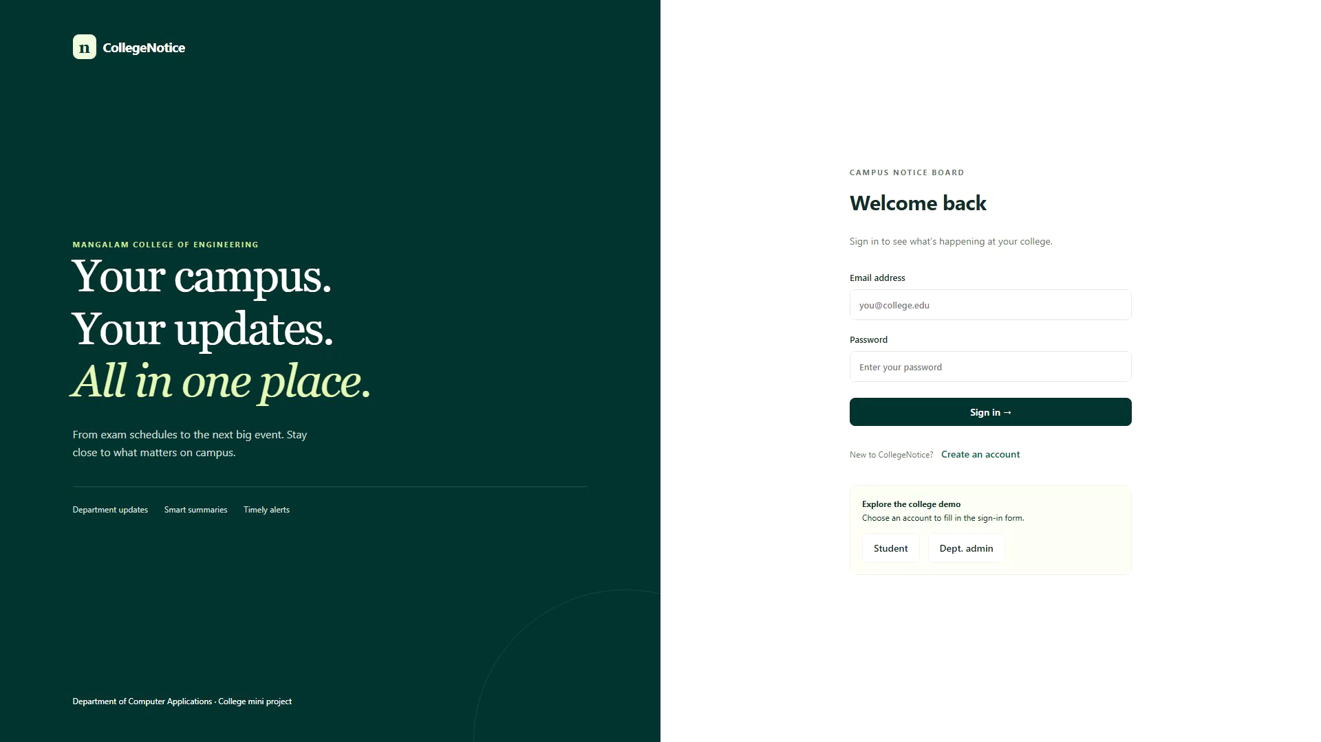
Screenshots / Output: Login
23
Notes:
Screenshot from the actual 13 October 2026 local demo recording. Original application colours retained as requested.

Slide 24
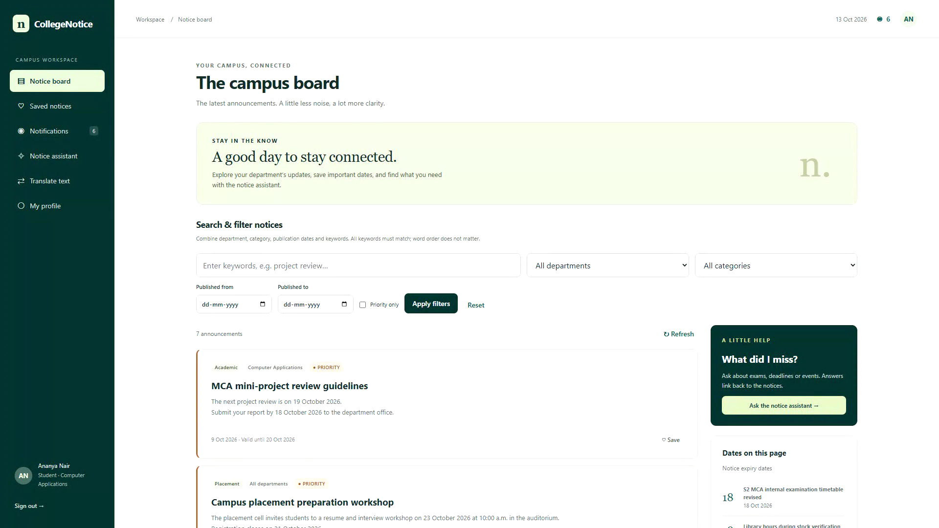
Screenshots / Output: Notice Board
24
Notes:
Screenshot from the actual 13 October 2026 local demo recording. Original application colours retained as requested.

Slide 25
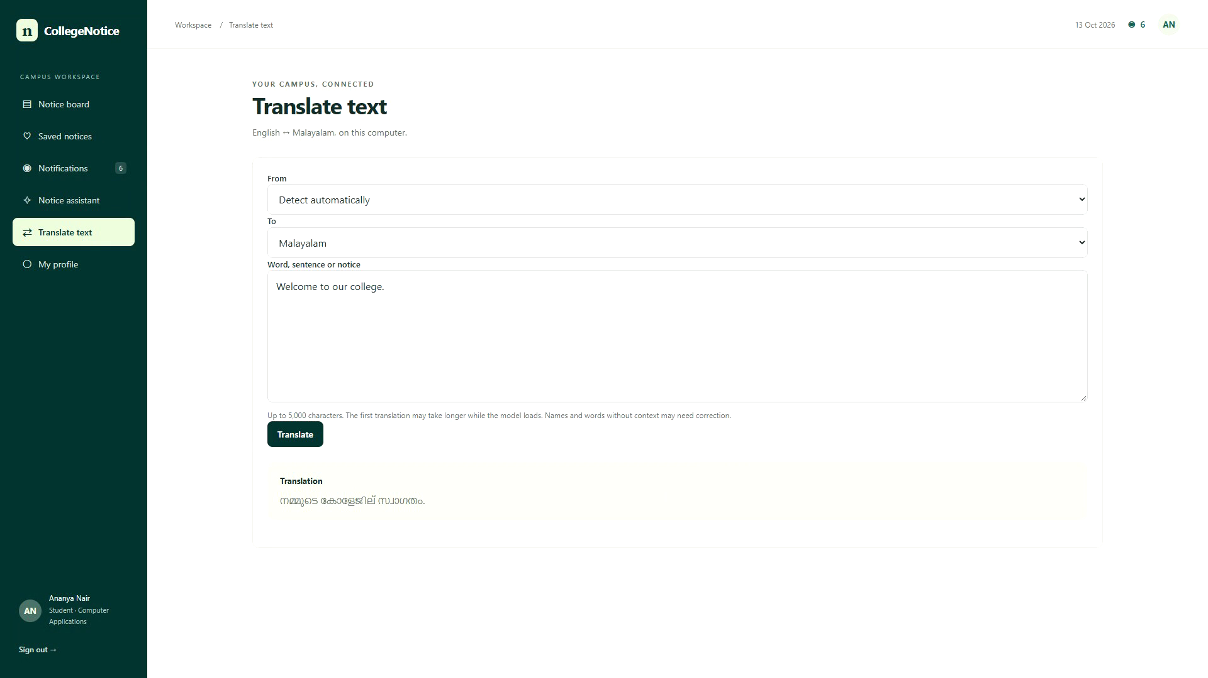
Screenshots / Output: Translation
25
Notes:
Screenshot from the actual 13 October 2026 local demo recording. Original application colours retained as requested.

Slide 26
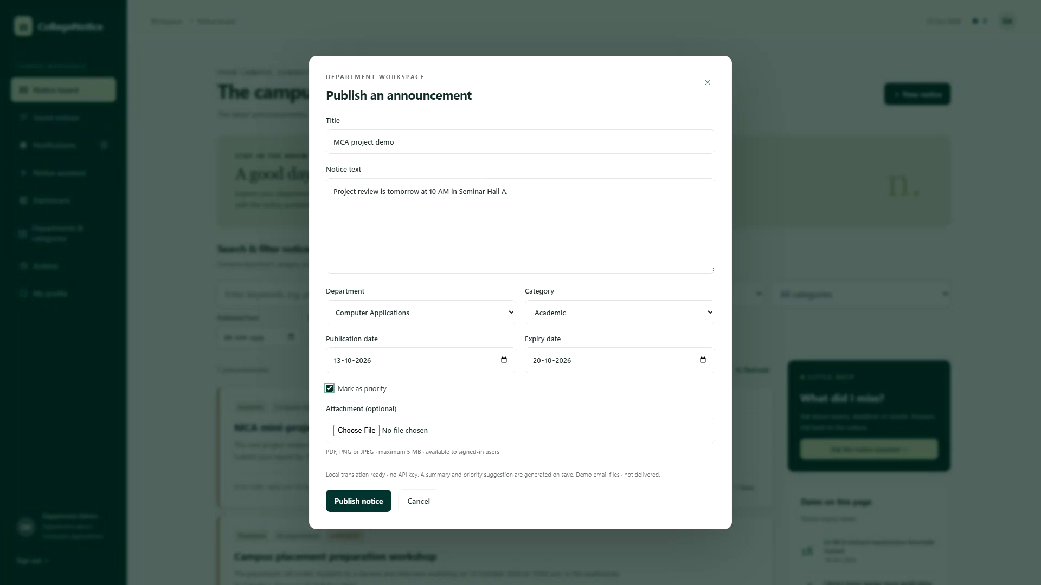
Screenshots / Output: Publication
26
Notes:
Screenshot from the actual 13 October 2026 local demo recording. Original application colours retained as requested.

Slide 27
Comparison with Existing System
Feature | Physical boards / informal groups | CollegeNotice prototype
Processing | Manual distribution and removal | Online publishing, expiry checks and archive
Finding notices | Browse boards or message history | Keyword, department, date and category filters
Access control | Channel-dependent permissions | Server-enforced roles and department write rules
Accessibility | Board location or group membership | Browser access while the server is reachable
Reporting | Separate manual records | Dashboard, activity log and CSV export
27
Notes:
Project evidence: CollegeNotice/README.md, board/models.py, board/views.py, board/ai.py, board/local_translation.py and static/*.js. Local demonstration and Django tests verified on 13 October 2026. Qualitative workflow comparison. No measured claims about accuracy, speed, cost savings or user satisfaction.

Slide 28
Testing
Test case | Expected result | Actual result | Status
Authenticated access | Valid user enters the workspace | Login and workspace verified | Pass
Role permissions | Student cannot publish notices | Automated write-denial checks pass | Pass
Search and bookmarks | Matching notice and saved record | Verified through browser workflow | Pass
Expiry and archive | Inactive notices leave active results | Automated lifecycle checks pass | Pass
Language and sources | Local translation and notice sources | Browser and automated checks pass | Pass
Method: automated unit/API tests and a browser system walkthrough. Formal user acceptance testing is pending.
28
Notes:
Project evidence: CollegeNotice/README.md, board/models.py, board/views.py, board/ai.py, board/local_translation.py and static/*.js. Local demonstration and Django tests verified on 13 October 2026. Django suite: 61 tests passed in 47.465 seconds. Tests cover authentication, permissions, notice lifecycle, validation, bookmarks, notifications, local assistance and service behavior. Browser system walkthrough completed. Formal user acceptance and load testing were not performed.

Slide 29
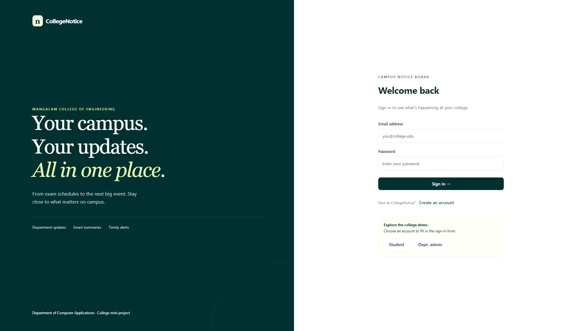
Demo Video
Click the recording to play the 1-minute demonstration
29
Notes:
Actual one-minute CollegeNotice demo recorded at 1920 × 1080, 25 fps. MP4 is embedded in this slide. A separate MP4 remains available alongside the deck as a playback fallback.

Slide 30
Advantages
Students can revisit important announcements through bookmarks and search.
Department controls support accountable publishing and updates.
Expiry filtering reduces clutter from outdated notices.
Local translation supports English and Malayalam without a paid translation API.
Reports and activity records support administrative review.
30
Notes:
Project evidence: CollegeNotice/README.md, board/models.py, board/views.py, board/ai.py, board/local_translation.py and static/*.js. Local demonstration and Django tests verified on 13 October 2026.

Slide 31
Limitations
The current demonstration uses SQLite and immediate task execution.
Docker, PostgreSQL, Redis and distributed workers need integration validation.
Notifications poll every 10 seconds. Real SMTP delivery was not tested in this demo.
Translation and summary quality depend on the text. The original notice remains authoritative.
Public deployment, load testing and formal user acceptance remain pending.
31
Notes:
Project evidence: CollegeNotice/README.md, board/models.py, board/views.py, board/ai.py, board/local_translation.py and static/*.js. Local demonstration and Django tests verified on 13 October 2026.

Slide 32
Conclusion
CollegeNotice provides a working digital notice board for student and admin workflows.
The prototype combines controlled publishing with searchable announcements.
Local summaries, translation and source-linked answers support notice reading.
The demonstration and automated tests establish the current local functionality.
32
Notes:
Project evidence: CollegeNotice/README.md, board/models.py, board/views.py, board/ai.py, board/local_translation.py and static/*.js. Local demonstration and Django tests verified on 13 October 2026.

Slide 33
Future Scope
Deploy the application with HTTPS, backups and monitored infrastructure.
Validate PostgreSQL, Redis and Celery under concurrent use.
Add verified enrollment and a complete password-recovery workflow.
Evaluate translation and summarisation with reviewed college notice datasets.
Conduct accessibility and user acceptance studies with students and faculty.
33
Notes:
Project evidence: CollegeNotice/README.md, board/models.py, board/views.py, board/ai.py, board/local_translation.py and static/*.js. Local demonstration and Django tests verified on 13 October 2026.

Slide 34
References
[1] M. Ninawe, P. Sarangpure, P. Sahare, D. Shende, and M. Yadhav, “Web-Controlled Centralized Digital Notice Board for Smart Institutions,” International Journal of Electrical, Electronics and Computer Systems, vol. 14, no. 1, pp. 91–97, 2025, doi: 10.65521/ijeecs.v14i1.351.
[2] R. Mihalcea and P. Tarau, “TextRank: Bringing Order into Text,” in Proc. EMNLP, Barcelona, Spain, 2004, pp. 404–411. [Online]. Available: https://aclanthology.org/W04-3252/
[3] NLLB Team et al., “No Language Left Behind: Scaling Human-Centered Machine Translation,” arXiv:2207.04672, 2022, doi: 10.48550/arXiv.2207.04672.
34
Notes:
Sources: https://journals.mriindia.com/index.php/ijeecs/article/view/351 ; https://aclanthology.org/W04-3252/ ; https://aclanthology.org/W04-3252.pdf ; https://arxiv.org/abs/2207.04672 . The Ninawe paper is retained from the supplied review PPT. The other six generic citations in the earlier deck could not be verified from the supplied bibliographic details and are not used as evidence. TextRank is related research, not the implemented summary algorithm. Paper benchmark results are not CollegeNotice evaluation scores.

Slide 35
References: Technical Documentation
[4] Django Software Foundation, “Django 5.2 documentation.” Accessed: Oct. 13, 2026. [Online]. Available: https://docs.djangoproject.com/en/5.2/
[5] Django REST framework, “Django REST framework documentation.” Accessed: Oct. 13, 2026. [Online]. Available: https://www.django-rest-framework.org/
[6] OpenNMT, “CTranslate2 documentation.” Accessed: Oct. 13, 2026. [Online]. Available: https://opennmt.net/CTranslate2/
[7] Meta AI, “NLLB-200-distilled-600M model card.” Accessed: Oct. 13, 2026. [Online]. Available: https://huggingface.co/facebook/nllb-200-distilled-600M
35
Notes:
Verified official documentation: https://docs.djangoproject.com/en/5.2/ ; https://www.django-rest-framework.org/ ; https://opennmt.net/CTranslate2/ ; https://huggingface.co/facebook/nllb-200-distilled-600M

Slide 36
THANK YOU
Nithin Mathew
CollegeNotice: Digital Notice Board System
36
Notes:
Project evidence: CollegeNotice/README.md, board/models.py, board/views.py, board/ai.py, board/local_translation.py and static/*.js. Local demonstration and Django tests verified on 13 October 2026.

