Slide 1
The New Inn Country Pub & Dining
To Start … Soup of the day……………………………………………….........£4.25 Served piping hot with rustic bread and butter Butterfly King Prawn…………………………………..……........£4.95 King prawn in a crispy bread crumb, served with a sweet chilli dip sauce Southern Fried Chicken Dippers………………………………£4.25 Served with a sweet & smoky BBQ sauce and salad garnish Garlic Breaded Mushrooms Dippers(v)……………………£4.25 Crispy coated field mushroom slices, served with a garlic mayo dip
Baked Camembert………………………………………………..…£7.95 With rosemary and garlic, served with rustic bread
Pate……………………………………………………………………..…£4.95 With onion jam & rustic bread
Burger Bar… 6oz Gourmet Beef Burger………......…………..£8.00 Succulent beef burger in a brioche bun with lettuce, served with chips, onion rings & burger relish Chicken & Bacon Burger………………………..£8.00 Chicken fillet in a crispy batter, topped with grilled bacon & BBQ sauce, served in a brioche bun on a bed of lettuce with chips and onion rings Spicy Bean Burger.........£7.50 In a crispy crumb, served in a brioche bun on a bed of lettuce with chips, onion rings and mayo
Build Your Burger! Add extra toppings, 75p each: Cheddar Cheese Bacon Jalapenos Mushrooms Double up your burger patty for £2.00!

Slide 2
The New Inn Country Pub & Dining
New Inn Classics… Fish ‘n’ Chips…..…………………………………………..…………...........£8.95 Beer battered fillet of cod served with chips, peas, tartare sauce and a wedge of lemon Hunters Chicken…………………………………….…………………………£8.45 Succulent chicken breast topped with bacon & melting cheddar cheese then smothered in a warm BBQ sauce, served with chips and salad garnish Chicken Curry & Rice………………………………………….…………….£7.95 Curry of the day, on a bed of rice, served with naan bread and mango chutney. Please check out board for the curry of the day or ask a member of staff
Classic Mac & Cheese(v)……………………..…….........................£6.95 Served with garlic bread and side salad garnish Steak & Ale Pie………………………………………………….……………..£8.95 Slow cooked pieces of steak in a rich ale gravy, encased in a delicious pastry, served with a choice of chips or creamy mashed potato, onion gravy and peas Scampi & Chips………………………………………………………………..£8.95 Pieces of scampi in a crispy fried crumb, served with chips & peas BBQ Pork Ribs………………………………………………………………....£9.50 Succulent pork ribs in a delicious smoky BBQ marinade, served with sweetcorn, coleslaw & chips Super Food Salad (V)………………………………………………………..£9.50 A generous bowl of delicious super quinoa, broccoli, avocado & new potatoes Beef Lasagne……………………………………………………………………£7.95 Layers of bolognese & béchamel sauce, topped with melted cheese, served with fresh salad & garlic bread Chicken Caesar Salad..……………………………………………..………£7.95 Lettuce topped with anchovies, croutons and parmesan cheese, served with a Caesar dressing

Slide 3
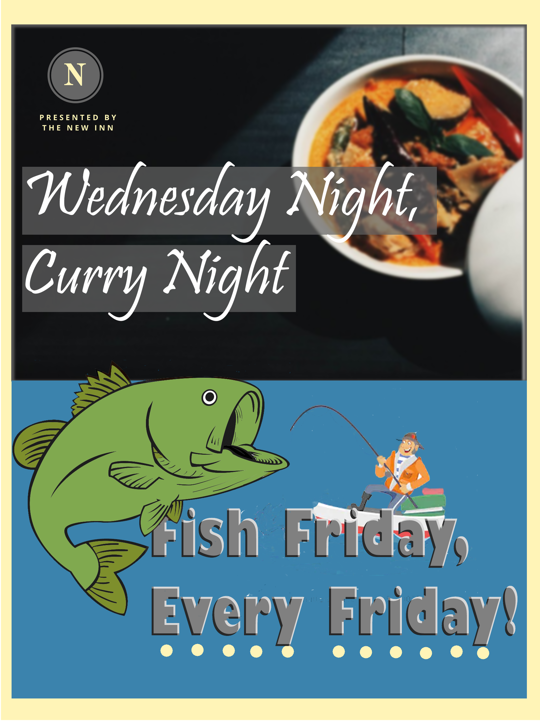
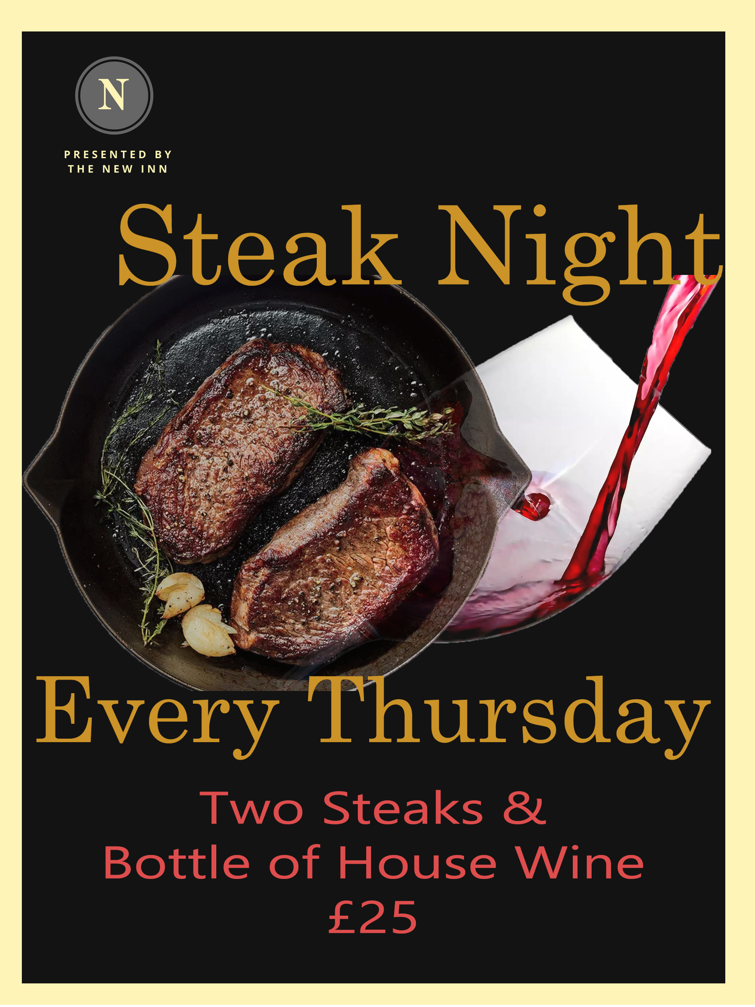
The New Inn Country Pub & Dining
Hot Off The Grill… 8oz Sirloin Steak…………..………………………………..........£14.95 8oz Rump Steak……………………………………………..........£12.95 Cooked to your liking, served with chips, mushrooms, onion rings and peas Mixed Grill………………………………................................£16.00 Chicken fillet, rump steak, local butcher sausage, gammon and fried egg, served with chips, mushrooms and grilled tomato 12oz Gammon Steak………………………………..……..........£9.95 Grilled gammon steak, topped with a fried egg or pineapple ring, served with chips, grilled tomato and peas
Just Desserts For a mouth watering dessert, see our board inside for our extremely tasty delicacies, the perfect way to end any meal.

Slide 4



The New Inn Country Pub & Dining
Lighter Bites…
Baguettes… Freshly made to order and served with a few crisps & salad garnish Steak & Onion…………………….£6.50 Fish Fingers, Mixed Leaves & Tartare Sauce……………….…….£4.75 Farmhouse Cheddar with Onion or Chutney(v)……………….…….£4.75 Tuna Mayonnaise………….…...£4.95
Jacket Potatoes… Hot & fluffy jacket potatoes served with a fresh salad garnish and your choice of filling from: Cheddar Cheese(v)…………….£4.50 Baked Beans(v)…………………..£4.50 Tuna Mayonnaise……………….£4.95 Chicken Curry……………..........£6.95 Add Extra Cheese for 75p!
Hot Drinks
Try one of our delicious full bean coffees, hot chocolate or tea
Espresso………………………£2.25
Americano………………….£2.25
Cappuccino or Latte……£2.60
Hot Chocolate…………….£2.60
English Tea………………….£2.25
Speciality Tea……………..£2.25
Kids Corner
£4.95 Each
All served with a choice of chips or mashed potatoes and baked beans or peas
Sausages Fish Fingers Chicken Nuggets
Kids Beef Burger
Cheese & Tomato Pizza (v)

