Slide 1

Chapter 5: Methods
Mathews
Walker
Johnny

Slide 2
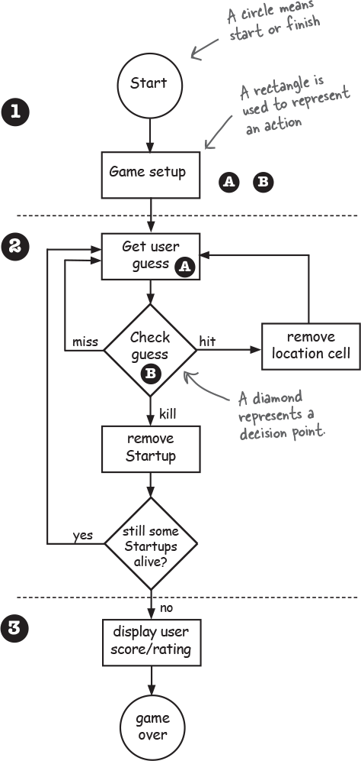
FLOW CHART
What is the first step in the process of planning? A setting an objective for plan
As you see, in order for a class or method to be created, you will have to come up with a plan
Represented by the flow.
First, we come to the circle
Rectangle signification output (A prompt for movement or B which is a hit)
Once successful, move on to your next action
Miss, Hit, or Kill
You will have to continue the loop until your opponent has been taken out

Slide 3
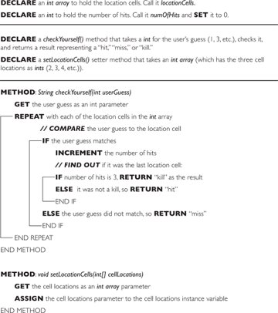
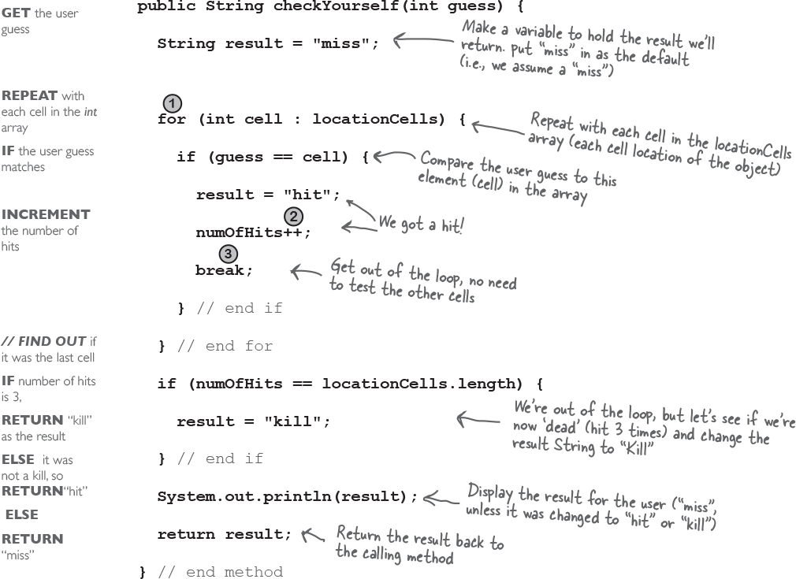
Layout of Program
PSUEDO

Slide 4
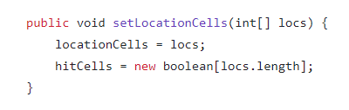
setLocationCells() method
The purpose of this method is to set the cell locations for the ships using an array as in input.
This method also tracks the cells that were hit using the Boolean array hitCells[].

Slide 5
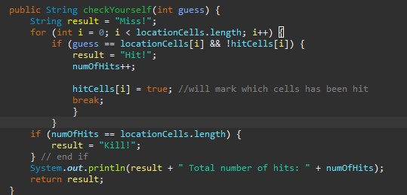
checkYourself() method
The purpose of the second method was to figure out how many hits were made, mark the cells that were hit, and the location of the cells.
To mark which cells were hit in the checkYourself(), we added the line hitCells[i] = true and a break so it would stop the if statement and mark the location as unhittable, and each time the if statement was fulfilled the number of hits was increased by one.

Slide 6
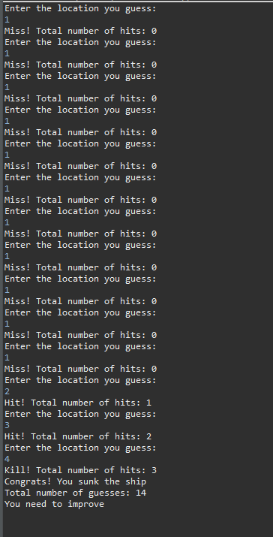
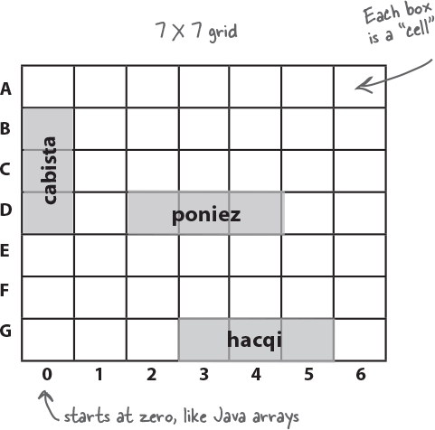
Final Result
When you guess the locations, the program will tell you if you hit the target or miss and will show how many hits you have so far. When all three locations are correctly guessed the program will tell you how many guesses it took you to get it correct and give you a rating based on that

