Slide 1
Claim My Bag
Claim My Bag
Group 11: Shalmi Patel, Diya Mathews, Mevin Mathew, Kshitij Mehta, Scott Williams

Slide 2
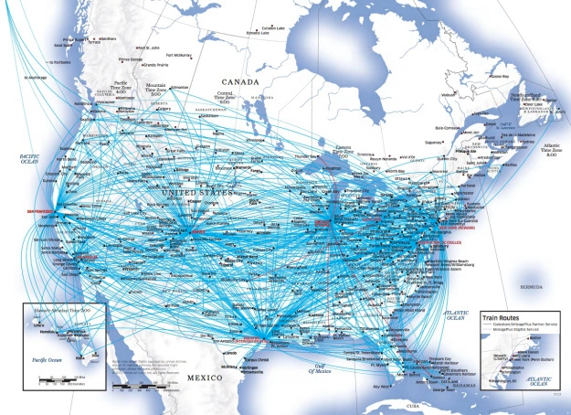
Project Objective, Motivation and Scope
Objectives: Create an application that can narrow down the location of a specific piece of luggage by claim number, and feed data involving incidents at airports to a graph to find safest route (providing real-time use).
Motivation: Millions of cases of mishandling of luggage every year, so we have to find the safest route no matter what it is.
Claim My Bag

Slide 3
Project Objective, Scope, Motivation
Scope: This project will consist of creating a user interface that will allow the user to locate their lost luggage. The project will use data of lost luggage provided from TSA’s open dataset. An extension to the project that would be achieved is a service that will allow the user to input their origin and destination, and receive the best route to take based on lost baggage statistics as well as recorded routes.
Claim My Bag

Slide 4
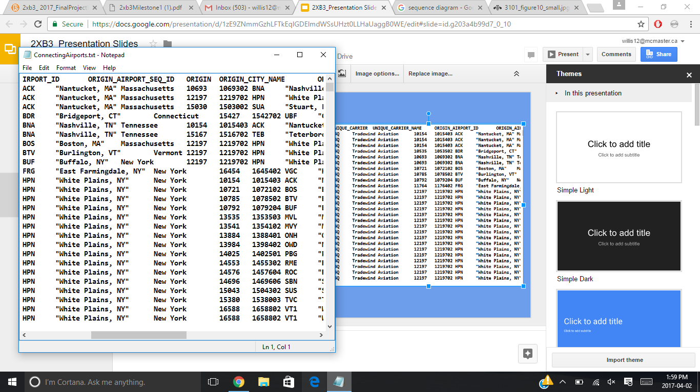
Open Data Sets
Open Data Set provided by the TSA involving lost luggage cases across United States airports.
Data set consisting of routes across the United States by airport code and city names for multiple airline companies.
Claim My Bag

Slide 5
Functional and Non-Functional Requirements
Functional:
Have a designated search by given claim number.
Receive input from user by airport codes and month to feed information to two different graphs.
Provide results pertaining to the task that is associated with the program in both results.
Non-Functional Requirements:
Three key ones:
Performance
Accuracy
Reliability
Claim My Bag

Slide 6
Design Specifications
Major Inputs:
Luggage Search: Claim Number
Safe Path Calculation: Starting/Ending Airport Code, Month
Major Outputs:
Luggage Search: Result of Finding or Not: Info Provided If Found
Safe Path Calculation: Route from Location to Location in Airport Codes and by City Name, State
Algorithmic Challenges:
Ensuring quick searching for luggage finding
Reading files three times to feed data from one graph to another for determining Dijkstra path.
Claim My Bag

Slide 7
Verification and Validation
Incremental Testing performed during implementation
Tested addition of unique airport codes and vertices inside LinkedHashMap through iteration and checking for no duplicate entries.
Checked starting entries of route dataset to verify that the first element of Hash Map is the very first airport code. Then, check for no duplicates within the first 20 routes (as duplicate airport codes are present).
Claim My Bag

Slide 8
Demonstration Time!!!
Claim My Bag

Slide 9
References
United Airlines to drop San Francisco-Toronto service on April 1. [Web]. Available:
https://worldairlinenews.com/2013/01/22/united-airlines-to-drop-san-francisco-toronto-service-on-april-1/
Claim My Bag

