Slide 1

The DSO's monster. Every house keeps it on a leash.
GRIDZILLA
A signed, bounded grid signal for home batteries, cars and heat pumps,
with DeepSeek running the grid and a real plant in Blatnica following it live.
Mathew Stafurik · Peter Mikeška · Matthew · Grid-Serving Storage track · github.com/mathewstars/Gridzilla · gridzilla.victronlab.sk
Notes:
0:00-0:45. Click the speaker icon top right the moment the slide is up: 30 seconds of trailer, say nothing, let it land. Then One sentence: a DSO signal that home batteries, cars and heat pumps follow, signed, bounded, with the owner always in control. Say what is real: a Victron plant and a Viessmann heat pump in Blatnica are on the board right now.

Slide 2
Europe's largest battery fleet is in people's basements. The grid cannot use one of them
0
4.2 kW
3 GWh
DSO-level signals to home storage in Slovakia. The only flexibility pilot served the TSO, not the street transformer
The best case, Germany's §14a: a dimmer for new devices, charging only, used in under 1 % of hours
Home batteries installed in Ukraine in 2025 alone. People charge by hand before the published outage queue
What breaks
Evening peaks: heat pumps and EV chargers push street transformers past rating; the DSO's only tools are curtailment or copper
PV noon: everyone exports at once, the feeder voltage rises, new connections get refused or capped for the whole year
Crisis: when a transformer is hit or the country is short, everyone is cut equally, including the houses that could have ridden through
Notes:
0:45-1:45. Three numbers, then the three failure modes. The point: the storage exists, the signal does not.

Slide 3
One signed, bounded signal from the DSO to every house, on whatever path the vendor likes
DSO
GRIDZILLA
BROKER
HOUSE AGENT
BATTERY · EV · HEAT
sees a transformer or feeder heading past rating
policy guard, Ed25519 signature, one topic per grid segment
MQTT over TLS, delivery only, no authority
verifies, merges with the owner's limits, applies, acks
a limit at the meter, never a setpoint
The signal names a limit at the grid connection point: import ceiling, export ceiling, export floor, target SoC. It never names a device or a register
The owner's limits always win: minimum SoC, max current, opt-out. The house may answer partial or refused
Four-hour maximum, enforced on the platform and again on the device; revert on window end or 120 s without heartbeat
Pay on the meter: limits are a yes or no per 15-minute interval on the DSO's own smart meter, so there is nothing to game
Notes:
1:45-2:30. Walk the chain left to right. Stress: limits not setpoints, owner wins, device enforces time bounds itself, settlement on the meter.

Slide 4
Six signals, one grammar: limits for a window
PREPARE
ABSORB
SUPPORT
Fill the battery, the car and the tank to a target by a deadline, in the quiet hours
PV surplus: cap export, charge, soak it into the car and the hot water, curtail last
Peak or deficit: "take 3 kW only", and if the street needs more, "give at least 2 kW"
STRETCH · vision
RECOVER
RELEASE
Street is dark: grid-forming inverters island the street, batteries are rationed until restoration, export locked to zero. Today's home inverters cannot form a grid; the signal is ready for the ones that will
After restoration: staggered recharge so the street does not refill at once
Event over. Owner mode, immediately
Envelopes: a SUPPORT or ABSORB carries one ceiling per 15-minute slot, the meter's settlement interval. Cohorts let one signal address half a street, so the other half exports while the first charges.
Notes:
2:30-3:00. Do not read all six. Point at SUPPORT and ABSORB, the everyday ones, PREPARE and RECOVER, the crisis ones, and name STRETCH as the vision: a street that keeps its lights on from its own basements needs grid-forming inverters, which are arriving. The protocol already has the signal for them.

Slide 5
The household is the unit: everything behind one meter, one agent, eight functions
Battery
The agent, any language, forty lines
the lever of last resort: discharge to cover the house or feed the street, within the owner floor
Pin the platform key at registration
Subscribe to the segment topics, outbound only
Verify signature, sequence, freshness, scope
Merge with owner limits: floor, caps, opt-out
Apply: the only vendor-specific step
Ack, signed with the device key
Watch the heartbeat and the window
Revert to owner mode
EV charger
the first lever: throttled 16 to 6 A under a cap, soaks surplus, paused when the street is dark
Heat pump
second lever: tank to 55 °C under surplus, floor at 40 °C under a cap, 3 kW shed per house
Boiler
same rules at 65 and 45 °C; an electric boiler is a kilowatt-hour sponge
Blatnica, the real one: Victron Cerbo GX with MultiPlus-II and a 15 kWh battery, an 11 kW Victron EV station, and a Viessmann Vitocal heat pump via ViCare. One house on the board.
Notes:
3:00-3:30. The vendor only owns step five. Everything else is identical on the Victron, on the ViCare cloud agent and on the 270 simulated houses.

Slide 6
DeepSeek runs the grid every 15 minutes. The guard is the brake
SENSE
DEEPSEEK DECIDES
GUARD
SIGN + PUBLISH
72 transformers, 90-minute forecast, trigger at ±85 % of rating
DeepSeek-V4.1-Flash on the DGX Spark proposes mode, segment, cap, window and a dynamic envelope, in ~3 s
deterministic policy: window, depth, rate, reverse rating, cooldowns. Not AI. Refuses or passes
Ed25519, one topic per segment, over TLS. Houses merge with owner limits and ack
Three modes: autonomous, operator approves, off. In autonomous mode nothing waits for a human; the guard and the device-side bounds are the safety
Scope is physics: a street transformer is relieved only by its own houses; a feeder or substation by every house under it; a village can feed its neighbours through the 22 kV line
Every decision is logged with its reasoning, latency, verdict and the acks it earned. That log is the audit trail
Notes:
3:30-4:15. AI proposes, guard disposes. Say it twice. Then: why the guard is not AI.

Slide 7
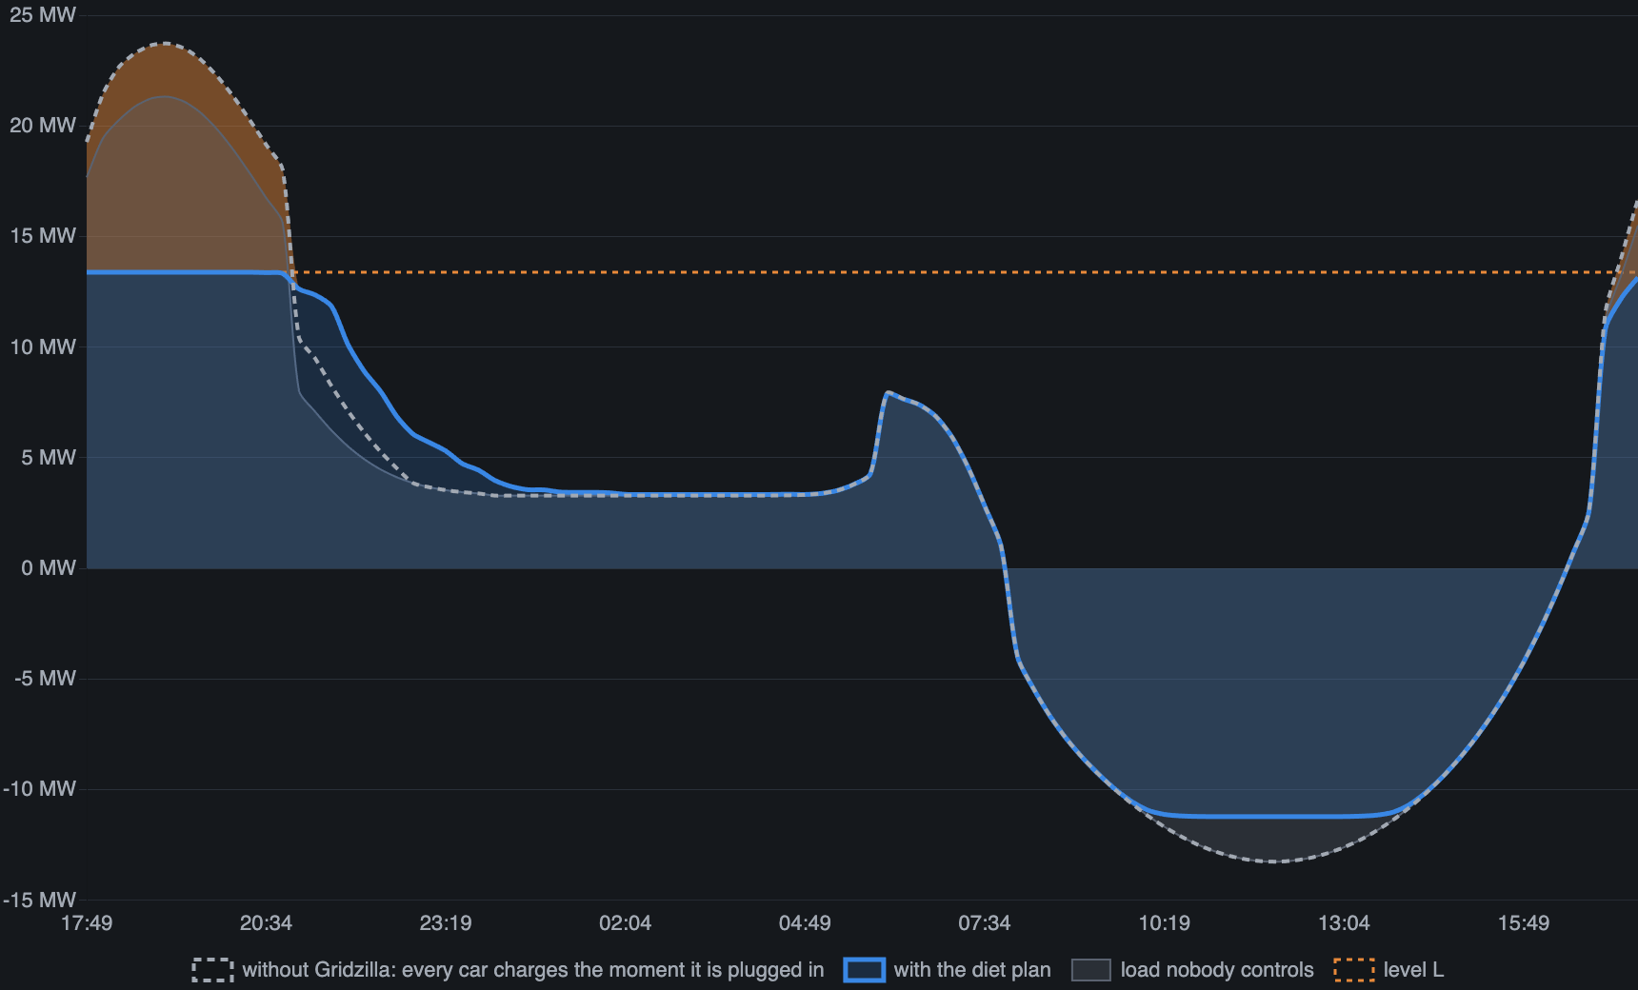
The monster is on a diet: water-filling flattens every street
79 → 45 %
the planner's forecast for tonight, of transformer rating: 23.7 MW becomes 13.4 MW. Measured result on the next slide
10.5 MWh
of car charging moved from dinner into the night valley; every car full by 07:00
L
the lowest level where the cars fit below it and the peak above it fits in the batteries. Two ceilings per 15 min, per house, signed, renewed every 2 h
Notes:
4:15-5:15. Monster talk: Gridzilla eats peaks, but it is on a diet: it eats exactly the slice above L and not a watt more. A car plugged in at 18:00 trickles through dinner and gulps at 02:00. A battery swallows the peak and burps it back into the house. At noon it drinks the PV surplus. Nobody notices; the transformer sleeps at 70 instead of 110 percent. Then the algorithm in one breath: forecast what nobody controls, count the flexible energy, water-fill, send the ceilings. DeepSeek sits on top for what the plan cannot see: a cold snap, an outage, backflow.

Slide 8
What is real, what is modelled, and what the numbers mean
REAL TODAY
MODELLED
The control path: signed signal in, a Victron plant and a Viessmann heat pump move, verified acks come back
The flattening algorithm and the guard, running on the fleet every two grid hours
Measured on streets with cars: 18-31 % off the evening peak, inside what published smart-charging and home-battery pilots report (3-6 kW per EV house, 1-2 kW per battery at the peak)
The fleet: 271 simulated households, each standing for 8 real ones: 2,184 program houses with 10-25 kWh batteries, 1,190 with an 11 kW charger needing 6-26 kWh a night
The "without" curve is the same houses with no signal: a car charges on 55 % of nights, arrivals spread over three hours, full power until full. No inflated coincidence
Program houses carry ~30 % of a street's evening load here: a 2030 picture, not a street today
−176 kW
−5.2 MW
0 kW
1
one street, Speising-22: 574 → 398 kW at the evening peak, 31 %, measured tonight
Vienna with 2,184 enrolled houses: 26.6 → 21.7 MW at the evening peak, 19 %, measured tonight
on a street where no car charged tonight: the gap is the cars and the batteries, nothing else
real house in the fleet tonight. The fleet is the part we are asking you to build
Notes:
5:15-6:00. Say it before the jury asks: the signal path and the algorithm are real, the fleet is simulated, and the counterfactual is honest: same cars, same batteries, realistic charging coincidence. The street numbers sit inside published pilots; the city number is that times 2,184 enrolled houses.

Slide 9
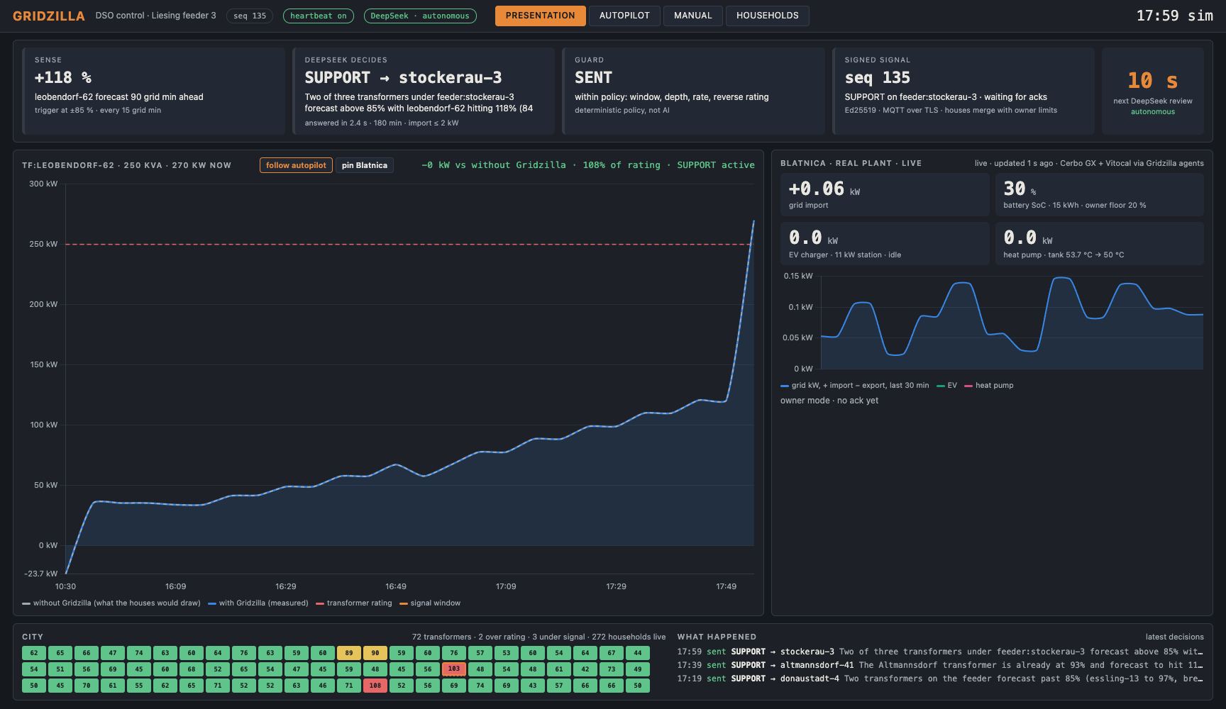
Live, three windows: this deck, the Gridzilla board, VRM
Four minutes, alt-tab
Board: city view, 72 transformers, 272 households live, one of them real
Board: one DeepSeek review, sense, decide, guard, signed signal, countdown
Board: the curve, with vs without, on the transformer it chose
Board, Flattening tab: the 24 h diet plan for Vienna, then one street; cars moved into the valley, batteries eat the peak
Board, pin Blatnica: send SUPPORT from the Manual tab; tiles move within seconds
VRM: the same plant from Victron's side, grid setpoint and battery power reacting
Board: pause the heartbeat, every house reverts to owner mode
Notes:
6:00-9:15. Alt-tab: deck, Gridzilla board, VRM. Pin Blatnica before the SUPPORT step so the curve stays on our transformer. VRM is the independent witness: Victron's own portal showing the setpoint change. If the venue network dies, show the recorded video.

Slide 10
Everything on that screen runs on real infrastructure today
272
72
2
~3 s
households on the board, 8,070 houses represented
street transformers, 24 feeders, 8 substations with Wiener Netze names
real devices: a Victron plant and a Viessmann heat pump, 60 km from here
DeepSeek decision latency on the DGX Spark
Real plant
Heat pump
Cerbo GX on Venus OS Large, a 53-node Node-RED agent we deploy over the admin API; EV Charging Station throttled first; ESS limits written and restored
Vitocal CU401B through the ViCare REST API with a refresh token; hot-water setpoint and one-time charge, verified on the unit
Transport
Platform
Mosquitto on our own server, Let's Encrypt, TLS only, credentials and topic access lists; devices open outbound connections only
FastAPI on a Ubuntu box behind Apache and Let's Encrypt; registry tree, guard, signing, history, autopilot; public board at gridzilla.victronlab.sk
Simulation
Protocol
262 households with battery, PV, EV commutes, heat pumps and boilers with real tank physics; each agent speaks the same protocol as the Cerbo
Frozen as PROTOCOL.md with JSON Schemas for envelope, signal and ack; any vendor can implement the eight functions from it
Notes:
9:15-9:45. The point of this slide is credibility: nothing is a mock-up. Name the two real devices and the public broker.

Slide 11
Any vendor, four lines each. Any household, paid on the meter
Three paths to the same agent
Why a DSO pays and a household joins
Vendor cloud: GoodWe SEMS, Huawei FusionSolar, SolarEdge, Tesla Fleet, SMA, Fronius. Export limit, discharge to cover load, forced discharge schedule, grid charge schedule
Local controller: Home Assistant, EVCC, OpenEMS, SunSpec Modbus. What the demo runs on Node-RED today
Standards gateway: EEBus LPC and LPP are literally our import and export caps; OpenADR 3, IEC 61850, OCPP 2.0.1 for chargers
GoodWe is one apply function away: the registers and the hardware are on the team
Limits are verifiable, reductions are not: the DSO's own smart meter answers yes or no per 15-minute interval. No baseline to inflate
No ack, no pay; compliance gates the perks; the DSO's existing disconnect is the backstop in a crisis
The hook: a dynamic export limit beats today's static cap on all but a few afternoons, and gets a refused connection approved
Plus an availability fee, per-kWh payment for forced feed-in, a full battery before an outage, and a shorter shedding queue
Noon export is worthless when everyone exports; the same kilowatt-hours leave at six, paid
Notes:
9:45-10:30. Left: vendor independence is proven by the simulators, which run no Victron code. Right: the economics in two sentences, pay on the meter and the dynamic connection.

Slide 12
Production at a DSO: the effort, the cost, the saving
EFFORT
COST TO RUN
SAVING
Protocol and agents are the small part; they exist
The DSO must add: enrolment bound to the meter point and operator login, a PKI with key rotation, settlement on meter data, the real network model feeding the tree and ratings, 24/7 operations, NIS2 and energy-law compliance
10-house pilot on one transformer: 3 months
A district of a few thousand homes: 12-18 months, 6-8 people, roughly 1.5-3 M€ including the security audit
The platform is cheap: two servers and a broker
The real cost is the incentive: a flat 100-200 € per enrolled house per year, plus energy at crisis prices during STRETCH and SUPPORT
Paid only to houses whose meter proves they followed the signal. No enforcement, no payment, no saving
Street transformer upgrade 50-150 k€, feeder reinforcement hundreds of k€, a substation tens of M€
Every street held at ~70 % at the evening peak defers the reinforcement the EV and heat-pump wave otherwise forces this decade
Vienna scale: hundreds of M€ of capex deferred against a few M€ a year of incentives
Plus a tool for the outage: PREPARE before it, RECOVER after it, and with grid-forming inverters STRETCH keeps a dark street alive from its own batteries
Notes:
10:30-11:15. Our numbers, not a quote. The point is the shape: small platform, incentive is the real opex, capex deferral is the saving, and enforcement on the meter is what makes the saving real.

Slide 13
A pilot street, a second vendor, a DSO that wants the signal
NEXT
Enrolment bound to the meter point and operator login, two weeks. GoodWe agent on our own plant, one week.
A ten-house pilot with a Slovak or Austrian DSO on one real transformer, this winter.
The vision: streets that island on grid-forming inverters when the 22 kV line is gone, rationed by the same signal.
github.com/mathewstars/Gridzilla · gridzilla.victronlab.sk · protocol, platform, agents and this deck are in the repo
Notes:
11:15-12:00. The ask is a transformer to pilot on. Stop talking, take questions.

Slide 14
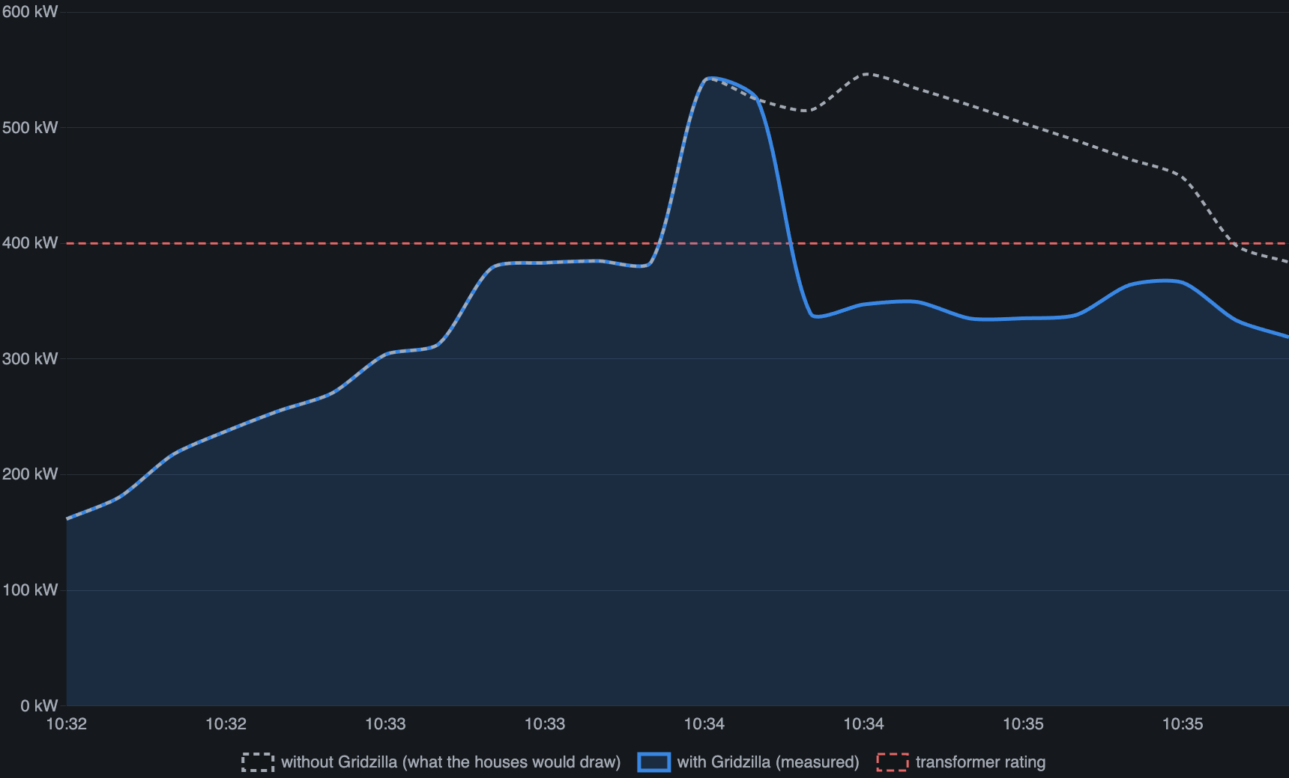
What the flattening looks like: speising-22, 400 kVA, from an earlier run
−199 kW
largest cut below the counterfactual on this transformer
2 kW
import cap per house DeepSeek chose; EVs throttled first, batteries second
0
owner floors crossed; partial acks where a battery hit its reserve
Notes:
Appendix, for questions. Grey is what the same houses would have drawn, blue is what they drew, red is the transformer. The gap is the product. Real numbers from the running system, 8 houses per simulated household.

Slide 15
Security of the control plane: the DSO can ask, it can never command
Authenticity
Replay
every signal, heartbeat and ack carries an Ed25519 signature; the device pins the platform key and signs with its own
monotonic sequence numbers persisted on the device, 120 s freshness, heartbeats with sequence and timestamp
Bounded
Owner veto
limits, never setpoints; four-hour window enforced on the device itself; depth and rate capped by the guard
minimum SoC, max current, opt-out merged on the device; a compromised DSO key moves nothing past them
Fail-safe
Transport
window end, heartbeat loss or RELEASE restore the owner's settings; a dead platform leaves every house in owner mode
TLS with a real certificate, per-role credentials, topic ACLs; a device cannot publish a signal even if it tried
Named before you ask
Enrolment is open, any device id can register a key; production binds it to the meter point with a one-time code. The operator board has no login for the demo; production is SSO plus a two-person rule for feeder-level signals. Neither changes the protocol.
Notes:
Appendix, for questions: the security slide. Six controls, then the two gaps yourself. A juror who finds a gap you named is on your side.

