Slide 1
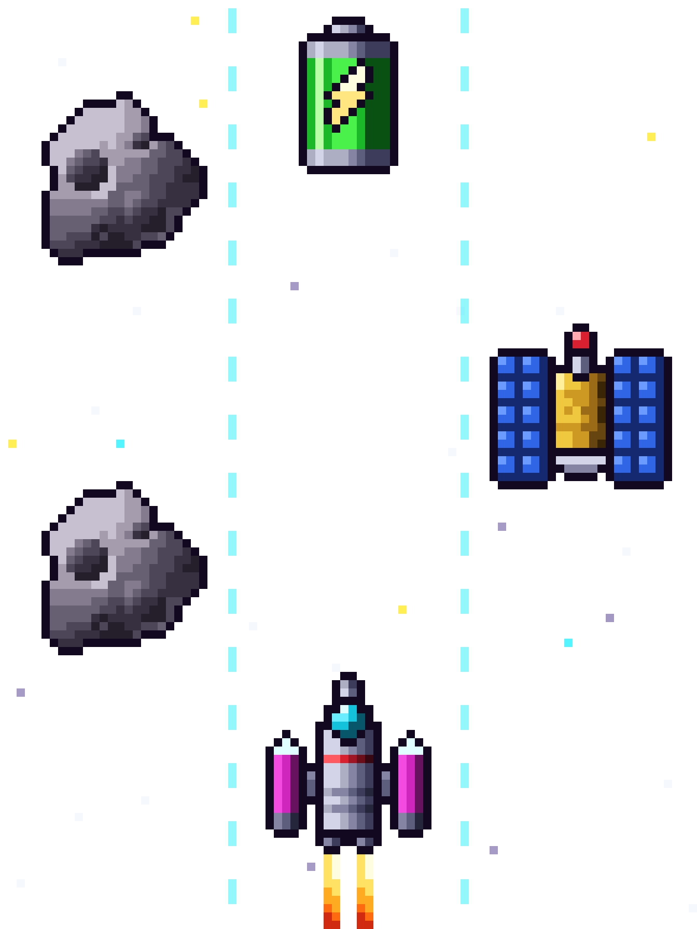
M-Space
PRESENTATION AND LIVE DEMO
An arcade game flown with a physical Arduino controller.
Arduino · MQTT · .NET · SignalR · Canvas
Notes:
Introduce the project in one sentence: a space arcade game in the browser, steered with touch pads on an Arduino board that also reacts to what happens in the game with LEDs, sound and a screen. The next three slides cover the architecture and the events we exchange; then we switch to the live demo.

Slide 2


How the pieces talk
ARCHITECTURE
Arduino
Mosquitto
Backend
Frontend
MKR WiFi 1010 with touch pads, LEDs, buzzer and screen
MQTT broker running in Docker
.NET service bridging MQTT and SignalR
Canvas game in the browser, served by nginx
MQTT
MQTT
SignalR
Redis · high scores via REST
Docker Compose · one command to start
Every link is two-way: player input flows right, game events flow left.
M-Space
2 / 5
Notes:
Walk the chain left to right. The Arduino only sends input and shows feedback; the game itself runs in the browser. Mosquitto is the MQTT broker. The backend is the bridge: it reads MQTT from the board and pushes it to the browser over SignalR, and sends game events back the other way. Redis stores the high scores, and everything starts with docker compose.

Slide 3
What the controller tells us
EVENTS · ARDUINO TO BACKEND
Topic | Event | Meaning
mspace/<all>/input | MOVE_LEFT | Pad 00: ship one lane left
mspace/<all>/input | MOVE_RIGHT | Pad 04: ship one lane right
mspace/<all>/input | START_GAME | Pad 02: start a new game
mspace/<all>/status | {"online":true} | Board connected (retained)
mspace/<all>/status | {"online":false} | Last Will: the broker sends it when the board vanishes
{"event":"MOVE_LEFT","timestamp":"2026-11-02T10:07:00Z"}
M-Space
3 / 5
Notes:
These are the messages the board publishes. Each touch pad sends one JSON message with an event name and a UTC timestamp. The deviceId is the board's MAC address, printed at boot. The status topic is retained and carries a Last Will, so the broker itself tells us when the board disappears.

Slide 4
How the board reacts
EVENTS · GAME TO ARDUINO
mspace/<all>/event
mspace/all/event
Event | Data | The board reacts with
GAME_START | none | Green LEDs, short beep, “GO!”
GAME_OVER | none | Long red LEDs, low beep, “GAME OVER”
OBSTACLE_HIT | shields: N | Red LEDs, low beep, shields updated
ENERGY_CELL_HIT | shields: N | Green LEDs, high beep, one more shield
BORDER_HIT | none | Short orange LEDs, short beep
BOOST_ACTIVATED | none | Blue LEDs and “BOOST” until it ends
BOOST_DEACTIVATED | none | LEDs go back to off
M-Space
4 / 5
Notes:
The backend publishes these events to the board's own topic. A shared topic, mspace/all/event, reaches every board at once. OBSTACLE_HIT and ENERGY_CELL_HIT must carry the number of shields left. Unknown events and broken JSON are ignored by the board.

Slide 5
If the board vanishes, the game stops
BROWSER LINK AND HEALTH CHECK
SignalR hub /game-hub
Health check
ReceiveArduinoEvent: backend to browser, carries MOVE_LEFT, MOVE_RIGHT, START_GAME and CONNECTION_LOST
SendArduinoCommand: browser to backend, then out over MQTT to the board
The board keeps a 3 second MQTT keep-alive
When it goes silent, the broker publishes the Last Will {"online":false}
The backend raises CONNECTION_LOST and the game stops
Live demo
Start with pad 02, steer with pads 00 and 04, watch the board react, then unplug it.
M-Space
5 / 5
Notes:
The browser talks to the backend over one SignalR hub: it receives the board's events and sends game events back. For the health check we rely on MQTT itself: the board sets a short keep-alive and a Last Will, so a lost board is noticed in a few seconds and the game stops. Then switch to the live demo: start a game with pad 02, steer with pads 00 and 04, show the LEDs on a hit, and finish by unplugging the board.

