Slide 1

Estimating Uber Prices
Predicting where I need to be as an uber Driver
Mathew Thomas
02/26/2017

Slide 2
Introduction
Uber is a worldwide transportation network company which allows users to request a ride using their smart phone
By end of 2015 Uber had 327000 active drivers on the road in the US more than doubling the 160,000 that gave rides in 2014.
A large portion of the drivers in Uber drive the cab as a part time job to earn a little extra cash.
Beneficial to drivers to find out which areas have a higher demand in the near term future to maximize their profits

Slide 3
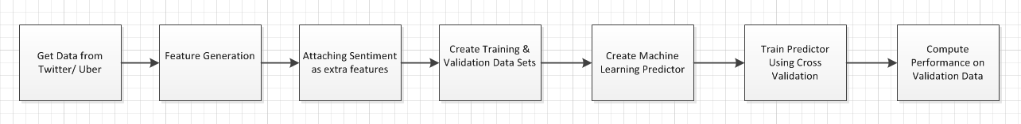
Proposed Solution
Find out important factors affecting surge pricing
Use social media content like twitter which is huge repository of current information of peoples thoughts, moods etc
Create a predictive model based on these factors to estimate the price of a cab for a given latitude-longitude coordinate

Slide 4
Data Sources
Twitter Data Stream
Python library tweepy used to stream data for a specific geographical area.
Only tweets which had geolocation enabled were filtered
Total of 11178 tweets for the period 2/14/2017 to 2/21/2017
Geo coordinates specified were [-73.984098,40.578532,-73.859795,40.9271] which is bounding coordinates of New York City
Data Column | Description
tweet_id | Unique Twitter ID
tweet_text | Tweet Text
lat_origin | Latitude Coordinates
long_origin | Longitude Coordinates
Tweet_Time | Time of tweet
user_id | Unique Id of User

Slide 5
2. Uber API
get_price_estimate method used – Input parameters are latitude and longitude coordinates of starting and destination points.
To compute the coordinates of the destination an algorithm was used to calculate an offset of in metres from original coordinates
 | Description
Uber_product | Type of Uber Product
High Estimate | High Estimate of Price
Low Estimate | Low Estimate of Price
Surge Multiplier | Surge Multiplier
Request_Time | Time of Request

Slide 6
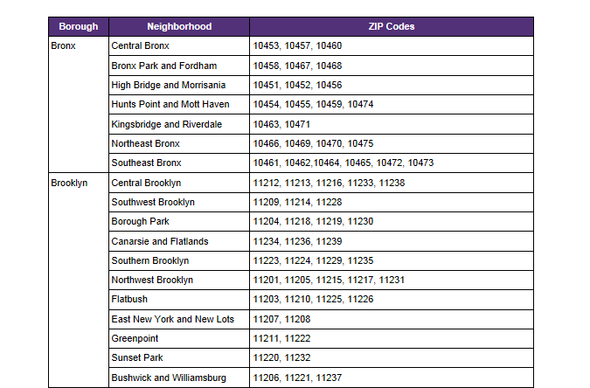
3. Additional Data Sources
Google’s revese_geocode API method used to convert latitude longitude to postal code
Postal codes mapped to neighborhoods to create a broader data element for our model.
Total of 36 neighborhoods in New York City and each neighborhood assigned a code

Slide 7
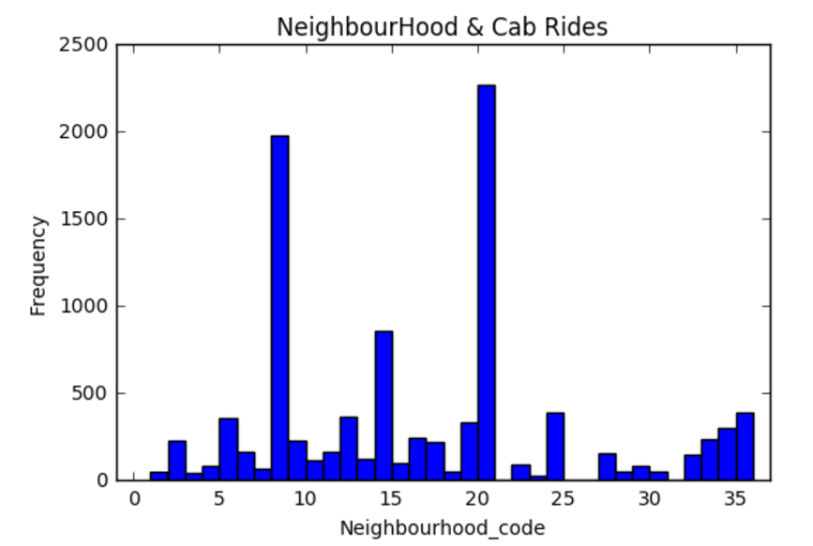
Exploratory Analysis
Neighborhood
Location of an area has significant impact on the demand for a cab
Certain neighborhoods which busier and will have a higher proportion of people tweeting which can indicate that there are more users requesting a cab in that location.
Neighborhood 20 and 9 have significantly higher number of tweets compared to other neighborhoods

Slide 8
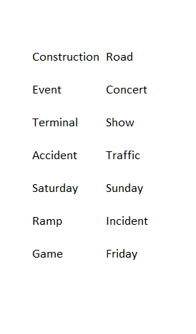
2. Bag of words
Identify most frequently occurring hashtags, words, bigrams and trigrams
Ignore stop terms like punctuations, emoji's, prepositions and city specific terms
Find words with high occurrence and have high price estimate

Slide 9
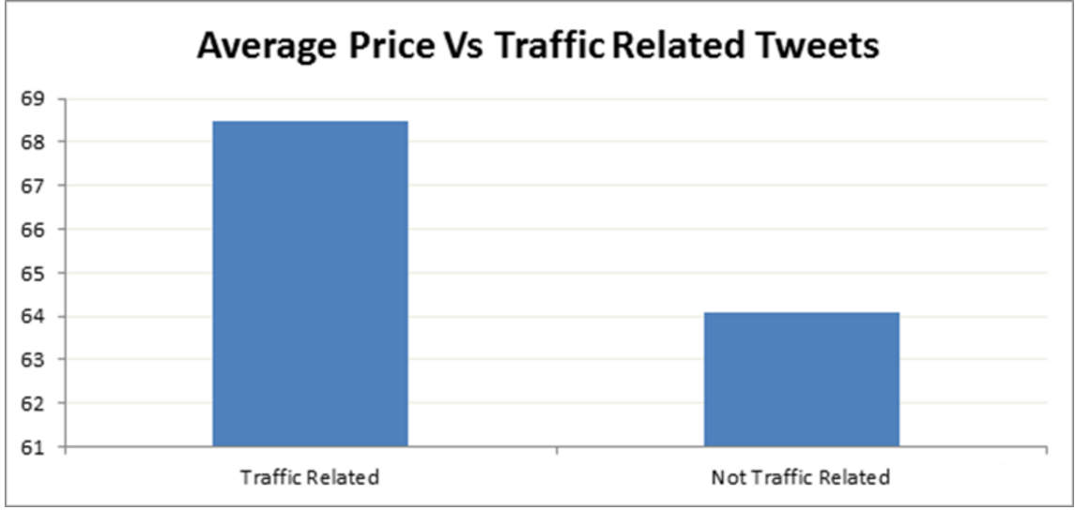

Slide 10
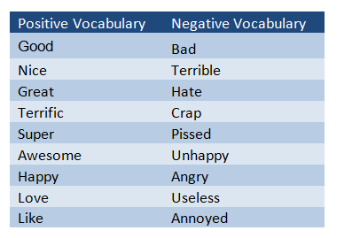
Sentiment Analysis
Sentiment of tweet may have correlation with demand for cab
Presence of positive and negative vocabular can be good predictors for the sentiment of tweet
Semantic Orientation as the difference between its associations with positive and negative words and a measure of closeness called “Pointwise Mutual Information”

Slide 11
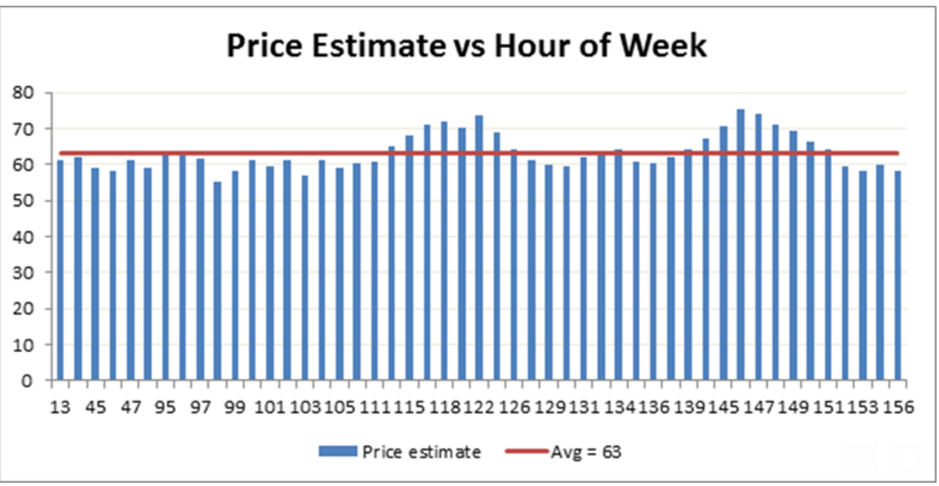
3. Time
Price Estimate depends on time of requesting cab
Depends on Day of week
Single variable to avoid collinearity -Hour of week is calculated as (Day_of_week)*24 + Hour_of_day
Price is clearly above average during hours 115 to 120 and 140 to 145.

Slide 12
Regression Model
Best-fitting line for the observed data is calculated by minimizing the sum of the squares of the vertical deviations from each data point to the line.
y_{i} = ₀ + ₁x_{i1} + ₂x_{i2} + ... _{p}x_{ip} + _{i} for i = 1,2, ... n.
Indepedent Variables are
Neighborhood
TrafficRelatedTweet
Hour_Of_Week

Slide 13
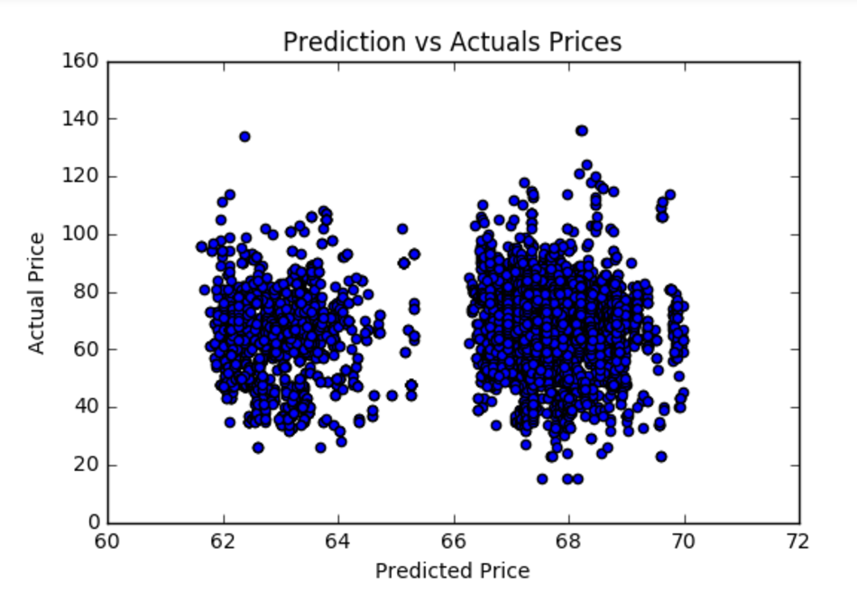
Results
Different combinations of independent variables tried out
Adjusted R- square calculated for each model
Model 7 with all 3 independent variables has relatively the highest value of R-square.
Model | Variables | Adj R-Square
Model 1 | Neighborhood | .002
Model 1 | Traffic_Related_tweet | .013
Model 3 | Hour_of_Week | .0091
Model 4 | Neighborhood+ Hour_of_Week | .08
Model 5 | Hour_of_Week + Traffic_related_tweet | .061
Model 6 | Neighborhood+ Traffic_related_Tweet | .075
Model 7 | Neighborhood+Hour_of_Week+traffic_related_tweet | .162

Slide 14
Further Analysis
Fine tune our feature vectors to better capture data points that vary a lot from the mean.
Initial bag of words identified need to be expanded to find out more terms that may have a higher correlation with our desired outcome
Some aspects of natural language are not captured by our sentiment analysis approach, more notably modifiers and negation: how do we deal with phrases like not bad or very good?
Other models like decision tree regression model, kernel regression or support vector classification model may be considered to better predict our outcome.

Slide 15
Thank You!

