Slide 1
IOT AND PLC BASED HOME AUTOMATION SYSTEM WITH PV INVERTER Project guide : Prof. Athira Prasad Project coordinator : Dr. Jinsa Kuruvila
SUBMITTED BY,
MATHEW VARGHESE
AMEER FAYIZ

Slide 2
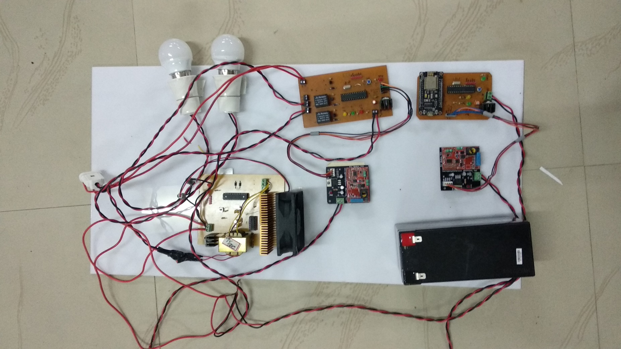

Slide 3
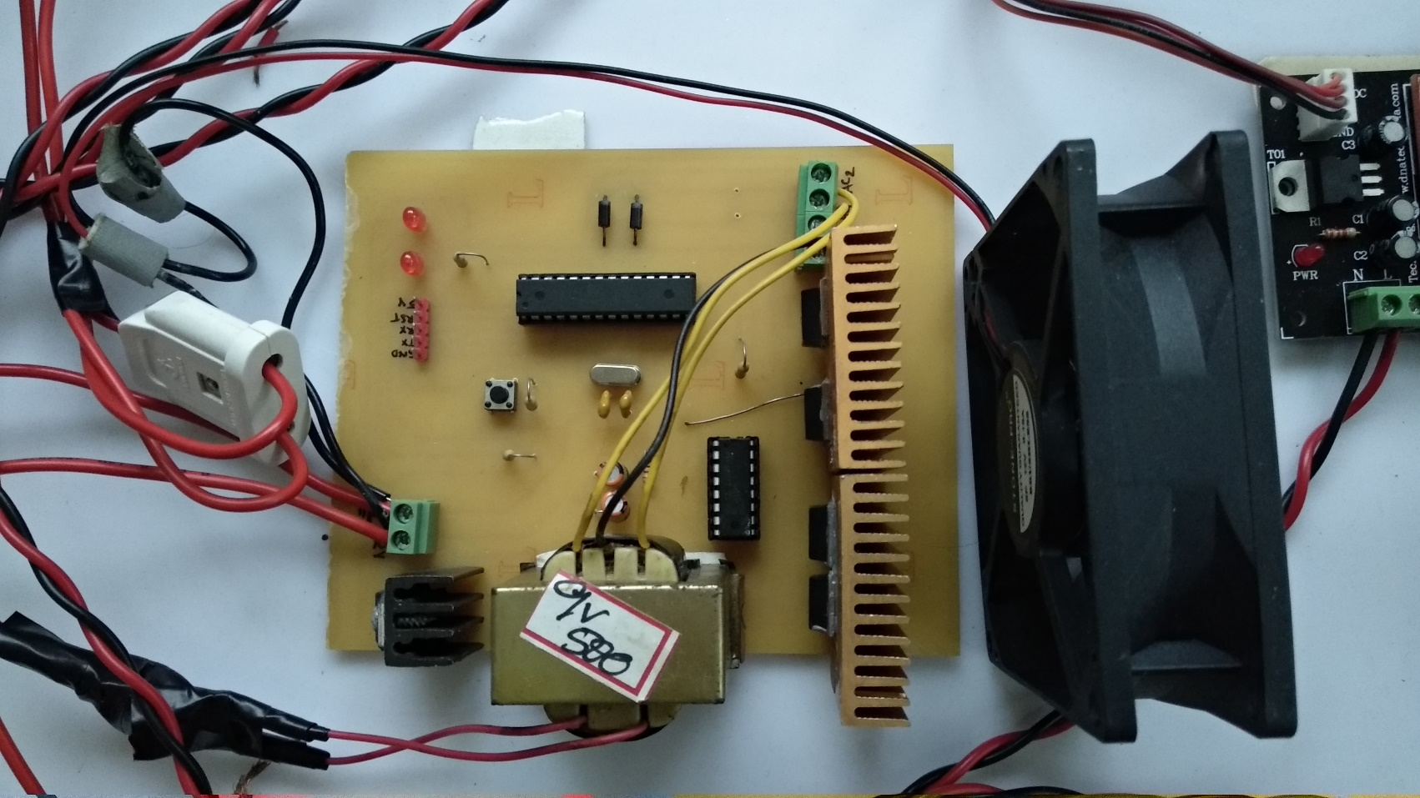
Pure sinewave inverter

Slide 4
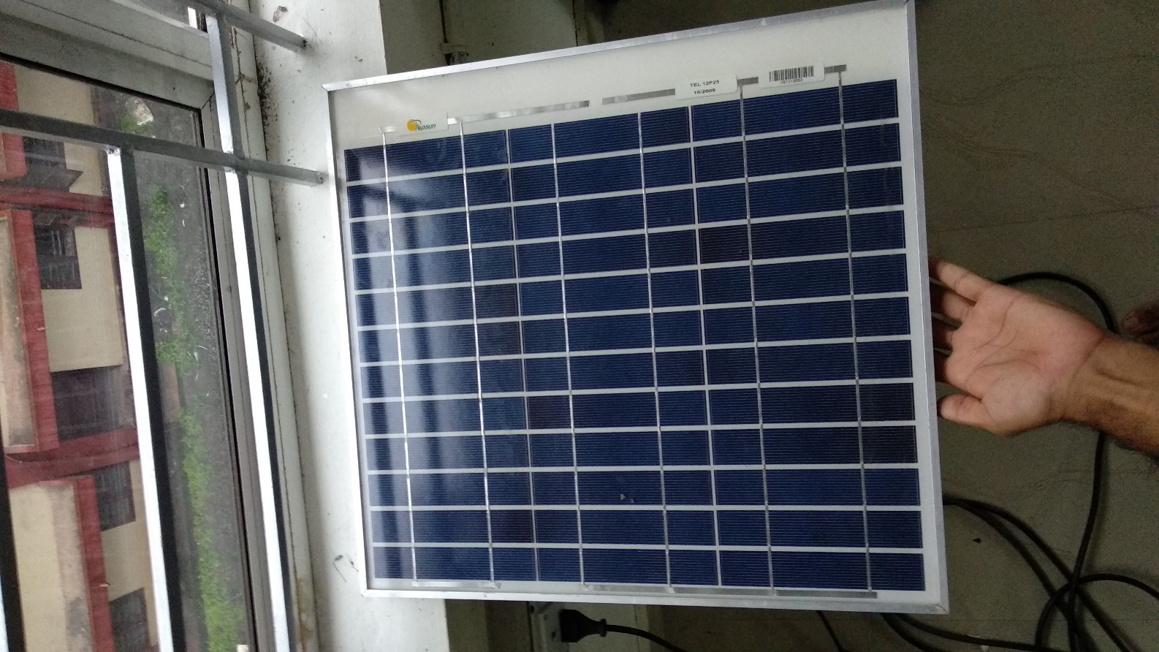
Solar Panel

Slide 5
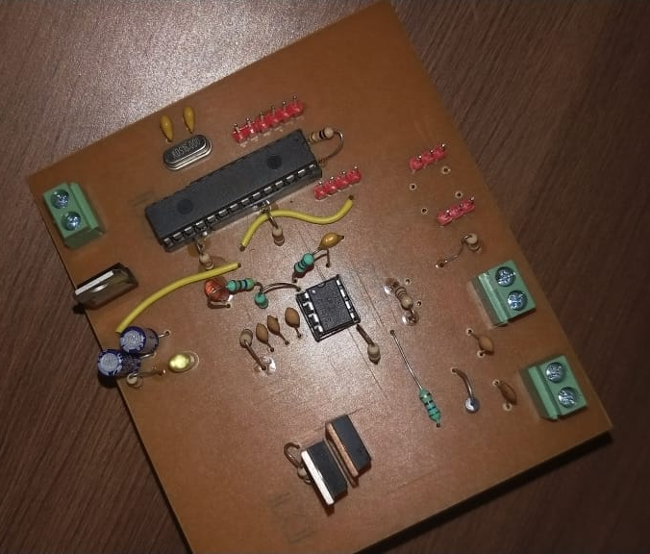
Charge Controller Circuit

Slide 6
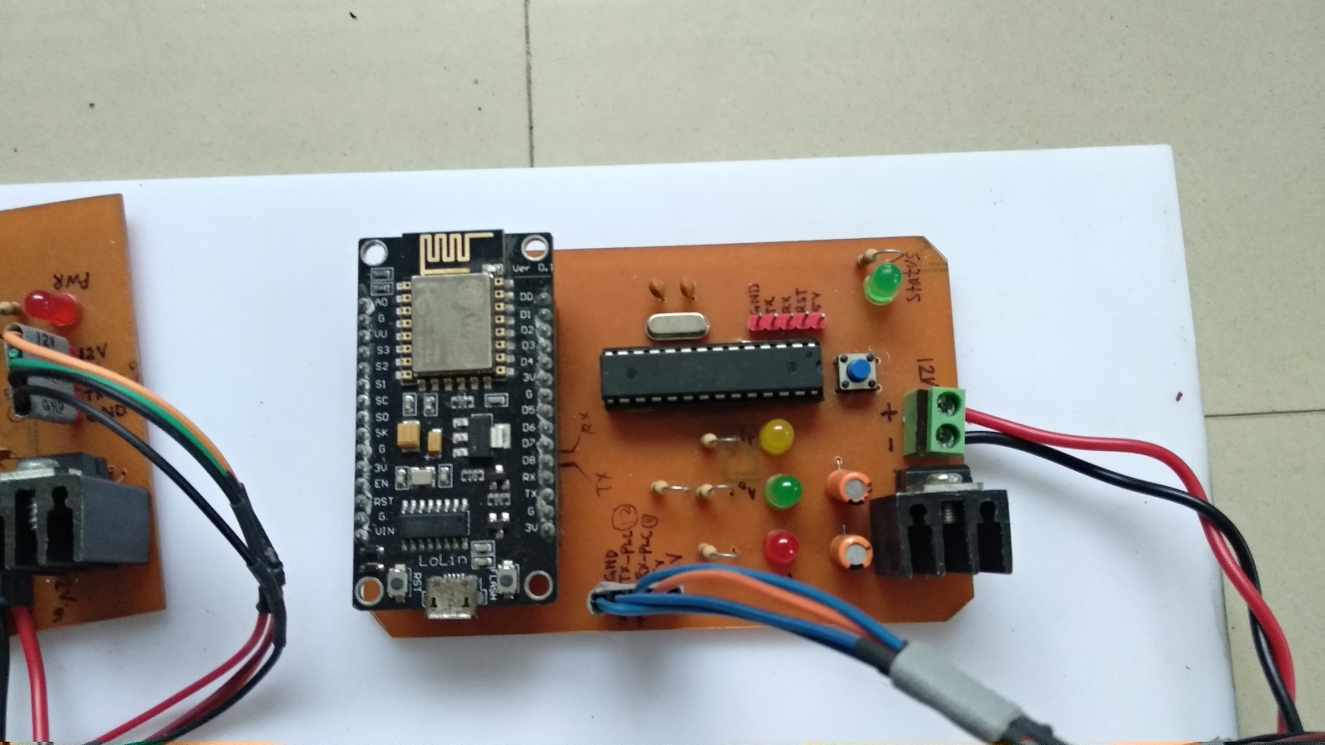
Base Station

Slide 7
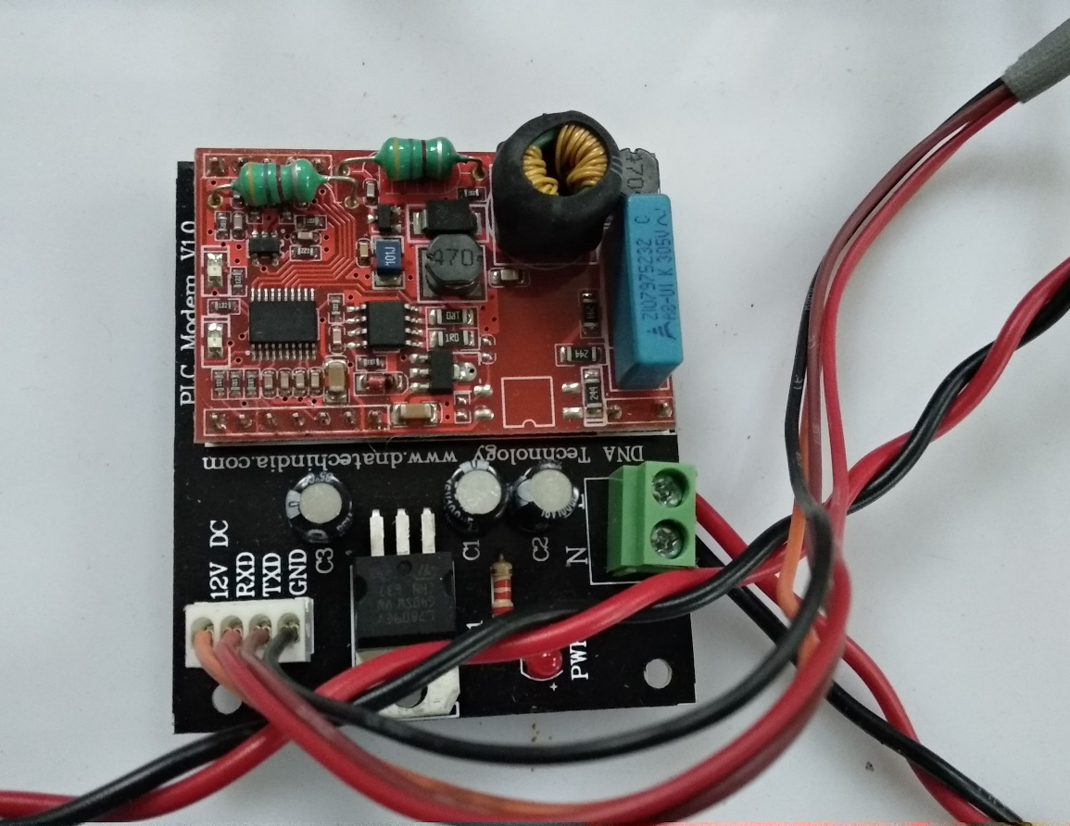
PLC Modem

Slide 8
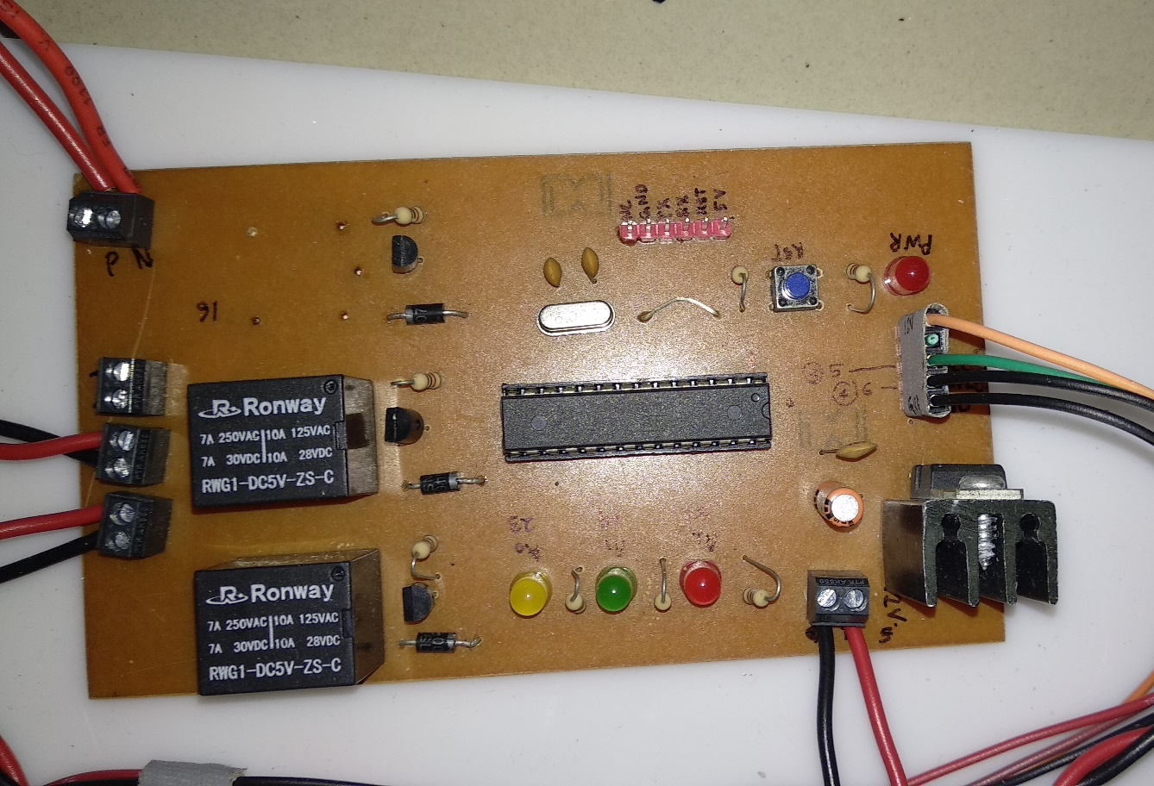
Receiver node 1

Slide 9
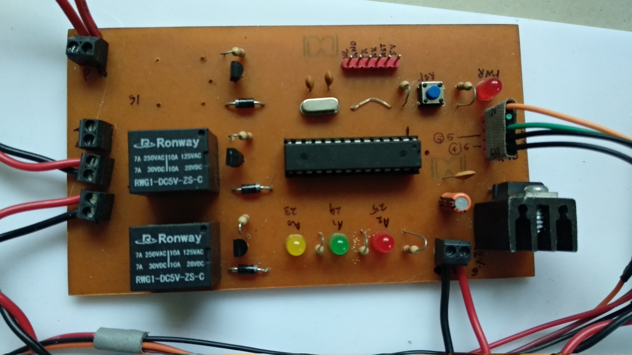
Receiver node 2

