Slide 1
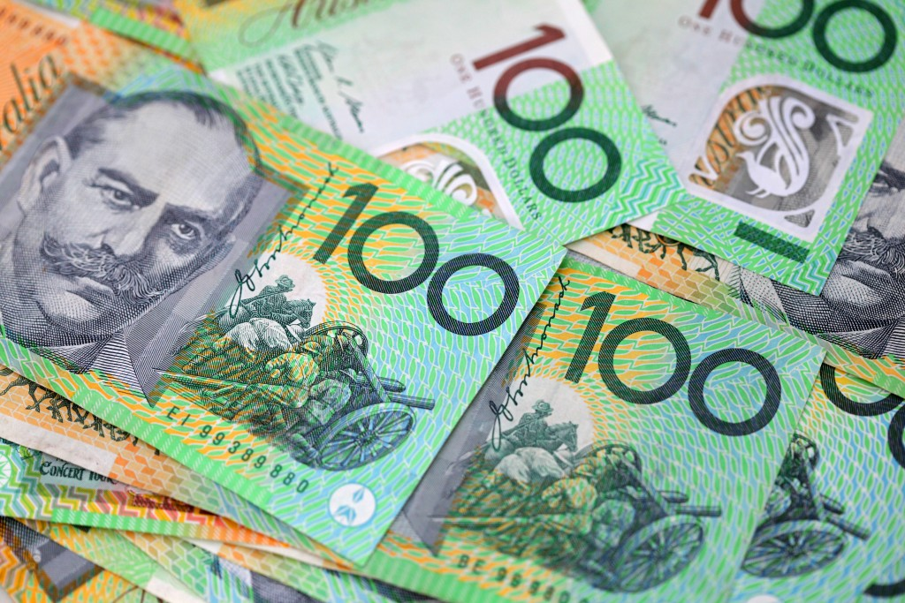


A thrilling, multi-player guessing game!

Slide 2
HOW TO PLAY
Players have to reveal the hidden phrase by guessing the letters one at a time. If a letter appears more than once in a phrase, each guess will only reveal ONE instance of that letter. In the following example:
‘H E L L O W O R L D’, the player would have to call ‘l’ three times.
Players commence the game with: $1000 prize money. Each correct guess increases their bank by $50, an incorrect guess results in a deduction of $200, plus – verbal abuse.
Players win the game and a subsequent prize if they solve the puzzle with money still in their bank. They may continue to guess providing they still have money in their bank. If players run out of money before solving the puzzle they are considered ‘nil’ and must ‘step off’ (eliminated).

Slide 3
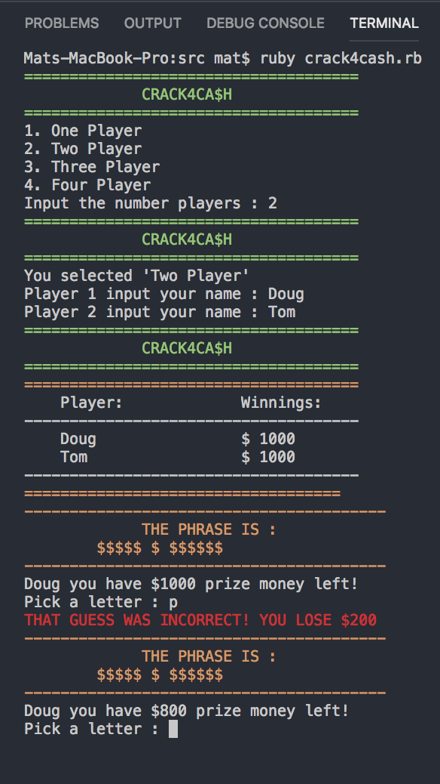
GAMEPLAY
Players use [1], [2], [3], [4] keys to select # of players
Players enter their names, using keyboard and [enter]
Listed each player’s Winnings ($) – starts at $1000
THE PHRASE IS : $$$$ $$ $ $$$$$$
Using keys [a – z] players “guess” each letter hidden by
the “$” signs. Press [enter] to submit.
If active (+$ prize money left) player can “Pick a letter:”

Slide 4
WHY? Crack4Ca$h
Inspired by Hangman, Wheel of Fortune (guessing games of chance)
Scalability and Intuitive (only using keys [a – z] and [enter]
Potential to improve gameplay with sophisticated variables as our
coding skills increase.
Multi-player (family friendly) OR…

Slide 5
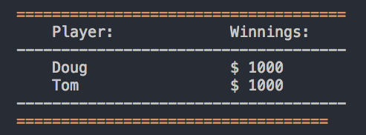
CHALLENGES/UPDATES
Update scoring system. Active player/winnings highlighted (green)
- Passing through players in multi-mode
Pass to next player when guess = “incorrect”. Currently, players round concludes either when puzzle solved or winnings == $0.
Update phrases, create levels (increase difficulty, scoring potential)
Lottery score per round, introduce a “spin” feature. (number randomiser)
Incorporate ”risk” variable: “miss_a_turn”, “bankrupt” etc.

