Slide 1
Wisconsin Breast Cancer Dataset
Names Here

Slide 2
What is breast cancer
Why is it a big deal
What is the dataset?
Its from 1993
Original data has 30 features, why did we choose only 1

Slide 3
Experiment Purpose
Breast cancer diagnosis is traditionally performed with a full biopsy.
Fine needle aspirations require less tissue but with less accuracy.
The goal was to use machine learning to classify benign from malignant tumors by examining cellular characteristics.
W.N. Street, W.H. Wolberg and O.L. Mangasarian. Nuclear feature extraction for breast tumor diagnosis. 1993

Slide 4
Data Features
569 fine needle aspirates of breast tumors were digitized.
The images were analyzed for a total of 10 distinct cell features.
Radius
Perimeter
Area
Compactness
Smoothness
Concavity
Concave points
Symmetry
Fractal Dimension
Texture

Slide 5
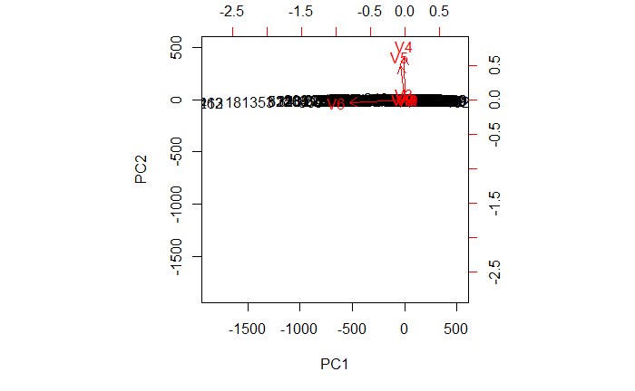
PCA

Slide 6
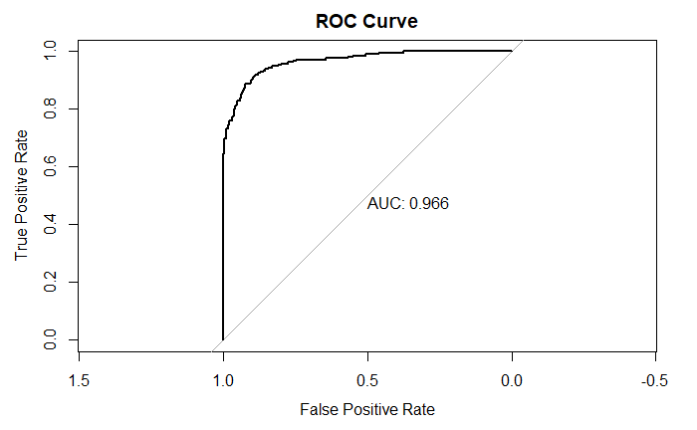
Logistic Regression ROC/AUC

