Slide 1
Gitclass
Ivan Bogdev
Emanuel Mateuse
Jeffery Buonamici
Nathan Shummoogum
Mathiaco-Lee Bessane
Aghiles Sait
Yousef Abo El Foul

Slide 2

What is GitClass?
A web based chat application
Create and join classes and groups.
Post comments, upload files and chat
Track Github statistics

Slide 3
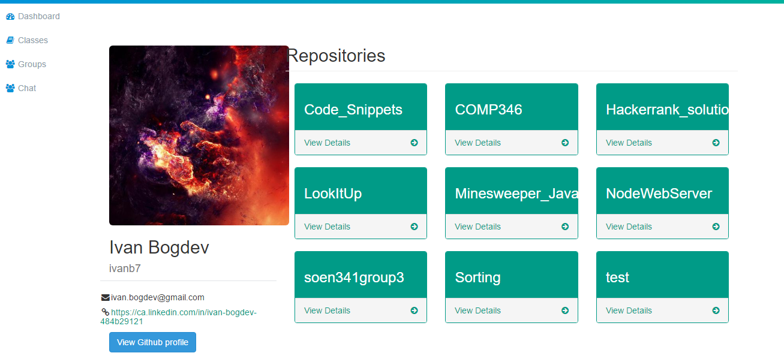
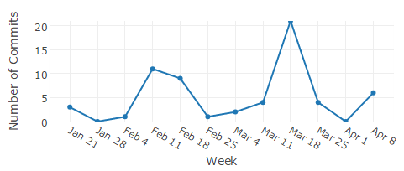
Tracking Github Statistics
Each member has a profile page linked to their github.

Slide 4
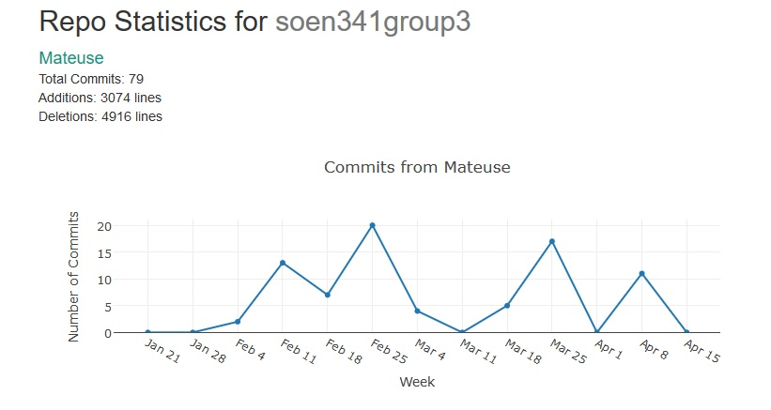
GitHub Statistics
Chart generated using Plot.ly library

Slide 5
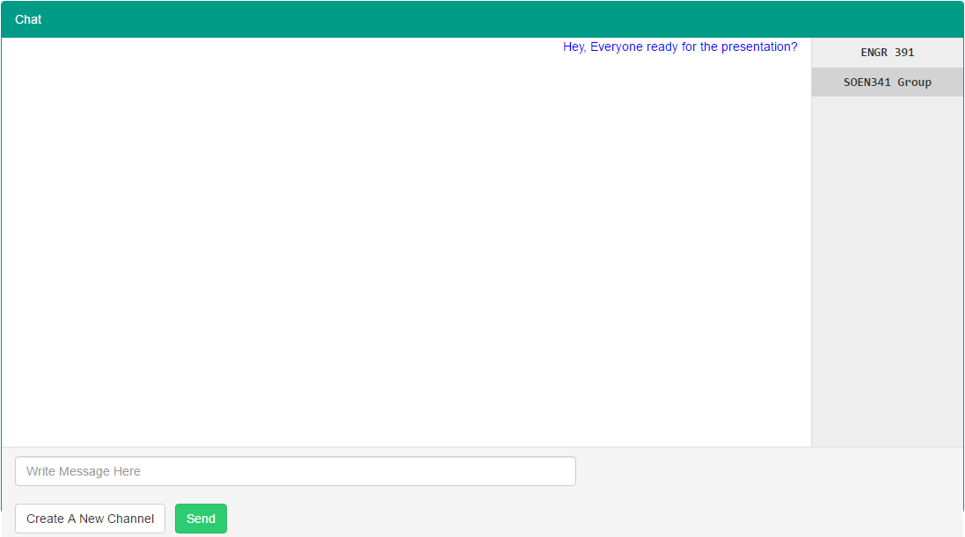
Chat with students and TAs
Send and receive messages from users in the selected channel.

Slide 6
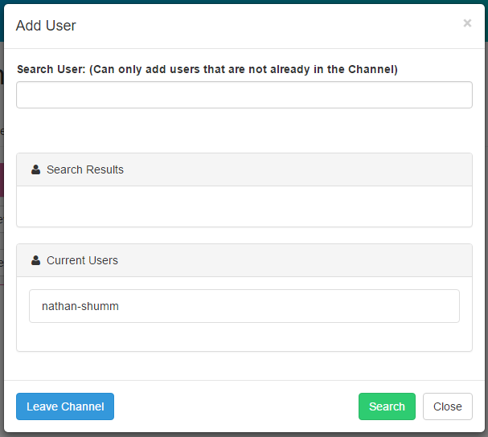
Manage Chat Channels
Users may create channels.
Add and remove users from their channels.

Slide 7
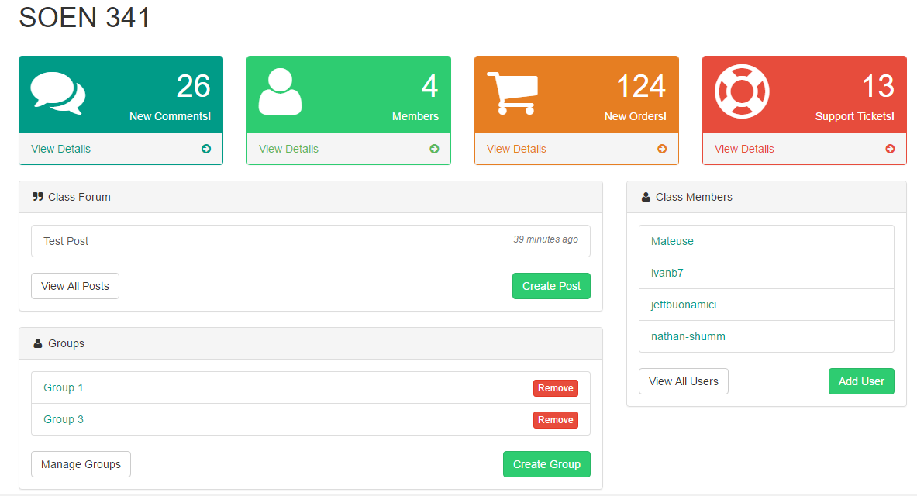
Create Classes and groups!

Slide 8
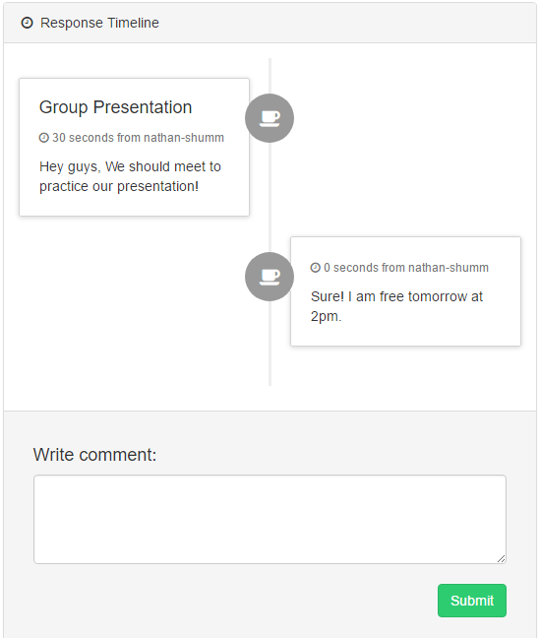
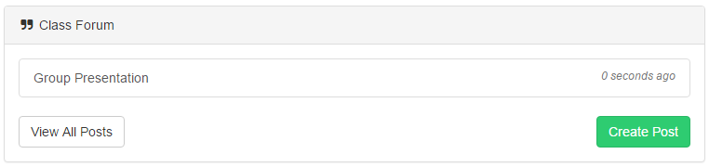
Create posts
Post to a group or class
Comment on posts

Slide 9
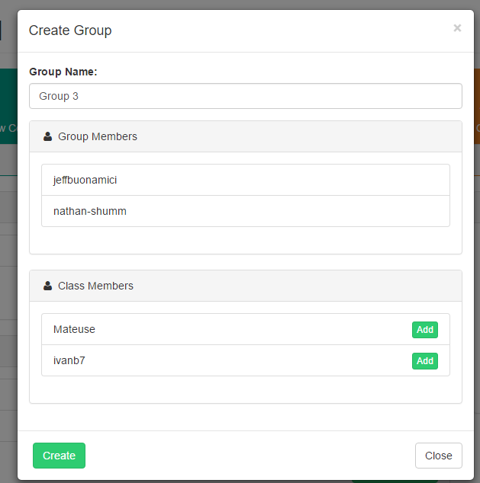
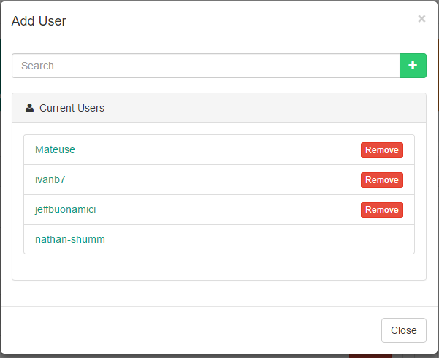
Manage classes and groups

Slide 10
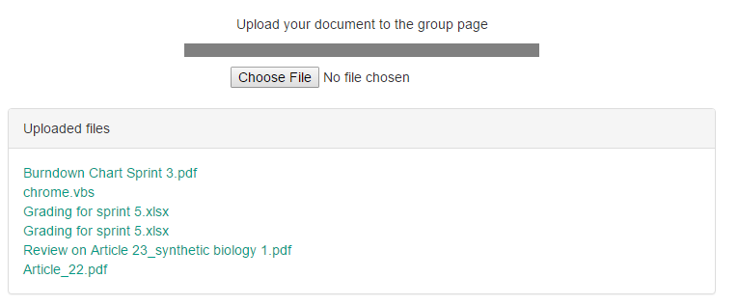
Upload files to your group

Slide 11
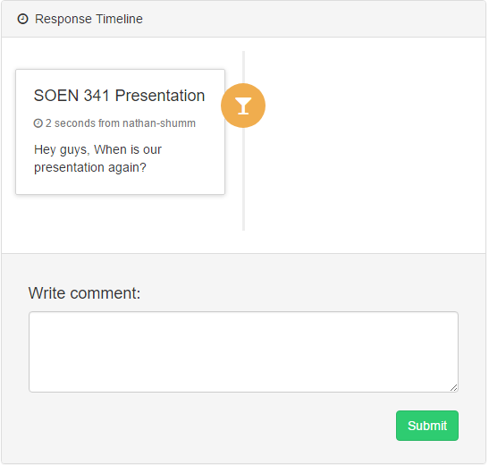
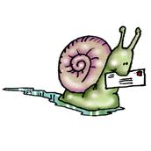
Why do we need Gitclass?
Quick communication with TA, Groups and classmates!
Email and Moodle are slow and unreliable

Slide 12
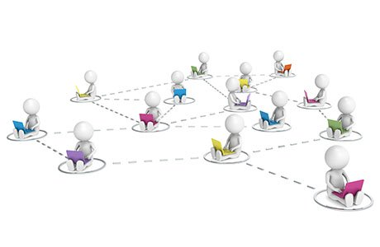
Why do we need Gitclass
Organize and Supervise groups
Easy and Efficient Interactions
Increase of interactions
Safe and Secure!
Only authorized TAs can make changes.

Slide 13
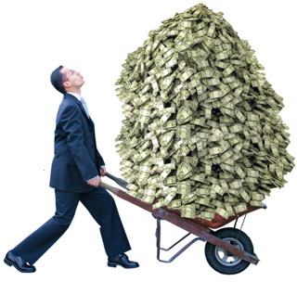
How will we make money?
Sell software to schools.
Stand alone application is cheaper than modifying
current systems.

Slide 14
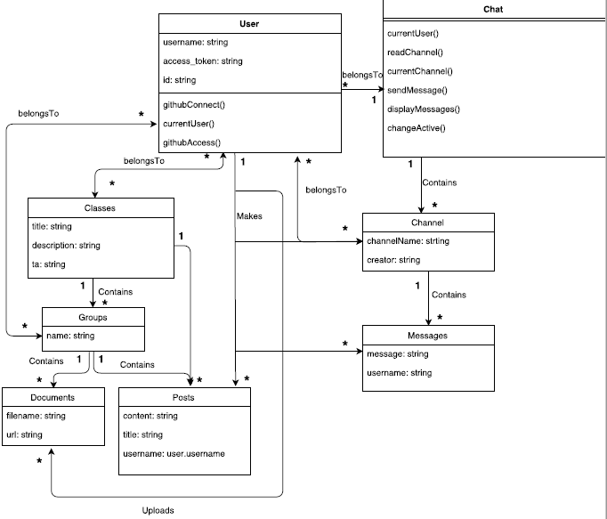
Overall Architecture

Slide 15
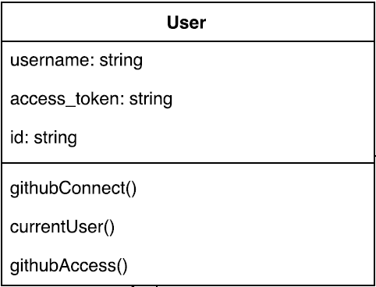
UML Diagram: User

Slide 16
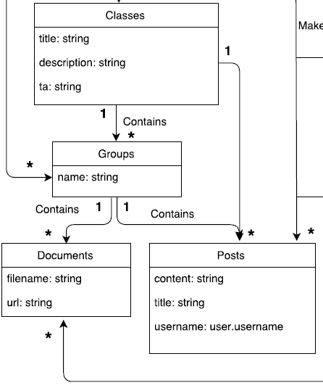
UML Diagram: Classes, Groups, Posts

Slide 17
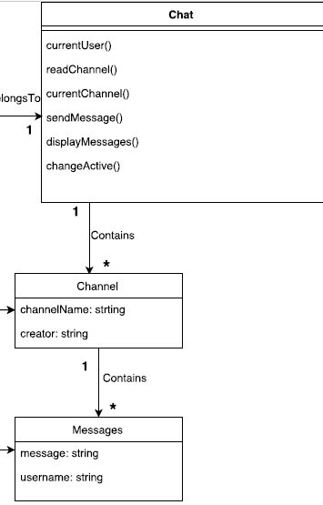
UML Diagram: Chat, Channel and Messages

Slide 18
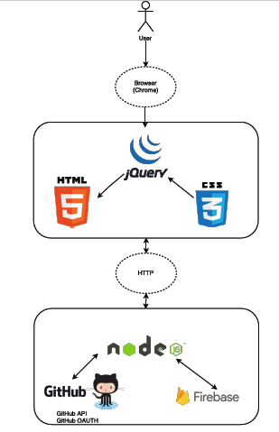
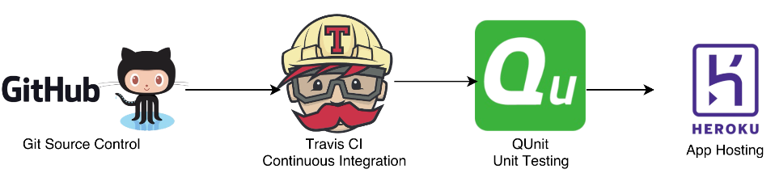
Frameworks, Languages and Services used.

Slide 19
User Story Walkthrough
As a user, I want to post to my class, so that I can notify my group members of important information.
Risk: Dependent on successful completion of other user stories
Priority: 1
Story Points: 5
Task Breakdown:
Posts are listed in a section.
Users may comment on the posts.
Comments and posts are timestamped and saved.

Slide 20
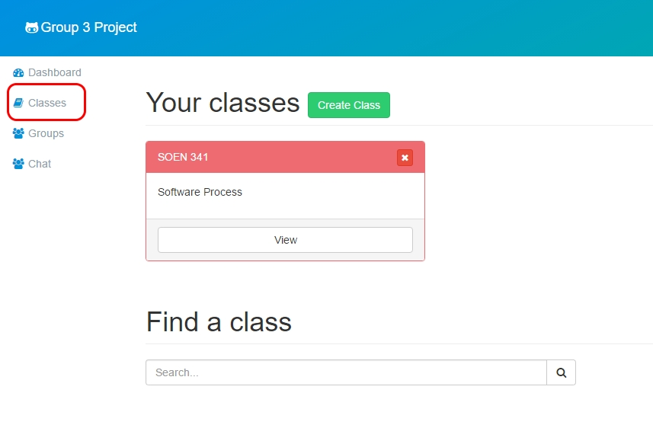
Creating a Post
Given: User is part of a class
Click on classes tab.
Click on the view button for the desired class.

Slide 21
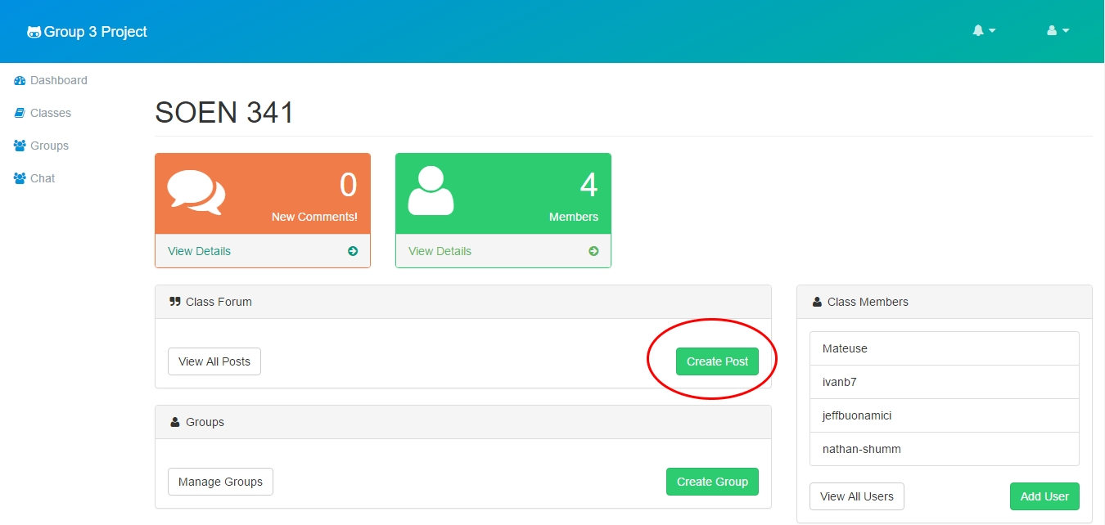
Creating a Post
3. Click on “Create Post”.

Slide 22
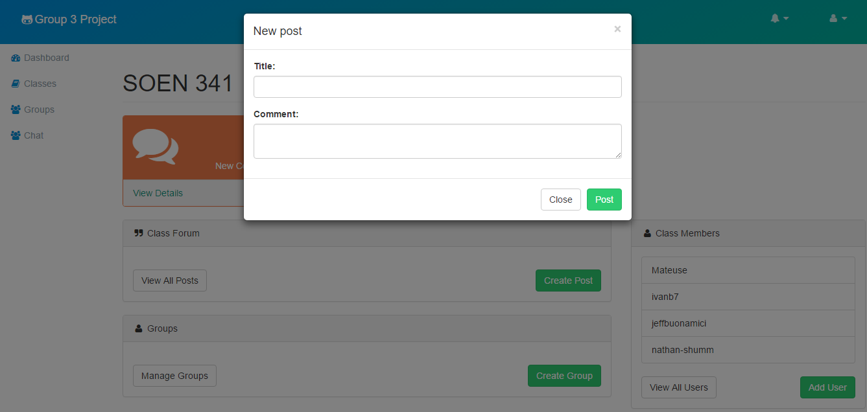
Creating a Post
4. A new panel pops up. Give the post a title and a comment then click on post.

Slide 23
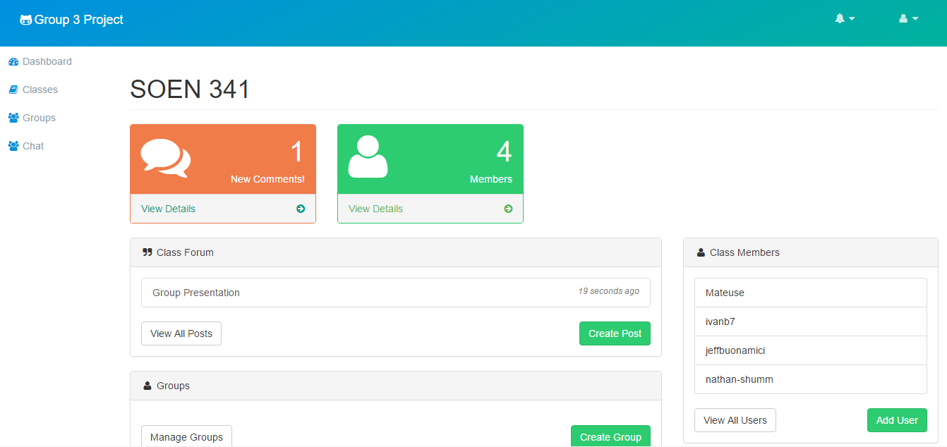
Creating a Post
A new post will be listed in the class forum.

Slide 24
Creating a Post
Upon clicking on the post a new page renders.
Any class member may leave comments.
Timestamps of each comment are recorded
And displayed.

Slide 25

Lessons Learned
Managing a large team is not easy!
Proper planning and is required!
Time management is crucial!

Slide 26
Summary
Gitclass is a web based communication app for students and TAs.
Ease the communication between peers.
An educational environment promoting interactions.
Track github statistics and work being done by students.

