Slide 1
Deep Learning with CNTK & F#

Slide 2

Hello :)
Mathias Brandewinder
@brandewinder
Interests: F#, numerics

Slide 3
Context
Deep Learning is a hot topic
Deep Learning & .NET is not a hot topic
Microsoft: release of CNTK .NET API
This is my current work on CNTK + F#

Slide 4

Plan
A Shallow Introduction to Deep Learning
Using CNTK: fundamentals
Composing models in CNTK

Slide 5
Deep Learning: A Shallow Introduction

Slide 6
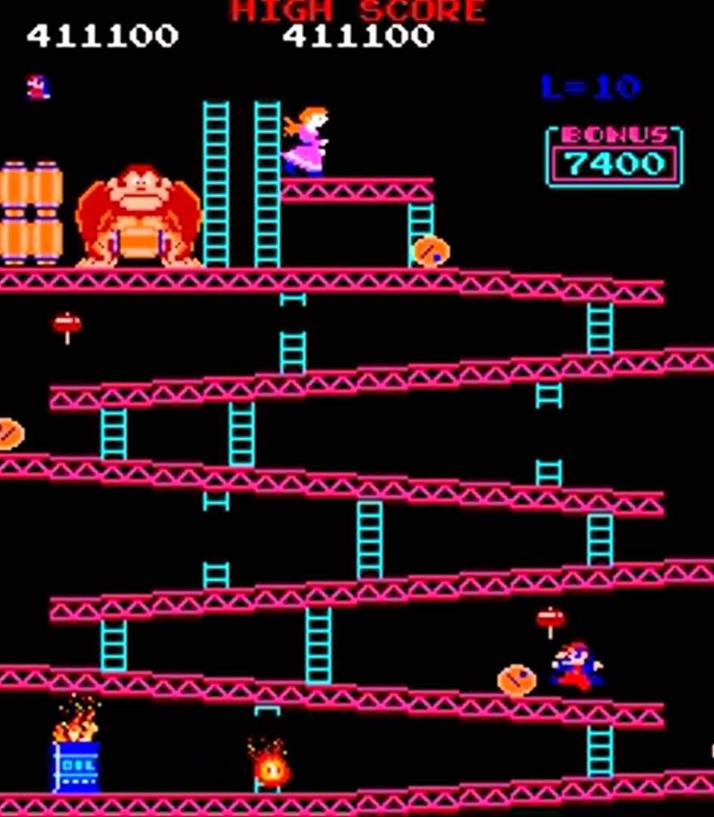

Slide 7
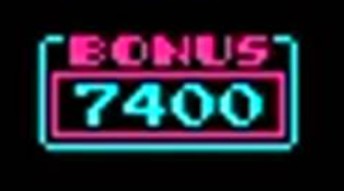

Slide 9
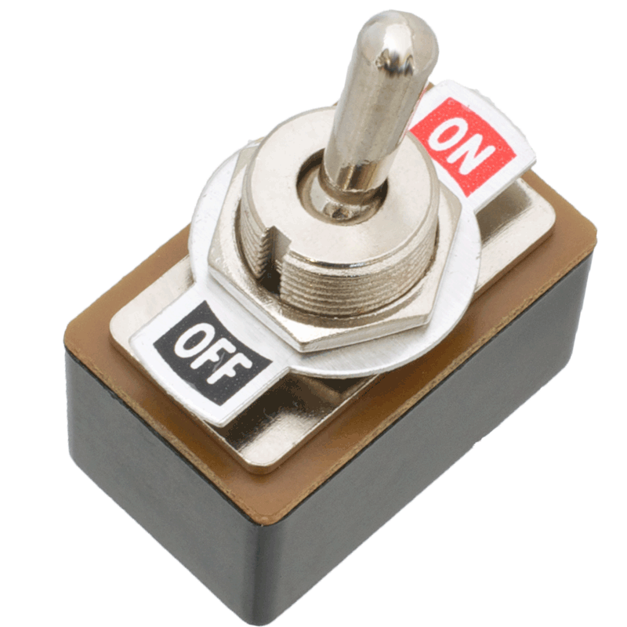
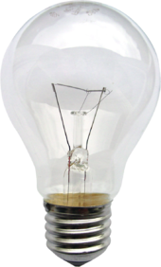

Slide 10
Activation Gate
Threshold
1
0

Slide 11
Displaying a “1”
1

Slide 12
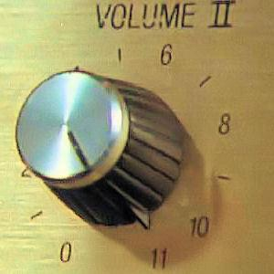

Slide 13
Weights to control signal strength
0%
100%
1
0%

Slide 14
Weights form a filter
1
weights
output

Slide 15
Extend to 1, 2, 3…
1
2
3

Slide 16
Can we reverse engineer this?
?%
1
?%
2
?%
3

Slide 17
Can we reverse engineer this?
0%
Σ
1
20%
2
0%
3
“dense layer”

Slide 18
Learning by example
Pass an image that is known to be a 1
Compute the output
Tweak the weights to…
Increase 1 signal output
Decrease 2, 3, … outputs
Rinse & Repeat (Backwards Propagation)

Slide 19
How should the weights look like?
1
2

Slide 20
Learned Weights as Knowledge
1
2

Slide 21
Robustness
1
2

Slide 22
Comments
Perceptron / Logistic Regression
Densely Connected Layer
“Shallow Learning”
Learning is about “finding weights that work”

Slide 23
Learning a Circuit / Board
1
2

Slide 24
Composing more complex “circuits”

Slide 25
Composing more complex circuits
1
2

Slide 26
Composing more complex circuits
1
1
1
1
2
1

Slide 27
Composing more complex circuits
0
0
1
0
2
0

Slide 28
Composing more complex circuits
1
0
1
0
2
0

Slide 29
Model: Composition of Blocks
Sensor
Sensor
Sensor
Sensor
1
Sensor
Sensor
2
Sensor
Sensor

Slide 30
Model: Composition of Layers
1
2

Slide 31
Recap
Model composed of Layers
Layers composed of Filters / “Sensors”
Learn by example

Slide 32
CNTK Fundamentals

Slide 33
What is CNTK?
Microsoft Cognitive Toolkit
Open Source (GitHub/Microsoft/CNTK)
CPU, GPU, distributed GPUs
Used internally: Skype, Bing, Cortana, Xbox…
C++ core, multiple languages on top
Similar to TensorFlow

Slide 34
What does CNTK do?
Specify how input and output are connected
Specify how to read example data
Learn weights
Save (and open…) learned models

Slide 35
Core components
NDShape (Tensor)
Function
Input Variable, Parameter, Constant
Trainer
Minibatch Readers

Slide 36
What the hell is a Tensor?
Tensors are n-dimensional Arrays
NDShape: N-dimensional shape
Convenient for composition

Slide 37
Functions
1
2
Input Variable
2D Tensor
Dim = [ 8; 8 ]
Weights: Parameters
2D Tensor
Dim = [ 8; 8 ]
Output, 0 or 1:
1D Tensor
Dim = [ 1 ]

Slide 38
Functions
1
Output1 =
Input.[0,0] x Weight.[0,0] +
Input.[0,1] x Weight.[0,1] +
… + Input.[7,7] x Weight.[7,7]
Output2 =
if Output1 > Threshold
then 1.0
else 0.0

Slide 39
Functions
let model
input : float[,]
weights : float[,]
threshold : float =
Array2D.product input weights
|> Array2D.sum
|> ActivateIfGreaterThan threshold

Slide 40
Functions
Input Variable, or Features: what we observe
Function:
Expression of
Input Variable(s) and Parameter(s)
1
Parameters, or
Weights:
what the computer
can “tweak”
Input Variable, or Labels: what the function
should evaluate to

Slide 41
Demo: recognizing 1s from 2s
1
2

Slide 43
Demo: recognizing 1s from 2s
1

Slide 44
… let’s build and learn a model :)

Slide 45
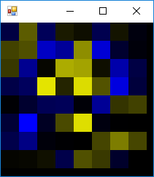

Slide 46
Composing models in CNTK

Slide 47
This is *not* pleasant
Very low-level
Very far from “composing layers” (Keras)
Can we do better?

Slide 48
Sequential Models
Input
Input
Input
Layer
Layer
Layer
Layer
Layer
Layer
Output
Output

Slide 49
… I’ve seen that somewhere!
let model =
input
|> transform layer1
|> transform layer2
|> transform layer3
|> …

Slide 50
Demo: MNIST dataset
Hand-written digits
Goal: recognize 0, 1, 2, … 9
Architecture: convolutional network
Layers: Convolution, Activation, Pooling

Slide 51
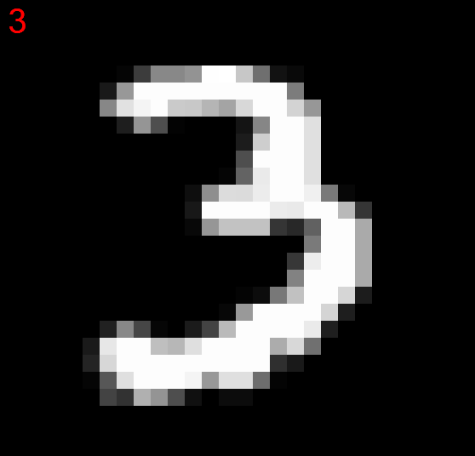
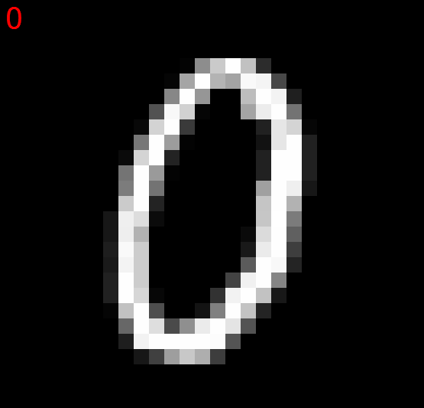
MNIST input

Slide 52
… let’s deep-learn a model :)

Slide 53
Conclusion
Work in progress, but usable
Repository & NuGet: CNTK.FSharp (0.1.5)
Sequential models, convolutions, GPU
WIP: more layers, LSTM, non-sequential models
Thanks to @aviavni :)
Side note: TensorFlowSharp

Slide 54
Thank you :)
Mathias Brandewinder
@brandewinder
Repo/NuGet: CNTK.FSharp
fsharp.org Slack

