Slide 1
Deep Learning with CNTK & F#

Slide 2

Hello :)
Mathias Brandewinder
@brandewinder
Interests: F#, numerics

Slide 3
Context
Deep Learning is a hot topic
Deep Learning has been lacking on .NET
Microsoft: release of CNTK .NET API
This is my current work on CNTK + F#

Slide 4

Plan
A Shallow Introduction to Deep Learning
Using CNTK: fundamentals
Composing models in CNTK

Slide 5
Deep Learning: A Shallow Introduction

Slide 6


Slide 8
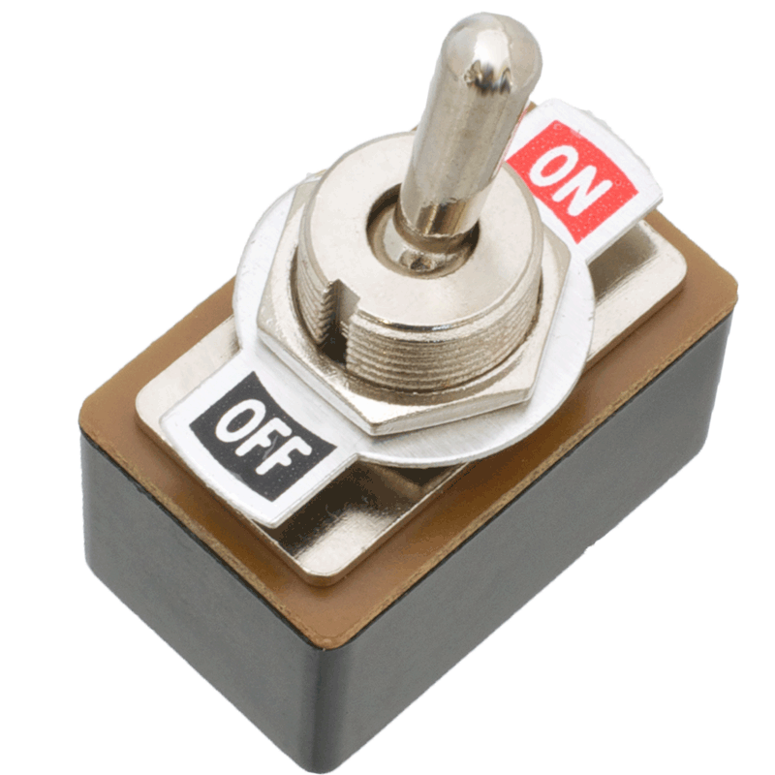


Slide 9
Activation Gate
Threshold
1
0

Slide 10
Displaying a “1”
1

Slide 11
Weights to control signal strength
0%
100%
1
0%

Slide 12
Extend to 1, 2, 3…
1
2
3

Slide 13
Can we reverse engineer this?
?%
1
?%
2
?%
3

Slide 14
Can we reverse engineer this?
0%
Σ
1
20%
2
0%
3

Slide 15
Learning by example
Pass an image that is known to be a 1
Compute the output
Tweak the weights to…
Increase 1 signal output
Decrease 2, 3, … outputs
Rinse & Repeat (Backwards Propagation)

Slide 16
How should the weights look like?
1
2

Slide 17
Learned Weights as Knowledge
1
2

Slide 18
Robustness
1
2

Slide 19
Comments
Perceptron / Logistic Regression
Densely Connected Layer
“Shallow Learning”
Multiple outputs: pick strongest signal
Learning is about “finding weights that work”

Slide 20
Learning a Circuit / Board
1
2

Slide 21
Composing more complex circuits
1
2

Slide 22
Model: Composition of Blocks
Sensor
Sensor
Sensor
Sensor
1
Sensor
Sensor
2
Sensor
Sensor

Slide 23
Model: Composition of Layers
1
2

Slide 24
Recap
Model composed of Layers
Layers composed of “Sensors”
Learn by example

Slide 25
CNTK Fundamentals

Slide 26
What is CNTK?
Microsoft Cognitive Toolkit
Open Source (GitHub/Microsoft/CNTK)
Used internally: Skype, Bing, Cortana, Xbox…
CPU, GPU, distributed GPUs
C++ core, multiple languages on top
Similar to TensorFlow

Slide 27
What does CNTK do?
Specify how input and output are connected
Specify how to read example data
Learn weights
Save (and open…) learned models

Slide 28
Core components
NDShape (Tensor)
Function
Input Variable, Parameter, Constant
Trainer
Minibatch Readers

Slide 29
What the hell is a Tensor?
Tensors are n-dimensional Arrays
NDShape: N-dimensional shape
Convenient for composition

Slide 30
Functions
1
2
Input Variable
2D Tensor
Dim = [ 8; 8 ]
Weights: Parameters
2D Tensor
Dim = [ 8; 8 ]
Output, 0 or 1:
1D Tensor
Dim = [ 1 ]

Slide 31
Functions
1
Output1 =
Input.[0,0] x Weight.[0,0] +
Input.[0,1] x Weight.[0,1] +
… + Input.[7,7] x Weight.[7,7]
Output2 =
if Output1 > Threshold
then 1.0
else 0.0

Slide 32
Functions
let model
input : float[,]
weights : float[,]
threshold : float =
Array2D.product input weights
|> Array2D.sum
|> ActivateIfGreaterThan threshold

Slide 33
Functions
Input Variable, or Features: what we observe
Function:
Expression of
Input Variable(s) and Parameter(s)
1
Parameters, or
Weights:
what the computer
can “tweak”
Input Variable, or Labels: what the function
should evaluate to

Slide 34
Demo: recognizing 1s from 2s
1
2

Slide 35
Demo: recognizing 1s from 2s
1

Slide 36
… let’s build and learn a model :)

Slide 37
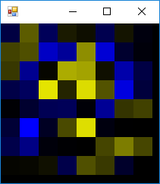

Slide 38
Composing models in CNTK

Slide 39
This is *not* pleasant
Very low-level
Very far from “composing layers” (Keras)
Can we do better?

Slide 40
Sequential Models
Input
Input
Input
Layer
Layer
Layer
Layer
Layer
Layer
Output
Output

Slide 41
Demo: MNIST dataset
Hand-written digits
Goal: recognize 0, 1, 2, … 9
Architecture: convolutional network
Layers: Convolution, Activation, Pooling

Slide 42
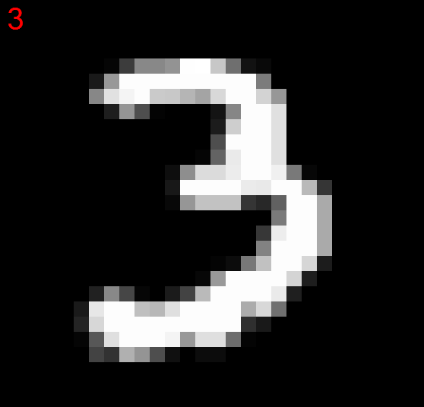
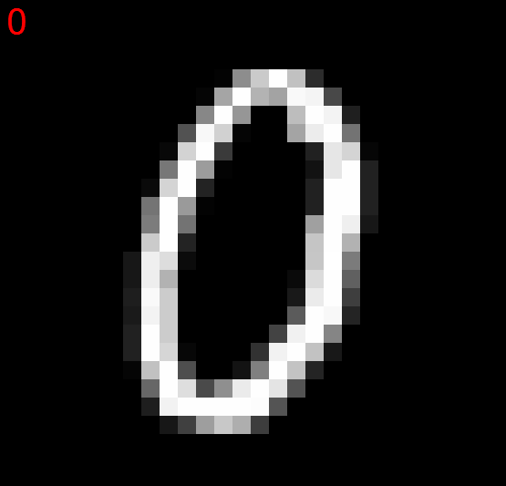
MNIST input

Slide 43
… let’s deep-learn a model :)

Slide 44
Conclusion
Work in progress, but usable
Decent sequential composition
Next: more layers, non-sequential models
Repository: CNTK.FSharp (NuGet coming soon)
Side note: TensorFlowSharp

Slide 45
Thank you :)
Mathias Brandewinder
@brandewinder
Repo: CNTK.FSharp
fsharp.org Slack

