Slide 1

The Joy of Pex
mathias@clear-lines.com

Slide 2
What is Pex?
White box unit testing tool for .Net
Microsoft Research
Visual Studio 2008/2010 add-in
Free for personal use or with MSDN license

Slide 3
What does Pex do?
Pex = Project Exploration
Given a public method, Pex
Helps find “interesting” inputs for methods
Generates parameterized unit tests
  Supports multiple testing frameworks
Today: only exploration

Slide 4
A simple example
public class Password
{
public static bool IsStrong(string password)
{
if (password.Length < 8)
{
return false;
}
return true;
}
}

Slide 5
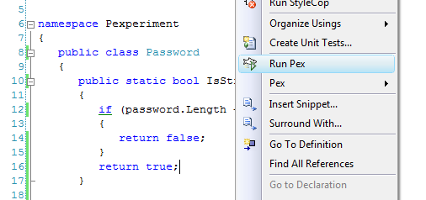
Running Pex in Visual Studio

Slide 6
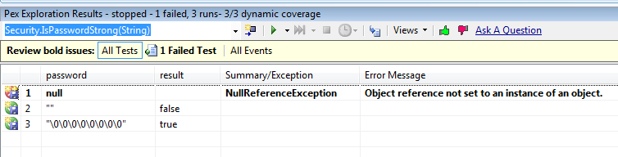
Pex produces “interesting” inputs

Slide 7
What are “interesting inputs”?
Full coverage
  All paths in method have been exercised
Identified possible exception
Produced “simplest” set of inputs
Not necessarily the ones you would think of
  Should we prevent escape characters?

Slide 8
More complex case
public static bool IsReallyStrong(string password)
{
var lowers = 0;
var uppers = 0;
var numbers = 0;
foreach (Char c in password)
{
if (Char.IsNumber(c))
numbers++;
if (Char.IsUpper(c))
uppers++;
if (Char.IsLower(c))
lowers++;
}
if (lowers <= 2 || uppers < 2 || numbers < 2)
return false;
return true;
}

Slide 9
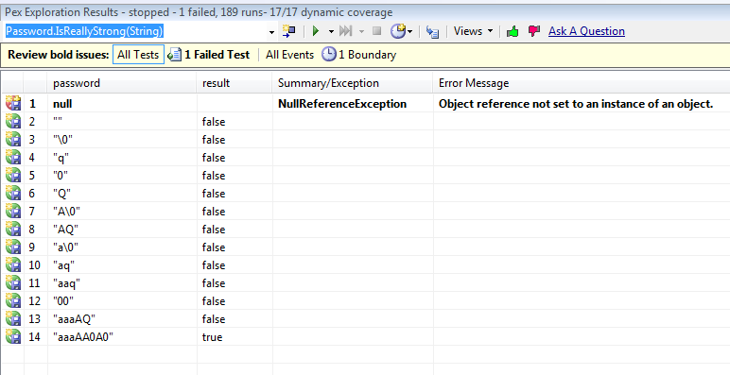
Pex is pretty exhaustive

Slide 10
Why should you care?
Finding good test cases takes time
  Being complete is “expensive”
  Ex: exception cases tests
Finding good test cases takes skill
  Thinking like a bug is difficult
Analyzing existing code can be lengthy

Slide 11
So what?
Very useful tool to write more robust code
Very useful to investigate legacy code
Potentially useful to create unit tests
Download Pex:
http://research.microsoft.com/projects/pex/
Contact me:
mathias@clear-lines.com

