Slide 1
Seminar Public Services
Midterm Presentation
19.10.2023

Slide 2
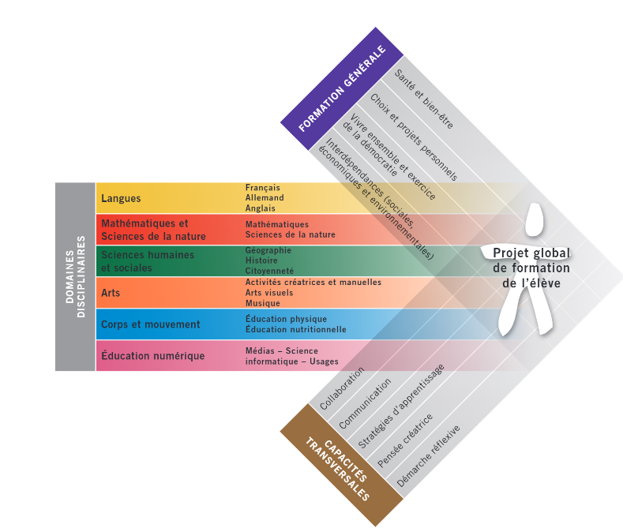
PER (Plan d’étude Roman)
Comprehensive plan for education
Agreed upon by all French speaking Cantons
Students from 4 to 15 years old
Standardization of learning

Slide 3
PER: Actual ressources
Plan (https://portail.ciip.ch/per/domains) divided in 3 Axis
Subject Areas
General Education
Cross Education
Teaching units available for teachers (https://portail.ciip.ch/rn/resources)
PER: What’s missing ?
Collaboration between teacher from different disciplines
General Education and Cross Education difficult to implement

Slide 4
Our artifact : Supra-sequence
Focus on a PER objective from General or Cross Education
Span multiple weeks, across any Subject
Initiated by teacher for one class
Can be joined by teacher on a voluntary basis
Each teacher can, in the context of the Supra-sequence :
See what's been done by other teachers
Plan for what will be done in the supra-sequence
Allows to adapt the future lessons

Slide 5
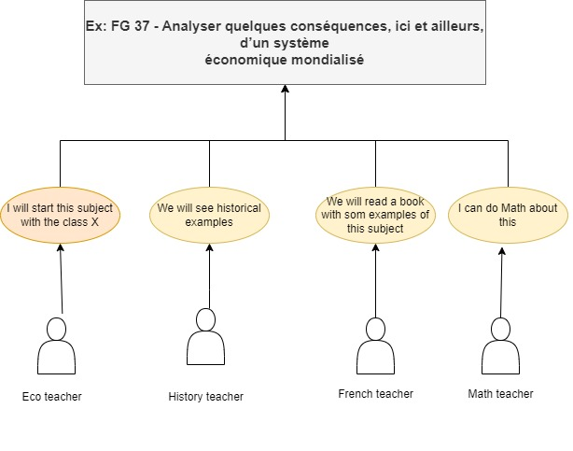
Our Artifact: Use case

