Slide 1
Advanced Algorithms
Lecture 10
Multithreaded Algorithms
Tung Kieu
tungkvt@cs.aau.dk

Slide 2
ILO of Lecture 10
Multithreaded algorithms
to understand the model of dynamic multithreading, including nested parallelism and parallel loops;
to understand work, span, and parallelism — the concepts necessary for the analysis of multithreaded algorithms;
to understand and be able to analyze the multithreaded merge sort algorithm.

Slide 3
Agenda
Background
Nested parallelism
Work, span, and parallelism
Parallel loops
Multithreaded merge sort

Slide 4



Parallel computers
Computers with multiple processing units
Chip multiprocessors / Low price
A single multi-core chip has multiple processing “cores”.
My laptop: Intel® Core™ i7-7700U Processor has 2 cores.
Clusters / Intermediate price.
Individual computers that are connected with a dedicated network.
Supercomputers / High price.
Combination of custom architectures and custom networks to deliver the highest performance.
Memory models
Shared memory: all processors can access any location of memory.
Distributed memory: where each processor has a private memory.
No agreement on a single architectural model for parallel computers so far.

Slide 5
Static vs. dynamic threading
Static threading
Each thread maintains an associated program counter and executes code independently of the other threads.
Threads persist for the duration of a computation.
Directly using static threading is difficult and error-prone.
Dynamic threading
Specify parallelism in applications without worrying implementation details.
A concurrency platform’s scheduler does communication, load balancing, etc.
Nested parallelism and parallel loops.

Slide 6
Agenda
Background
Nested parallelism
Work, span, and parallelism
Parallel loops
Multithreaded merge sort

Slide 7
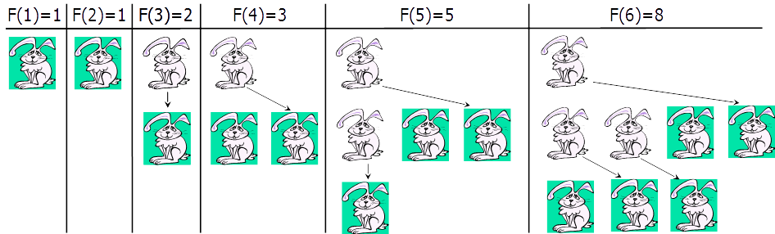
Fibonacci Numbers
Leonardo Fibonacci (1202):
We have a rabbit in the beginning.
A rabbit starts producing offspring on the second generation after its birth and produces one child each generation.
How many rabbits will there be after n generations?

Slide 8
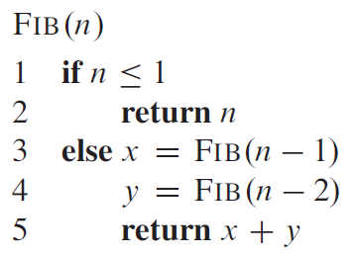
Fibonacci Numbers (2)
F(n)= F(n-1)+ F(n-2)
F(0) =0, F(1) =1
0, 1, 1, 2, 3, 5, 8, 13, 21, 34 …
Straightforward recursive procedure is very very slow!
Why? How slow?
Let’s draw the recursion tree.
O(2^{n})

Slide 9
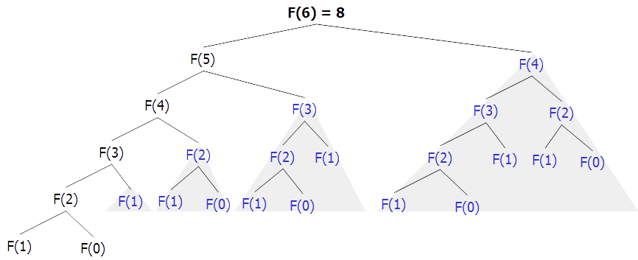
Fibonacci Numbers (3)
Dynamic Programming
Memoization (Top Down)
Tabulation (Bottom Up)
We keep calculating the same value over and over!
Sub-problems are overlapping – they share sub-sub-problems.
Do you still remember how we can avoid calculating the same sub-problems?

Slide 10

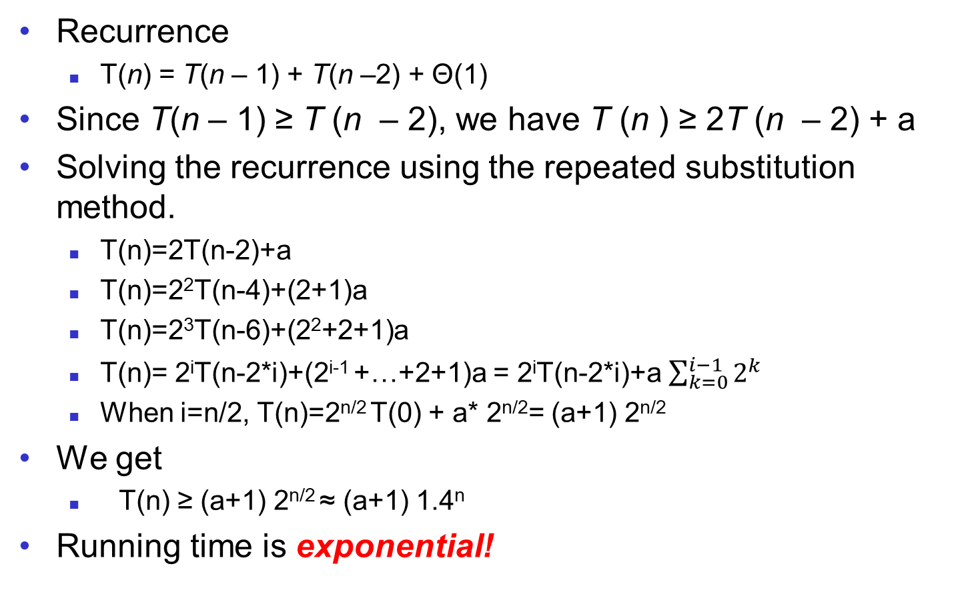
Fibonacci Numbers (4)
Recurrence
T(n) = T(n – 1) + T(n –2) + Θ(1)
Since T(n – 1) ≥ T (n – 2), we have T (n ) ≥ 2T (n – 2) + a
Solving the recurrence using the repeated substitution method.
T(n)=2T(n-2)+a
T(n)=2²T(n-4)+(2+1)a
T(n)=2³T(n-6)+(2²+2+1)a
T(n)= 2^{i}T(n-2*i)+(2^{i-1} +…+2+1)a = 2^{i}T(n-2*i)+a $\sum_{k=0}^{i−1}{2^{k}}$
When i=n/2, T(n)=2^{n/2} T(0) + a* 2^{n/2}= (a+1) 2^{n/2}
We get
T(n) ≥ (a+1) 2^{n/2} ≈ (a+1) 1.4^{n}
Running time is exponential!
Master theorem
T(n-2)=2T(n-4)+a
T(n-4)=2T(n-6)+a
Notes:
Geometri series

Slide 11
Multithreaded version
What if we can do the two recursive calls in parallel?
Using the so-called nested parallelism
Call a procedure. Don’t wait for it to return and go to next step.
Call Fib(5), we do not need to wait for Fib(5) returns results and we can call Fib(4).

Slide 12
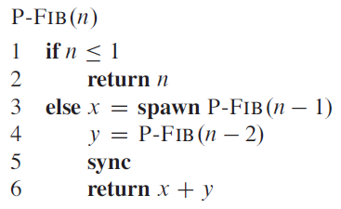
Concurrency keywords
Spawn
If the keyword spawn precedes a procedure call, it indicates a nested parallelism.
No need to wait for the procedure with keyword spawn.
We do not wait P-FIB(n-1) to complete and we can execute P-FIB(n-2) on another processing unit.
Sync
Must wait for all spawned procedures to complete before going to the statement after sync.
Before “return x+y”, we must wait P-FIB(n-1) to complete.

Slide 13
Analysis
Recurrence:
T(n) = max(T(n – 1), T(n – 2)) + c = T(n – 1) + c
Can you try to solve this recurrence?
Solving the recurrence, we have T(n) = Θ(n).
The serial version is exponential whereas the multithreaded version is only linear.
T(n) = T(n-1) + c
T(n-1) = T(n-2) + c
T(n) = (T(n-2) + c) + c = T(n-2) + 2c
T(n-2) = T(n-3) + c
T(n) = T(n-3) + 3c
…
T(n) = T(0) + nc

Slide 14
Agenda
Background
Nested parallelism
Work, span, and parallelism
Parallel loops
Multithreaded merge sort

Slide 15
Work, Span, Parallelism
Three main concepts (informally):
Work – the running time on a machine with one-processor (T₁).
Fibonacci: Θ(φ^{n})
Span – the running time on a machine with infinite processors (T∞).
Fibonacci: Θ(n)
Parallelism = Work/Span – how many processors on average are used by the algorithm.
Fibonacci: Θ(φ^{n} / n)
More formally, work and span are defined using a computation DAG (directed acyclic graph).
Vertices are instructions or sets of instructions.
Edges represent dependencies between instructions.
An edge (u, v) means that u must execute before v.
u
v

Slide 16
Computation DAG
Using an example of computing Fibonacci number of 4.
Lines 1-3
Lines 4-5
Line 6
P-FIB(4)
Notes:
For convenience, however, if a chain of instructions contains no
parallel control (no spawn, sync, or return from a spawn—via either an explicit
return statement or the return that happens implicitly upon reaching the end of
a procedure), we may group them into a single strand, each of which represents
one or more instructions. Instructions involving parallel control are not included
in strands, but are represented in the structure of the dag.

Slide 17
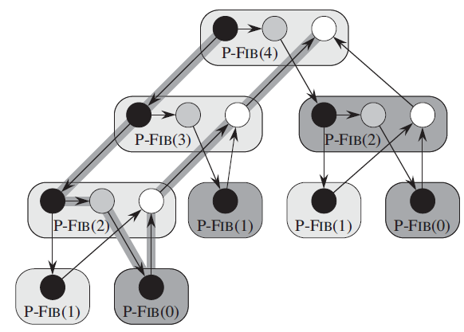
Computation DAG
Edge(u, v) means that
u must execute before v.
continuation edge
Spawned procedure
spawn edge
return edge
P-FIB(3)
call edge
Called procedure
P-FIB(2)
Work: number of vertices, 17
Span: the length of the longest path (critical path), 8

Slide 18
Work law and span law
Notation
Work T₁
Span T∞
Multithreaded computation on P processors: T_{P}
Work law: T_{P} ≥T₁ / P
An ideal parallel computer with P processors can do at most P units of work.
Span law: T_{P} ≥ T∞
An ideal parallel computer with P processors cannot run any faster than a machine with unlimited number of processors.
Ex: O(n²) → O(n) if we have n processor

Slide 19
Speedup
Work law
Speedup: T₁/T_{P}:
How many times faster the computation on P processors than on a single processor.
Recall the work law says that T_{P} ≥T₁ / P, so that the speedup must be smaller than or equal to P.
The speedup on a P-processor machine can at most be P.
If the speedup is P, we have perfect linear speedup.

Slide 20
Mini quiz
Considering the case for computing P-Fib(4).
We already know that the work T₁ =17 and the span T ∞ = 8
Consider the following setups, each setup corresponds to a machine with P processing units. Which one is the most likely setup to achieve the perfect linear speedup?
P=2, P=3, P=4, P=5, P=10

Slide 21
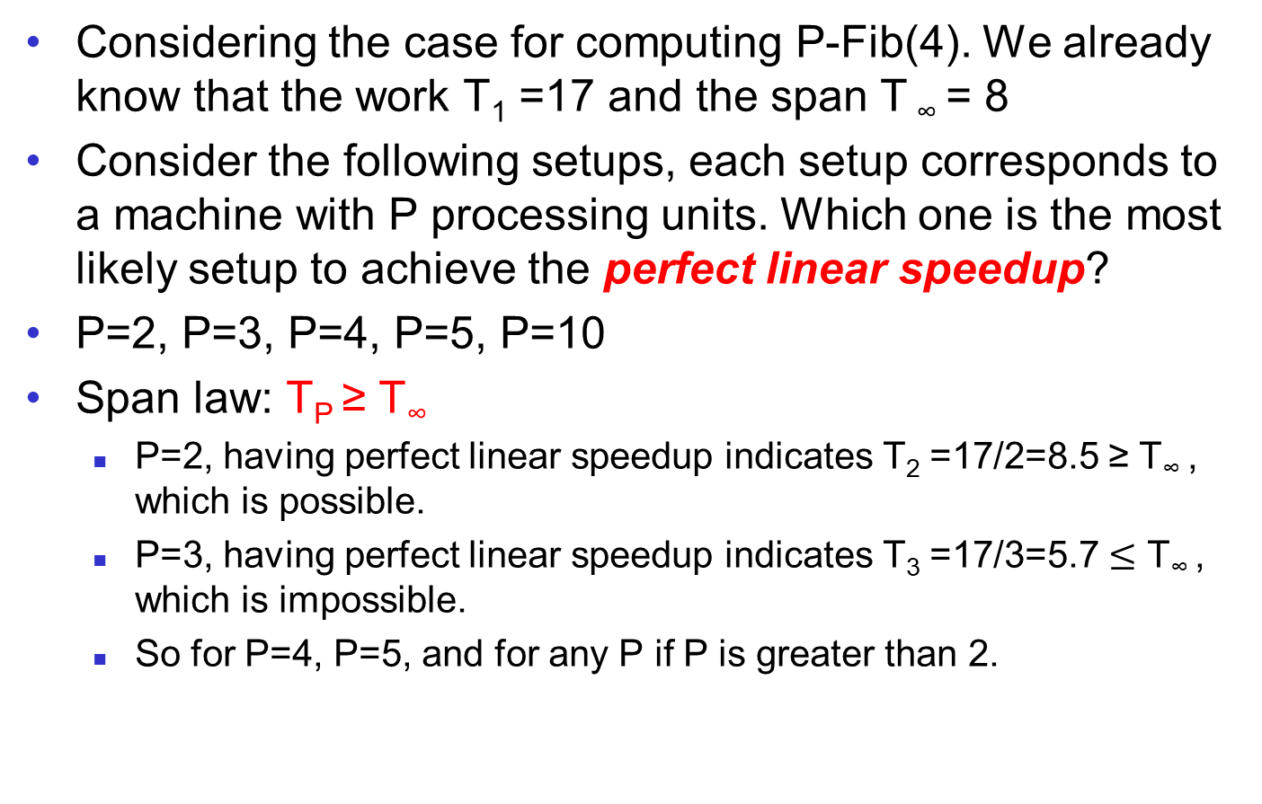
Mini quiz
Considering the case for computing P-Fib(4). We already know that the work T₁ =17 and the span T ∞ = 8
Consider the following setups, each setup corresponds to a machine with P processing units. Which one is the most likely setup to achieve the perfect linear speedup?
P=2, P=3, P=4, P=5, P=10
Span law: T_{P} ≥ T∞
P=2, having perfect linear speedup indicates T₂ =17/2=8.5 ≥ T∞ , which is possible.
P=3, having perfect linear speedup indicates T₃ =17/3=5.7 $≤$ T∞ , which is impossible.
So for P=4, P=5, and for any P if P is greater than 2.

Slide 22
Parallelism and Slackness
17/8
Parallelism: T₁ / T ∞ :
The maximum possible speedup that can be achieved on any number of processors.
Once the number of processors exceeds the parallelism, the computation cannot possibly achieve the perfect linear speedup.
Slackness: Parallelism/P = T₁ / PT ∞
Assume that P increases from 1 each time by 1.
Slackness drops from Parallelism to 1 and then from 1 to 0.
Slackness >=1: closer to perfect linear speedup.
Slackness <1: diverges further away from perfect linear speedup.
Example: parallelism = 10.
P=2, slackness=5, perfect linear speedup is possible.
P=10, slackness=1, perfect linear speedup is possible but more difficult than when P=2
P=20, slackness=0.5, impossible to achieve perfect linear speedup, i.e., 20 speed up, due to the parallelism=10
17/P8
P=1 → 17/8
P=2 → 17/16
P=3 → 17/24

Slide 23
To Summarize
Notation | Meaning
T₁ | Work, the running time on a machine with one processor.
T∞ | Span, the running time on a machine with infinite processors.
T_{P} | The running time on a machine with P processors.
T_{P} ≥ T₁ / P | Work law
T_{P} ≥ T∞ | Span law
T₁ / T_{P} | Speedup. Speedup must be ≤ P according to the work law. When speedup is equal to P, it achieves perfect speed up.
T₁ / T∞ | Parallelism. The maximum possible speedup that can be achieved on any number of processors
T₁ / PT ∞ | Slackness = Parallelism/P. The larger the slackness, the more likely to achieve perfect speed up. When slackness is less than 1, it is impossible to achieve perfect speed up.

Slide 24
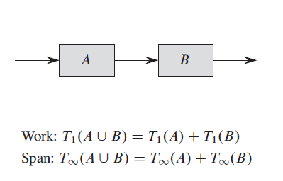
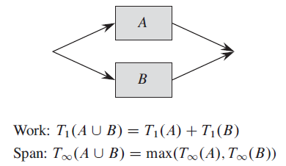
Analyzing multithreaded algorithms
We have two sub-computations A and B.
If they are joined in series:
If they are joined in parallel:

Slide 25
Analyzing multithreaded Fibonacci
T ∞(n) = max(T ∞(n – 1), T ∞(n – 2)) + c
T ∞(n) = T ∞(n – 1) + c
...
T ∞(n) = T ∞(0) + nc
T ∞(n) = Θ(n).
Parallelism of P-FIB(n) is T₁(n)/ T ∞(n) = Θ(φ^{n} / n)
As n increases, the parallelism grows.
T ∞(n – 2) ≤ T ∞(n – 1)
T ∞(n – 1) =max(T ∞(n – 2) + T ∞(n – 3)) + c

Slide 26
Agenda
Background
Nested parallelism
Work, span, and parallelism
Parallel loops
Multithreaded merge sort

Slide 27
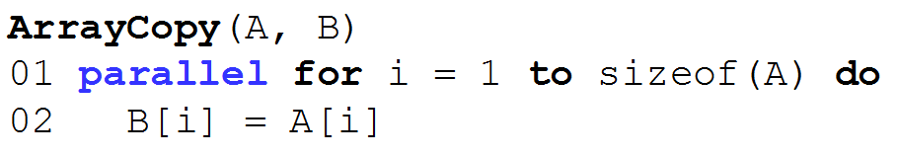
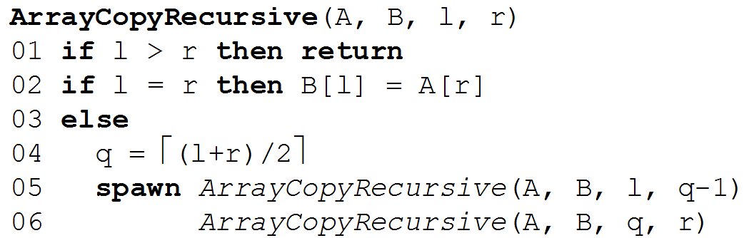
Concurrency keywords: parallel
Parallel for parallel loops
Just like a for loop but loop executions run concurrently
Implemented in a divide-and-conquer manner by using spawn.
Here, we only make 1 spawn.
What if we make 2 spawns?
And what if we make n-1 spawns?
Span: T∞(n) = max(T∞(n/2), T∞(n /2))= T∞(n /2)+c=Θ(lgn)
Work: T₁(n) = 2T₁(n/2)+c=Θ(n)

Slide 28
Why not spawn n-1 times?
Creating a thread is not free, but takes some time.
Assume that it takes constant time c.
Implemented in a divide-and-conquer manner by using one (or a constant number of) spawn(s).
Using one spawn
Span: T∞(n) = max(T∞(n/2), T∞(n /2)) + c
T∞(n) = T∞(n /2) + c
Θ(lgn)
Work: T₁(n) = T₁(n/2) + T₁(n/2)
T₁(n) = 2T₁(n/2) + c
Θ(n)

Slide 29
Why not spawn n-1 times?
Creating a thread is not free, but takes some time.
Assume that it takes constant time c.
Using two spawns
Span: T∞(n) = max(T∞(n/3), T∞(n /3), T∞(n /3)) + 2c
T∞(n) = T∞(n /3) + 2c
Θ(lgn)
Work: T₁(n) = 3T₁(n/3) + 2c
Θ(n)

Slide 30
Why not doing n copies in parallel?
Creating a thread is not free but takes some time.
Assume that it takes constant time c.
If we make n-1 spawn threads and each thread copies one element, then we have the following:
Span: T∞(n) = max(T∞(n/n), ..., T∞(n/n)) + (n-1)*c=
T∞(n) = a+(n-1)*c
Θ(n)
Work: T₁(n) = nT₁(1) + (n-1)*c
Θ(n)

Slide 31
Why not doing n copies in parallel?
Creating a thread is not free but takes some time.
Assume that it takes constant time c.
Assume that we have P processing units, and we make P-1 spawn threads.
Span: T_{P}(n) = max(T_{P}(n/P), ..., T_{P}(n/P)) + (P-1)*c
T_{P}(n) = T_{P}(n/P)+(P-1)*c
Θ(Plg_{P}n)
Assume that P=2, T_{P}(n) = Θ(2lg₂n)=Θ(lgn)
Assume that P=3, T_{P}(n) = Θ(3lg₃n)=Θ(lgn)
Assume that P=n, T_{P}(n) = Θ(nlg_{n}n)=Θ(n)

Slide 32
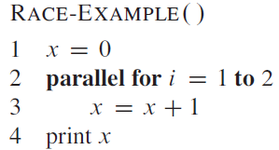
Race conditions
Race conditions happen when
Two logically parallel instructions access the same memory location and at least one of the instructions performs a write.
How to avoid?
Need to make sure that the two threads are independent - no writing to memory that other threads are reading from.

Slide 33
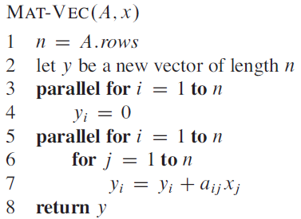







Matrix-vector multiplication
A n*n matrix multiplies a n*1 vector. We get a n*1 vector.
i: row
j: column
O(n²)
Can we make this also
a parallel loop?
$$\begin{matrix}a11 & a12 \\ a21 & a22 \\ … & …\end{matrix}$$
$$\begin{matrix}… & a18 \\ … & a28 \\ … & …\end{matrix}$$
$$\begin{matrix}x1 \\ x2\end{matrix}$$
The first parallel loop: same with ArrayCopy that we just saw.
The second parallel loop: a bit complicated.
Still use D&C and Spawn.
Base case is the for loop with j.
$$\begin{matrix}… \\ x8 \end{matrix}$$
$$\begin{matrix}a81 & a82 \\ & \\ & \end{matrix}$$
$$\begin{matrix}… & a88 \\ & \\ & \end{matrix}$$
Notes:
No parallel for in line 6 but only a normal for loop.
Race condition.

Slide 34

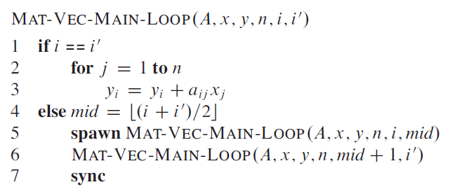
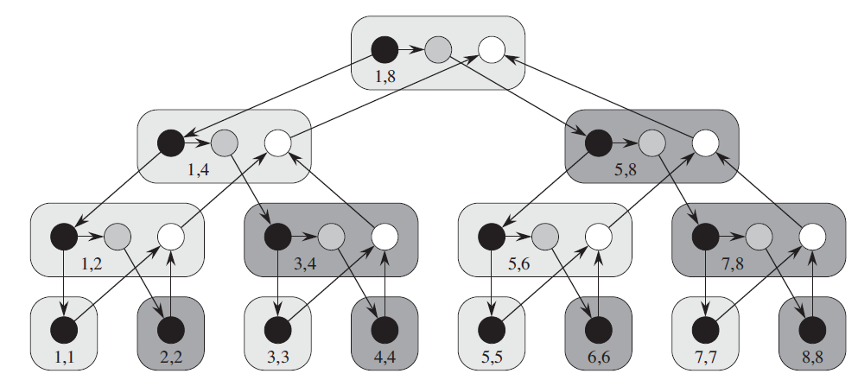
The second parallel loop
A: input matrix.
x: input vector.
y: output vector.
n: the dimension of the vector.
i and i’: start and end positions.
Lines 1-5
Lines 6-7

Slide 35
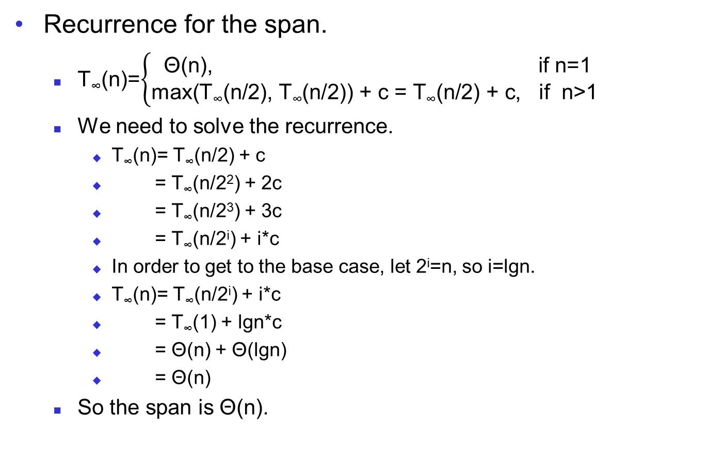


Analysis
Recurrence for the span.
T∞(n)=$\left\{\begin{aligned}\text{Θ}\text{(}\text{n}\text{), }\text{if} \text{n}\text{=1} \\ \text{m}\text{ax}\text{(}\text{T}\text{∞}\text{(}\text{n}\text{/2), }\text{T}\text{∞}\text{(}\text{n}\text{/2)}\text{) + }\text{c}\text{ =} \text{T}\text{∞}\text{(}\text{n}\text{/2) + }\text{c}\text{, }\text{if} \text{n}\text{>1 }\end{aligned}\right.$
We need to solve the recurrence.
T∞(n)= T∞(n/2) + c
= T∞(n/2²) + 2c
= T∞(n/2³) + 3c
= T∞(n/2^{i}) + i*c
In order to get to the base case, let 2^{i}=n, so i=lgn.
T∞(n)= T∞(n/2^{i}) + i*c
= T∞(1) + lgn*c
= Θ(n) + Θ(lgn)
= Θ(n)
So the span is Θ(n).
T∞(n/2) = $\text{T}\text{∞}\text{(}\text{n}\text{/4) +} \text{c}$
$\text{T}\text{∞}\text{(}\text{n}\text{/4) }$= $\text{T}\text{∞}\text{(}\text{n}\text{/8) +}\text{c}$
Notes:
Since the tree is a full binary tree, the number of internal nodes is 1 fewer than the n leaf nodes, so this extra work is Θ(n).
Each leaf node corresponds to one iteration of loop, and the extra work of recursive spawning can be amortized across the work of the iterations, so that it contributes only constant work.
Concurrency platforms sometimes coarsen the recursion tree by executing several iterations in each leaf, reducing the amount of recursive spawning.
The span is increased by Θ(lg n) due to the addition of the recursion tree for Mat-Vec-Main-Loop, which is of height Θ(lg n). In some cases (such as this one), this increase is washed out by other dominating factors (e.g., the span in this example is dominated by the nested loops).
Continuing with our example, the span is Θ(n) because even with full utilization of parallelism the inner for loop still requires Θ(n)

Slide 36

Analysis
Recurrence for the work.
T₁(n)=$\left\{\begin{aligned}\text{Θ}\text{(}\text{n}\text{), }\text{if} \text{n}\text{=1 } \\ \text{2}\text{T}\text{1}\text{(}\text{n}\text{/2)}\text{ + }\text{c}\text{, }\text{if} \text{n}\text{>1}\end{aligned}\right.$
The work is Θ(n²) due to the nested loops in 5-7
The parallelism Θ(n²)/ Θ(n)= Θ(n)
Notes:
Master method does not work.

Slide 37
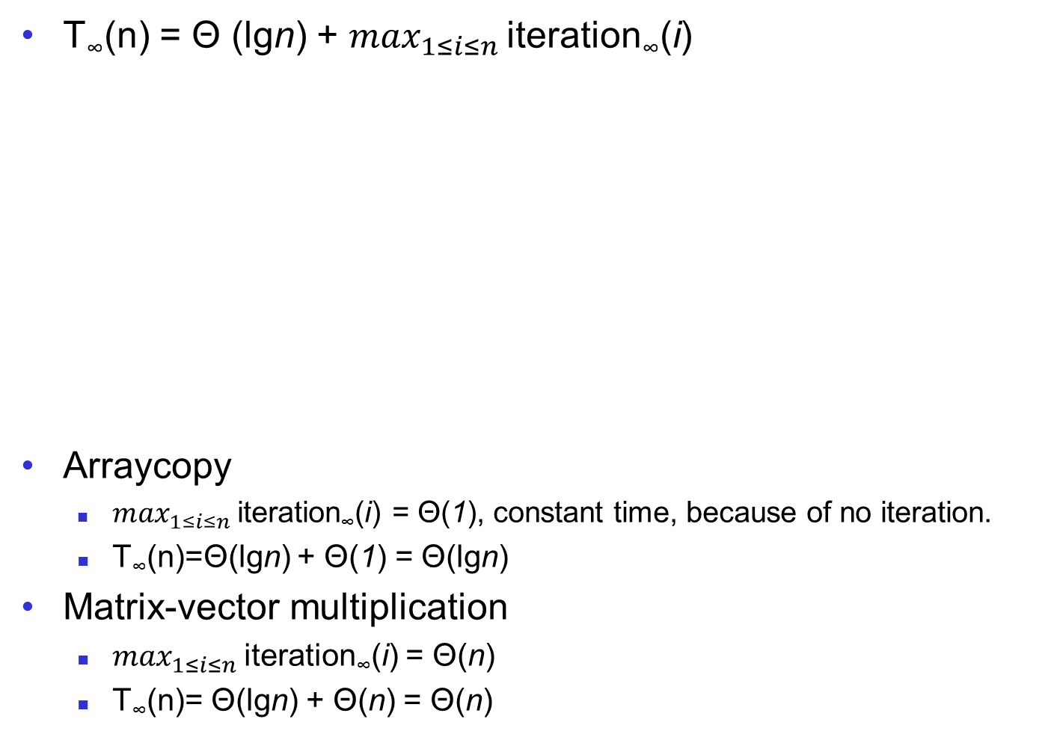
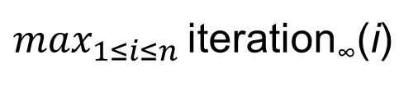
Analysis of parallel loops
iteration∞(i):
the span of
the i-th iteration in
the parallel loop.
T∞(n) = Θ (lgn) + $\max_{1≤i≤n}$ iteration∞(i)
Arraycopy
$\max_{1≤i≤n}$ iteration∞(i) = Θ(1), constant time, because of no iteration.
T∞(n)=Θ(lgn) + Θ(1) = Θ(lgn)
Matrix-vector multiplication
$\max_{1≤i≤n}$ iteration∞(i) = Θ(n)
T∞(n)= Θ(lgn) + Θ(n) = Θ(n)
Height of the
recursion tree
is Θ (lgn)
$\max_{1≤i≤n}$ iteration∞(i)

Slide 38
Agenda
Background
Nested parallelism
Work, span, and parallelism
Parallel loops
Multithreaded merge sort

Slide 39
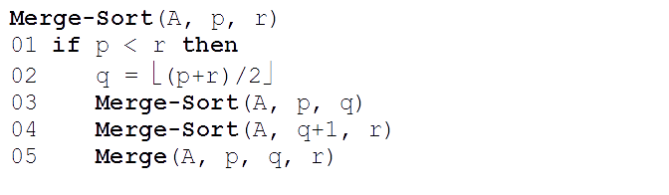
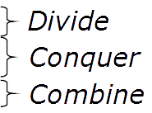
Merge sort
Run-time?
T(n)=2T(n/2)+ Θ(n)
Θ(nlgn)
T(n) = aT(n/b) + f(n)
a=2, b=2, f(n) = n
→n^{log}bª = n^{log}2² = n == f(n)
T(n) = Θ(nlgn)
Notes:
O(n) is for merge

Slide 40
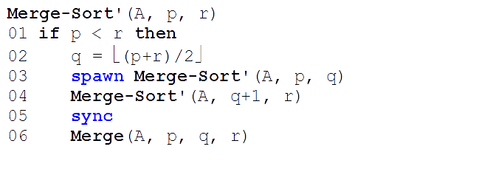
Multithreaded merge sort
Work: use W to denote T₁
W(n)=2W(n/2)+ Θ(n)
=Θ(nlgn), the same with serialized merge sort.
Span: use S to denote T∞
S(n)=max(S(n/2), S(n/2))+ Θ(n)
=S(n/2)+Θ(n)
=Θ(n)
Parallelism
W(n)/S(n)= Θ(nlgn)/Θ(n) = Θ(lgn).
The parallelism is rather low.
Can we do better, i.e., higher parallelism?
If yes, which part can we further improve?
Notes:
A=1 b=2
F(n/2)<=c 5n
5n/2<= c 5n

Slide 41
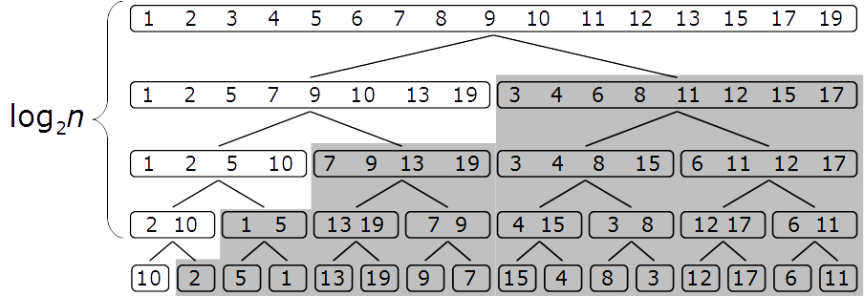
Merge
The bottleneck: the Merge() function is very serial.
At the top level, only one processor does Θ(n) work in serial!
At the second level, only two processors do Θ(n) work.
…
Can we make Merge more parallel?

Slide 42
Multithreaded merge
Main idea – make Merge() divide-and-conquer and use nested parallelism.
P-Merge
p1
p2
Input
1
2
5
7
10
11
13
16
3
4
6
8
9
12
14
15
1. Get middle element, pivot
2. Do binary search
Output
1
2
3
4
5
6
7
8
9
10
11
12
13
14
15
16
3. Place the pivot to the output, do 4 and 5 in parallel
4.Merge left halfs, place the result to the left of pivot
5.Merge right halfs, place the result to the right of pivot
P-Merge
P-Merge
1
2
5
7
3
4
6
8
9
11
13
16
12
14
15
1
2
3
4
5
6
7
8
9
11
12
13
14
15
16
Notes:
To find the four lists for which this works, we
Choose the longer list to be the first list, T[p₁ .. r₁] in the figure below.
Find the middle element (median) of the first list (x at q₁).
Use binary search to find the position (q₂) of this element if it were to be inserted in the second list T[p₂ .. r₂].
Recursively merge
The first list up to just before the median T[p₁ .. q₁-1] and the second list up to the insertion point T[p₂ .. q₂-1].
The first list from just after the median T[q₁+1 .. r₁] and the second list after the insertion point T[q₂ .. r₂].
Assemble the results with the median element placed between them, as shown below.

Slide 43
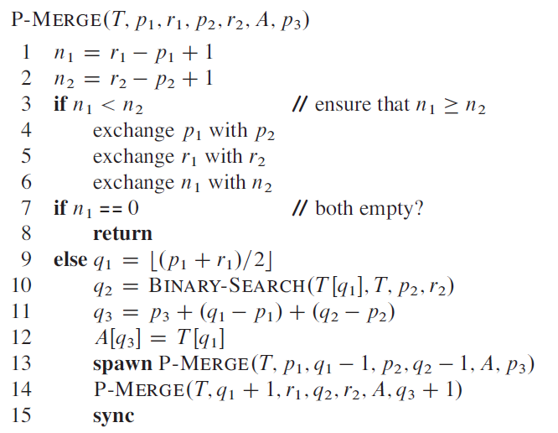
P-Merge
T: input array.
p1… r1 and p2..r2 in T: two sorted sub-array.
A: output array.
p3: starting position in A.
Why do we need to make sure n₁≥ n₂?
q₁: the middle element’s index.
T[q₁]: the pivot element.
Binary search for T[q₁] from p₂ to r₂ elements in T.
Place the pivot in
the right place in A.
Merge the left and right halves in parallel.

Slide 44
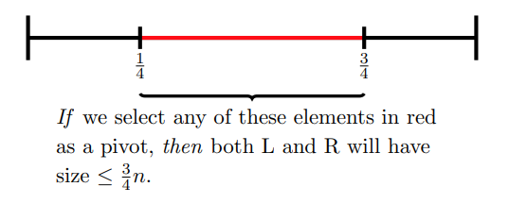
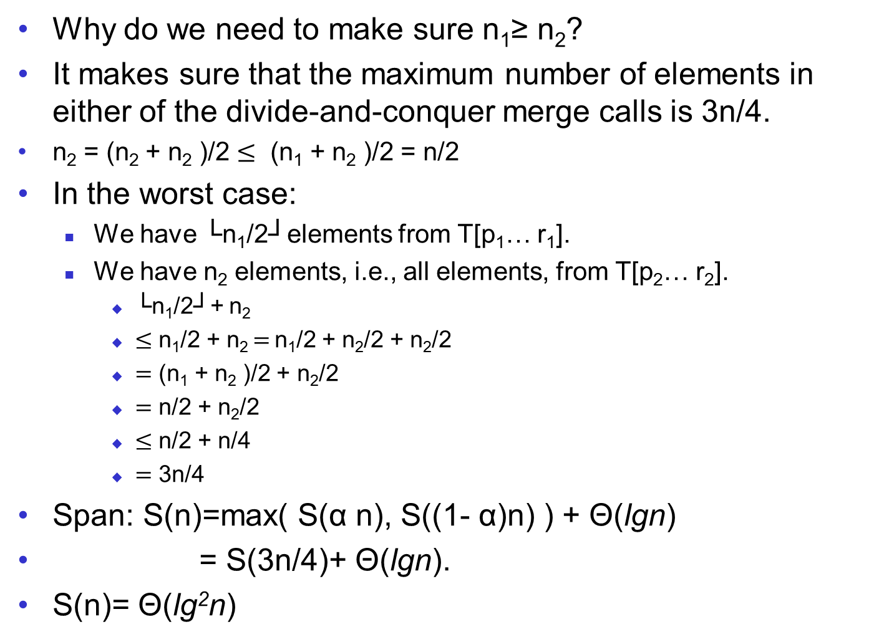
P-Merge
Why do we need to make sure n₁≥ n₂?
It makes sure that the maximum number of elements in either of the divide-and-conquer merge calls is 3n/4.
n₂ = (n₂ + n₂ )/2 $≤$ (n₁ + n₂ )/2 = n/2
In the worst case:
We have └n₁/2┘elements from T[p₁… r₁].
We have n₂ elements, i.e., all elements, from T[p₂… r₂].
└n₁/2┘+ n₂
$≤$ n₁/2 + n₂ $=$ n₁/2 + n₂/2 + n₂/2
$=$ (n₁ + n₂ )/2 + n₂/2
$=$ n/2 + n₂/2
$≤$ n/2 + n/4
$=$ 3n/4
Span: S(n)=max( S(α n), S((1- α)n) ) + Θ(lgn)
= S(3n/4)+ Θ(lgn).
S(n)= Θ(lg²n)
Running time for binary search.
See exercise 4.6-2, CLRS.
Extension to Master Method.
Notes:
Lgn : Binary search in line 10
No master method: a=1 b=4/3
F(3n/4)<=cf(n)
The work performed by the algorithm for two arrays holding a total of n elements, i.e., the running time of a serial version of it, is O(n). This is optimal since n elements need to be copied into C. To calculate the span of the algorithm, it is necessary to derive a Recurrence relation. Since the two recursive calls of P-Merge are in parallel, only the costlier of the two calls needs to be considered. In the worst case, the maximum number of elements in one of the recursive calls is at most {\textstyle {\frac {3}{4}}n} since the array with more elements is perfectly split in half. Adding the {\displaystyle \Theta \left(\log(n)\right)} cost of the Binary Search, we obtain this recurrence as an upper bound:

Slide 45
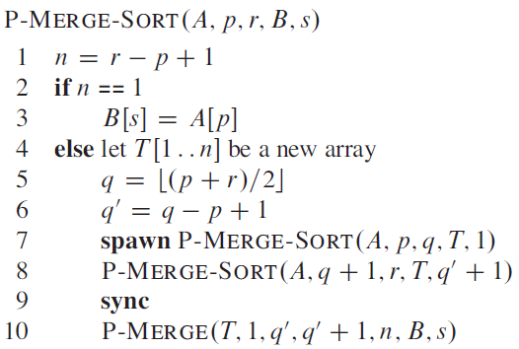
Multithreaded Merge Sort with P-Merge
Work: W(n)= Θ(nlgn)
Span: S(n)=max(S(n/2)+S(n/2))+Θ(lg²n) =S(n/2)+ Θ(lg²n)
Θ(lg³n)
Parallelism: Θ(n lgn) / Θ(lg³n) = Θ(n / lg²n)
This is a better (higher) parallelism compared to Θ(lgn).
P-Merge-Sort
P-Merge

Slide 46
To summarize
Work: Θ(nlgn)
 | Merge Procedure | Span | Parallelism
Naïve merge | Θ(n) | Θ(n) | Θ(lgn)
P-Merge | Θ(lg²n) | Θ(lg³n) | Θ(n / lg²n)

Slide 47
Goal of the multi-threaded algorithm design
Goal of the multi-threaded algorithm design – increase parallelism.
Parallelism = work / span
Usually achieved by decreasing span
MergeSort without P-Merge and with P-Merge
Θ(n) vs. Θ(lg³n)
It may pay off to slightly increase work, if span can be decreased significantly (in practice, relevant for highly parallel systems, such as supercomputers, GPUs)

Slide 48
ILO of Lecture 10
Multithreaded algorithms
to understand the model of dynamic multithreading, including nested parallelism and parallel loops;
to understand work, span, and parallelism — the concepts necessary for the analysis of multithreaded algorithms;
to understand and be able to analyze the multithreaded merge sort algorithm.

