Slide 1
Question 5
Clustered Storage

Slide 2
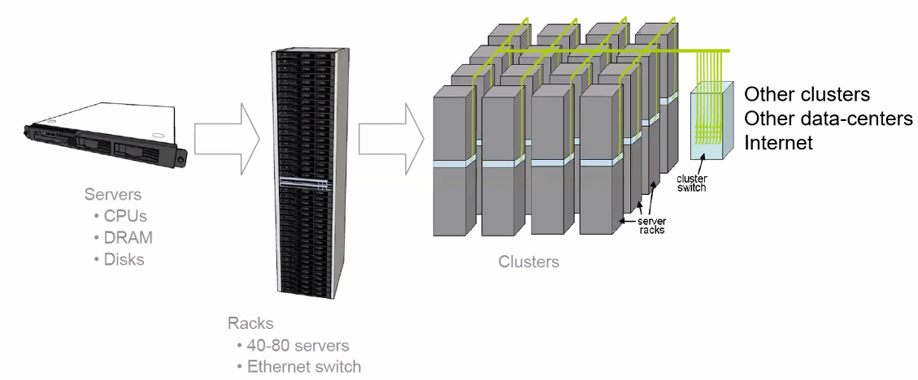

Slide 3
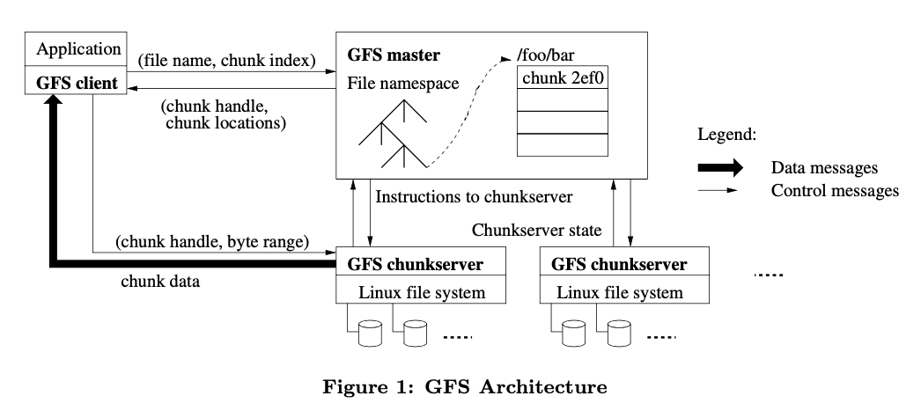

Slide 4
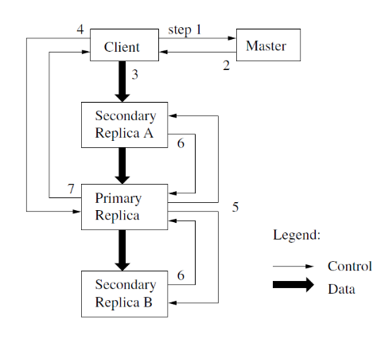

Slide 5
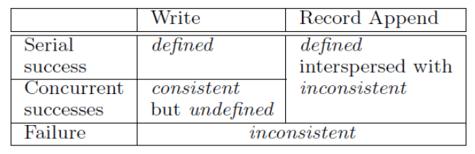

Slide 6
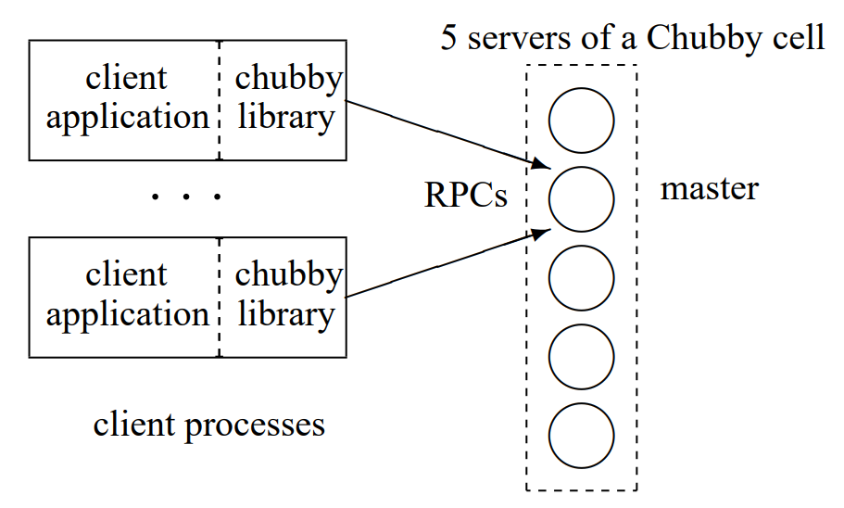

Slide 7
fh = Open(“/ls/exampleCell/gfs/master”)
success = tryAcquire(fh)
if(success) write(fh, myID)

Slide 8
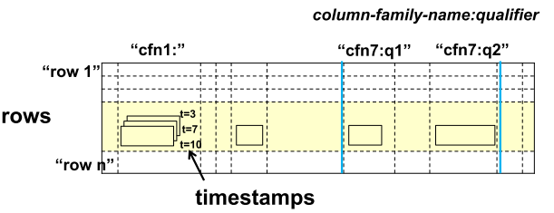
(row: String, column: String, time: int64) -> String

Slide 9
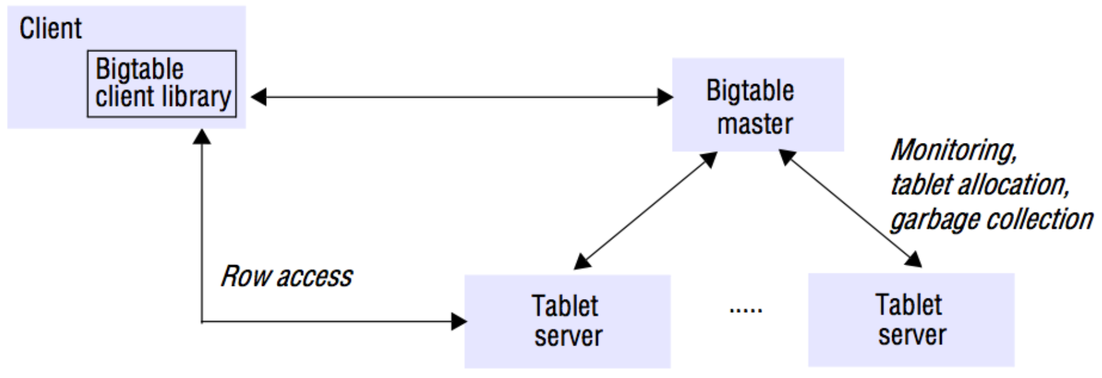

Slide 10
