Slide 1
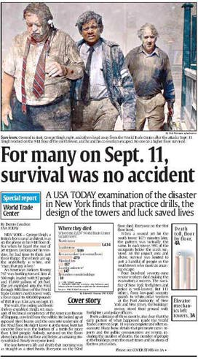
World Trade Center Survivors: USA Today

Slide 2

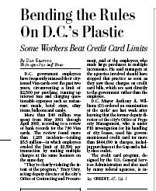
Credit cards
Notes:
One D.C. teacher, for example, had 10 charges on a Friday last November totaling $ 15,805 at Capital Services & Supply, an office supply store, and 18 other charges the following Monday totaling $ 20,000. On March 8, 2002, a school business manager had five charges for $ 2,492.50 apiece, plus one for $ 537.50, at Arie's Supply in Herndon, for a total of $ 13,000.
Another story later detailed spending at one vendor, that no one could say what was purchased or where the money went. That vendor and the employee are now under investigation by the U.S. Attys office.

Slide 3
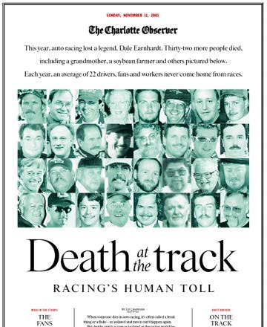
Death at the Track: Racing's Human Toll
Notes:
Created a database of all racing deaths they could find. Findings: A surprising number of people die at the track, many of them fans who were unaware of the dangers.

Slide 4
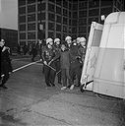
Battered Cargo, The Philadelphia Inquirer
Notes:
This Inquirer series detailed a secret but enduring tradition in Philadelphia policing: the wild wagon ride. Again and again, the newspaper found, handcuffed suspects were placed in the back of police wagons that lacked seatbelts or protective padding and were tossed about the hard interior as the driver made sudden stops and sharp turns. Passenters in the wagons sustained serious injury, and the city had paid out more than $2.3 million in legal settlements for the practice. The investigation started when the paper begain reviewing cases of alleged excessive force; by building a database the paper was able to expose teh hidden form of police brutality that was known by police as the "nickel ride." So longstanding was the practice that the term used to describe it traced back to the days when an amusement park ride cost five cents.

Slide 5
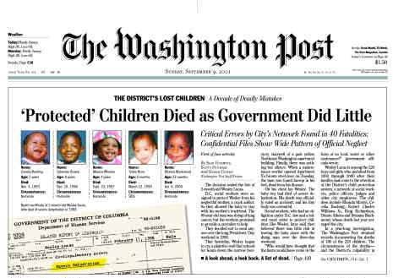
The District's Lost Children
Notes:
The Washington Post
Self-made database of all children who died after coming to the attention of government workers, along with the recommendations for improving performance they made in conneciton with those deaths.
Findings: 40 boys and girls, mainly infants and toddler, died after the city failed to act to protect them or actually put them in danger.

Slide 6
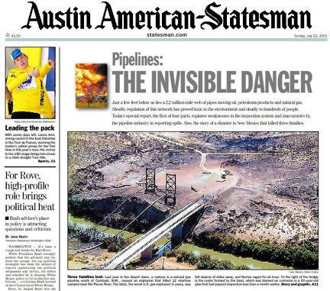
Pipelines, The Invisable Danger: Austin American-Statesman
Notes:
Austin American Statesman

Slide 7

Death in the Workplace : Orange County Register

Slide 8
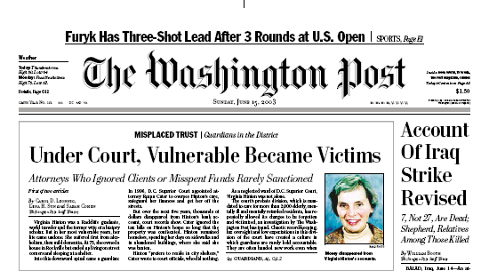
Guardians
Notes:
The court’s probate division, which is mandated
to care for more than 2,000 elderly, mentally
ill and mentally retarded residents, has repeatedly
allowed its charges to be forgotten
and victimized, an investigation by The Washington
Post has found. Chaotic record-keeping,
lax oversight and low expectations in this division
of the court have created a culture in
which guardians are rarely held accountable.
They are often handed new work even when they have ignored their charges or
let them languish in unsafe conditions.
The Post’s review of more than
10 years of case dockets and hundreds
of court files, as well as interviews
with more than 200
judges, attorneys, and clients and
their families, found hundreds of
cases where court-appointed protectors
violated court requirements.
Since 1995, one of five
guardians has gone years without
reporting to the court. Some have
not visited their ailing charges. In
more than two dozen cases, guardians
or conservators have taken or
mishandled money.

Slide 9
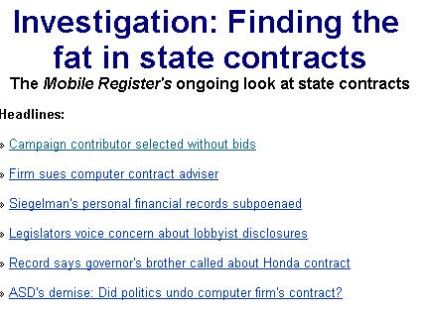
Finding The Fat in Government Contracts : The mobile register

Slide 10
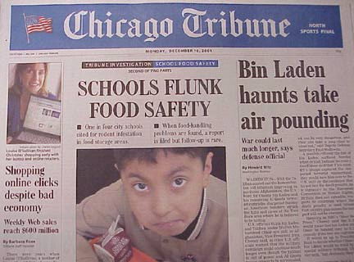
School Food Safety
Notes:
School food illness outbreaks have become increasingly frequent across the U.S. and the Chicago Tribune found dangerous practices exist in the factories where school food is made and in the kitchens and cafeterias where it is served. This national investigation required FOIA work at the federal, state and local levels because when federal agencies released records to the Tribune on school illness outbreaks, they follwed industry-driven guildelines and deleted portions that would show where the outbreaks occurred, how many children were affected and who manufactured the food. The Tribune had to use other sources to determine that information.

Slide 11

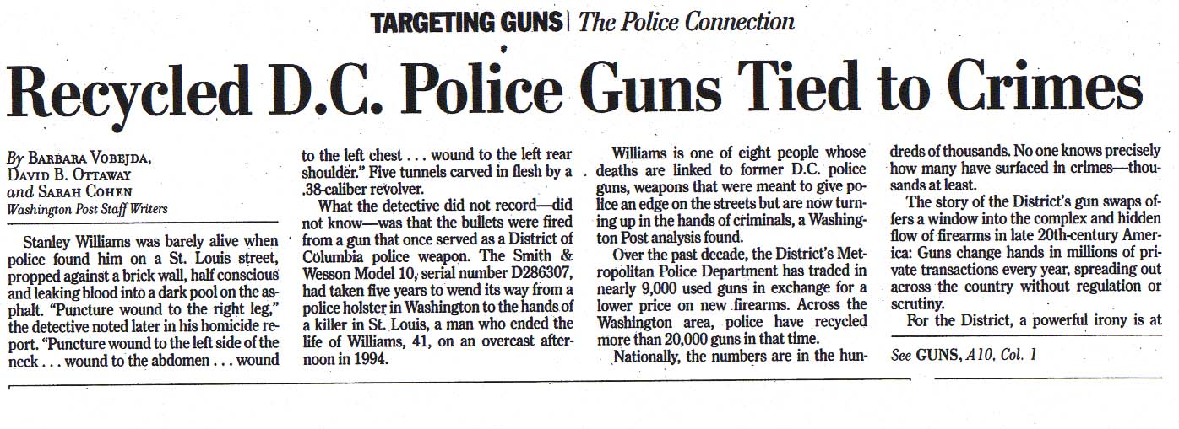
Recycled guns
Notes:
The Washington Post
Data: Redacted version of the ATF Firearms Tracing System; Virginia State Police database of recovered weapons; database hand-entered by the Post of firearm sold or traded in by the D.C, Baltimore County and Virginia State police departments; and the ATF multiple-sales database.
Findings: The Post linked the deaths of eight people to former D.C. police guns, weapons that were meant to give police an edge on the streets but are now turning up in the hands of criminals. Over the past decade, the District's Metropolitan Police Department has traded in nearly 9,000 used guns in exchange for a lower price on new firearms. Across the Washington area, police have recycled more than 20,000 guns in that time. Nationally, the numbers are in the hundreds of thousands. No one knows how many have surfaced in crimes--thousands at least.

Slide 12

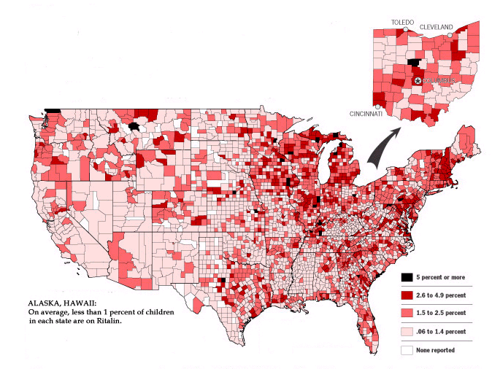
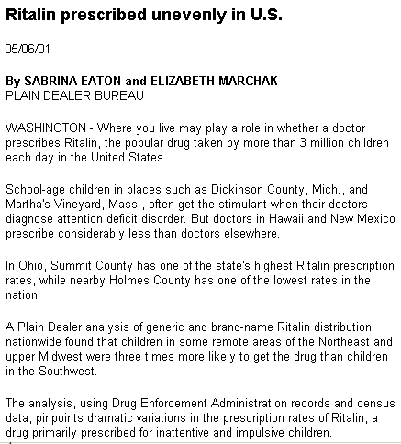
Plain Dealer: Ritalin
Notes:
The Cleveland Plain Dealer
Data: Ritalin prescription data from the Drug Enforcement Administration, US Census data.
Findings: A Plain Dealer analysis of generic and brand-name Ritalin distribution nationwide found that children in some remote areas of the Northeast and upper Midwest were three times more likely to get the drug than children in the Southwest.

Slide 13

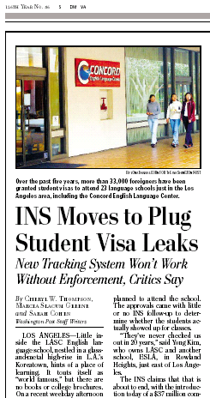
The Washington Post: INS

Slide 14
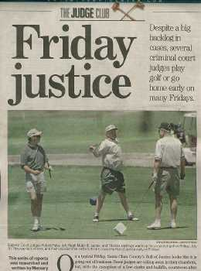
San Jose Mercury News Friday Justice
Notes:
Four reporters and a photographer worked the story. They checked the judges courtrooms twice a way to see if they were open or closed. If a courtroom was closed, they checked the parking lot to see if the judges cars was gone. On Friday, they followed the judges as they left to go golfing.
Among unique sources of data: The Northern California Golf Association handicap index, where judges and other submit their scores and dates of play for tournament handicaps. Voter registration (most of the judges vote..) for home addresses. Vacation records.

Slide 15
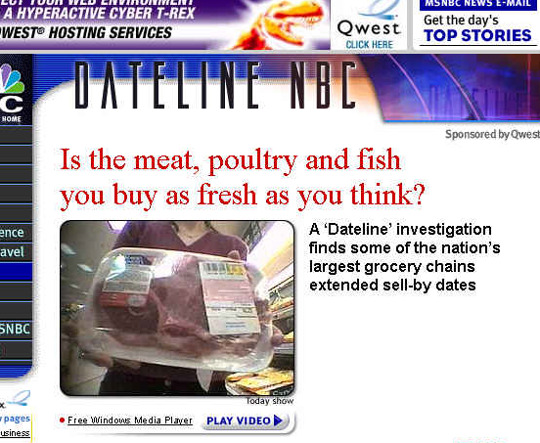
Dateline NBC: Sell-by dates
Notes:
Dateline used a novel approach to finding out whether sell-by dates on meats were faked: It created a small, round impression that it then could dial to the date. Reporters went into stores and pressed it against the back of the meat package. They then returned days later and checked their impression against the date on the package.

Slide 16
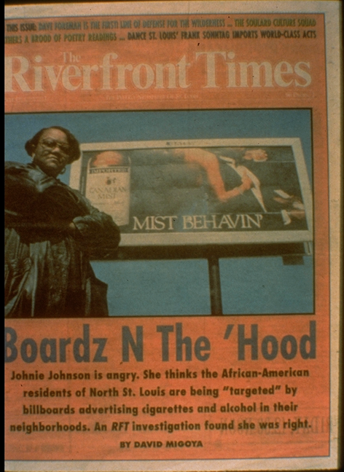
Boardz N The ‘Hood
Notes:
The Riverfront Times had heard the same things that we all have – that “sin” billboards, for liquor, cigarettes and lotteries are disproportionately targeted to minority neighborhoods. What’s interesting was how David Migoya went about proving it. He first found that property records detail the location of every billboard. But no one documents what’s ON those billboards. So he got in his car and drove around. When he was done, he had better questions for the companies and compelling evidence that it was true. They couldn’t deny it anymore.

Slide 17
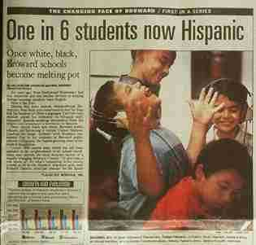
Miami Herald
Notes:
Miami Herald: The Changing Face of Broward-The 1990 census data is getting long in the tooth and in South Florida it's even less useful than elsewhere. That's because immigration, both domestic and foreign, and the aftermath of Hurricane Andrew caused immense demographic shifts. It was clear just by looking that Broward was changing. The question was how to show that. On the 20th day of each school year, the school district counts students by ethnicity and we decided to use that as a kind of surrogate. The Miami Herald assembled four years worth of hot data and waited for the release of the fifth year. It came out on a Tuesday; Thursday was the first day of a three-day series, focusing first on schools and then on the county at large. There were lots of caveats -- particularly because a lot of students in Broward attend private schools. But by combining data analysis with street reporting the Herald was able to present a picture of the county in change.

Slide 18

Philadelphia Inquirer
Notes:
This might be my favorite project last year, because they did some extremely sophisticated reporting to prove something we’ve all suspected: the police in Philadelphia were routinely “downgrading” crimes to show a lower crime rate. Some examples: An elderly man is robbed at knifepoint and it’s classified as a “disturbance.” A woman is raped by one man while four others watch and the police response is that an investigation of a suspicious person is warranted.
Some of the analysis that helped them know they were pointed in the right direction: Philadelphia has a remarkably low aggravated assault rate compared with other cities. Major cities routinely book 50 assaults for every murder; Philadelphia was booking only 15.. Statisticians know that the murder rate is the far more reliable statistic because it’s hard to “downgrade” a dead body.
Among the results of the story, the new police chief has already remarkably changed reporting standards and he withdrew three years of figures previously reported to the FBI, Residents of Philly can now begin to learn how safe their city is, or isn’t, Already there’s a 9% surge in crime that officials say is due to more complete reporting.

