Slide 1
Tackling numbers in the newsroom
Sarah Cohen | SABEW 2012

Slide 2
What’s a number?
A guess
A summary
An opinion

Slide 3
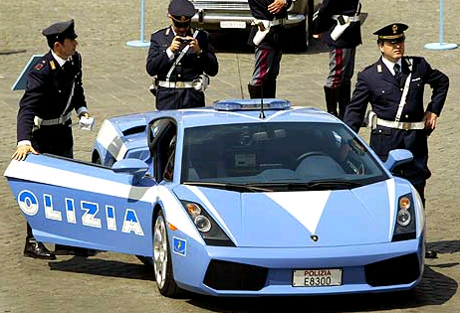
The statistics police
Notes:
Biggest problem with numbers: statistics police, lurking around every corner ready to scold you on rounding errors.

Slide 4


Stranded at sea
Or without a translator
Notes:
How you feel about numbers – we’ve managed to put 26 letters into combinations of things that we can picture, intuitively. Never done that with 10 digits. So here’s how you feel around numbers. At sea, without an anchor or a compass; in a foreign country without a translator.

Slide 5
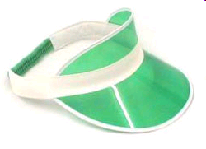

Fear of being wrong
…or boring our readers and viewers
Notes:
Why afraid?

Slide 6
5
Sarah Cohen | SABEW 2012
Notes:
What do you think of with 5? Digits – toes, fingers?

Slide 7
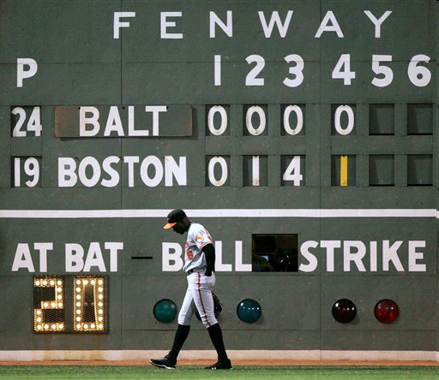
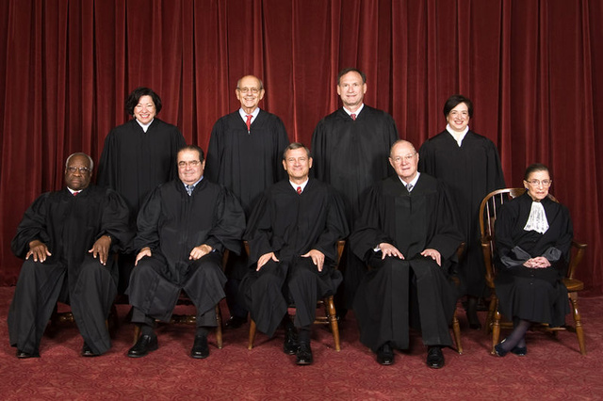
5-4
Sarah Cohen | SABEW 2012

Slide 8
million
billion
Notes:
what’s 304 million? (people in U.S.) What’s billion? one letter – big difference

Slide 9
.0081
Notes:
Death rate in the U.S. each year.

Slide 10
270 million
vs
2.4 million
*can you picture it??

Slide 11
Common mistakes
Too much precision
Too little precision
Ignoring the experts
Deferring to experts too much
Trying too few approaches
Notes:
Too much precision: We start with some number that’s a rough guess with lots of internal problems, then try to work around it as if it’s exactly right. Decimal points – for meaning not emphasis. Make sure your broad point is true no matter how imprecise the numbers are – then it won’t matter if you can’t get an exact figure.
Too little precision: However, in some stories, getting the number exactly right is really important: children who died at the hands of a foster parent, or people killed by police officers. Very small numbers should be exact, or can’t compare.
Ignoring the experts: Soemtimes think we know more than we do, so we just keep going without running it by people who know better. Try to read their literature and learn from them
But then sometimes they are just useless – they insist that no number is good, so we have to ignore them all. In this case, I make them understand that something will be published – up to them if they want to help me make it as good as possible.
A lot of times people get stuck doing one and only one thng. We’ll see next session about visualization, but I want to

Slide 12
Key math skills
Averages
Changes
Rates
Percentages

Slide 13
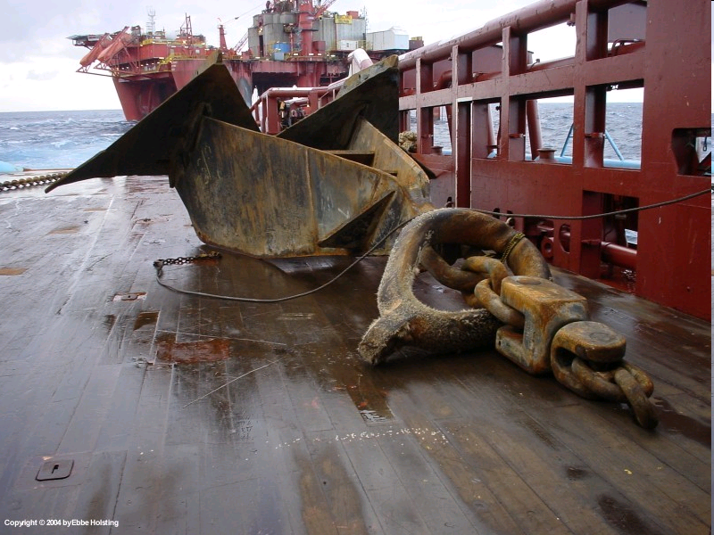
Anchors
A standard or goal
Historical numbers
Portion of a whole
Other places

Slide 14
Writing tips
Fewer than eight digits per paragraph
Memorize
Round off
Think in ratios
Use common devices
Envision success
Learn from other media

Slide 15
Questions
Sarah.cohen@nytimes.com

