Slide 1
The theme:
Using leaked documents more effectively

Slide 2
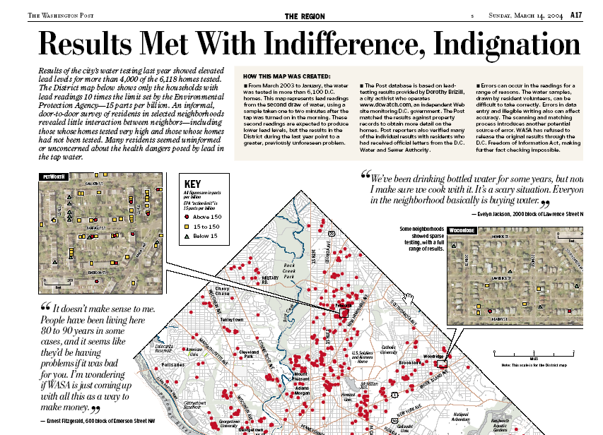

Slide 3
The theme:
Imaginative story conception
A few cases thoroughly reported using all techniques available

Slide 4
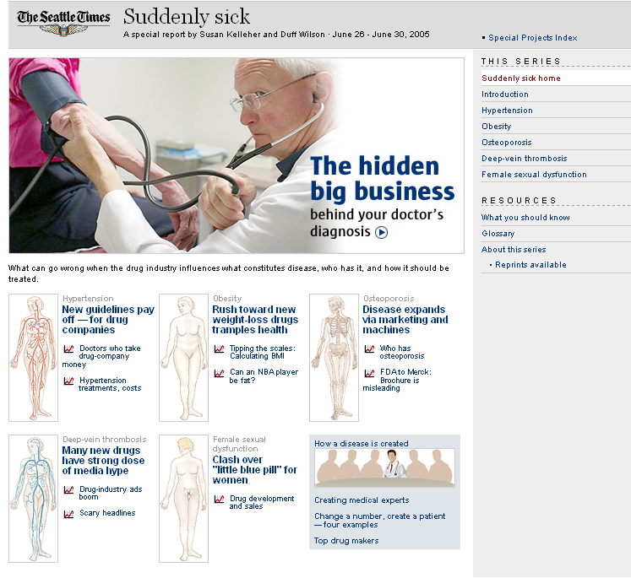
Notes:
You walk into your doctor's office for a physical exam and step on the scale. Last year, the doctor said you were overweight. Now he says you are obese — at the same weight.
A nurse takes your blood pressure. You have hypertension — with the same previously healthy reading you've had for years.
The doctor scans your wrist bone. You have a condition called "osteopenia" — with the same bone density that was fine last time you were measured.
You mention you are not enjoying sex as much as you used to. Diagnosis: a new kind of sexual dysfunction.
You leave the office with a head full of worry and a fistful of new prescriptions, joining more than 40 percent of Americans who take one or more prescribed drugs daily in the effort to stave off more serious trouble.
You are suddenly sick, simply because the definitions of disease have changed. And behind those changes, a Seattle Times examination has found, are the companies that make all those newly prescribed pills.
The Times found that:
• Pharmaceutical firms have commandeered the process by which diseases are defined. Many decision makers at the World Health Organization, the U.S. National Institutes of Health and some of America's most prestigious medical societies take money from the drug companies and then promote the industry's agenda.
• Some diseases have been radically redefined without a strong basis in medical evidence.
• The drug industry has bolstered its position by marketing directly to the health-conscious consumer, leading younger and healthier people to consider themselves at risk and to start taking medications.

Slide 5
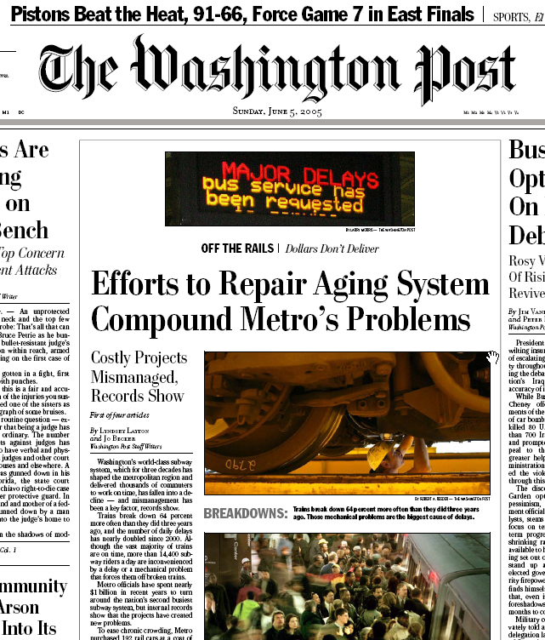

Slide 6
The theme:
Cajoling for records, when they are not clearly public

Slide 7
The theme:
Analyzing data that no one else will in more sophisticated ways

Slide 8
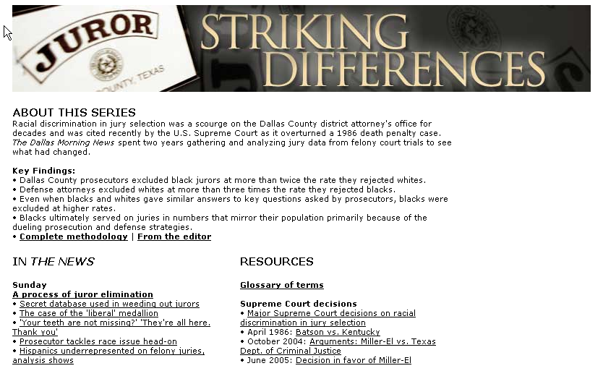

Slide 9
The theme:
Boiling our work down into graphics that tell more than words

Slide 10
