Slide 1
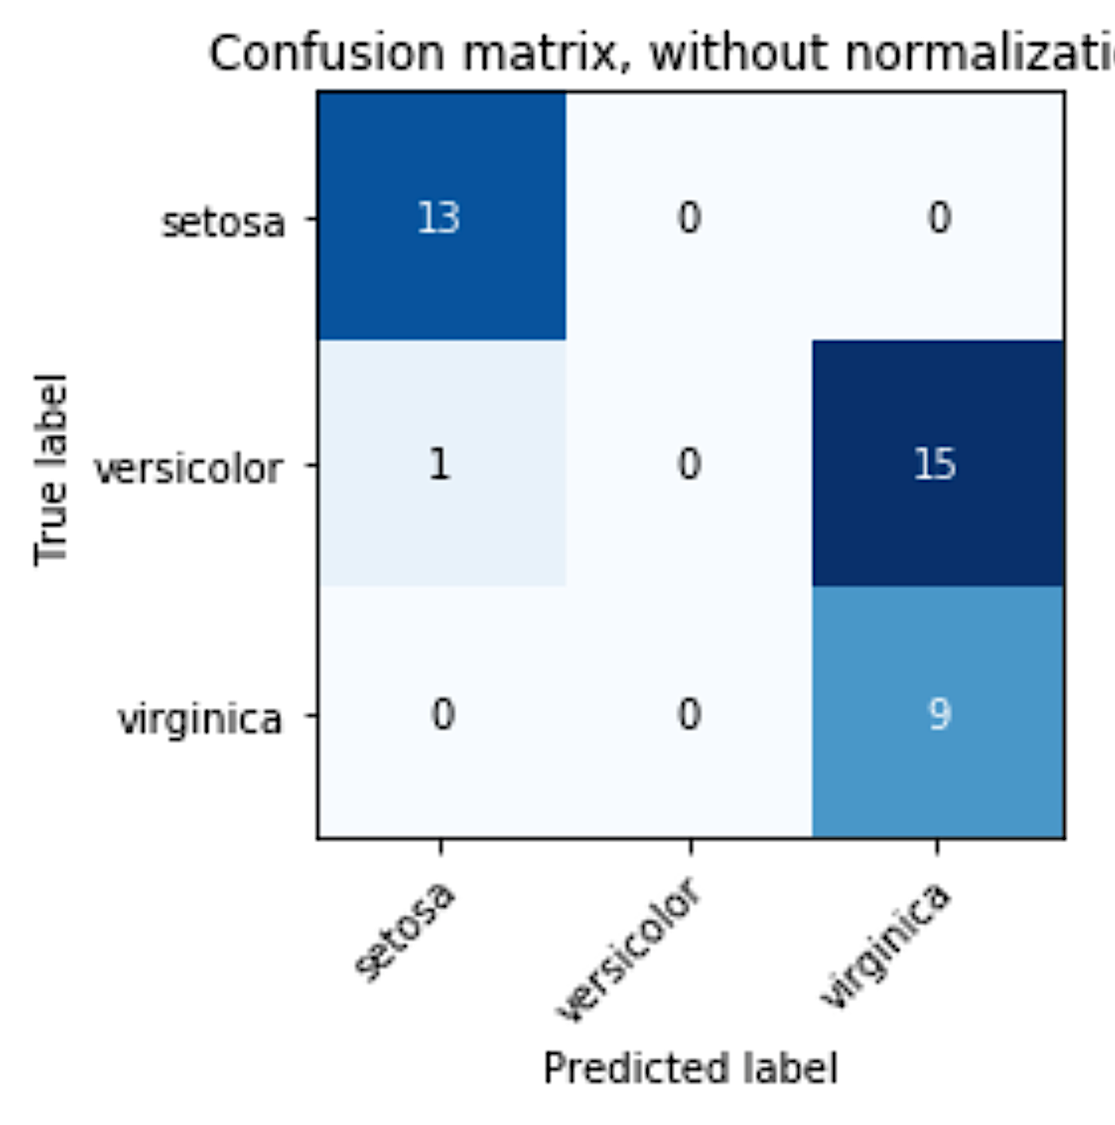
Explanation, truth table, for class ‘Setosa’:
TP = Predicted is ‘Setosa’ with truth is ‘Setosa’
FP = Predicted is ‘Setosa’ with truth is not ‘Setosa’
FN = Predicted is not ‘Setosa’, with truth is ‘Setosa’
TN = Predicted is not ‘Setosa’ with truth is not ‘Setosa’
TP
FN
FP
TN
Exercise (groups)
Identify TP, FP, FN, TN for the other two Classes’ 2x2 confusion matrices – namely for ‘Versicolor’ and ‘Virginica’.
Calculate for each of the three classes:
Accuracy
Precision
Recall
Confusion Matrix: Class 1 (only!)

