Slide 1
5. Architectural Prototyping
Mathias Nielsen

Slide 2
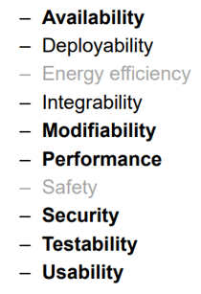
Quality attributes
Et skridt tilbage...
Ticketmaster system eg.
Sql Database

Slide 3
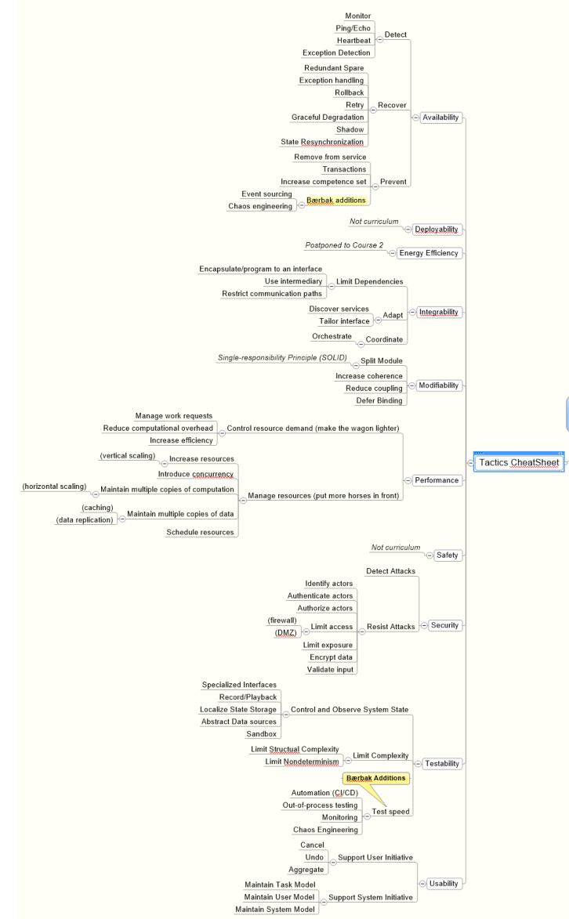

Slide 4
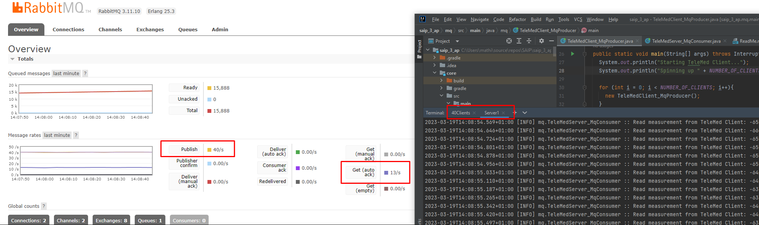
Example
Telemed PUB/SUB / Messagin

Slide 5
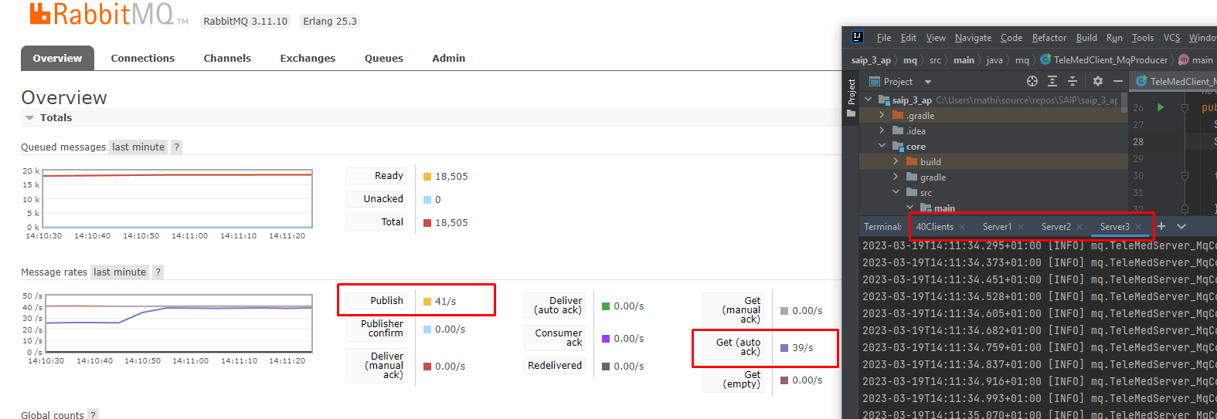

Slide 6
