Slide 1
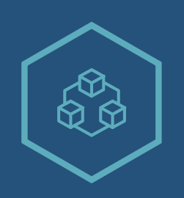
YouRecord
Empowering Patients, Assisting Doctors
by Uniledger

Slide 2
Meet the Team
Alberto Leonardi
Mathias Santoso
Kartikey Badgaiyan

Slide 3
Issues in Healthcare
Patient Data
Slow Treatment
Expensive Healthcare
Distrust in Government held records

Slide 4
Why:
Result: well-being
Data: transparency, completeness, symmetry
Transaction: faster, cheaper, precise
Brand
Implementation – blockchain
Experience – safe, digital and decentralised access to medical record
Job – provide and acquire information
How
Private IDs
What
Health Record
Who
Patients and Doctors

Slide 5
Value Proposition
We offer a blockchain solution which allows patients to have full control of their personal health record, and grant access to the doctors they visit whenever and wherever they wish.

Slide 6
Blockchain Usage
Novelty/Uniqueness
Cross-border decentralised health record system
Only patient and their doctors have private access to the health records
Effect on society/user
Faster and more accurate diagnosis on patients
More efficient healthcare system
Leveraging blockchain features:
Decentralisation
Trusted data
Eliminating intermediaries (e.g. government as a central healthcare database)

Slide 7
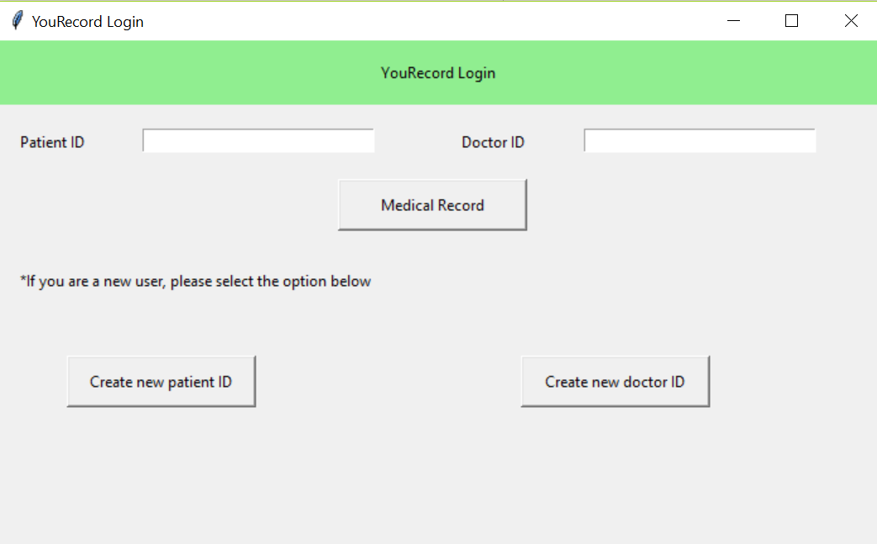
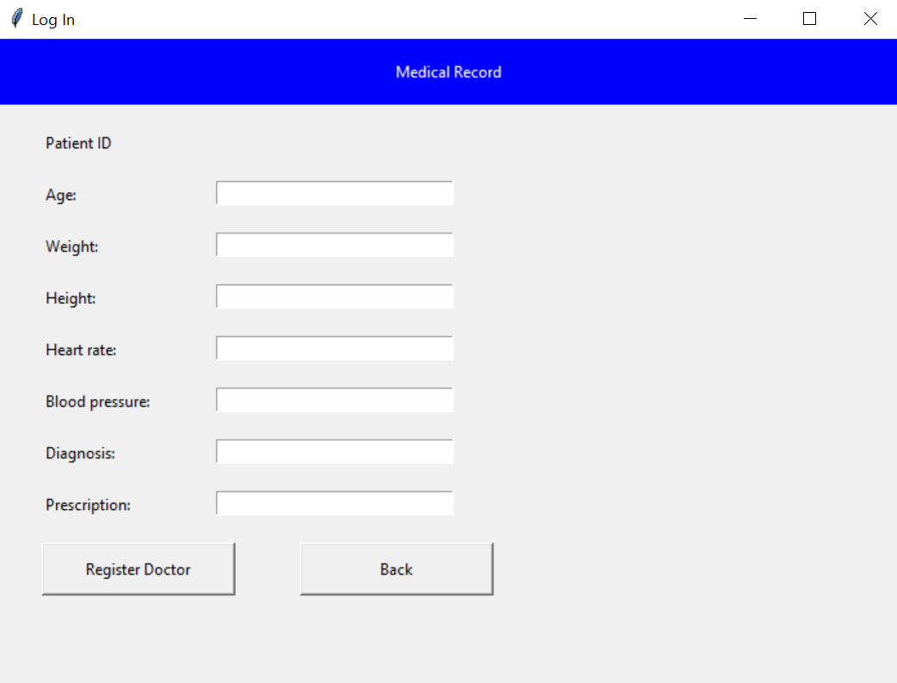
Demo

Slide 8
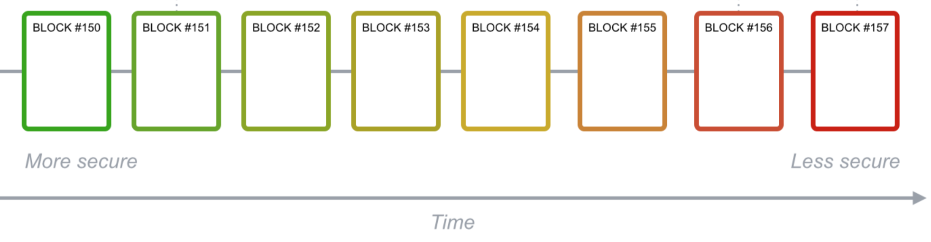
Blockchain Implementation
Patient 1 ID
Patient Details
……
……
Doctor 1 ID
Diagnosis
……
Patient 3 ID
Patient Details
……
……
Doctor 1 ID
Diagnosis
……
Patient 5 ID
Patient Details
……
……
Doctor 1 ID
Diagnosis
……
Patient 1 ID
Patient Details
……
……
Doctor 1 ID
Diagnosis
……
Doctor 2 ID
Diagnosis
……

Slide 9
Market & Competitor Analysis
Australian healthcare spending (2015): $170 billion
Global healthcare spending (2015): $7,071 billion
Existing competitors: MedicalChain (UK)
How we differ:
Cross-border decentralized health record system

Slide 10
Monetary Value
Cost of a medical record

Slide 11
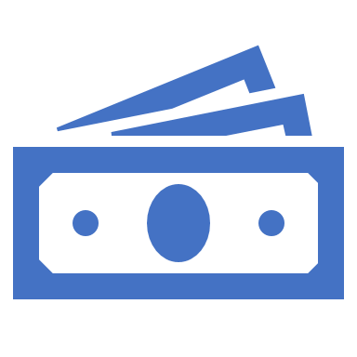
Business Viability
Blockchain-as-a-Service (BaaS) platform
Web-based and mobile-based
Revenue stream:
Registration fee
Pay-as-you-go structure (every doctor visit)
Cost structure:
Maintenance cost
R&D investment

Slide 12
Summary
Complete patient health information in real-time
Faster diagnosis and more effective treatment
Cheaper healthcare
Medical records can be accessed and updated globally

Slide 13
Future Steps
Integration with smart health devices such as fitbit

