Slide 1
ITSMAP Roomienator
2016-10-25
Developed by
Jeppe Malmberg NIelsen
Maria Noerholm Dam
Jonas Bæch
Mathias Siig Nørregaard

Slide 2

Overview

Slide 3
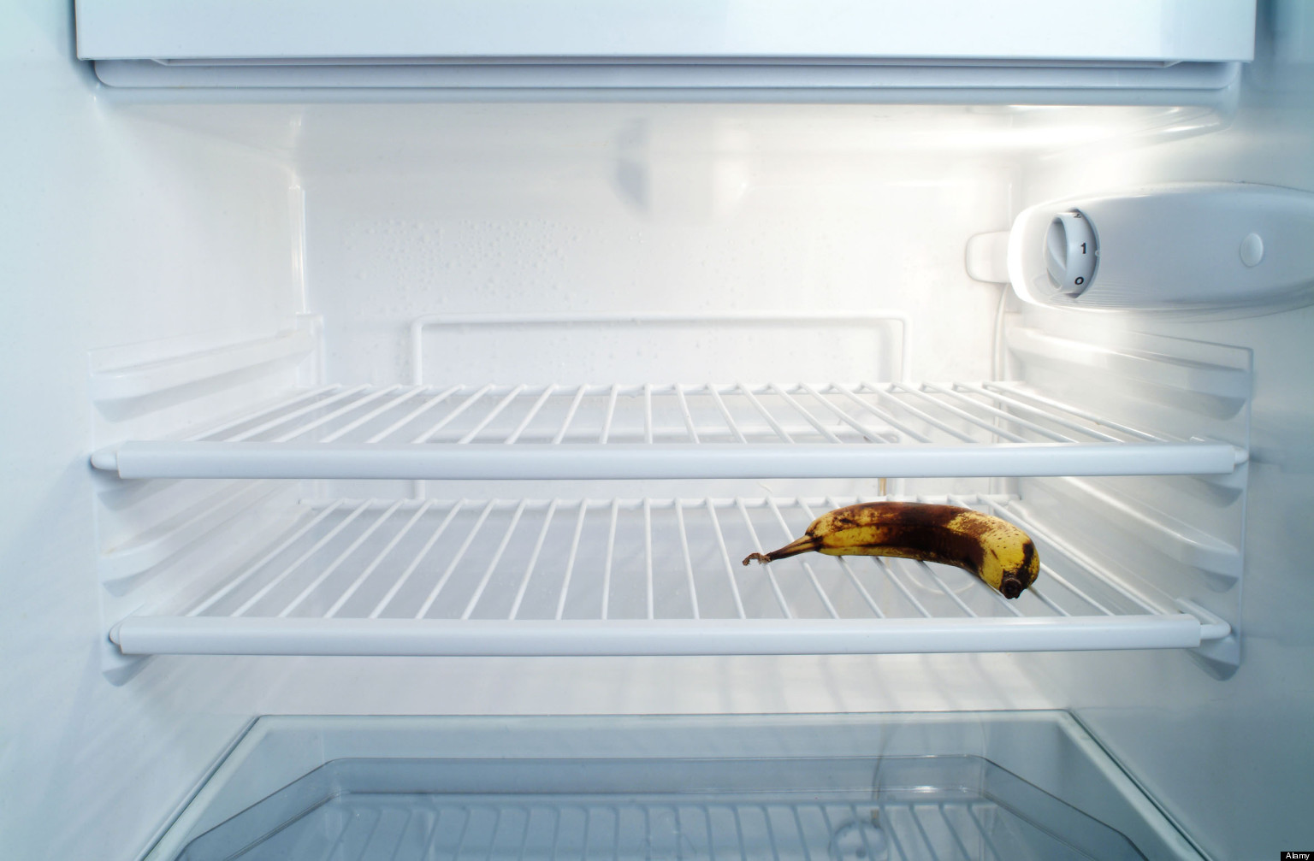
The problem
Shared apartments
Missing groceries
Shared economy

Slide 4
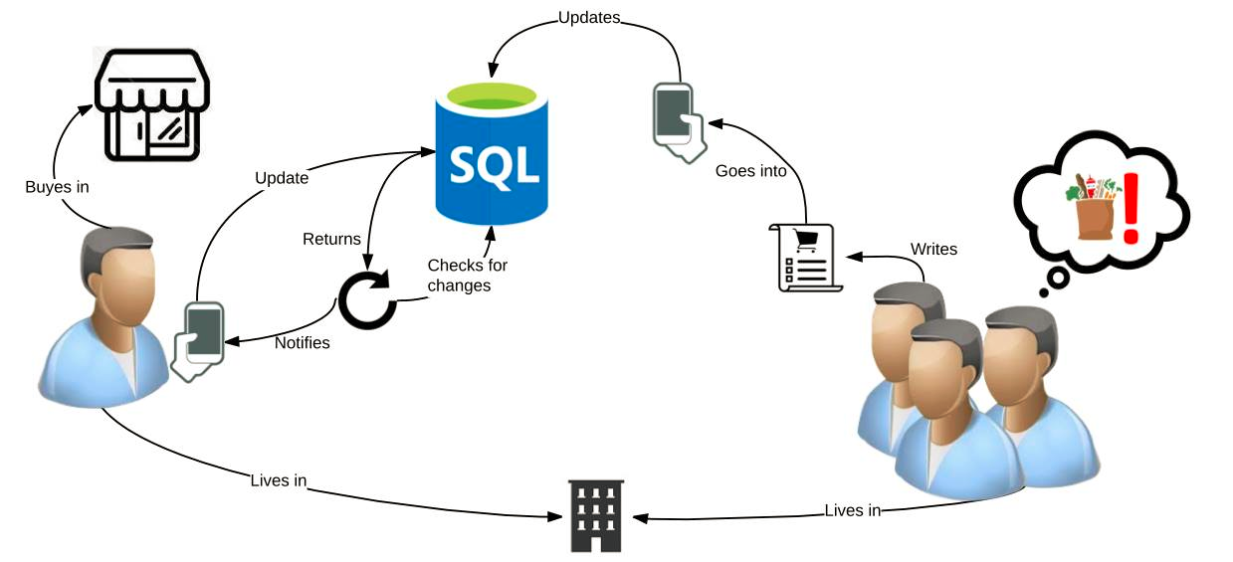
The solution
Buys in

Slide 5
Android Project Structure
7 activities
4 adapters
5 fragments
3 models
Apartment
GroceryItem
User

Slide 6

Diagrams

Slide 7
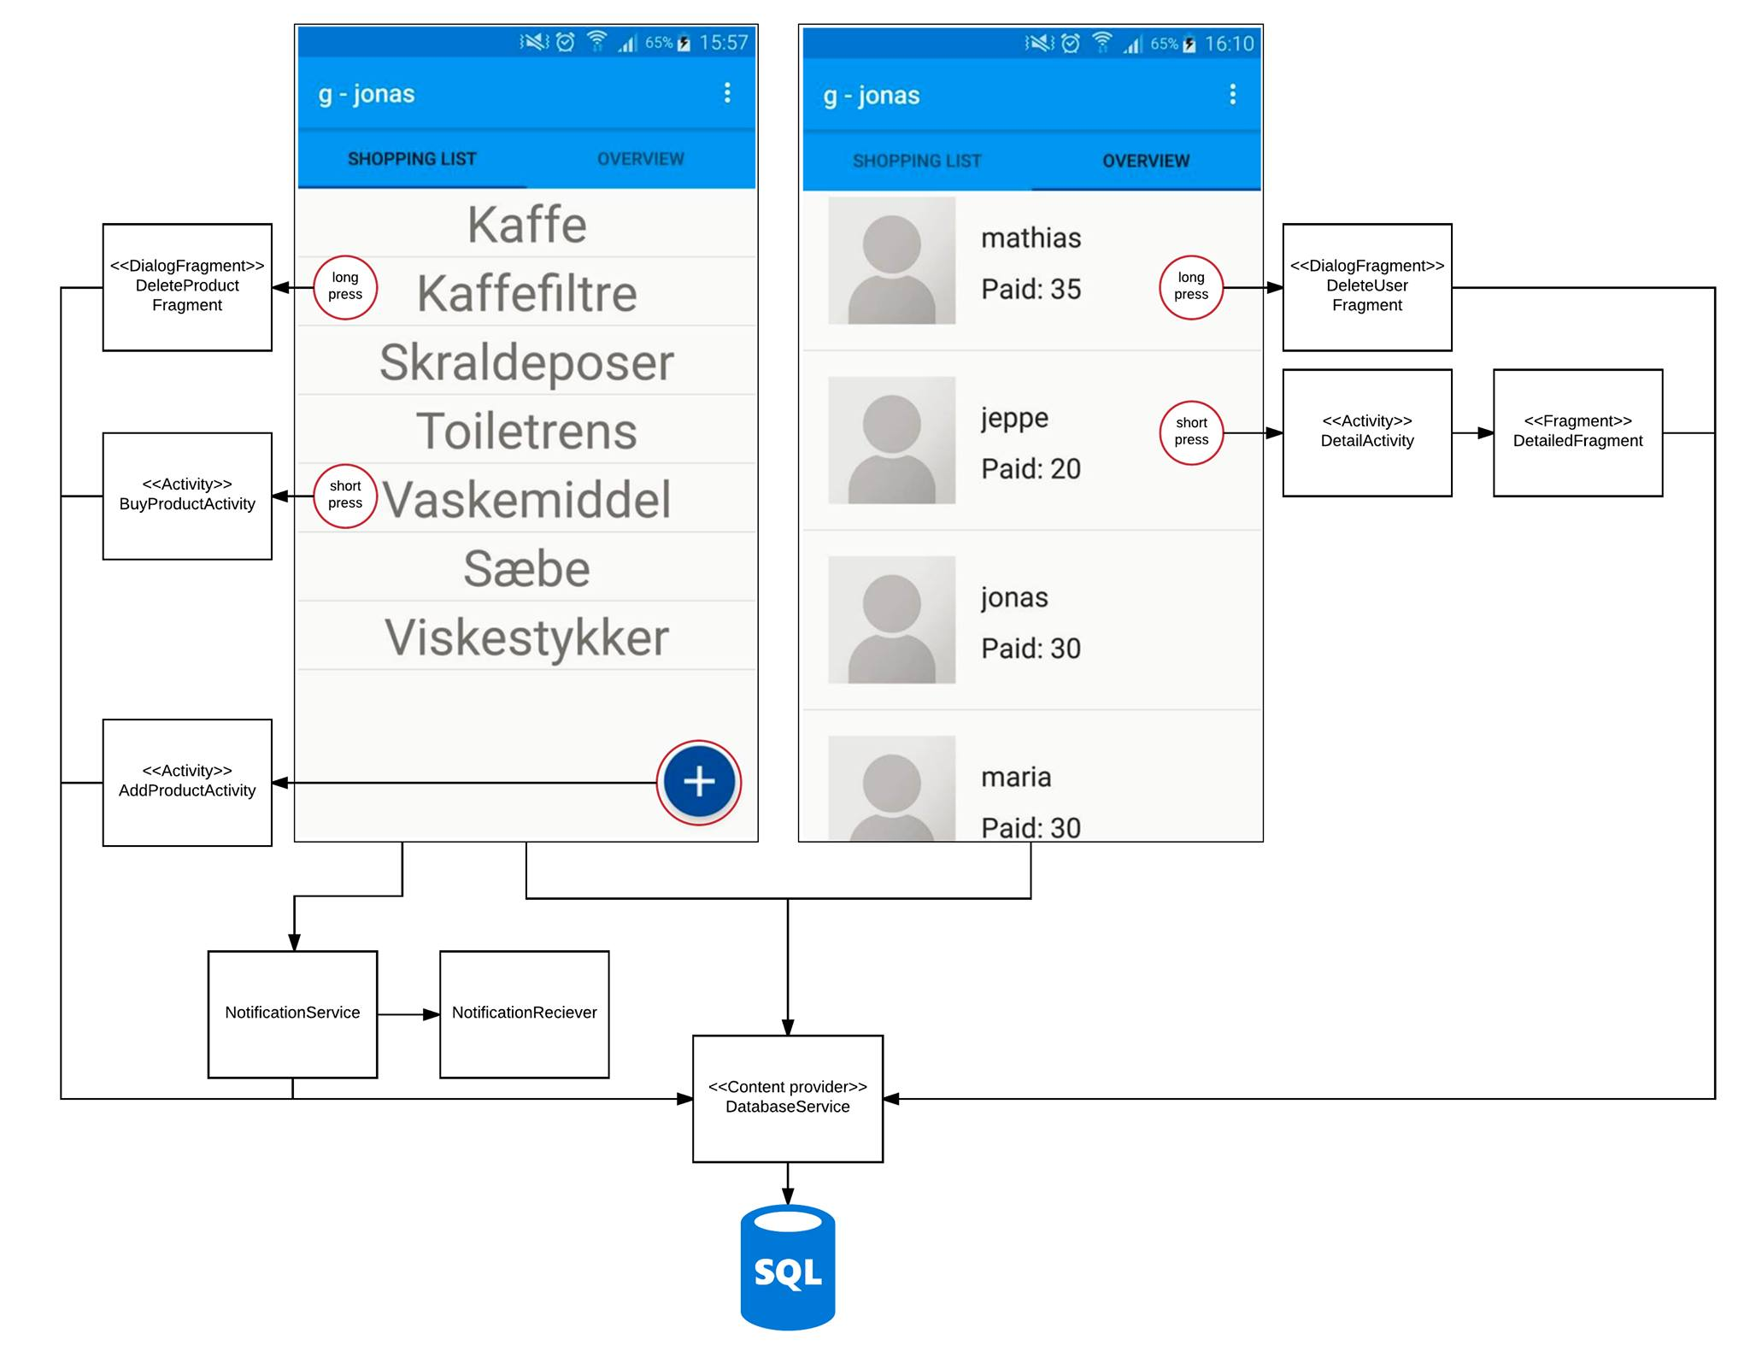

Slide 8
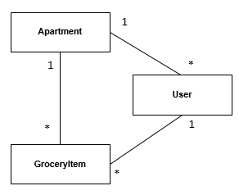
Model relationship

Slide 9
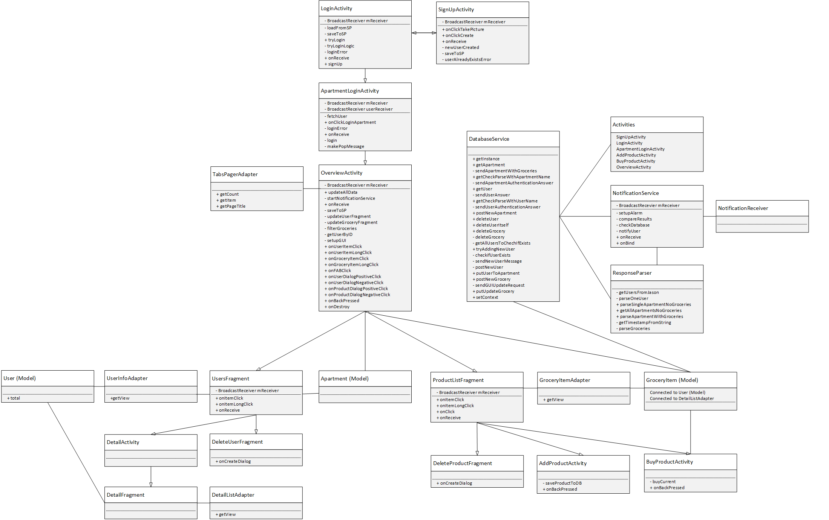
Class Diagram

Slide 10
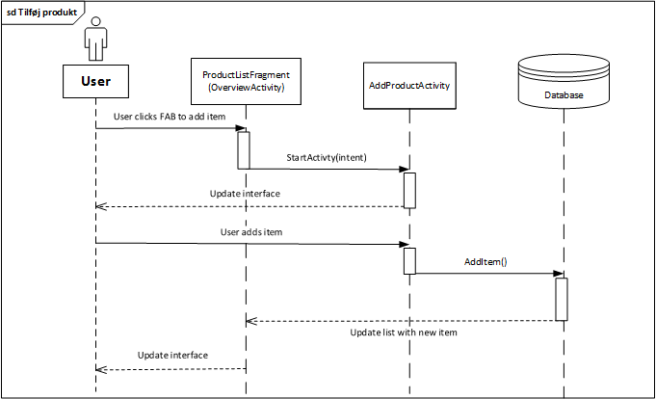
Sequence Diagram

Slide 11

Code

Slide 12
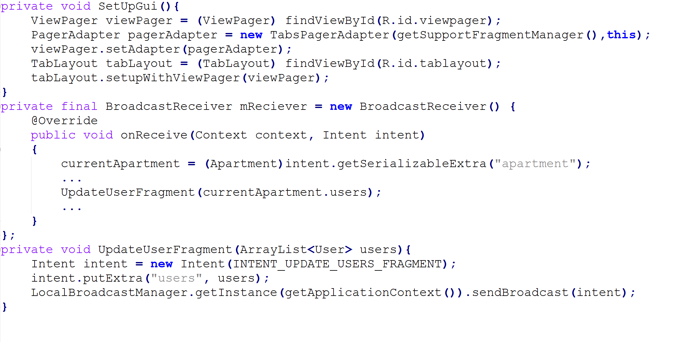
Code snippet – Populating GUI

Slide 13
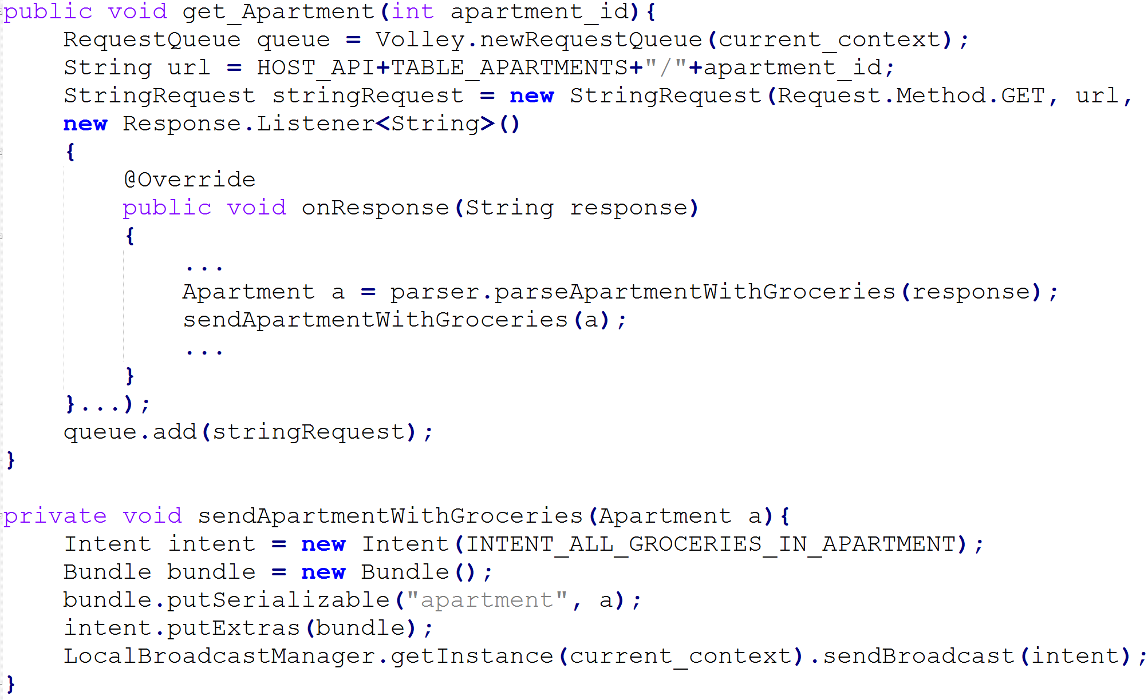
Code snippet – Retrieving data
Volley
Azure web
Json-parsing
Async
Intent, extras

Slide 14
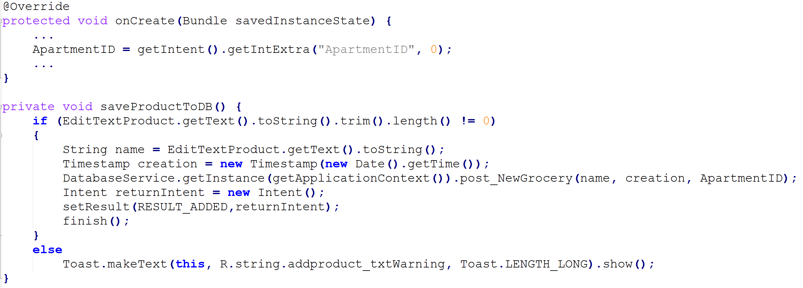
Code snippet – Adding a grocery

Slide 15
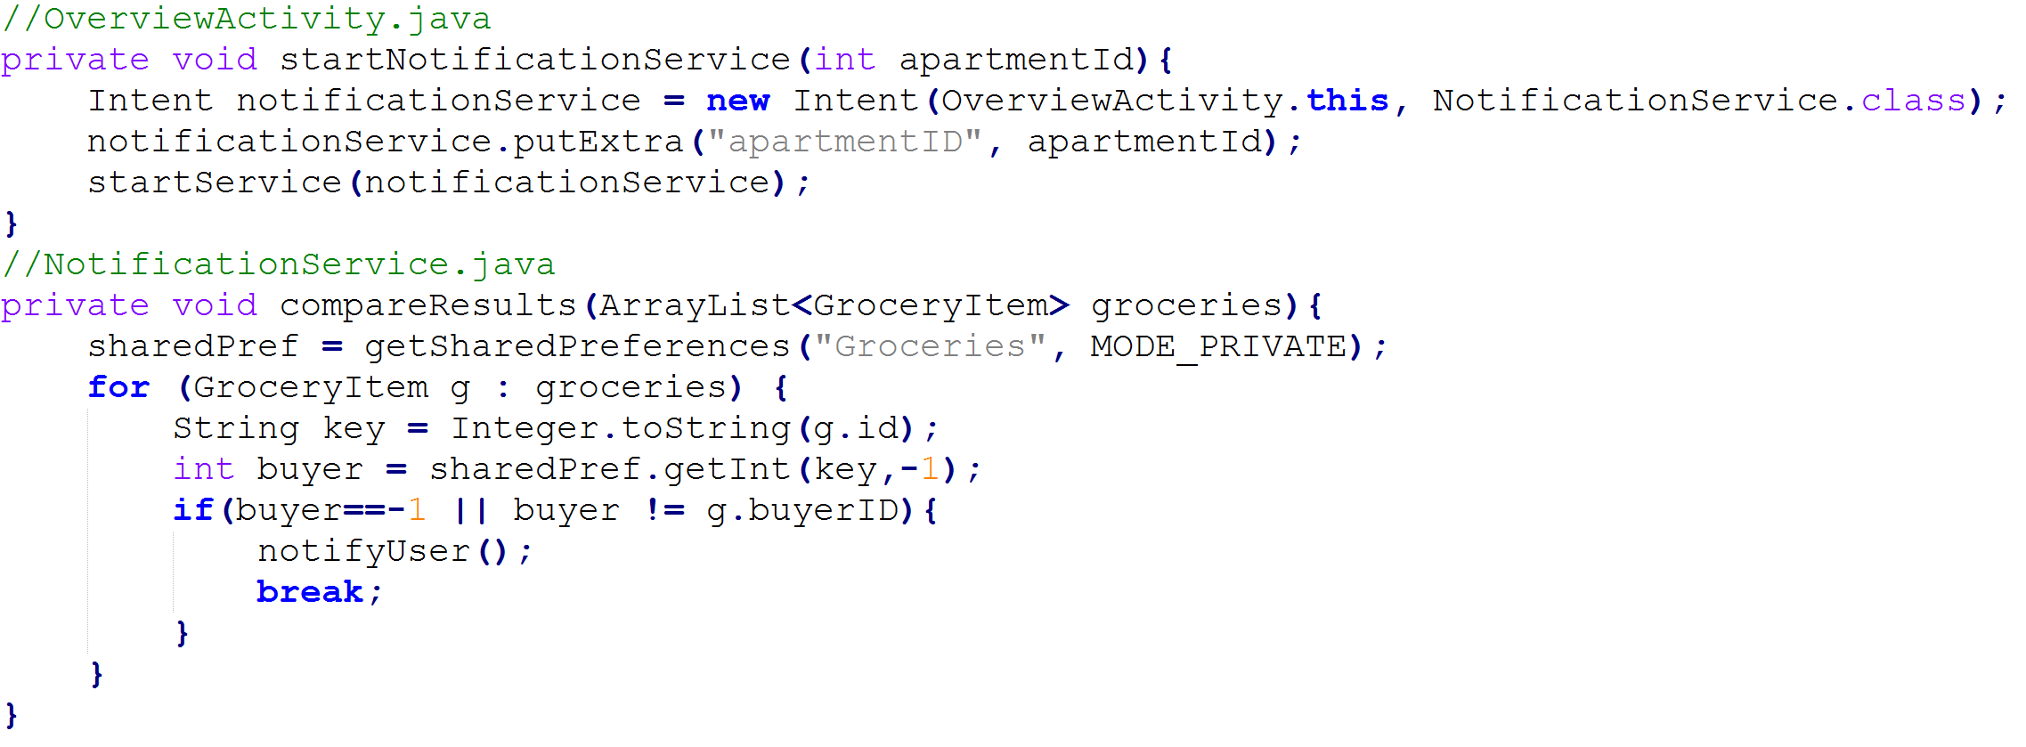
Code snippet – Notification Service

Slide 16
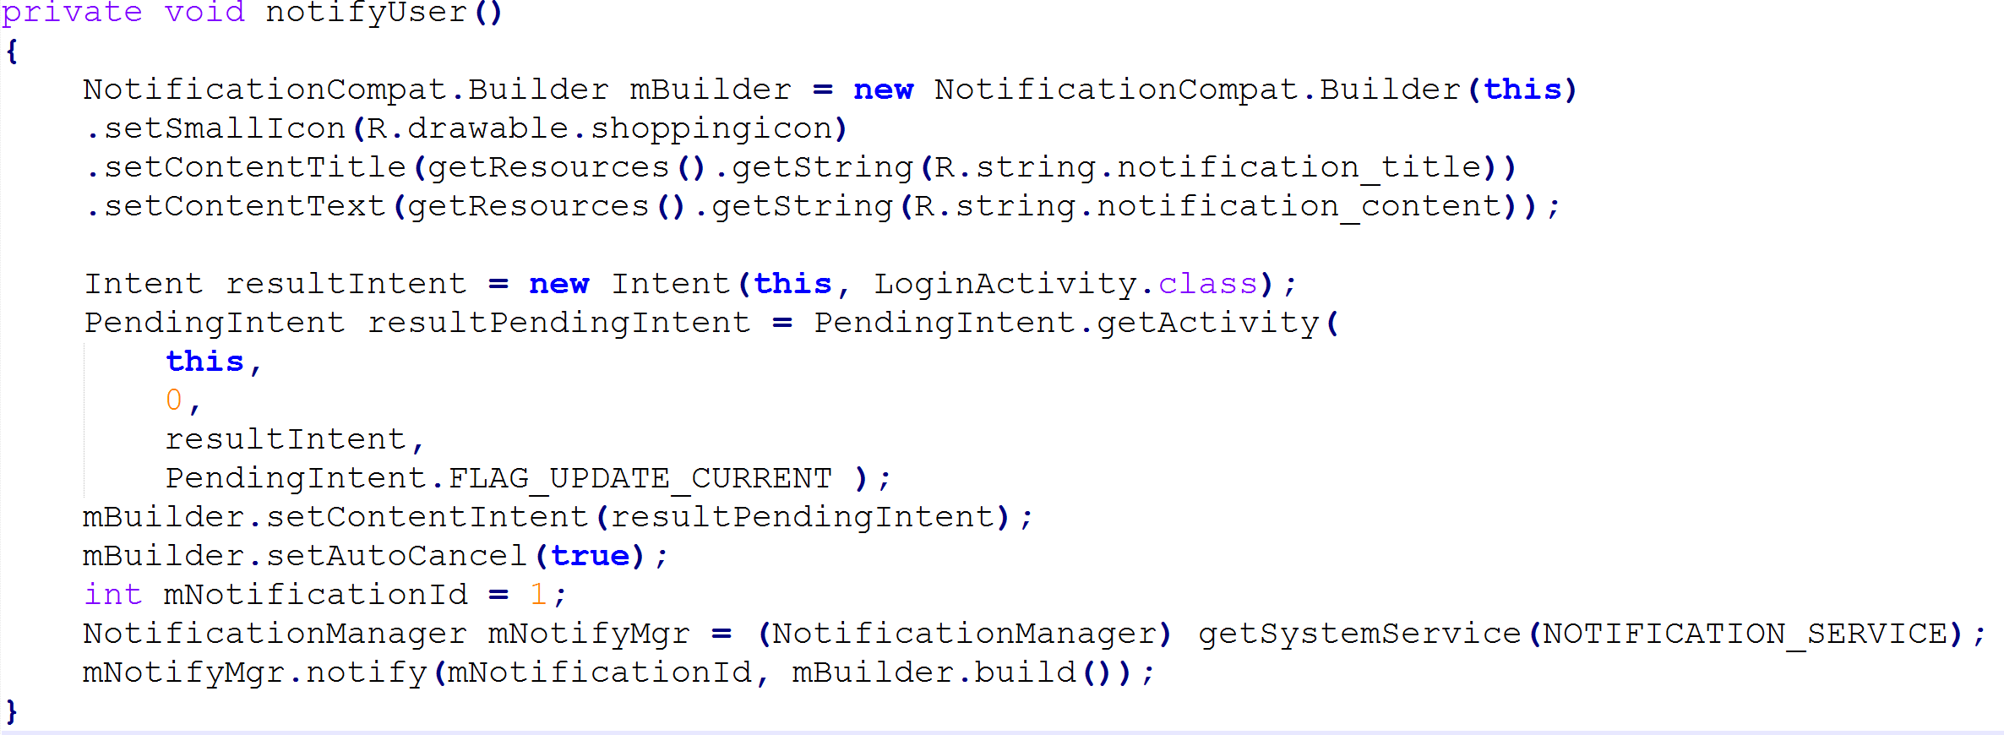
Code snippet – Notifying a user

Slide 17

Android Framework

Slide 18
Utilization
Broadcast Receivers
Started Service
Notification Manager
Fragments
Alarm Manager
Shared Preferences

Slide 19
Further development
Location Services
Firebase for:
Logging in
Storing data online
Storing data locally

Slide 20
Pros and cons
Component | Pros | Cons
Broadcast Receivers | Communication across Activities done easy | Putting extras can be annoying. No assurance that data is in intent.
Services | Get things done w/o blocking UI thread or having the app open. Lots of options. | Binding or starting or both? A service dies exactly when?
Fragments | Reusability | Data communication convoluted
Shared Preferences | Easy to use | Easy to mess up
Notification Manager | Good amount of options for building a notification | Could have shorter methods of building a very simple notification
Alarm Manager | Good alternative to using thread sleeping for a long time | Has to have a class that implements Broadcast Receiver

Slide 21
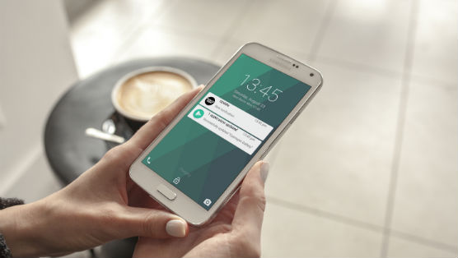
Demo

Slide 22

Questions?

