Slide 1

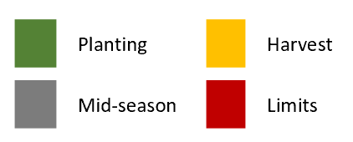
Post-harvest visits
Post-planting visits
Corn (South)
Corn (North)
Millet
Rice (South)
Rice (North)
Sorghum
Yams
 |  | Jan | Feb | Mar | Apr | May | Jun | Jul | Aug | Sep | Oct | Nov | Dec

