Slide 1

BLUETOOTH SECURITY MONITORING PLATFORM
Protecting Your Wireless Environment
Research-Grade Sniffing & Jamming Device | Raspberry Pi Powered
Mathias Vera • Daniel Halbleib Jr • Andrew Sauls
NABC Presentation | 2026

Slide 2
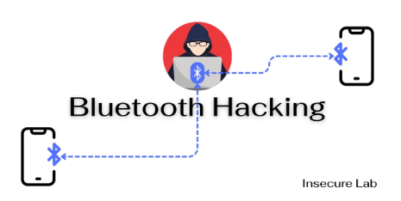
THE PROBLEM
Bluetooth devices are everywhere in modern workplaces — headphones, keyboards, speakers, fitness trackers. Yet most organizations have ZERO visibility into what Bluetooth devices are operating in their space.
Eavesdropping
Unauthorized Access
BlueBorne Attacks
Attackers intercept audio from BT headsets and speakers used in sensitive meetings
Rogue devices pair with company hardware, exfiltrating data through BT connections
Unpatched BT stacks are vulnerable to remote code execution without any user interaction

Slide 3
WHO'S AT RISK?
Any organization where Bluetooth devices operate near sensitive data or conversations.
Corporate Offices
Finance & Legal
Healthcare
Government & Defense
Wireless headphones & speakers
BT keyboards & mice
Conference room devices
BYOD personal phones
Client-confidential calls
Sensitive document transfers
Trading floor comms
Regulatory compliance
HIPAA-protected conversations
Medical IoT devices (BLE)
Patient data on wireless
Telemedicine endpoints
Classified facility monitoring
SCIF perimeter security
Counter-intelligence ops
Insider threat detection

Slide 4
OUR APPROACH
1
DETECT
2
ANALYZE
3
RESPOND
Dedicated Raspberry Pi monitor placed in key areas. Passive BLE + Classic BT scanning via HCI interface.
Real-time pattern detection. Identify unknown devices, anomalous behavior, and potential attack signatures.
Instant admin alerts via web dashboard. Optional reactive jamming. Full audit logging for incident response.
▶
▶
TECH STACK
■ Raspberry Pi 4/5
■ BlueZ (Linux BT stack)
■ Python + Bleak (BLE)
■ HCItool + HCIdump
■ Flask Web Dashboard
■ JSON Audit Logging

Slide 5
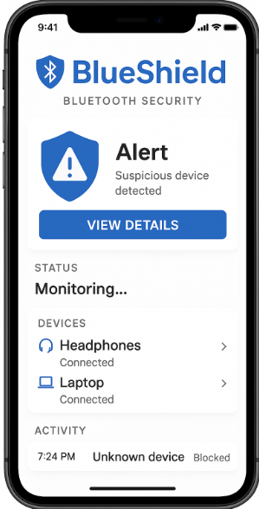
WEB DASHBOARD
BlueShield Web Dashboard | http://localhost:8080
BLUESHIELD v0.1.0 | Bluetooth Security Monitor | 2026-03-11
Scanner: SCANNING Jammer: OFF Scans: 47 Interface: hci0
┌─ DEVICE SUMMARY ───────────────────────────┐
│ Total: 13 Known: 5 Unknown: 8 Alerts: 3 │
└─────────────────────────────────────────────┘
ADDRESS NAME TYPE RSSI ALERT
────────────────────────────────────────────────────
C9:FA:86:C0:DC:4E Amazfit Band 5 ble -83dBm WARNING
BE:67:01:F3:0C:21 ELK-BLEDOM01 ble -62dBm WARNING
EC:47:0C:4B:D1:3F Platco PR1 ble -65dBm CRITICAL
63:BD:DD:71:5F:63 Apple Device ble -49dBm OK
EC:B8:3B:E7:7A:E7 Apple Device ble -47dBm OK

Slide 6
REVENUE MODEL
Research License
Professional
Enterprise
Managed Service
$0
$299/unit
$999/yr
Custom
Open-source for academic and security research. Full scanner + dashboard. Community supported.
Pre-configured RPi hardware + software bundle. Technical support. 1 year of updates.
Multi-device deployment. Central management. Custom alert integrations. Dedicated support.
Fully managed monitoring. 24/7 SOC integration. Incident response. Compliance reporting.

Slide 7
THE BENEFITS
<5s
24/7
100%
<$50
Alert Response
Monitoring
BLE Detection
Hardware Cost
Real-Time Monitoring
Privacy Protection
Continuous passive scanning detects every Bluetooth device the moment it appears. No gaps, no blind spots.
Identify devices that could eavesdrop on sensitive conversations or exfiltrate data wirelessly.
Audit & Compliance
Easy Deployment
Complete JSON logging of every device, alert, and action. Ready for auditors and incident response.
Plug-and-play RPi hardware. Web dashboard runs in any browser. No complex setup or training needed.

Slide 8
CONSTRAINTS & COMPETITION
CONSTRAINTS
COMPETITIVE LANDSCAPE
FCC regulations restrict jamming in production use
BT 5.x frequency hopping limits passive sniffing
RPi range limited to ~30m without external antenna
Requires root access for HCI-level operations
CPU limits on high-density BLE environments
Kismet
General wireless monitor. No BT-specific alerting. Complex setup required.
Ubertooth One
Powerful BT hardware. $120+ per unit. Requires deep technical expertise.
Enterprise WIDS
Cisco/Aruba solutions. $10K+ per deployment. Not Bluetooth-focused.
BLUESHIELD ADVANTAGE
Low-cost (<$50 hardware) ● Purpose-built for BT security ● Research-grade + commercial path ● Open architecture

Slide 9
WHAT WE NEED
Hardware
$500
Software & Tools
$300
Raspberry Pi 4/5 units
External BT antennas
USB BT 5.0+ adapters
Protective deployment cases
Cloud hosting for dashboard
Security testing lab access
Code signing certificates
CI/CD pipeline
Research & Testing
$400
Go-to-Market
$800
Controlled RF test environment
Various BT devices for testing
Security audit / pentest review
Academic publication support
Product packaging & branding
Demo units for conferences
Marketing website
Legal review (FCC compliance)
TOTAL ASK: ~$2,000

Slide 10
SECURING THE INVISIBLE WIRELESS LAYER
Thank You
Questions?
Mathias Vera • Daniel Halbleib Jr • Andrew Sauls
github.com/your-repo | blueshield@security

