Slide 1
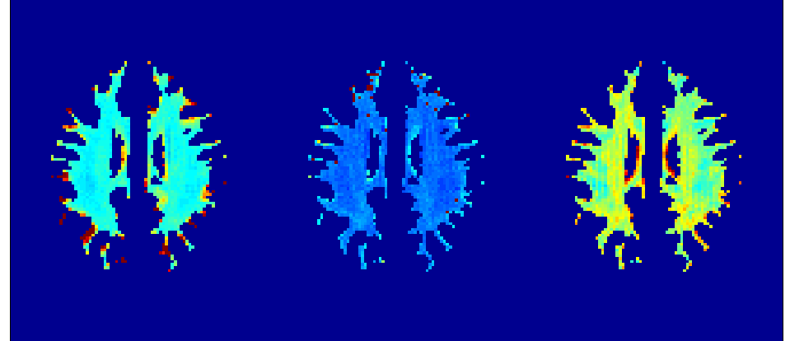
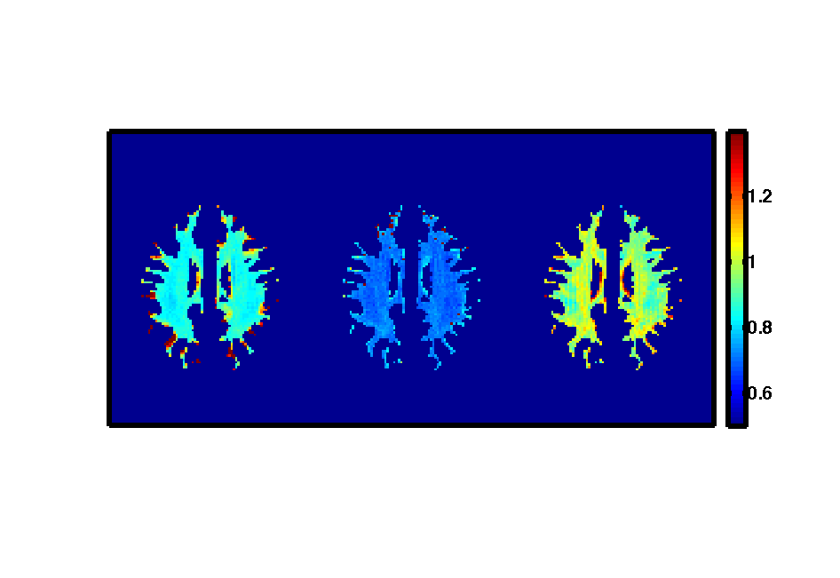
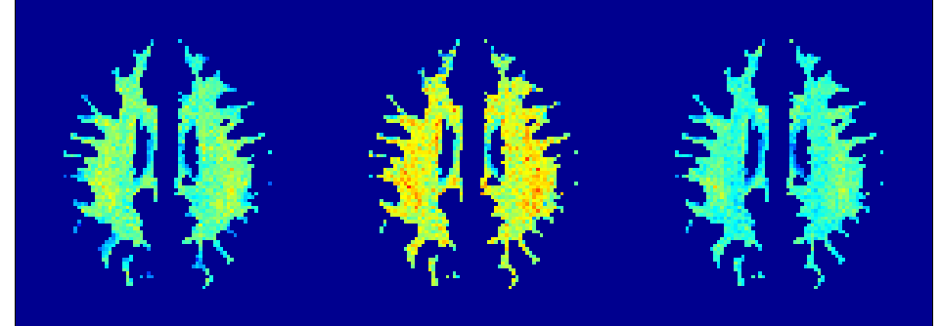
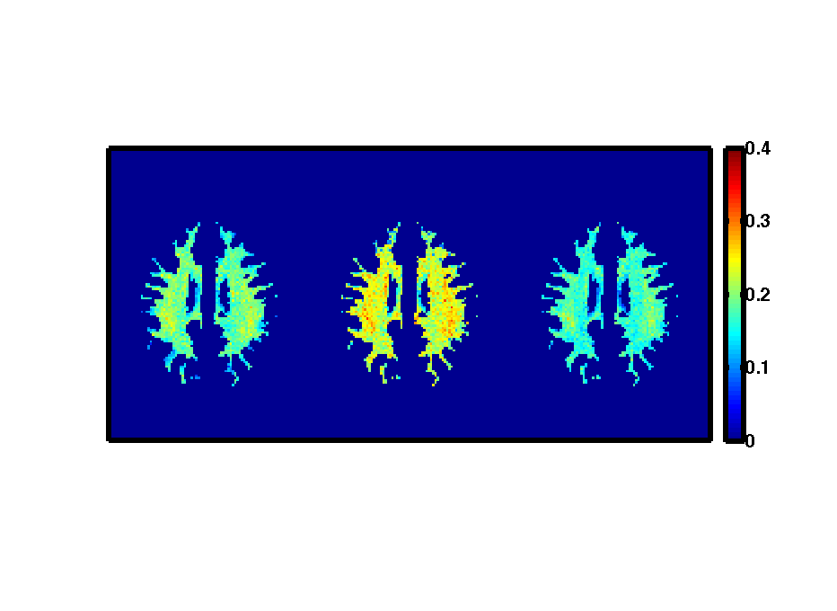
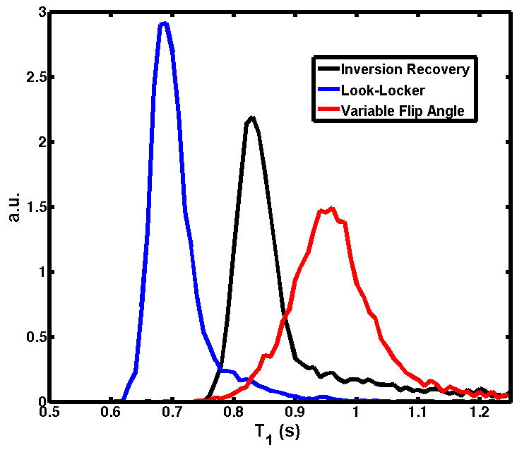
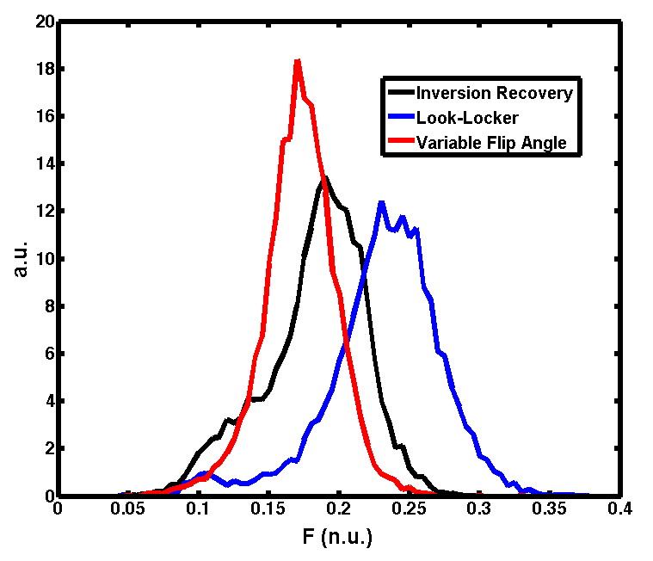
--
Effect of Different T₁ Mapping Techniques on a Quantitative Magnetization Transfer MRI Biomarker for Myelin Density
Mathieu Boudreau¹, Nikola Stikov¹, G. Bruce Pike²
¹McConnell Brain Imaging Center, Montreal Neurological Institute, McGill University, Montreal, Quebec, ²Hotchkiss Brain Institute, Faculty of Medicine, University of Calgary, Calgary, Alberta
Introduction
Results
Results
The quantitative MT (qMT) parameter F (macromolecular pool size ratio) correlates strongly with histological measures of myelin in post-mortem MS brains^{1.}
T₁ maps, required for qMT, have recently been observed to vary in white matter (WM) between three commonly used methods at 3T².
Literature WM T₁ values also vary across scanners and sites.
This study investigated the effect of three different T₁ mapping techniques on the qMT parameter F, a biomarker for myelin density, in white matter of healthy subjects.
Figure 2 shows a single-subject comparison between WM T₁ maps produced using three T₁ mapping methods (IR, LL, VFA), and the qMT F maps produced using each T₁ map.
Table 1 shows the pooled mean, pooled standard deviation, and intersubject standard deviation of F. Relative to IR, LL overestimated F by 27%, and VFA underestimated it by 5%. The pooled VFA histogram was 25% narrower than IR, which which cannot be explained by intersubject variations in F.
IR
9m16s / slice
LL
2m20s / slice
VFA
3s / slice
1.4
Table 1. Statistics of WM F values for 6 subjects using 3 T₁ methods.
T₁
(s)
1.2
T₁ | Pooled F Mean | Pooled F SD | Intersubject F SD
IR | 0.182 | ± 0.036 | ± 0.005
LL | 0.232 | ± 0.041 | ± 0.008
VFA | 0.172 | ± 0.027 | ± 0.004
1.0
0.8
0.6
0.4
qMT F
(n.u.)
0.3
Methods
0.2
Pooled F SD is the standard deviation of the pooled F values (Figure 2b). Intersubject F SD is the standard deviation of the mean F between subjects.
0.1
Siemens 3T Tim Trio MRI system, 32-channel head coil
6 healthy adult volunteers
Single slice, AC-PC orientation, slightly above the corpus callosum (2x2x5 mm³)
White matter tissue masks: 1x1x1 mm³ MP-RAGE classified using INSECT³ (WM, GM, CSF). WM masks were resampled to match the qMT slice using a majority voting algorithm.
Pulse Sequences
B₀ → Two-point GRE phase-difference method
B₁ → Double angle method
T₁ → Three methods compared: Inversion recovery (IR, gold standard), Look-Locker (LL), and Variable Flip Angle (VFA)
qMT → Spoiled GRE optimal 10-point protocol⁴, Gaussian-Hanning MT pulses, Sled and Pike qMT model⁵
0.0
Figure 2. WM T₁ maps T₁ (IR, LL, VFA) and qMT F maps of a healthy adult subject.
Discussion
Results
Overestimations in WM T₁ measured with VFA (relative to IR) resulted in a 5 % reduction in mean qMT F values (Table 1).
The 6-subject pooled WM VFA T₁ distribution is broader than IR (Fig. 3a), the VFA F distribution was 25% narrower (Fig. 3b).
Unlike LL and IR, VFA requires a B₁ map, thus inaccuracies in B₁ propagate through two pathways into F when using VFA.
These results suggest that VFA may be a better alternative compared to LL for fast qMT mapping, and that gold standard IR T₁ values should be reported when using alternative T₁ methods.
Figure 3a shows the pooled 6-subject WM T₁ histograms for IR (black), LL (blue) and VFA (red). Figure 3b shows the pooled WM F histograms depending on the T₁ method used. The T₁ values for each method agree with previously reported values². The differences in F between methods were modest in comparison to those observed in T₁.
a
b
B₀
B₁
Summary
VFA
OR
IR
OR
LL
This work explored the effect of three different T₁ mapping techniques on the qMT parameter F, a biomarker for myelin density, in white matter of healthy subjects.
VFA underestimated WM F by 5 % relative to IR, and LL overestimated F by 27 %.
MS Researchers using qMT should report typical IR gold standard healthy WM T₁ values for their site/scanner when other methods such as VFA are used.
T₁
qMT
Figure 1. Quantitative MRI protocol processing hierarchy.
Figure 3. WM T₁ (IR, LL, VFA) and qMT F pooled histograms for 6 subjects.
References: [1] K. Schmierer et al., J. Magn. Res. Imag. 26:41-51 (2007) [2] N. Stikov et al., ‘Validation of T₁ Mapping Techniques: Are Phantom Studies Sufficient’ Proc. of ISMRM (2012) [3] L. Collins et al. IPMI 1999, LNCS, Vol. 1613, Springer, Heidelberg 210-223 (1999) [4] Levesque I. et al, Magn. Res. in Med 66:635-643 (2011) [5] Sled J. and Pike G. B., MRM 46:923-931 (2001)
Acknowledgments: This work was funded by the Natural Sciences and Engineering Research Council’s Doctoral Alexander Graham Bell Canada Graduate Scholarship (M.B.), and grant funding was provided by the Canadian Institutes of Health Research.
Contact: mathieu.boudreau2@mail.mcgill.ca

