Slide 1


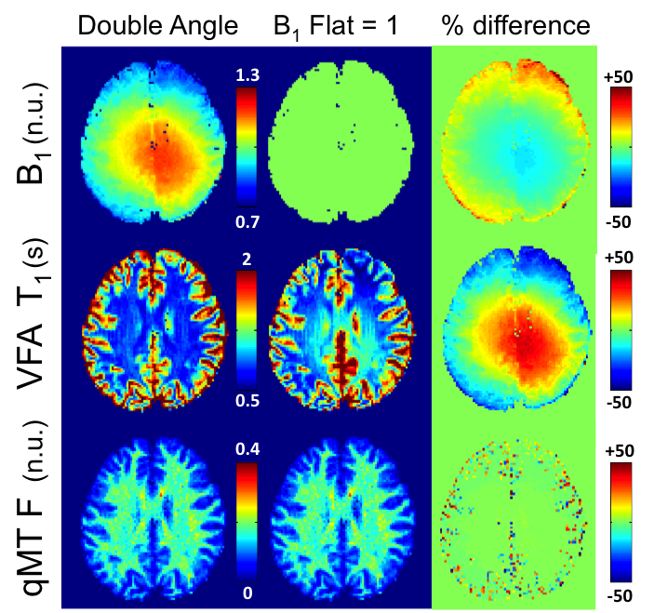
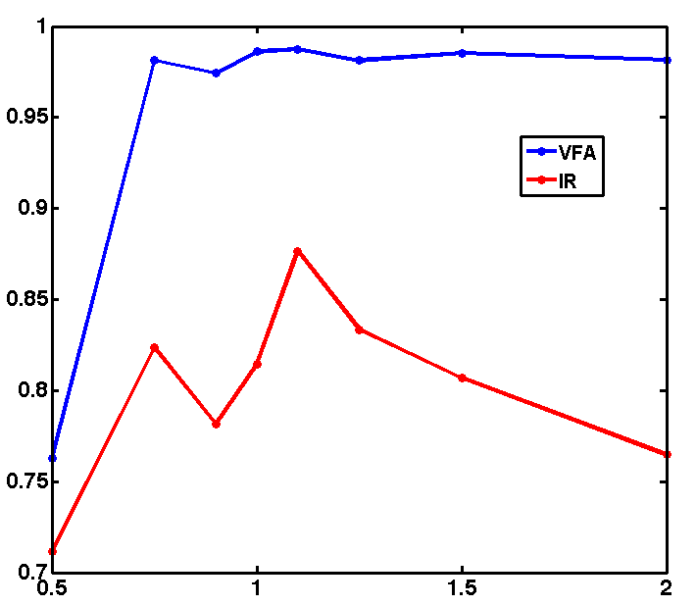
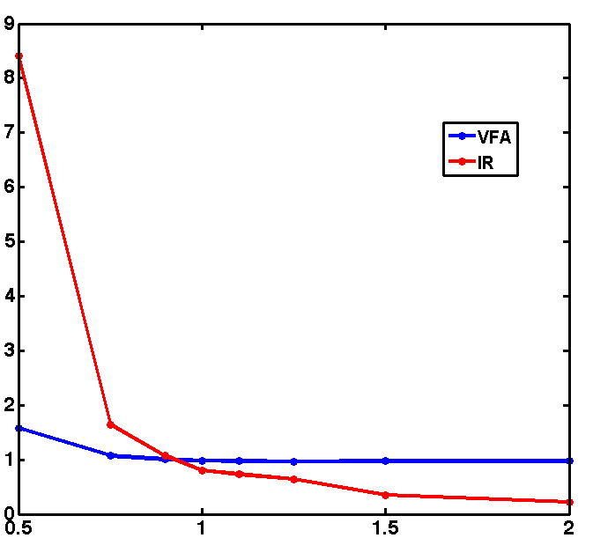
--
A B₁-Insensitive qMT Protocol
Mathieu Boudreau¹, Nikola Stikov¹, G. Bruce Pike²
¹McConnell Brain Imaging Center, Montreal Neurological Institute, McGill University, Montreal, Quebec, ²Hotchkiss Brain Institute and Department of Radiology, University of Calgary, Calgary, Alberta, Canada
Introduction
Results – Measured B₁ vs. Nominal FA
Results – qMT Parameters
Quantitative magnetization transfer (qMT) imaging requires B₀ and B₁ measurements to correct for instrumental biases, and a T₁ measurement to constrain parameters in the fitting model.
If using Variable Flip Angle (VFA) T₁ mapping¹, B₁ is used twice before fitting the qMT parameters: to correct the flip angles for T₁ mapping, and to scale the nominal MT saturation powers.
Inaccuracies in B₁ would propagate to the fitting of the qMT parameters through two pathways – through errors induced in T₁, and errors in MT saturation powers.
This work demonstrates that for the Sled and Pike qMT model², certain qMT parameters are insensitive to a large range of B₁ inaccuracies when using VFA for T₁ mapping.
Table 1. Voxelwise linear regression analysis of all fitted qMT parameters, using each T₁ method (VFA - left, IR-right), and a comparison of the measured (DA) and nominal FA (B₁ flat = 1) maps.
VFA
qMT
IR
 | vs. |  | vs.
qMT | Pearson ρ | Slope | Pearson ρ | Slope
F | 0.99 | 0.98 | 0.81 | 0.81
k_{f} | 0.32 | 0.31 | 0.52 | 0.57
R_{1f} | 0.81 | 0.98 | 0.78 | 0.71
T_{2f} | 0.99 | 0.95 | 0.93 | 1.02
T_{2r} | 0.92 | 0.90 | 0.87 | 0.91
DAM
VFA
DAM
qMT
Flat B₁
qMT
IR
qMT
Flat B₁
Methods
Siemens 3T Tim Trio MRI system, 32-channel head coil
3 healthy adult volunteers
Single slice, AC-PC orientation, slightly above the corpus callosum (2x2x5 mm³)
Pulse Sequences
B₀ → Two-point GRE phase-difference method
B₁ → Double angle method (DAM) (α = 60°/120° )
T₁ → Variable Flip Angle³ (TR =15 ms, α = 3°/20°)
→ Inversion recovery^{4,5} (TI = 30, 530, 1030, 1530 ms )
qMT → Spoiled GRE optimal 10-point protocol⁶, Gaussian-Hanning MT pulses, Sled and Pike qMT model²
Simulated B₁ Errors
B₁ → Flat B₁ maps = 0.5, 0.75, 0.9, 1, 1.1, 1.25, 1.5, 2 n.u.
Figure 2. Comparison of VFA T₁ and qMT F maps using measured (DA) and nominal (B₁ flat = 1) B₁ maps.
Discussion
Results – VFA vs. IR
VFA-based T₁ maps renders qMT F and T_{2,f} insensitive to B₁ errors.
Processing qMT F maps using VFA T₁ and a flat B₁ map results in nearly identical qMT F maps to using measured DA B₁ maps, (Fig. 2), except where CSF partial volume effects are suspected.
Severe overestimation of B₁ is better tolerated than severe underestimation for the qMT parameter F (Fig. 3).
The exact origin of the erroneous B₁ and VFA T₁ nearly cancelling out in qMT F maps remains to be clarified.
A possible explanation might be that errors in B₁ propagate to F via counterbalancing effects on T₁ estimation and MT saturation power.
Figure 3 shows the pooled whole brain Pearson correlation coefficients (a) and linear regression slopes (b) for qMT F parameter values between the measured DA B₁ maps and simulated flat B₁ maps, for VFA (blue) and IR (red) T₁ maps.
High correlation (a) and linear regression slope values near 1 (b) for qMT F values are observed using VFA T₁ maps for a large range of flat B₁ maps (0.75 - 2 n.u.). qMT F maps fitted using IR T₁ are sensitive B₁ errors, as expected.
DAM
OR
Flat B₁
a
b
B₀
B₁
VFA
OR
IR
Summary
T₁
Linear Regression Slope
This work demonstrated that qMT F maps fitted using VFA T₁ can be insensitive to B₁ inaccuracies.
A strong correlation (ρ = 0.99) between qMT F parameter values fitted using measured and nominal B₁ maps was observed when using VFA T_{1.}
More work in simulating the effects of B₁ and VFA T₁ inaccuracies on qMT parameter estimation is needed to have a clearer understanding of the limitations of this observation.
Pearson Correlation Coefficient for F
qMT
Flat B₁ amplitude (n.u.)
Flat B₁ amplitude (n.u.)
Figure 1. Quantitative MRI protocol processing hierarchy.
Figure 3. Linear regression analysis of the voxelwise qMT F parameter, comparing measured DA B₁ and a range of flat B₁ (VFA T₁, blue; IR T₁, red).
References: [1] Deoni S. et al, MRM 49:515-526 (2003) [2] Sled J. and Pike G. B., MRM 46:923-931 (2001) [3] Yarnykh V., MRM 63:1610-26 (2010) [4] Barral J. et al, MRM 64:1057-1067 (2010) [5] http://www-mrsrl.stanford.edu/∼jbarral/t1map.html (Accessed: October 2012) [6] Levesque I. et al, MRM 66:635-643 (2011) [7] Schmierer K. et al, JMRI 26:41-51 (2007) [8] Yarnykh V., MRM 68:166-178 (2012)
Acknowledgments: This work was funded by the Natural Sciences and Engineering Research Council’s Doctoral Alexander Graham Bell Canada Graduate Scholarship (M.B.), and grant funding was provided by the Canadian Institutes of Health Research.
Contact: mathieu.boudreau2@mail.mcgill.ca

