Slide 1


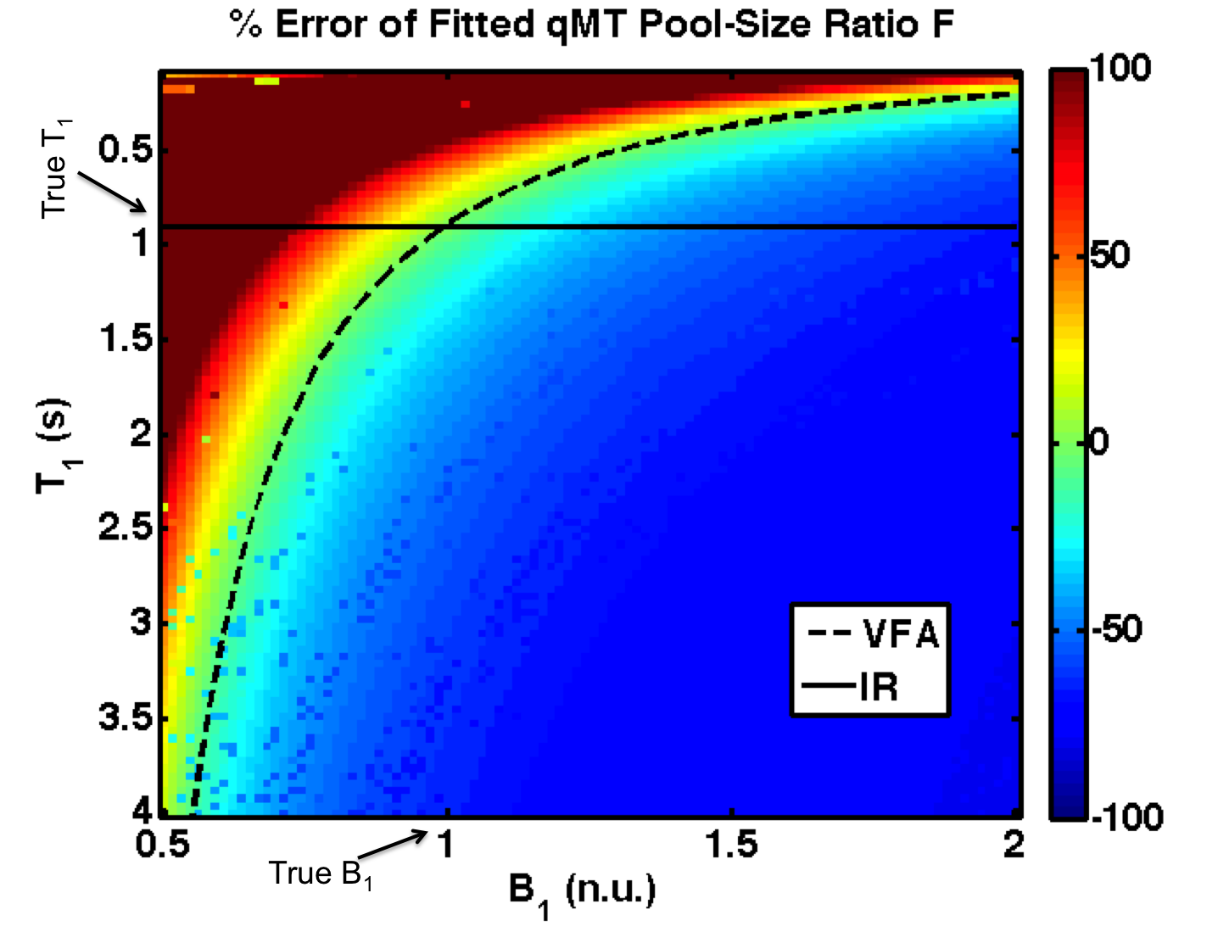
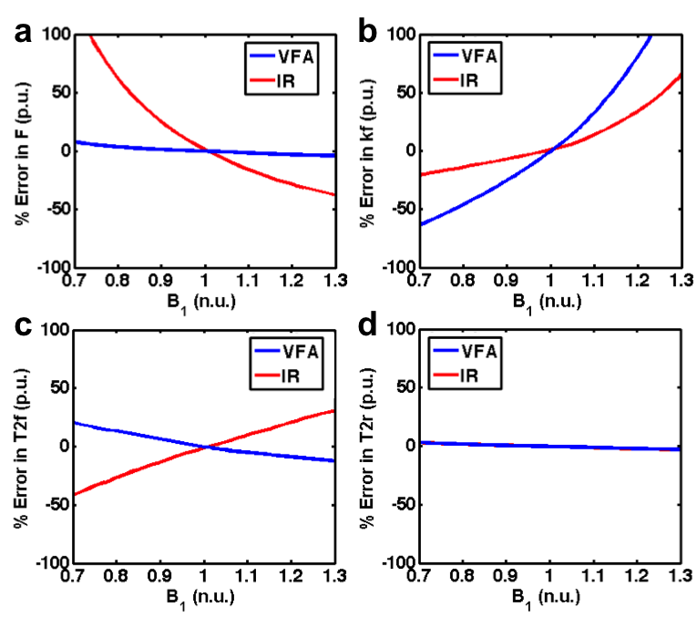
--
B₁-Sensitivity Analysis of qMT
Mathieu Boudreau¹, Nikola Stikov², G. Bruce Pike³
¹McConnell Brain Imaging Center, Montreal Neurological Institute, McGill University, Montreal, Quebec, ²Department of Electrical Engineering, Ecole Polytechnique de Montreal, Montreal, Quebec, Canada,³Hotchkiss Brain Institute, Department of Radiology, Faculty of Medicine, University of Calgary, Calgary, Alberta, Canada
Introduction
Results – B₁ vs. T₁
Results
B₁ mapping is an important measurement used to correct the excitation flip angle and MT saturation powers in pulsed quantitative magnetization transfer (qMT) imaging.
Additional measurements necessary for qMT (e.g. T₁ mapping) may also require B₁ maps. For example, variable flip angle (VFA) T₁ mapping requires B₁ maps, while inversion recovery (IR) typically does not¹.
Local (e.g. artifacts) or global (e.g. systemic biases) inaccuracies in B₁ mapping² will propagate to the fitted qMT parameters differently, depending on the T₁ method.
We present a simulation-based analysis of the B₁ sensitivity of pulsed qMT, investigating the propagation of the B₁ error to the qMT parameters using different T₁ mapping methods (VFA vs. IR).
We demonstrates the pool-size ratio F is robust against B₁ inaccuracies when VFA T₁ mapping is used, but this comes at the cost of an increase in error in the exchange rate kf.
The superimposed lines in Fig. 1 show the range of errors in the fitted pool-size ratio F using a B₁-independent T₁ method (e.g. IR) (solid line), and from VFA T₁ mapping (dashed line).
Figure 2 shows the errors in fitted qMT parameters (F, kf, T2f, T2r) using B₁-independent (IR) and VFA-measured T₁ for a range of B₁ inaccuracies that may be observed in vivo.
Errors in F induced by B₁ errors were greatly reduced by using VFA T₁ mapping (Fig. 2a - blue).
A substantial increase in errors of kf occurs for VFA relative to IR (Fig. 2b - blue), while T2r remains insensitive to B₁ inaccuracies for both cases.
Discussion
Figure 1. Percent error in fitted qMT F values in the presence of a wide range of B₁ and T₁ errors (B_{1,true} = 1 n.u., T_{1,true} = 0.9 s).
The qMT pool-size ratio F was shown to be nearly B₁-error insensitive when using VFA T₁ mapping (Fig. 2a - blue).
Using a B₁-independent T₁ measure, such as IR, produces large qMT F errors (>100% to -45% for B₁ errors between ±30%, Fig. 2a – red). VFA T₁ mapping kept qMT F errors within a moderate range (7% to -3%, Fig. 2a - blue).
These results suggest that, when investigating the pool-size ratio (a biomarker for white matter myelin density), VFA T₁ mapping should be used in the pulsed qMT protocol to reduce the effects of B₁ inaccuracies.
For applications of qMT where kf is the biomarker of interest (e.g. cartilage imaging⁶, systemic inflammation⁷), our results suggest that a B₁-independent measure of T₁ may be preferable instead of the VFA method (Fig. 2b – red).
Methods
Pulsed MT SPGR signals were simulated in MATLAB (MATLAB2011a, The Mathworks Inc.) using the Sled and Pike approximations⁴.
Healthy WM qMT Tissue Parameters
F = 0.122
kf = 3.97 s⁻¹
R1f, R1r = 1.11, 1.0 s⁻¹
T2f, T2r = 27.2 ms, 10.96 μs
qMT Protocol (SPGR)
TR = 25 ms
α_{excitation} = 7°
Gaussian-Hanning MT pulses
Pulse duration =10.2 ms
α_{MT} = 142° and 426°
Off-resonance frequencies (for each α_{MT}) = 423.9 Hz, 1,087.5 Hz, 2,731.6 Hz, 6,861.6 Hz, and 17,235.4 Hz.
Data Fitting
The qMT signal was subsequently fitted⁵ for 10,000 B₁ and T₁ value combinations.
T₁ varied independently of B₁ for this step (without any assumptions on the measurement method.).
100 B₁ values between 0.5 to 2 (B_{1,true} = 1).
100 T₁ value between 0.1 s to 4 s (T_{1,true} = 0.9 s).
qMT was also fitted using T₁ from simulated VFA signals¹:
TR =25 ms, α = 3° and 20°, T₁ = T_{1,true}.
T₁ values were fitted from the VFA data using each B₁ error value.
Results – VFA vs. IR
Summary
This work demonstrated that pulsed qMT pool-size ratio F maps fitted using VFA T₁ are nearly insensitive to B₁ inaccuracies.
Under certain circumstances, B₁ mapping could be omitted altogether without substantial bias to F values.
Pulsed qMT using B₁-independent measures of T₁ (e.g. IR) may be better suited for MT exchange rate (kf) mapping.
Further sensitivity analysis of the qMT equations for different measurement protocols could be used to determine optimal qMT protocols for reduced B₁- sensitivity.
Figure 2. Percent error in fitted qMT parameters for a range of B₁ errors (a – pool size ratio (F), b – magnetization exchange rate (kf), c – free pool T2 (T2f), d – restricted pool T2 (T2r)). See solid and dashed lines in Fig. 1 for the B₁-dependence of VFA (solid) and IR (dashed) T₁.
References: [1] Stikov, n. et al, MRM, doi: 10.1002/mrm.25135 (2014) [2] Boudreau, M. et al, Proc. of ISMRM, #3207 (2014) [3] Boudreau, M. et al, Proc. of ISMRM, #3167 (2014) [4] Sled J. and Pike G. B., JMR, 145:24-36 (2000) [5] Sled J. and Pike G. B., MRM, 46:923-931 (2001) [6] Stikov, N. et al, MRM, 66:725-734 (2011) [7] Harrison, N. et al, Biological Psychiatry, DOI: 10.1016/j.biopsych.2014.09.023 (2014)
Acknowledgments: This work was funded by the Natural Sciences and Engineering Research Council’s Doctoral Alexander Graham Bell Canada Graduate Scholarship (M.B.), and grant funding was provided by the Canadian Institutes of Health Research.
Contact: mathieu.boudreau2@mail.mcgill.ca

