Slide 2


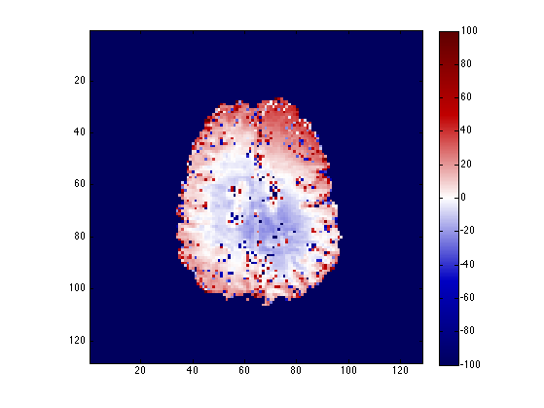
% Difference in F (DA vs B₁ Flat)
Uniform qMT
“Optimized” qMT
50%
-50%

Slide 3
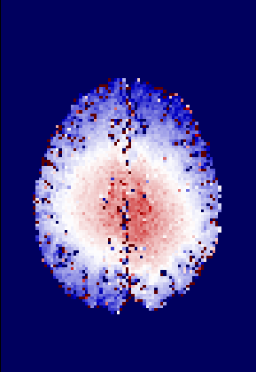

% Difference in F (DA vs B₁ Flat)
Uniform qMT
“Optimized” qMT
10%
-10%

Slide 4
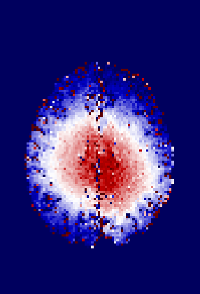

% Difference in F (DA vs B₁ Flat)
Uniform qMT
“Optimized” qMT
5%
-5%

Slide 5
Uniform
Optimized_{CRLB}
a
b
c

Slide 6
