Slide 1
B₁-Sensitivity Optimization
Paper Planning Ideas

Slide 2
Preliminary Work

Slide 3
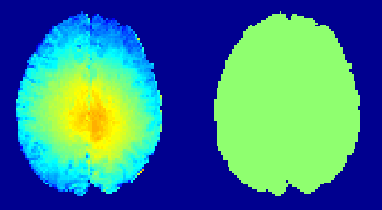
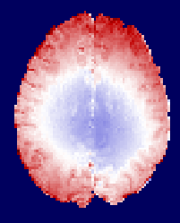
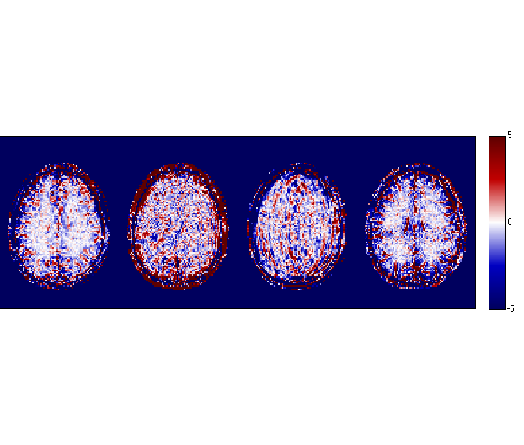
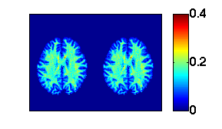
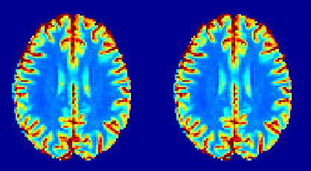
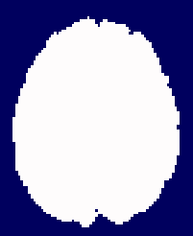
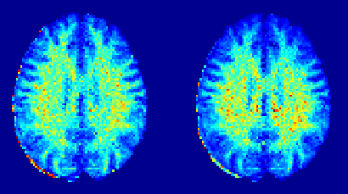
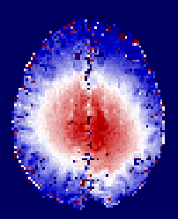
B_{1,flat}-IR-qMT -> large errors in F
Double Angle
B₁ Flat =1
% Difference
1.3
50
B₁ (n.u.)
0
0.7
-50
2
50
IR T₁ (s)
0
0.5
-50
0.5
50
qMT F (n.u.)
0
0
-50

Slide 4
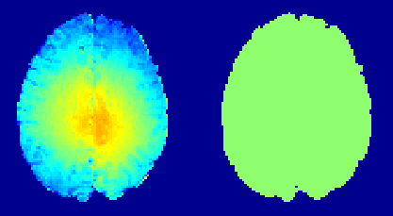

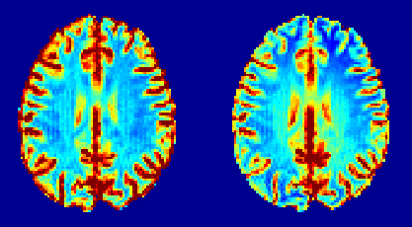
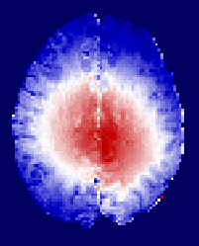
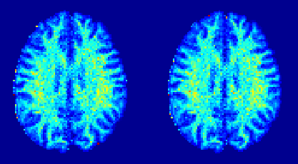
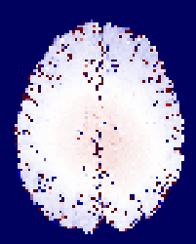
B_{1,flat}-VFA-qMT -> small errors in F
Double Angle
B₁ Flat =1
% Difference
1.3
50
B₁ (n.u.)
0
0.7
-50
2
50
VFA T₁ (s)
0
0.5
-50
0.5
50
qMT F (n.u.)
0
0
-50

Slide 5
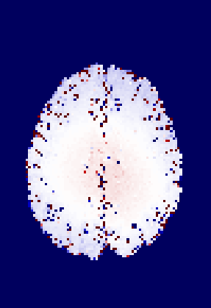
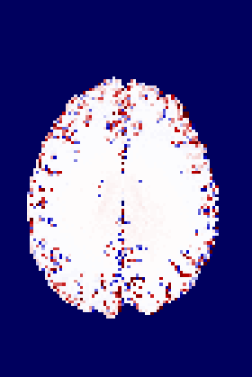
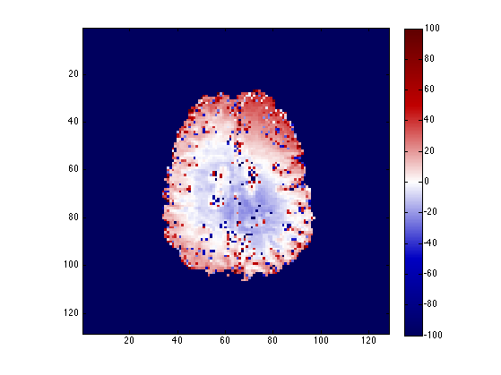
% Difference in F (DA vs B₁ Flat)
Uniform qMT
“Optimized” qMT
50%
-50%

Slide 6
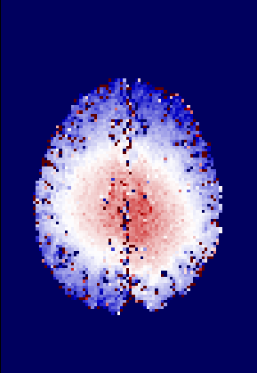
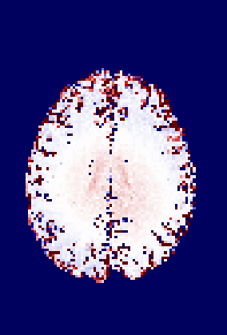
% Difference in F (DA vs B₁ Flat)
Uniform qMT
“Optimized” qMT
10%
-10%

Slide 7
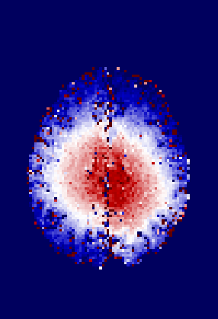
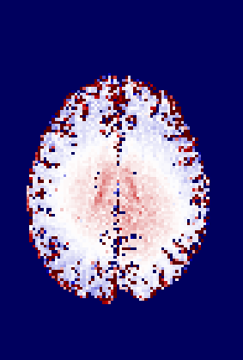
% Difference in F (DA vs B₁ Flat)
Uniform qMT
“Optimized” qMT
5%
-5%

Slide 8
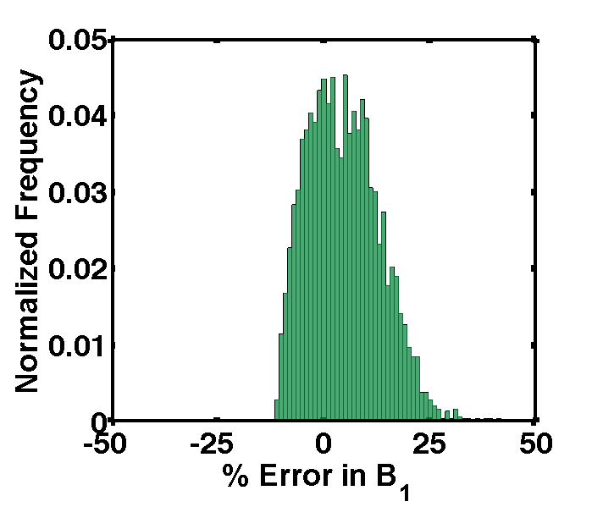
Error range for B₁ Flat = 1 (1 subject)

Slide 9
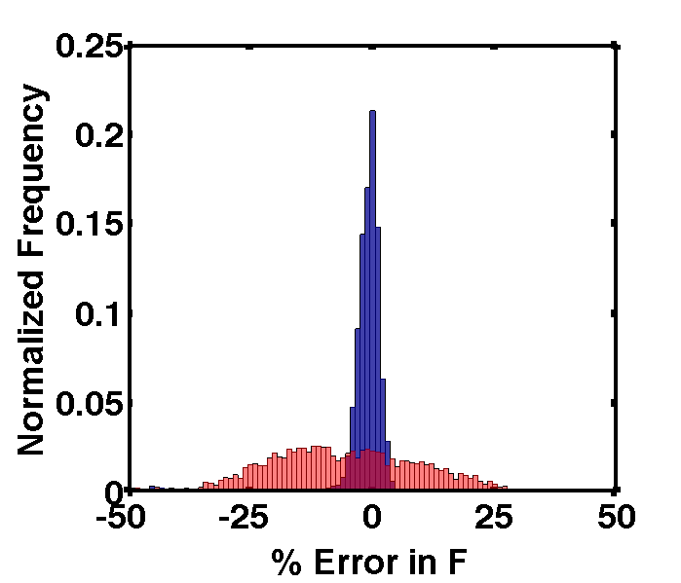
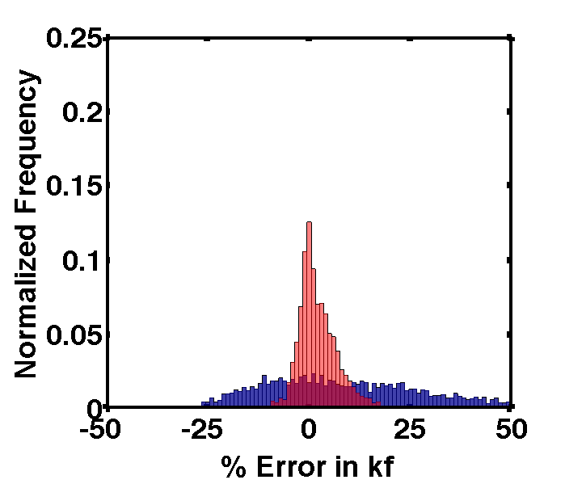
Error range for B₁ Flat = 1 (1 subject)
IR qMT_{uniform}
VFA qMT_{uniform}

Slide 10
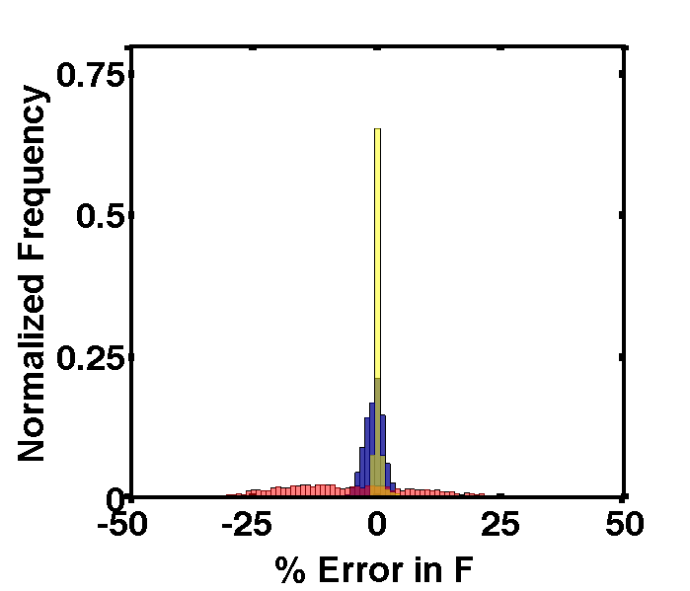
Error range for B₁ Flat = 1 (1 subject)
IR qMT_{uniform}
VFAq MT_{uniform}
VFA qMT_{optimized}

Slide 11
Research Methodology

Slide 12
3 ways to approach the problem
Analytical sensitivity analysis
Numerical sensitivity analysis
Data-driven sensitivity analysis

Slide 13
1. Analytical sensitivity analysis
Partial derivatives of Sled equations (after his approximations)
Need to use symbolic math toolboxes
Matlab, Python, Maple, etc.
Optimize qMT point protocol by iteratively removing points that are most sensitive to B₁ inaccuracies

Slide 14
1. Analytical sensitivity analysis
Pros
“Exact” partial derivative
Cons
Optimization performed for single tissue parameters
No noise
Alternating iterations with Ives CRLB optimization could help
Additional approximation may be needed
Sleds model pre-calculates Sf (dependant on
Partial derivative of the integral of lineshape… fix T_{2R}?
Close-form sensitivity equations would be quite heavy

Slide 15
2. Numerical sensitivity analysis
Numerical partial derivatives using qMT simulations
qMT simulation code already available
Numerical partial derivative convergence and precision considerations
Optimize qMT point protocol by iteratively removing points that are most sensitive to B₁ inaccuracies

Slide 16
2. Numerical sensitivity analysis
Pros
Lots of code ready to be used
More easily adaptable to other qMT techniques
Cons
Optimization performed for single tissue parameters
No noise
Alternating iterations with Ives CRLB optimization could help

Slide 17
3. Data-driven sensitivity analysis
Acquire large range of qMT data points in healthy subjects
Top ~60 points from Ives optimization
Instead of “B1 flat”, uniformly multiply the B₁ map by a value (1%, 5%, 10%, …)
Optimize qMT point protocol by iteratively removing points which leads to less error in overall (spatially) fits of F.

Slide 18
3. Data-driven sensitivity analysis
Pros
Easily adaptable technique to other qMT techniques
Noise, different tissue parameters, multi-tissue voxels are all naturally included (though different weighting)
Cons
Resolution must be a consideration (do we want pure GM voxels?)
Mask for certain tissue types?

Slide 19
Extended discussion on optimizing qMT for B₁
In addition to optimizing the qMT protocol to B₁, identify the key factors in the optimized protocol that promotes insensitivity to B₁
Which range of parameters?
Combos of parameters (more MT-FAs, better insensitivity/robustness?)
Beware traps
Must still fit well qMT parameters
10 points all far off-res or only low MT-FA will obviously be insensitive to B1, but not desirable

Slide 20
Ives 2011 paper was in MRM (Imaging Methodology – Communication), same/similar format?

Slide 21
Optimizing using Sensitivity Analysis (Analytical)

Slide 22
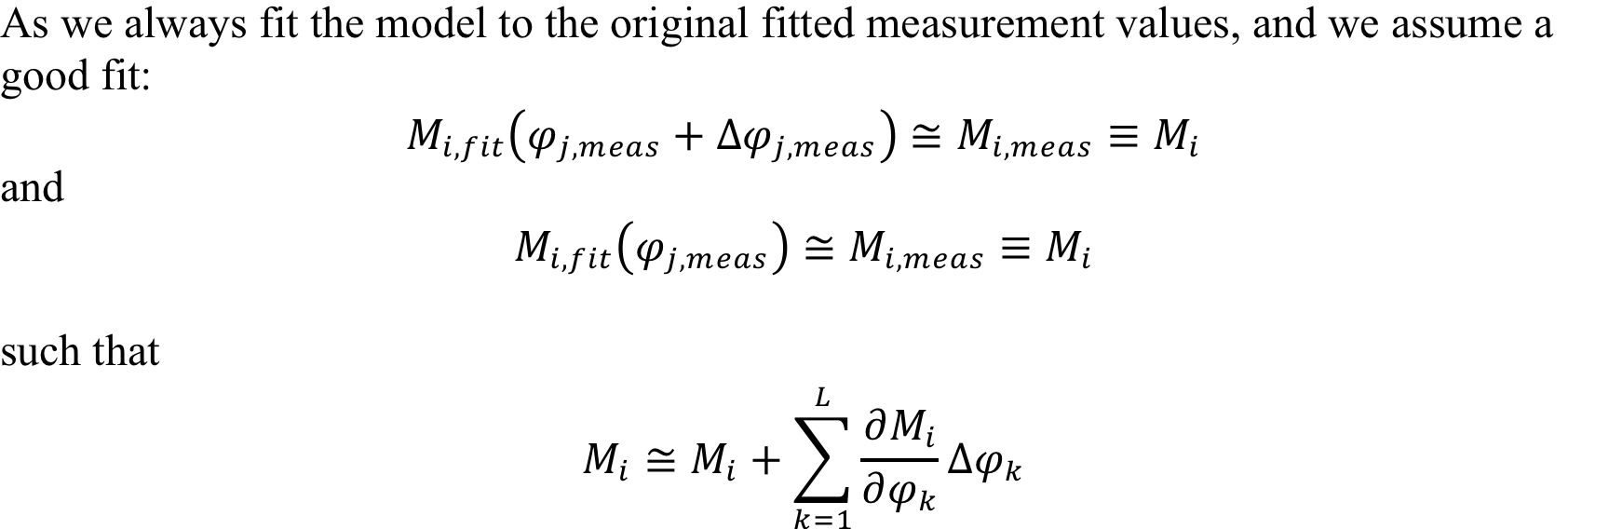
Optimizing using Sensitivity Analysis (Analytical)

Slide 23
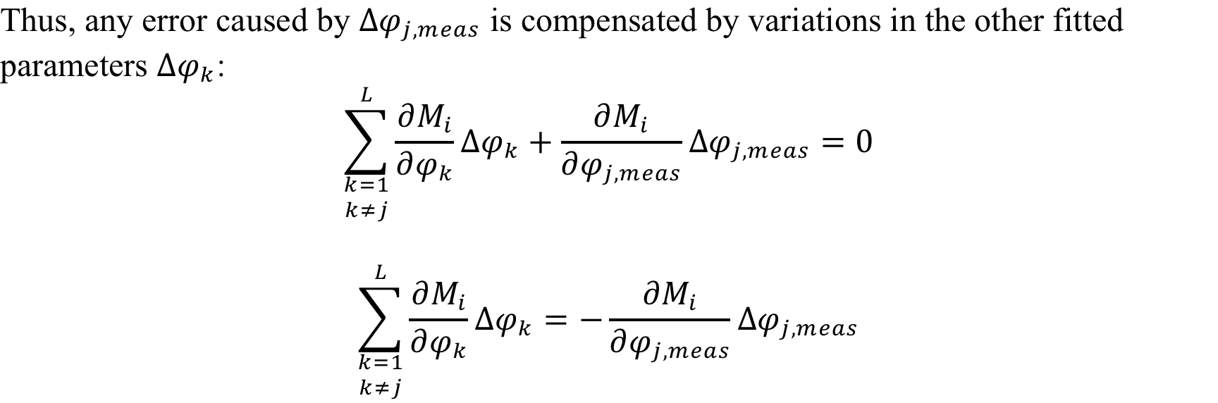
Optimizing using Sensitivity Analysis (Analytical)

Slide 24
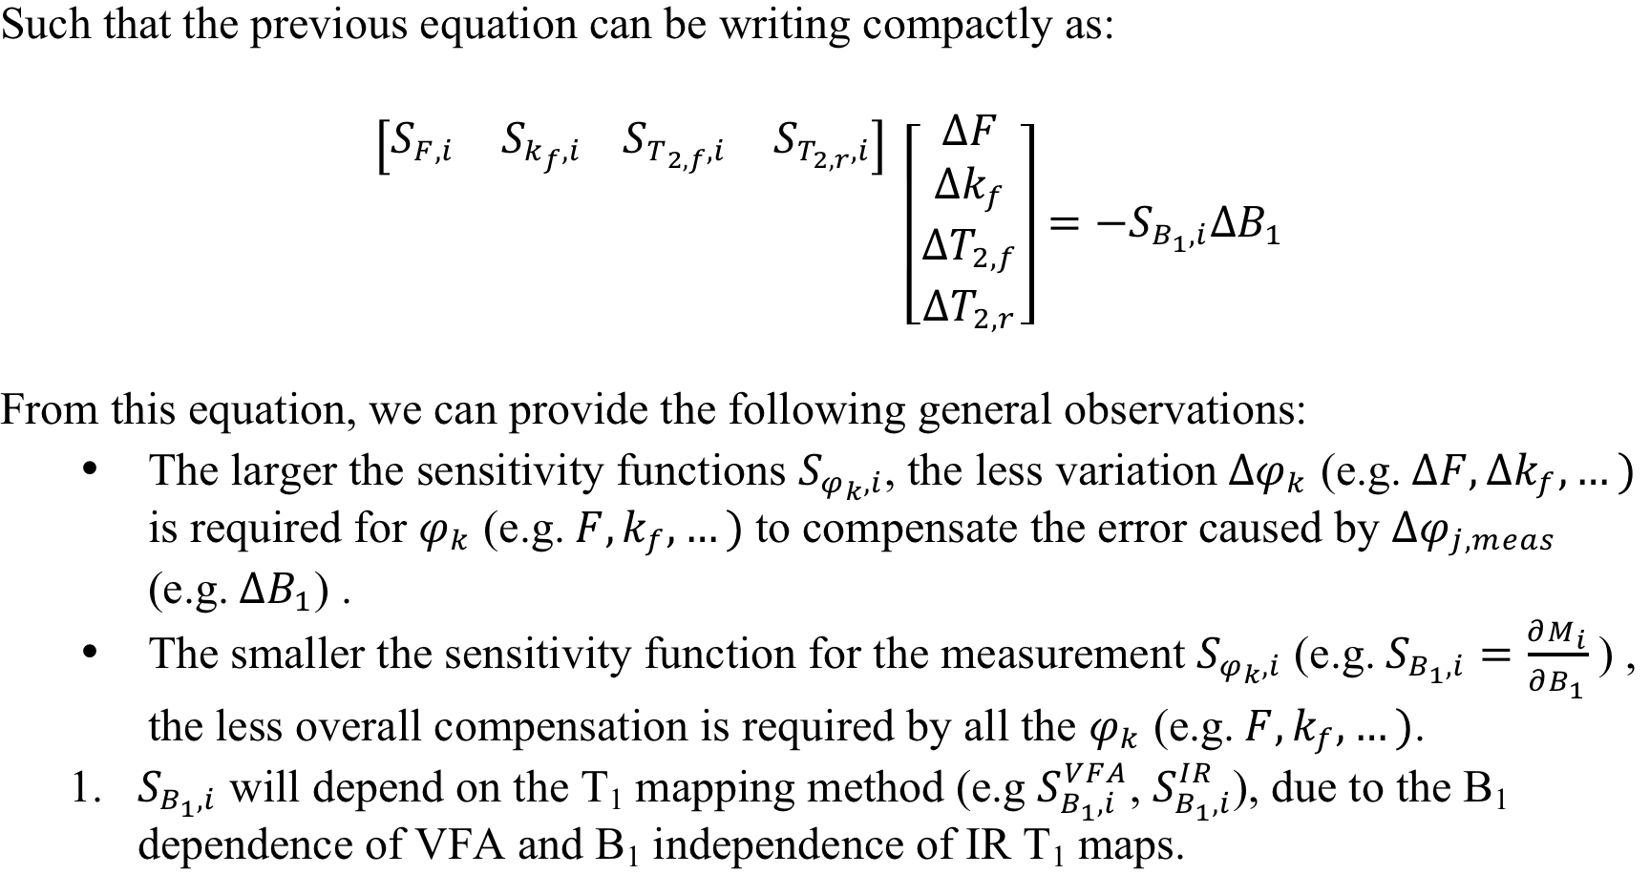
Optimizing using Sensitivity Analysis (Analytical)

Slide 25
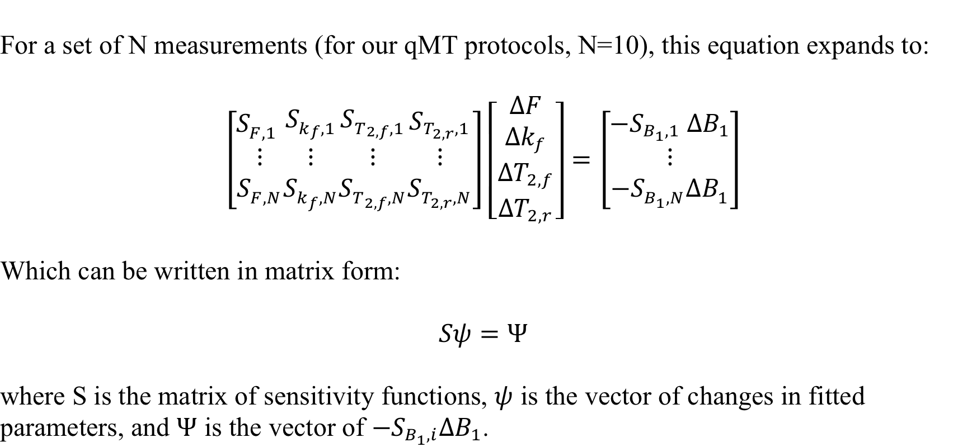
Optimizing using Sensitivity Analysis (Analytical)

Slide 26
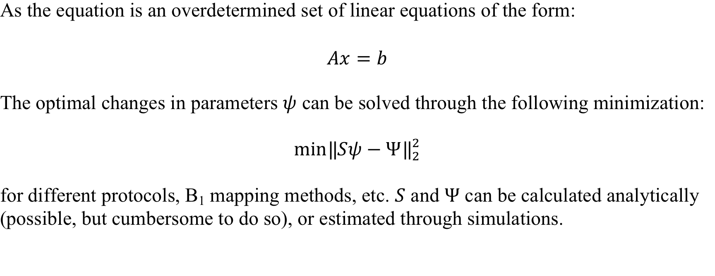
Optimizing using Sensitivity Analysis (Analytical)

Slide 27
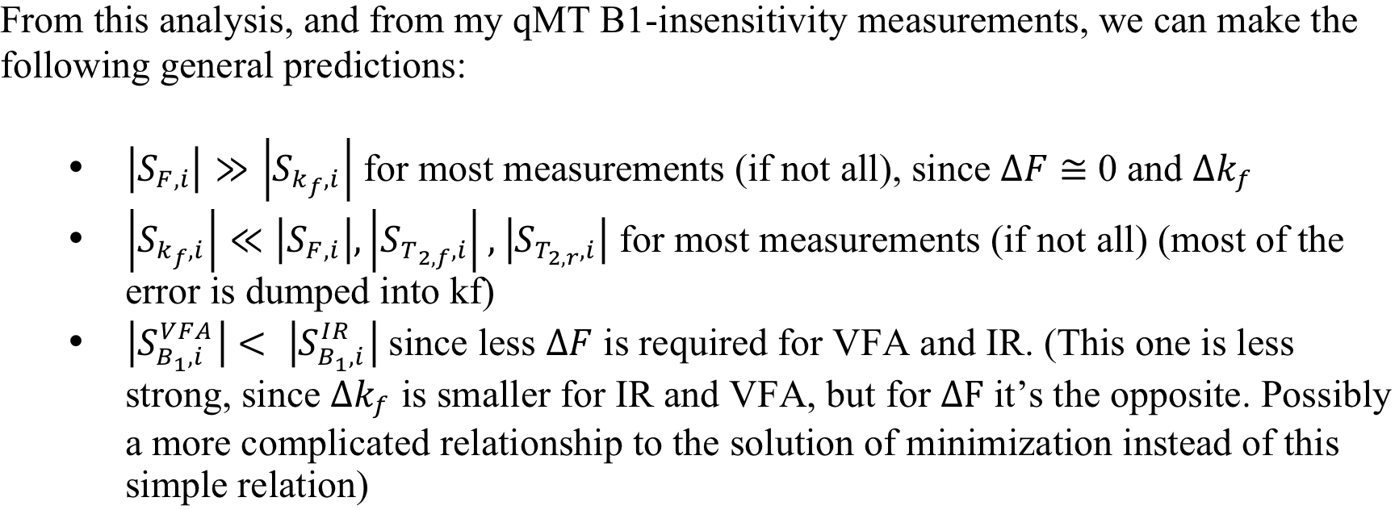
Optimizing using Sensitivity Analysis (Analytical)

Slide 28
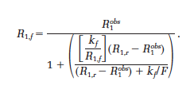
Optimizing using Sensitivity Analysis (Analytical)
Replace R_{1,f} in qMT equations so only dependent on R_{1,obs} (which is independent on B₁ for IR, dependent on B₁ for VFA).

Slide 29
More paper ideas
Determining best practices when blurring B1
People just seem to pick methods/kernel size/variables without a good defined set of guidelines within the community
Explore how blurring can go wrong, what will happen, and under which circumstances it is most likely to occur
Different B1 technique – susceptible to different types of artifacts/different regions. How to improve regional blurring or minimize regional error in blurring?

Slide 30
More paper ideas
Estimate a B1 map from uncorrected VFA data only
Get shape from spline smoothing
Change amplitude so that mean B1 in brain is 1 (?), masked for WM/GM (ignore csf..?)
Relationship between B1 shape an T1/VFA data may not be linear due to steady state, shape might be wrong, reverse the problem from spline to VFA/T1 data to B1 map?

